Slide 1
ASPIRE

Slide 2
For Case Managers Use
This tool is intended to generate a conversation which results in the youth creating a goal.
Select areas of interest to the youth or those which require immediate discussion.
Use Motivational Interviewing to elicit ideas and aspirations.
Connect the discussion to past, present, and future interests.
Allow the youth to write/draw in the workbook pages any thoughts and ideas.
Print this workbook double-sided, and in color.
Use the discussion starters on the next page to assist in beginning the conversation.

Slide 3
Discussion Starters to assist conversation*
*excerpts from Discussion Starters for Assessment / Case Managers, found on ASPIRE website toolkit

Slide 4
_______________________’s (name) ASPIRE Goal Workbook

Slide 5
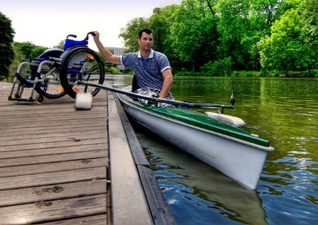
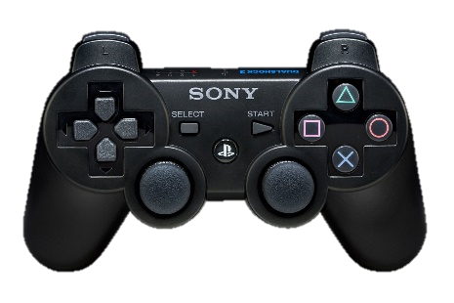
Fun
What do you like to do for fun?

Slide 6
Cost of Fun
How do you pay for activities? In the future?

Slide 7
Money
What kinds of things do you use money for?

Slide 8
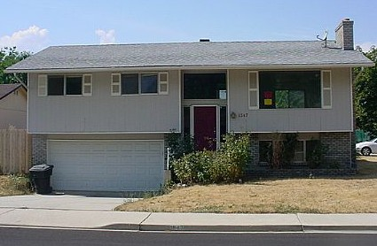
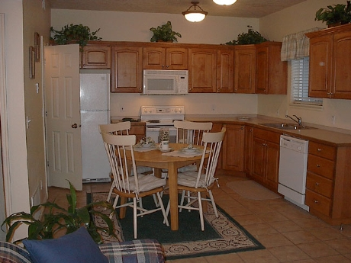
Place to Live
Would you like to move out someday? What would you like?

Slide 9
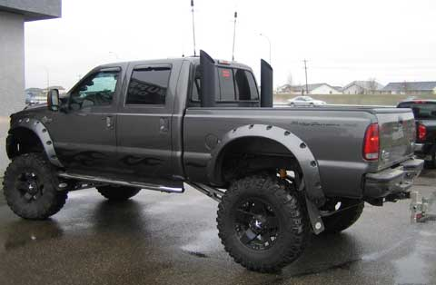
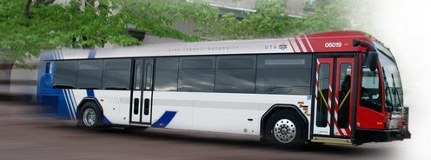
Go Places
How do you get around right now? In the future?

Slide 10
Buy Food
How do you get food now? In the future?

Slide 11
Work
How can work make you happy?

Slide 12
School
What do want from school?

Slide 13
Home
What do you want from home?

Slide 14
Make a Goal!

Slide 15
My goal is:
My goal:
Where I will work on my goal:
Who will help me reach my goal:
When will I reach my goal:
Why is this goal important to me:

Slide 16
Steps to reach my goal:
Steps to reach my goal:
Goal
Start

Slide 17
How will ASPIRE help:
Self-Determination
Financial Education
How will ASPIRE help?
Case Management
Parent Training
Benefits Planning
Youth Employment

Slide 18
Disclaimer
The ASPIRE Initiative (Achieving Success by Promoting Readiness for Education and Employment) produced this document under a cooperative agreement with the U.S. Department of Education, Office of Special Education Programs associated with PR Award # H418P130009. David Emenheiser served as the project officer. This document also was reviewed by the U.S. Department of Education prior to publication. Nevertheless, the contents of the document and any documents cited herein do not necessarily reflect the views or policies of the U.S. Department of Education. This product is in the public domain. Authorization to reproduce it in whole or in part is granted. While permission to reprint this publication is not necessary, the citation should be:
ASPIRE Initiative (2016). ASPIRE Goal Workbook.

