Slide 1

Equity, Inclusion, and Opportunity: Creating Educational Systems That Meet the Needs of All Groups of Students
OSEP Project Directors’ Conference
August 1-3, 2016
Julie Bollmer, IDC
Tom Munk, IDC
Nancy O’Hara, IDC

Slide 2
Objectives for this presentation
What is a “Success Gap?”
Outline components of a high-quality, equitable, inclusive educational program for children ages 3 through 12th grade.
Demonstrate the importance of disaggregating data to identify “success gaps.”
Describe and demonstrate a toolkit for identifying root causes of success gaps.
Identify how TA providers and states can use these resources to help districts and schools address success gaps.
Notes:
These are the objectives for the presentation.

Slide 3

Take a closer look…
Equity
Inclusion
Opportunity
Notes:
Main Idea: The success gaps tools can provide an opportunity to “take a closer look” at equity, inclusion, and opportunity in your district/school so that each and every child has access to quality education that results in positive long-term outcomes.

Slide 4

What is a Success Gap?
What is a Success Gap?

Slide 5
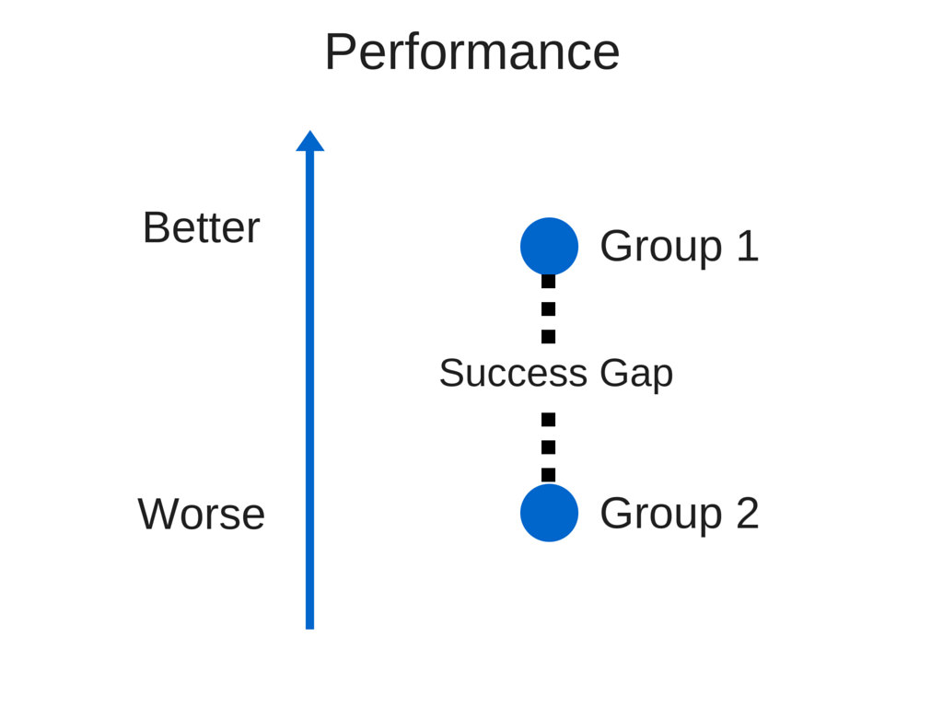
What is a success gap? (2)
Notes:
Script:
Definition of a “success gap”
Concept that this term is broader, more encompassing than “achievement gap” but includes any areas where some students’ performance or opportunity or achievement is significantly discrepant/different from other groups.
We hear a lot these days about the “achievement gap.” But there are other gaps too, between students with disabilities and their nondisabled peers, between black students and white students, between higher-SES and lower-SES students, etc. There are gaps related to dropout and graduation rates, gaps related to achievement in reading, math, or post-school outcomes, gaps between groups of students in the areas of discipline, identification as a student with a disability or in educational settings for student with disabilities.
Our definition of a “success gap,” which encompasses all of these gaps or discrepancies, is “ A gap in educational outcomes between different groups of students.” We call all these gaps Success gaps because they result in poor outcomes or lack of success for the students in those affected groups.

Slide 6
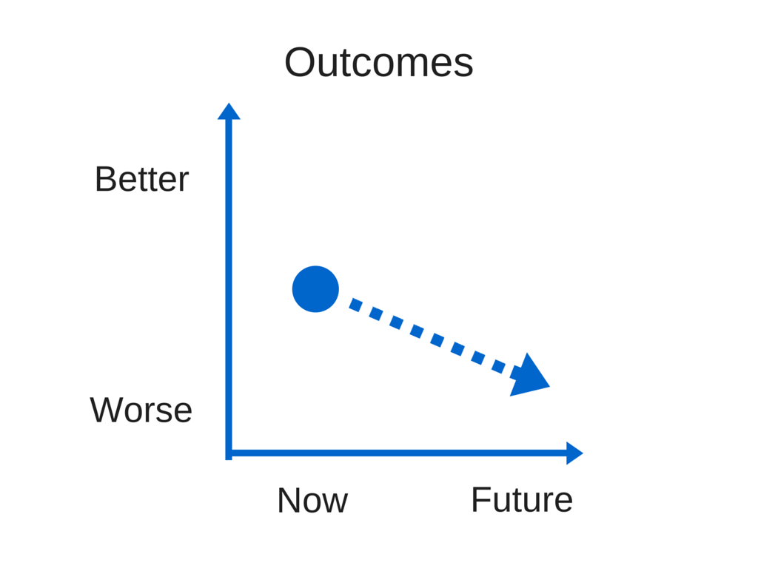
What are the results of success gaps?
Notes:
Main Idea: If you don’t address success gaps, the likelihood of poor long-term outcomes for particular groups of students greatly increases.
Script: As you well know, success gaps, particularly if they continue over the years or over the course of student’s school experience, result in poor long-term outcomes for individuals and entire groups of students. For example a child in third grade who has a large gap in reading level between himself and his peers without interventions may see the gap widen, poor academic performance, may not graduate , or may even drop out. You can most likely think of other examples of poor outcomes when a student is experiencing a success gap.

Slide 7
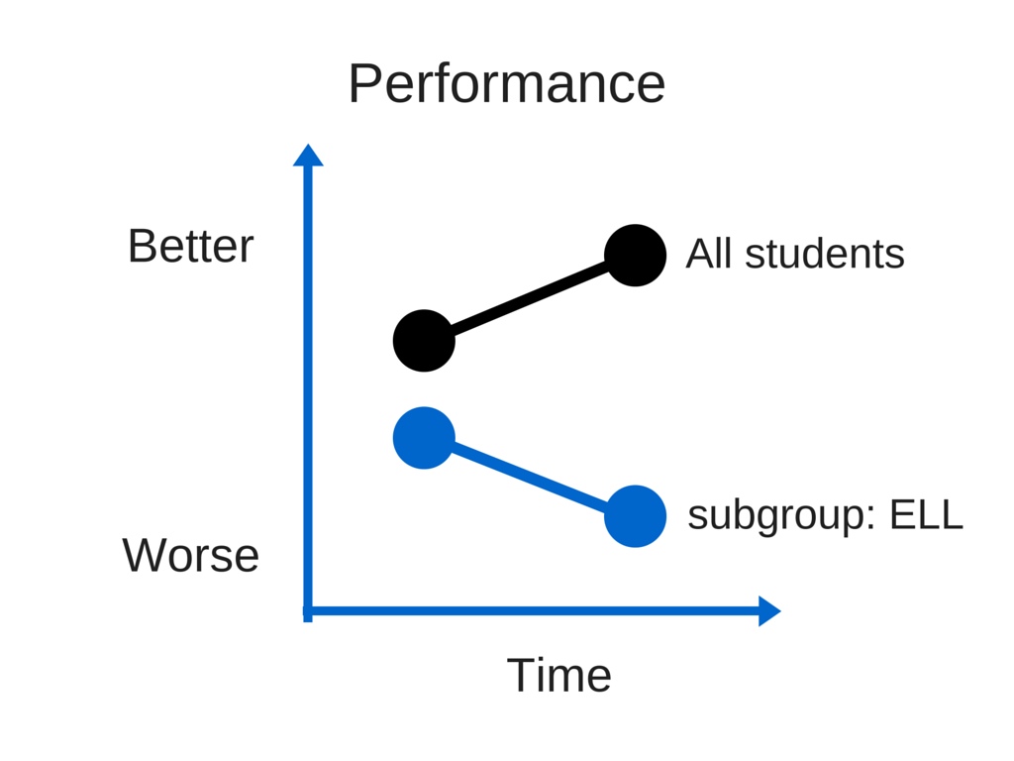
Disaggregating your data may reveal success gaps among subgroups of students
Notes:
Script: Your district or school may be focused on particular outcomes for students. It may be focused on reading or math, maybe you want to increase your graduation rate or lower your dropout rate for all students. The discrepancy between subgroups show up when you disaggregate the data. Subgroups of students include a variety of diverse learners whose learning gaps show up when data are disaggregated by disability, primary language, race/ethnicity, socioeconomic status, etc.
It’s easy to hide achievement gaps among schoolwide averages. Your schools may receive an overall high performance rating but have low performance for particular groups of students. As you look deeply at your local district or building data, consider disaggregating your data to focus on particular groups of students. These students may be able to make large gains with appropriate intervention.
If you disaggregate your data by subgroups, you get a clearer picture of how particular groups of students are performing. This will help you target your resources and tailor your intervention in ways that it will have the biggest impact

Slide 8
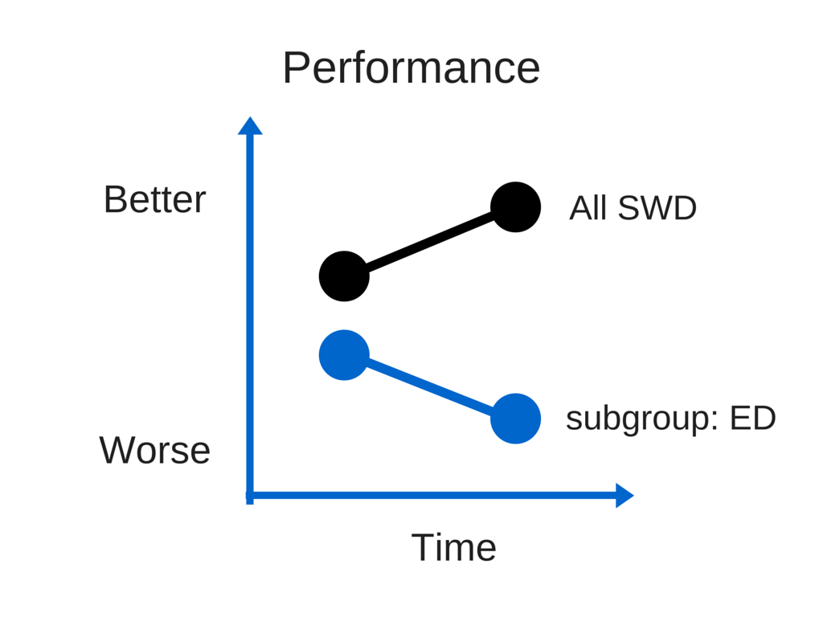
Disaggregating data within a subgroup may reveal success gaps between sub-subgroups
Notes:
Main Idea: It is often worthwhile to disaggregate data WITHIN larger groups in order to focus attention and resources more precisely. Large gains may be possible for sub-subgroups given equitable access to high-quality, culturally responsive instruction.
Script: In this picture, we see that, among students with disabilities, students with emotional disturbance perform more poorly than others. This is also a success gap.

Slide 9
Data Examples of Success Gaps

Slide 10
Achievement: Disaggregated Main NAEP reading scores, grade 4, 2013, Philadelphia, Pennsylvania
Notes:
Main Idea: If you disaggregate your data by subgroups, you get a clearer picture of how particular groups of students are performing. This will help you target your resources and tailor your intervention in ways that it will have the biggest impact.
Script: Now we’ll look at a number of slides intended to illustrate what we mean by success gaps.
Disaggregated NAEP test scores are available for the nation, states, and some large districts. Here is an example with NAEP data for reading in Philadelphia, PA. As we move forward, it will show the various subgroups of students and how disaggregating the data show where there are success gaps among the subgroups.

Slide 11
Achievement: Disaggregated Main NAEP reading scores, grade 4, 2013, Philadelphia, Pennsylvania (2)
Notes:
Main Idea: If you disaggregate your data by subgroups, you get a clearer picture of how particular groups of students are performing. This will help you target your resources and tailor your intervention
Script: The dark blue bars show the data for students who are or are not eligible for free and reduced-price lunch. You can see that there is a difference in achievement between the groups, a success gap, and a difference as compared to all students.

Slide 12
Achievement: Disaggregated Main NAEP reading scores, grade 4, 2013, Philadelphia, Pennsylvania (3)
Notes:
Script: The dark blue bars have added race/ethnicity to the subgroup breakdown. You can see that Asian/Pacific Islander and White perform better than all students. You can also see that Black and Hispanic students do not perform as well as all students or as well as some other groups.

Slide 13
Achievement: Disaggregated Main NAEP reading scores, grade 4, 2013, Philadelphia, Pennsylvania (4)
Notes:
Script: The dark blue bars have added the data for students who are or are not English language learners. Again you can see how the subgroup performs compared to other subgroups.

Slide 14
Achievement: Disaggregated Main NAEP reading scores, grade 4, 2013, Philadelphia, Pennsylvania (5)
Notes:
Script: The dark blue bars add the data for students with and without disabilities. You can see that the subgroup students with disabilities is the lowest performer in this example.
These bars are ordered from lowest to highest grade 4 test scores.
The group with the largest reading achievement success gaps in Philadelphia public schools is students with disabilities. What do the data in your district or school look like?
Disaggregated NAEP test scores are available for the nation, states, and some large districts. The phrase “main NAEP” in green in the title is a hot link to the source for the data, the NAEP site so that you could look up your own state and local data.

Slide 15
Percentage of preschool students receiving suspensions, by race/ethnicity
SOURCE: U.S. Department of Education, Office for Civil Rights, Civil Rights Data Collection, 2011–12.
Notes:
Main Idea: In the area of school discipline, some groups of students experience disciplinary actions at a rate that far exceeds what would be expected based on their overall percentage of the population.
Script: This is OCR national suspension/expulsion data for preschool. The pie chart on the left shows the percentage of student enrollment by race for two of the races. White is 43% and Black is 18%.

Slide 16
Percentage of preschool students receiving suspensions, by race/ethnicity (cont.)
SOURCE: U.S. Department of Education, Office for Civil Rights, Civil Rights Data Collection, 2011–12.
Notes:
The graph on the right breaks down out-of-school suspensions data by race. Black students comprise 18% of enrollment but 42% of out-of-school suspensions. White students comprise 43% of enrollment and only 28% of out-of-school suspensions. The data show there are disproportionate disciplinary data as early as preschool.

Slide 17
What are the most glaring success gaps that you find in the schools or districts with which you work?
What are the most glaring success gaps that you find in the schools or districts with which you work?

Slide 18

What are the results of success gaps?
Children do not achieve; gaps become larger.

Slide 19

What are the results of success gaps? (2)
Children miss valuable instruction when removed from the classroom.

Slide 20

What are the results of success gaps? (3)
Children become social outcasts.

Slide 21

What are the results of success gaps? (4)
Children drop out of school.

Slide 22


What are the results of success gaps? (5)
Children fail to graduate with a diploma and fail to access college and or careers.

Slide 23
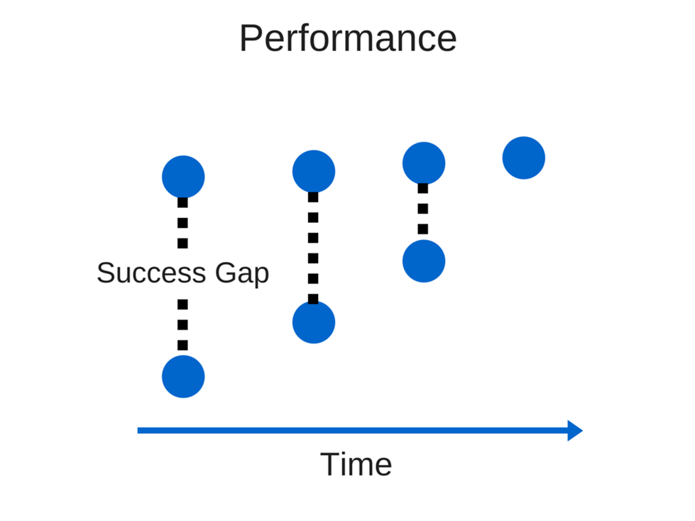
How to close success gaps

Slide 24
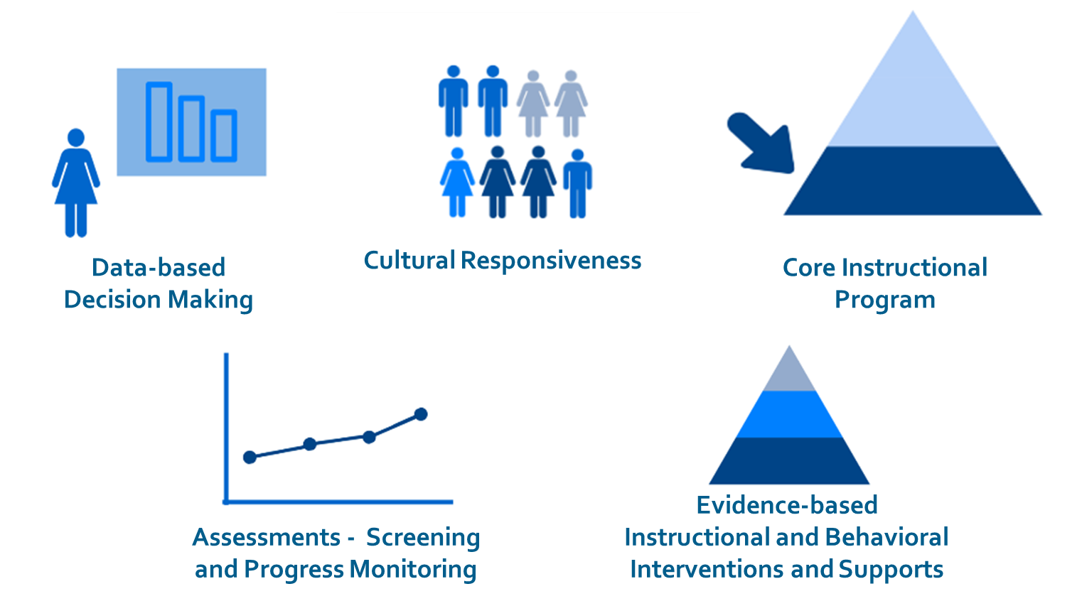
Equity, Inclusion, and Opportunity can lessen success gaps between groups of students
Notes:
Main Idea: If we are able to provide educational experiences and instruction that meet these criteria to all of our student subgroups and sub-subgroups, we will increase equity, inclusion, and opportunity that will lead to improved outcomes for all students, students with disabilities overall, and some subgroups of students with disabilities in particular.
Script:
Large gains in achievement or other outcomes may be possible for certain subgroups such as students with disabilities in your district/school IF these students have equitable access to appropriate and high-quality instructional programs. High-quality instruction is data-based, part of a high-quality core instructional program, built on universal screening and frequent progress monitoring data, part of a multi-tiered system of support AND is culturally responsive/sensitive to the diversity that students and families are bringing into schools and classrooms.

Slide 25
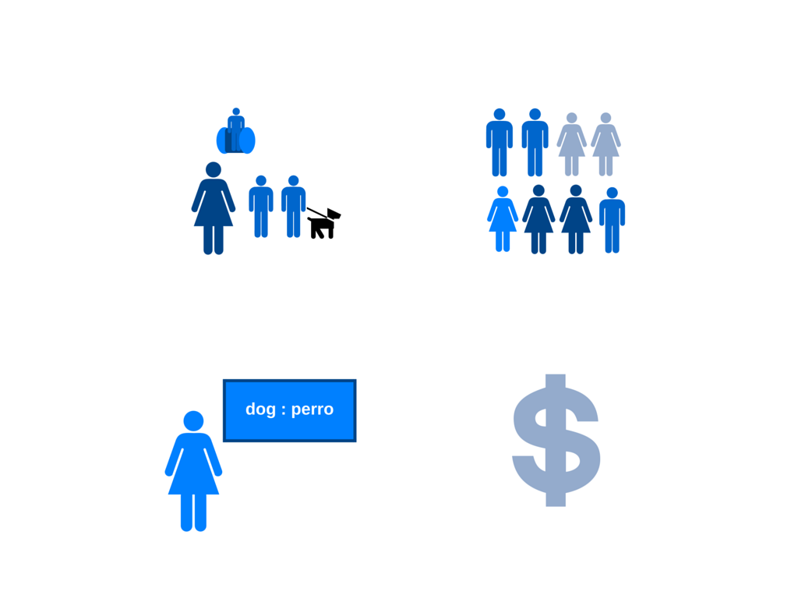
Which are the affected subgroups based on your data disaggregation?
Students with Disabilities
Racial/Ethnic Groups
English Language Learners
Income Levels
Notes:
It is important to disaggregate data to see where success gaps exist for particular groups of students. If you disaggregate your data, you may find discrepancies in achievement, in post-school outcomes, in early childhood outcomes, etc. between various subgroups of students or within subgroups.
Sometimes the best way to improve results for a school is to focus on large groups of students who are not succeeding well. Even a school that receives a high overall performance rating can receive a low performance rating for a group of students within that school. Sometimes, achievement gaps can hide among schoolwide averages.

Slide 26


Root Causes
To address your success gap, find the root causes
Two tools from the IDEA Data Center – Recently updated!
Notes:
Main Idea: These are the tools that have been developed.
Script: These are the success gaps tools: (1) a white paper/research brief that provides a research-based rationale and (2) the self-assessment rubric itself.
There should be copies of both documents in hard copy available for all participants. These are available online and can be completed electronically. Links will be provided at the end for these documents.

Slide 27

Success Gaps
Success Gaps white paper and rubric
  Newly revised to be more inclusive of preschool
  Updated language to be more inclusive of Every Student Succeeds Act (ESSA) language
Success Gaps Rubric offers one way to consider reviewing the practices component of a review of policies, procedures, and practices.
Success Gaps Toolkit will provide support to district and school leaders to “lead” this work.

Slide 28
How to Address Success Gaps
Identify the target group and topic area of your key success gap
Form a local district or school stakeholder team to focus on that success gap
Determine the root cause(s) of that success gap using the rubric
  Provide evidence
Consider the students experiencing a success gap
Ensure equitable participation
Develop a plan of action
Notes:
Script: Once you have identified the success gap you want to address in your district/school, consider these steps as a way to get started.
Form a stakeholder group/team.
Be sure this team includes: Families (and, in the upper grades, students) representing the group that is of concern in your school or district;
Special education and general education professionals who work with the target group;
Special education and general education professionals who work with the students who are succeeding;
Professional support staff such as school psychologists, school counselors, and others who may provide support to students who are struggling; and
Leaders with the authority to make the necessary changes.
Then review data…disaggregated by subgroups, use the rubric and as a team conduct the self-assessment…identify areas for improvement and develop a plan to address them.

Slide 29
Success Gaps Toolkit includes:
  Guidelines (instructions) for using the Success Gaps materials
  Meeting agendas for a series of meetings and presentation shells for each meeting
  Some materials for pre-reading
  Two videos, one to invite participants to be part of the success gaps work, one to introduce success gaps during the first meeting
  Sample action plan formats and meeting evaluation formats
  Written stories or examples of work in other states or districts
Notes:
Main idea: We have a toolkit to help you do this work with schools and districts

Slide 30
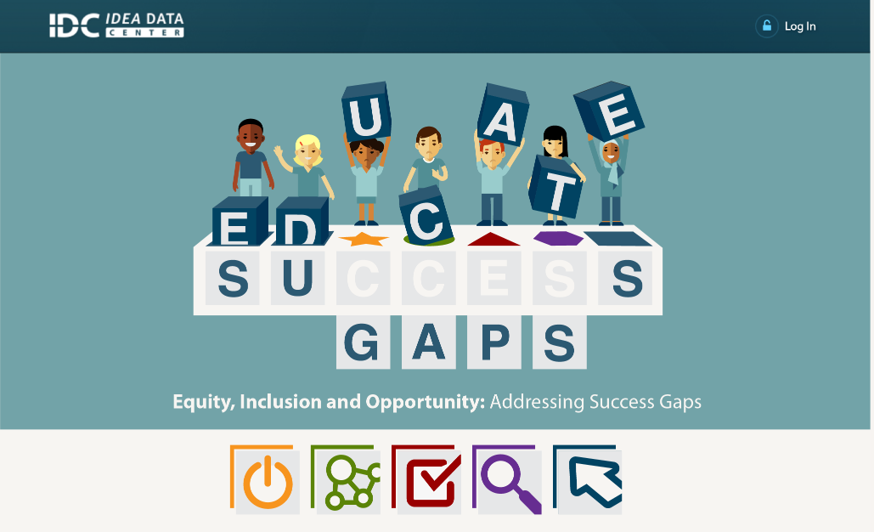
Educate Success Gaps
Notes:
Main idea: The toolkit is available from our attractive website.

Slide 31
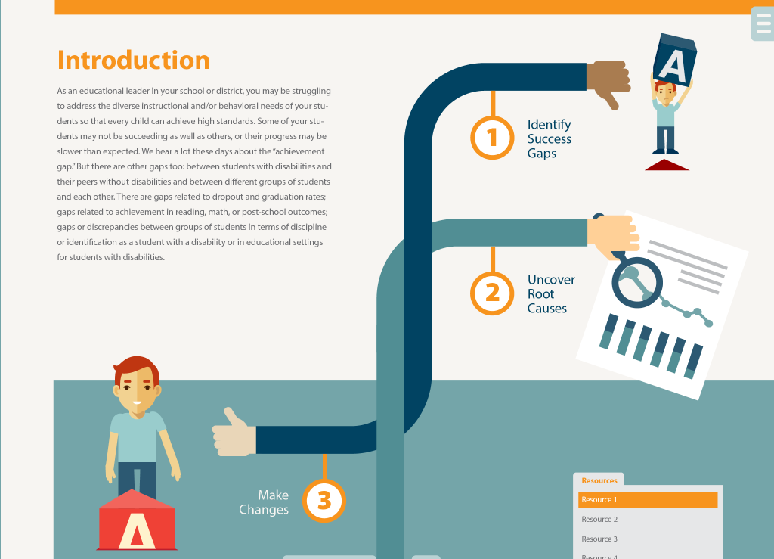
Introduction

Slide 32
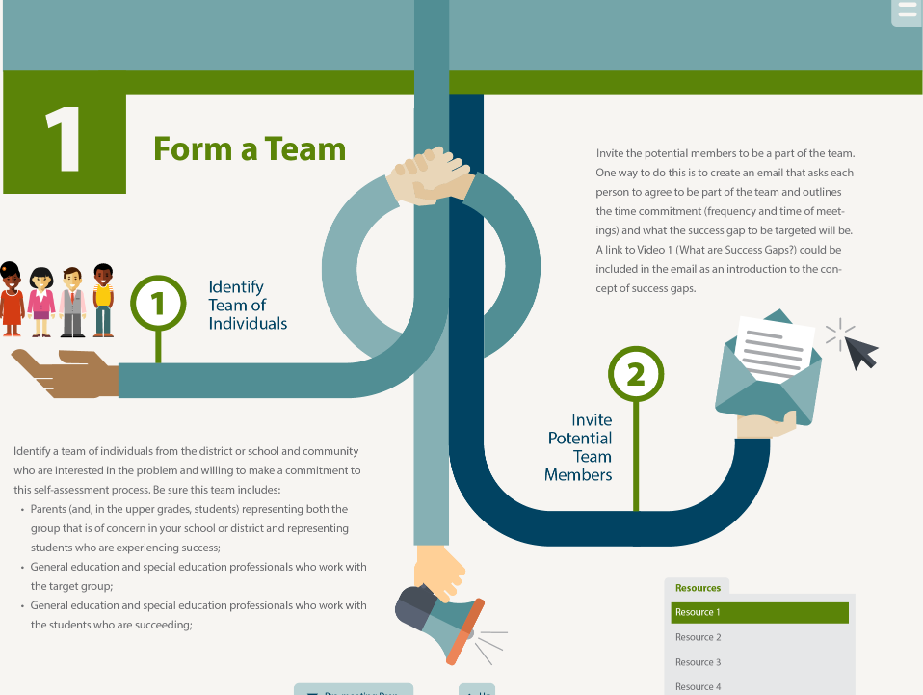
Form a Team

Slide 33
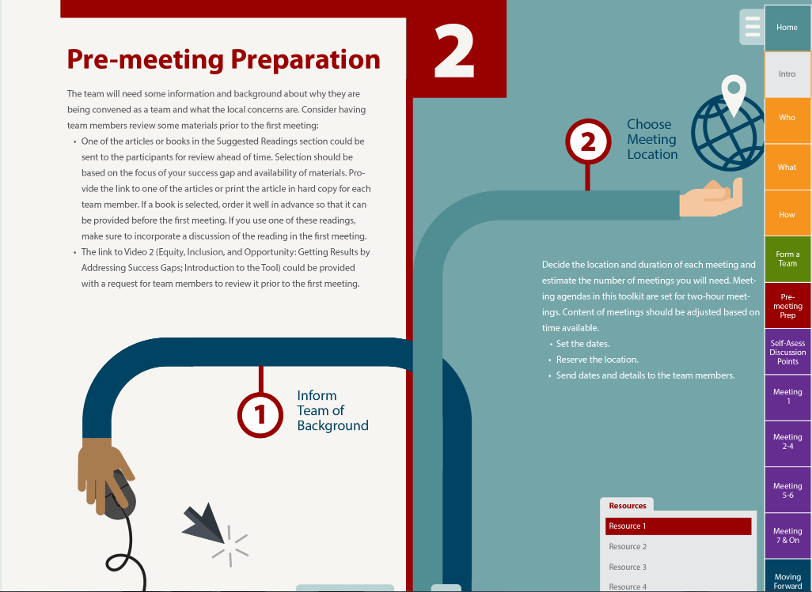
Pre-meeting Preparation

Slide 34
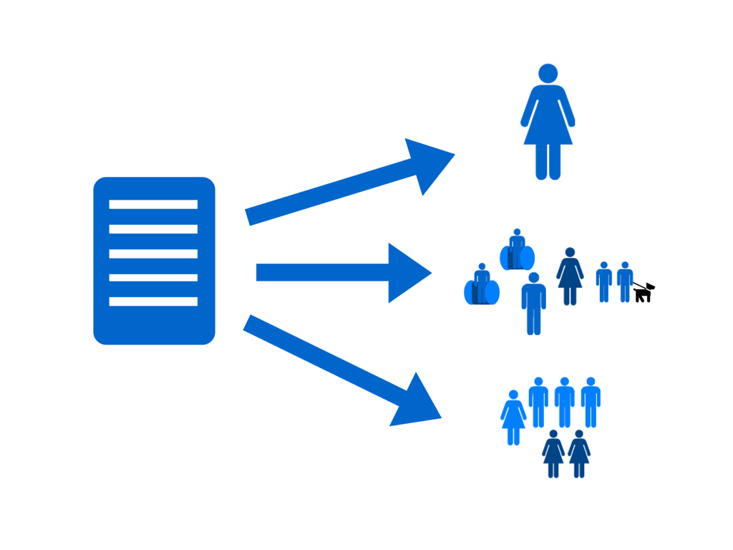
Who should use these tools?
Notes:
Script: These tools have been developed with various audiences in mind such as local district and school administrators, teachers, parents, and other stakeholders. Inequity of opportunity can affect any group of students in a school or a district. The success gaps rubric is designed to look at the policies, programs, practices in general education that may contribute to inequitable opportunities for groups of students such as students with disabilities, English language learners, or other subgroups.

Slide 35
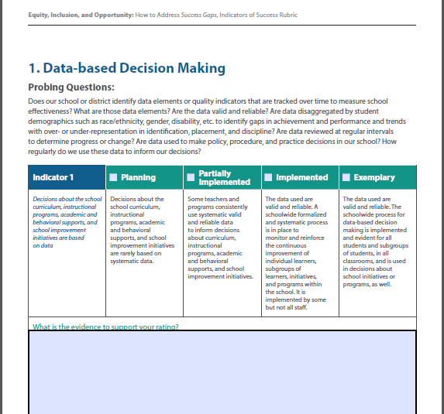
Data-based Decision Making
Notes:
Main Idea: Understanding how the rubric is structured.
Script: Using the Self-Assessment Rubric, there are four suggested possible ratings:
Planning,
partially implemented,
fully implemented or
exemplary.
Probing questions are provided to assist the team in determining where they are at this point.
Document what evidence exists to support the rating that the team selects.

Slide 36
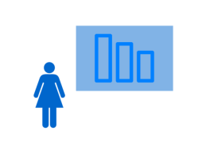


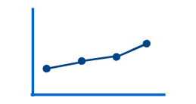

Self-assessment components
Data-based decision making
Cultural responsiveness
High-quality core instructional program
Assessment—universal screening and progress monitoring
Evidence-based instructional /behavioral interventions and supports
Notes:
Main idea: We present five components of an “appropriate education.” Are these available to all students in your school or district? Especially the target group? Keep the topic area of the success gap in mind!

Slide 37
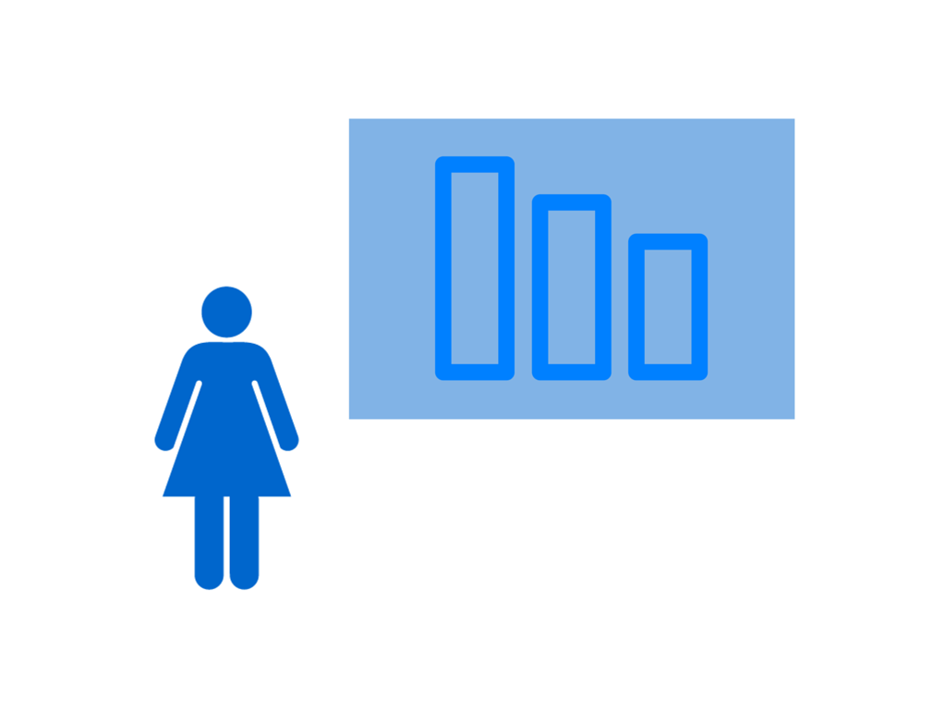
Data-based decision making
Notes:
Main Idea: What is meant by “data-based decision making?”
Decisions about the school curriculum, instructional programs, academic and behavioral supports, and school improvement initiatives are based on data that are disaggregated for the school, reflecting the differences in subgroups by gender, race/ethnicity, socioeconomic factors, disability, and native or home
language. For example, data on graduation, attendance, drop out, discipline, and achievement are all examined and considered individually and collectively.
Decisions about student interventions (behavioral and/or academic) are made based on multiple data sources, including screening, progress monitoring, and formative and summative assessment data.
Is data-based decision making used for all students and all subgroups of students? If not, could this be part of the cause of your success gap?

Slide 38

Cultural responsiveness
Notes:
Script: What is meant by “cultural responsiveness?”
Effective academic and behavioral practices for all learners are based on a school’s recognition of diversity across student ethnicity, language, and socio- economic status.
Training and resources are provided and designed so teachers can meet the linguistic needs of all students, including students with disabilities who are also English learners.
Parents from all backgrounds are included in discussions/meetings about the school, the school programs or initiatives, and their children’s academic and behavioral progress.
Is your school responsive to the cultures of all students and all subgroups of students? If not, could this be part of the cause of your success gap?

Slide 39

Core instructional program
Notes:
Main Idea: What is meant by “core instructional program?”
There is a rigorous, consistent and well-articulated K-12 instructional program (i.e., curriculum and instructional delivery) that is aligned with both English language arts and mathematics standards and delivered with fidelity.
Effective differentiation in the core curriculum addresses the needs of the full range of learners, learning styles, and cultural and linguistic backgrounds.
Universal design for learning guidelines are an integral component of the instruction.
Parents are informed, in their native or home language, about the differentiation of instruction and assessment data based on their child’s unique learning or behavioral needs.
Do all students and all subgroups of students have access to an equally high-quality core instructional program? If not, could this be part of the cause of your success gap?

Slide 40

Assessment—Universal screening and progress monitoring
Notes:
Main Idea: What is meant by “assessment?”
All students are screened for early identification of academic or behavioral risk factors using valid and reliable tools.
All student progress is monitored to make needed adjustments to instruction and/or interventions. Valid and reliable progress monitoring tools are identified and available at each school, with reasonable intervals for monitoring defined and implemented; performance data reviewed at regular intervals; and instruction/interventions adjusted based on data review cycles.
Parents and guardians are regularly informed in their native or home language of their child’s screening and progress monitoring results for academic or behavioral progress.
Could a differential access to early screening or effective progress monitoring (outside of special education!) be part of the cause of your success gap?

Slide 41

Evidence-based instructional and behavioral interventions and supports
Notes:
Main Idea: What is meant by “evidence-based instructional and behavioral interventions and supports?”
Evidence-based interventions and behavioral supports are embedded within a multi-tiered framework and implemented with fidelity.
School-level practices use evidence-based behavioral interventions and tiered response methods such as positive behavioral interventions and supports, restorative practices, etc.
District-level discipline policies that use tiered response protocols as opposed to zero tolerance policies.
Parents and guardians are regularly informed, in their native or home language, of interventions provided to their children and their children’s responses to those interventions for academic and behavioral skills.

Slide 42
To address success gaps…make a plan of action
  Recognize the need for change in your school’s or district’s current practices and policies to address a success gap.
  Identify the root causes of the success gap.
  Make a plan to address those root causes.
Notes:
Main Idea: The first step in the process is to recognize the need for change based on the identification of a success gap. The second step is to identify the root causes of that success gap – we have a toolkit to help you and your clients with this step. The third step is to make a plan to address the root causes of your success gaps. Integrate these actions into your local school improvement or accountability plans that are probably already in existence. Identifying and developing actions to address will support your improvement activities already in place.

Slide 43
Work in small groups and be prepared to share
  Review the content of the section
  Look closely at the probing questions
      Are these the appropriate questions for your state or states you work with?
      Would you add, delete, or re-word any of the probing questions?
  What are the challenges that a district or school would face completing this section?
  Whom do they need in the meeting?

Slide 44

Discussion
What, in your experience as a TA provider, has worked to address success gaps?
Do you see a way to use these materials /toolkit within the state?
What did you like about these materials?

Slide 45
Take a closer look…
Equity
Inclusion
Opportunity
Notes:
Main Idea: The success gaps tools can provide an opportunity to “take a closer look” at equity, inclusion, and opportunity in your district/school so that each and every child has access to quality education that result in positive long-term outcomes.

Slide 46

Tools and Resources
Resources
Success Gaps White Paper and Rubric and other significant disproportionality resources can be found in the IDC Resource Library at: https://ideadata.org/resource-library/
For technical assistance with significant disproportionality or the resources, contact one of the following:
  Your IDC State Liaison (https://ideadata.org/technical-assistance/)
  Julie Bollmer, JulieBollmer@westat.com
  Tom Munk, tommunk@westat.com
  Nancy O’Hara, nancy.ohara@uky.edu

Slide 47

For More Information
Visit the IDC website
http://ideadata.org/
Follow us on Twitter
https://twitter.com/ideadatacenter

Slide 48




Thank you!
The contents of this presentation were developed under a grant
from the U.S. Department of Education, #H373Y130002. However,
the contents do not necessarily represent the policy of the Department
of Education, and you should not assume endorsement by the
Federal Government.
Project Officers: Richelle Davis and Meredith Miceli
Project Officers: Richelle Davis and Meredith Miceli

