Slide 1
HOW TO TALK TO CHILDREN
And, why children are sometimes suspected of possessing hearing loss or central auditory processing disorders when they do not!

Slide 2
Authors
Raymond H. Hull, PhD, CCC A/SP, FASHA, FAAA
Professor of Communication Sciences and Disorders, Audiology/Neurosciences
College of Health Professions
Wichita State University
Wichita, Kansas

Slide 3
What we are talking about
What we are talking about here is directly applicable to our work with young children as teachers, clinicians, and parents.

Slide 4
Child’s peripheral and central auditory system
Let’s take a look at the child’s peripheral and central auditory system.

Slide 5
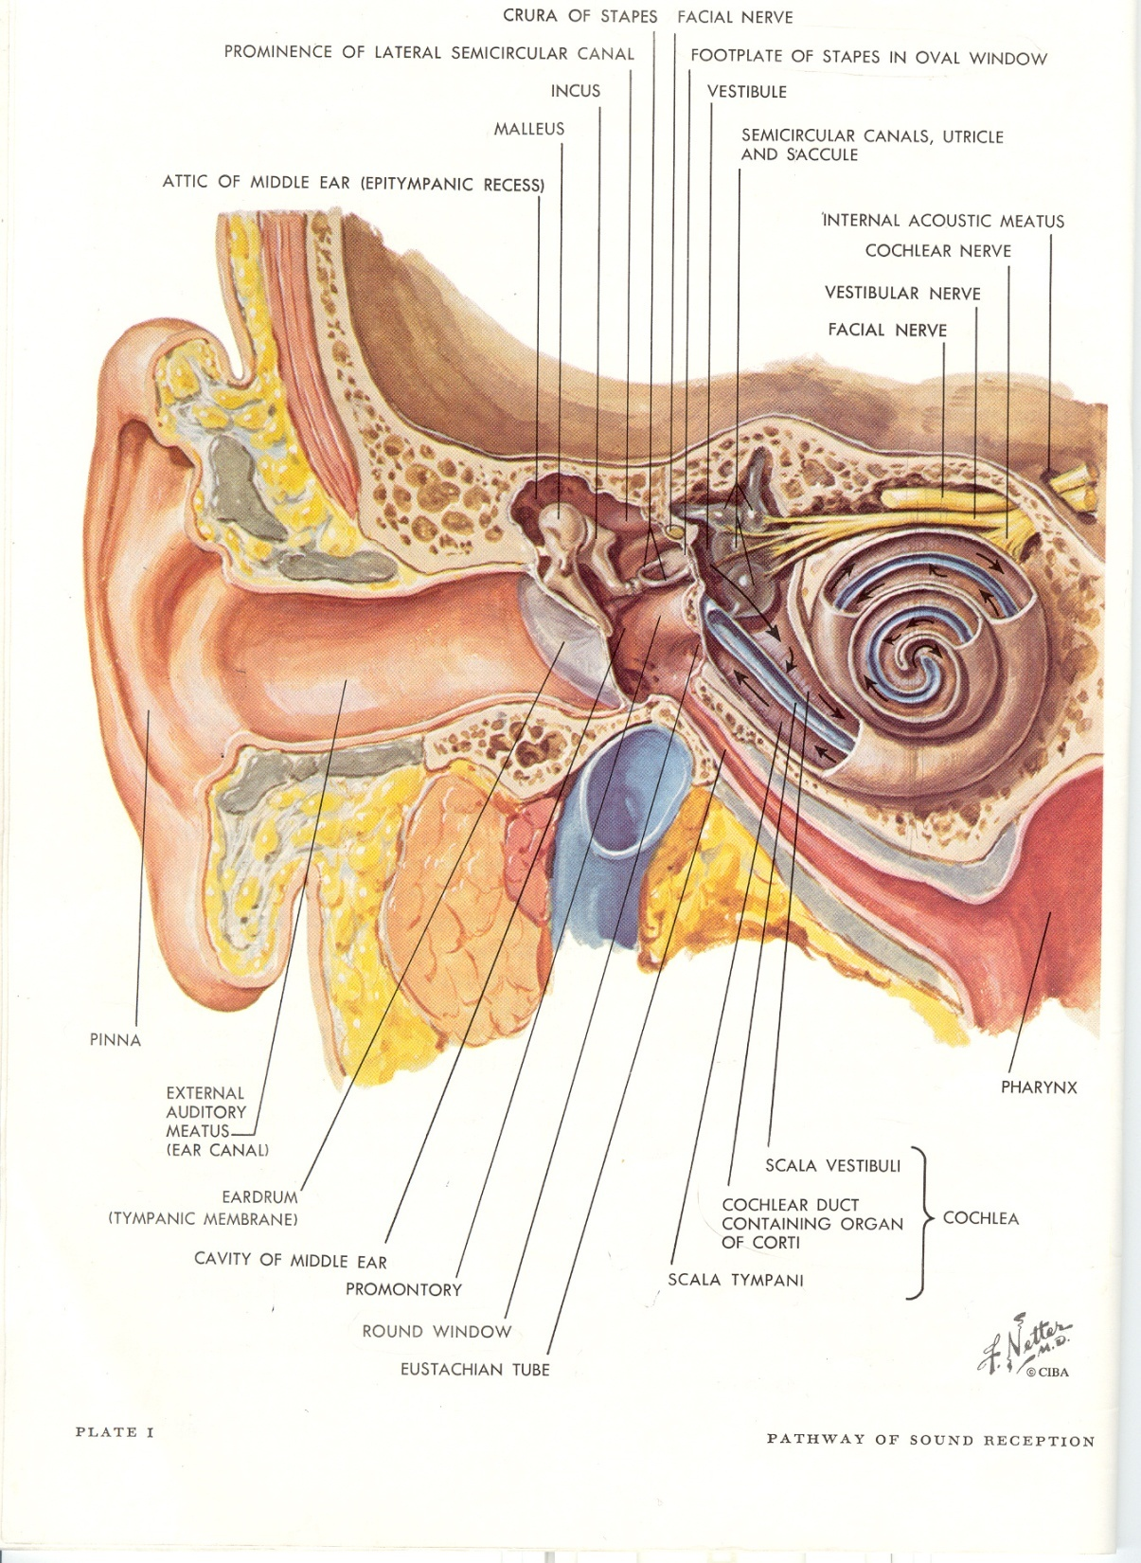
Peripheral auditory system

Slide 6
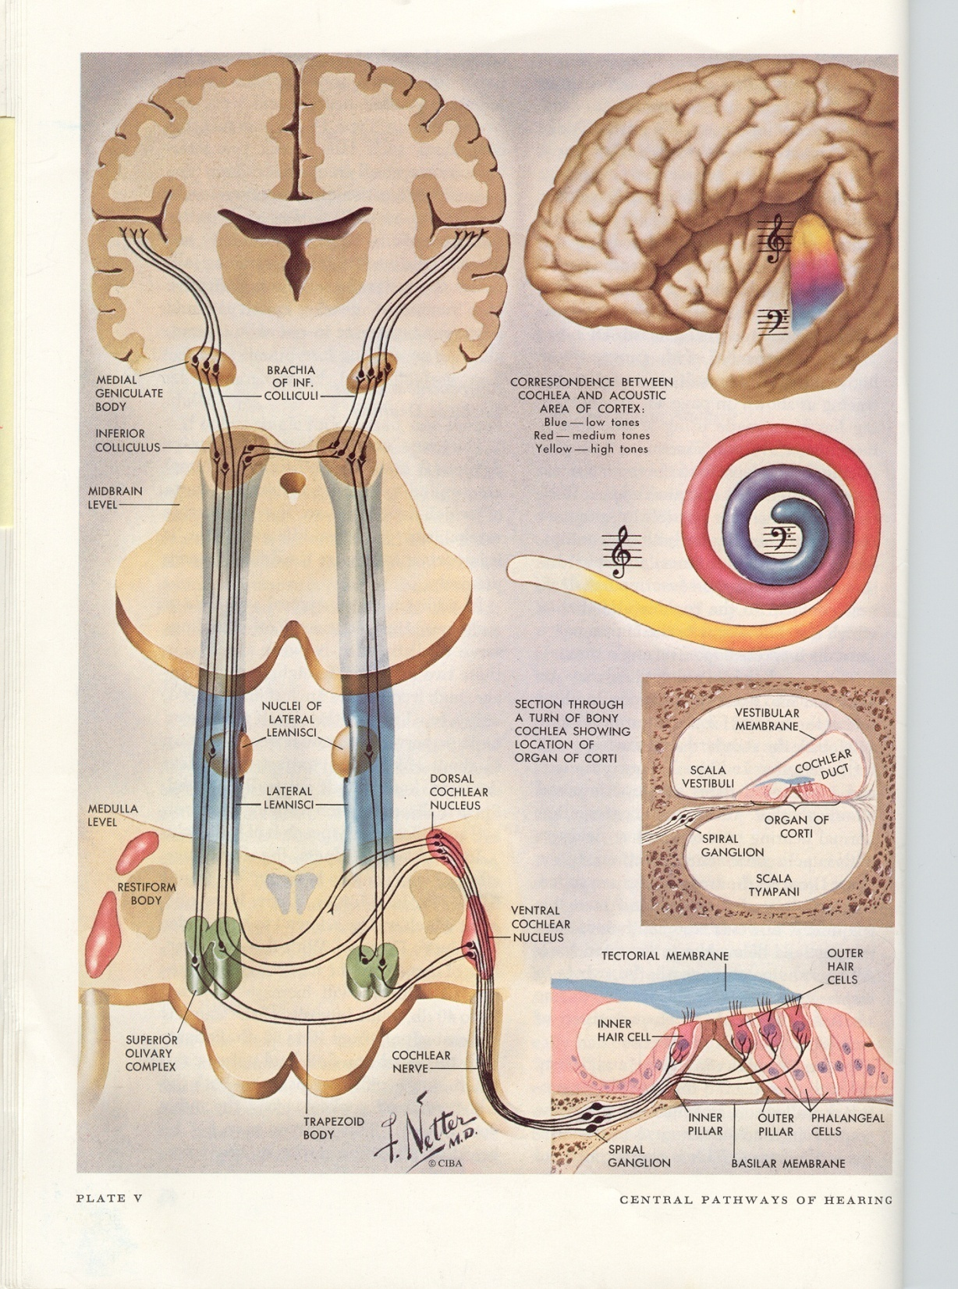
Central auditory system

Slide 7
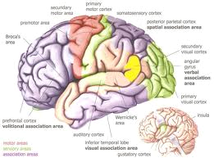
Brain

Slide 8
Describe what comprises good speech.
What is it?

Slide 9
Can you give me some examples of what people do in order to speak well?
Who Are Those People?

Slide 10
Who are those people?
Your hairdresser?
An entertainer?
Your primary care physician?
A television personality or movie star?
A news commentator?
The pastor at the church you attend?
WHY?

Slide 11
Why?
Our central nervous system is pre-tuned to accept and interpret input that it receives at the rhythms, precision and rates, and with the synchrony that it can process with greatest ease.

Slide 12
As adults, we primarily choose to be with those with whom we can hear, understand, and communicate with greatest ease.

Slide 13
For children, they are generally chosen for them!
They have few choices in that regard.

Slide 14
So, let’s talk about children.

Slide 15
The Developing CNS Auditory System

Slide 16
Not to criticize, but--- Most teachers, SLPs, audiologists, and parents have not been taught how to talk to children

Slide 17
Children are not adults, nor are the auditory transmission, storage and retrieval portions of their central nervous system

Slide 18
For Example
For Example---
At age 3-5 years, the typical child’s central auditory system can process the phonemic/linguistic codes of spoken speech at a rate of approximately 120 -124 WPM.

Slide 19
MR. ROGERS spoke (speaks) at a rate of approximately 124 wpm. And, young children adored him and watched his television show faithfully. Why?

Slide 20
For Adults, Walter Cronkite, and Tom Brokaw both practiced speaking at 124 WPM for use during news broadcasts. And, adults watched them on television faithfully. Why?

Slide 21
Back to Children…
Back to Children…
At ages 5 – 7 years, the normal CNS can process phonemic/linguistic codes well at the rate of approximately124-130 WPM when all else in the listening environment is at least nearly optimal…little to no background noise, visual distractions, etc.

Slide 22
Children
Children w/normally maturing CNS auditory systems who are in the upper elementary grades—5th thru 6th--are able to process speech uttered at around 135 WPM.

Slide 23
135 WPM
When these children are in middle school thru high school, they should be able to interpret speech uttered in the 135 WPM range, again when the listening environment is optimal.

Slide 24
Average WPM of most adults
However, the average WPM of most American adults, including elementary education and special education teachers, is approximately 160-180 WPM, and many reach 190-200 WPM !!

Slide 25
Children’s Shows
The speed of speech on some children’s television shows that are cartoon in format such as Dora the Explorer are timed at124 WPM so that children can attend to them and understand what they are saying. Captain Kangaroo in the earlier TV series along with characters like Mr. Green Jeans spoke at the same rate! And, again, don’t forget Mr. Rogers.

Slide 26
Children’s shows (2)
And, children loved those television shows probably primarily because they could understand what was being said. Perhaps those were among a few times children could understand what adults were saying without difficulty.

Slide 27
Sponge Bob!
Children’s television shows such as “Sponge Bob” contain speech timed at over 180-190 WPM. That program, and other cartoon shows for example on The Cartoon Network are timed at over 180-190 WPM. Children neglect the task of listening, and simply watch the action, so watching those shows becomes a visual rather than auditory/language activity.

Slide 28
Detrimental to listening skills
And, and even be detrimental to the development of listening skills in young children.

Slide 29
TV shows discourage listening
That is because those TV shows discourage listening. Children attend to the action on the screen, so the visual aspects are attended to rather than developing their listening skills.

Slide 30
Newscasters
And, news broadcasters for adults who this presenter has worked with have been timed by me at rates exceeding 200 WPM! And, they wonder why the television station receives complaints that adult viewers cannot understand what they are saying!

Slide 31
Children as listeners
Teachers and parents wonder why children do not seem to understand what they are saying, are not attentive, or “My children just aren’t good listeners! How many times do I have to say it before they understand! They just don’t seem to listen! I gave the assignment to the children three times, and they still acted like they didn’t understand! Why don’t they listen!”.

Slide 32
Parents
Parents say, “I have to repeat everything I say at least 4 times before Jimmy will do what I ask him to do. Finally I say, “Jimmy……listen to me! I….want….you…to….make….your….bed…NOW!” He then says, “O.K.”. It seems as though I have to get angry before he listens and does what I tell him!”

Slide 33
Talk at an appropriate speed
Teachers, therapists and parents must talk to children at a rate that a child’s CNS auditory system can be expected to process efficiently—both in speed of presentation, and vocabulary. They must also take the time to ask the simple question, “Do you understand? Do you know what that word means?”

Slide 34
Something else happens!
Something else happens when speed of spoken speech is reduced. Our CNS doesn’t like silence. Therefore, our CNS will inadvertently cause us to fill in those silent gaps of spoken speech with vowels and consonants that have greater duration, increased or enhanced suprasegmental aspects of speech, and more meaningful pauses. Thus, greater clarity!!

Slide 35
What a relief!
When those changes are made, teachers and parents, nurses, doctors, dentists and others who talk to children are impressed with the sudden increase in apparent attentiveness and understanding of the children who are listening to them!
WHAT A RELIEF!

Slide 36
The Environment

Slide 37
Four Acoustical Phenomena That Influence Speech Understanding For Children In All Listening Environments, but Particularly at home and in the Classroom.

Slide 38
Those are--
Signal--The primary signal (the teacher);
Noise-- Usually around 0 to +10 dB S/N;
Reverberation–(most classrooms are nothing more than reverberation chambers);
Modes– Room resonance (The acoustical influences of sound transmission in that environment).

Slide 39
TO COMPENSATE FOR THOSE FACTORS First and Foremost

Slide 40
After enhancing one’s speech habits, Enhance the Listening Environment

Slide 41
At School Change The Acoustical Characteristics Of The Room Which does not always mean adding carpet!

Slide 42
Most classrooms and service environments are filled with reflectent and reverberant elements
Rooms are square or rectangular
Floors are covered with reflectant tile
Ceilings are covered with “acoustical tile”
Blackboards
Exposed windows
Wooden desks and/or polyethylene chairs

Slide 43
Classroom environment
Add absorbent material, if possible including:
* Pretty drape material 2’ wide on the walls;
* Curtain material on the sides of windows;
* Shelves filled with books and materials;
* Stuffed toy animals on top of shelves;
Anything soft and absorbent!

Slide 44
ENHANCE THE VISUAL ENVIRONMENT

Slide 45
School visual environment
At School
Florescent Lights—cause tearing, headaches, inattentiveness, seizures;
Uncovered windows reflect sound & light
Other reflecting surfaces including:
desk tops
metal window blinds
“white” boards
Do Anything To Cut Down On Glare!
Use incandescent lightening whenever possible

Slide 46
ENVIRONMENTAL DESIGN AT HOME

Slide 47
At Home--
Parents must reduce auditory distractions— Turn down (or off) the TV or radio when they are talking with their child;
The parent should not speak unless the child can see her or his face; in other words, not from another room or while walking away from the child.

Slide 48
At Home
While schools are generally reverberation chambers, homes are anechoic chambers. Therefore, speech does not travel well in a home environment, only 6-7 ft. maximum for adequate auditory perception.
Nor, does speech travel well (1) around corners, (2) up or down stairs, or (3) through open doors!

Slide 49
What to do at home
By changing manner of speaking, changing the listening environment at school, offices, clinics, and at home, we will have fewer children who are suspected of having CNS auditory problems, or perhaps even misdiagnosed as having central auditory processing problems.

Slide 50
Thank you!
Thank you! Have A Great Conference!

