Slide 1
Learning from Variation: Implementation and Impact Results from a National Evaluation of Response to Intervention Practices
Rekha Balu
Senior Research Associate | MDRC
Presented at U.S. OSEP Conference| August 2016
rekha.balu@mdrc.org
Report Authors:
Rekha Balu, Pei Zhu, Fred Doolittle,
Ellen Schiller, Joseph Jenkins, and Russell Gersten

Slide 2
Why study tiered supports in reading
Growth in data-based decision-making means schools use decision rules, have assignment data for all students.
Widespread RtI practice adoption in elementary schools in 2000s (Bradley et al. 2011). More widespread understanding of National Reading Panel goals.
Prior efficacy studies did not study tiered structures in the “real world,” without researcher monitoring:
Build on studies of tiered interventions via small groups: Burns (2011); Case et al. (2010); Denton et al. (2010); Gilbert et al (2013); Kerins, Trotter, and Schoenbrodt (2010); Mathes et al. (2005); Vaughn et al. (2006); two studies in Wanzek and Vaughn (2008). Baker et al. (2015); Ebaugh (2000); Harn, Linan-Thompson, and Roberts (2008).
Notes:
Studying at scale presents opportunities and challenges for evaluation
No RCT – widespread adoption means we are not comparing schools with vs. without RtI practices.
But studying assignment mechanisms

Slide 3
Careful selection and surveying of schools
Screened 300+ schools from 500+ expert nominations.
Found 146 schools that for at least 3 years used key practices:
Universal screening of all students 2x/year
3+ tiers of increasing intensity to deliver reading services (with minimum number of students in each tier)
Regular progress monitoring of those receiving Tier 2 or 3 services, and add or subtract services as needed
Quantitative decision rules – thresholds – to assign students to tiers based on screening test scores.
Then we surveyed them about their small reading group services
Supplemental small group instruction, during the core reading block
Small group intervention, at any time of day
Notes:
Note the difficulty of collecting these “administrative records” to determine study admission, and then for analysis linked to outcomes
Nomination
The 13 states in this study include early and later adopters of RtI; of 45 districts, some had district-wide RtI guidelines.
2. Screening
3. Data collection for verification of cut point
4. Admission into the study

Slide 4
Analyses
Examine tier assignment of students.
Compare reading services between reading groups at different tiers/skill levels.
Estimate impacts on reading outcomes of students who fell just below school-determined eligibility for intervention services.
Identify sources and patterns of variation for schools and students.

Slide 5
Types of variation
Variation in decision rules to assign students: if schools use different rules, it helps with generalizability of resulting findings
Variation in practice: When there are practice principles rather than practice standards or manuals, what can researchers expect for implementation?
If there is variation in implementation, what does it suggest for impacts?

Slide 6
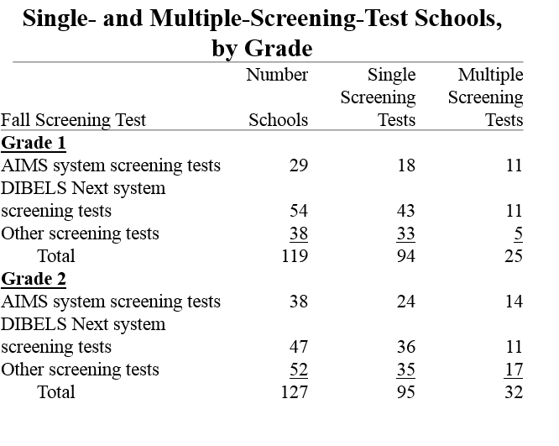
Variation in use of benchmark tests for tier assignment
Notes:
Rows are test systems
Columns are number of schools
First source of variation: type and number of tests multiple tests
There isn’t a dominant commercial system among schools in our sample
Each system has different recommended rules, and schools are ultimately setting their own threshold scores for Tier 2

Slide 7
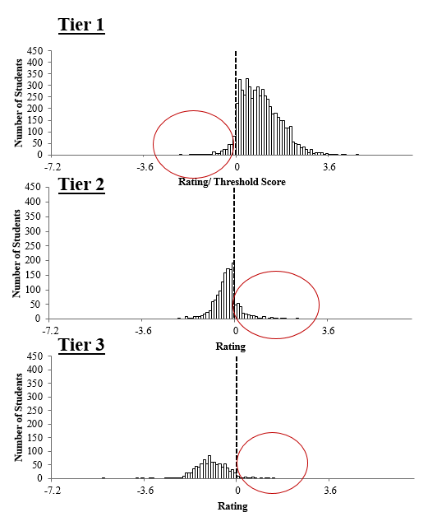
Variation in tier assignment:
Schools follow decision rules and assign most students below the threshold to Tier 2 or 3 in the Fall.
But variation in how closely they follow the decision rule.
Notes:
Explain rating variable, centered threshold score at 0
Combining the previous two slides, based on Fall screening test data
Remind about equivalence between tiers and reading levels

Slide 8
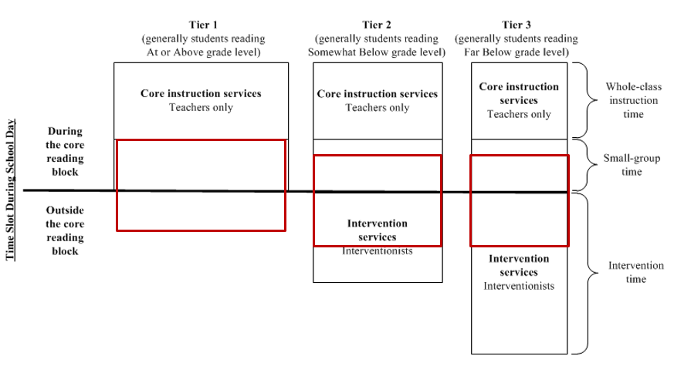
Expected time use
Notes:
Width of bars reflects number of kids served
Because of variations we describe:
- intervention services did not always occur outside of the core, so it may reduce the total amount of time Tier 2/3 students receive, relative to what is shown here
- difference in time between Tier 2 and Tier 1 may not be as great as what is shown here

Slide 9
Service intensity differed between student reading levels in impact sample schools.
Groups serving students reading below grade level vs. groups reading at or above grade level on commonly measured dimensions:
Time (minutes per week) | Group Size | Content/ reading skills | Specialized staff | Frequency of progress monitoring
↑ | ↓ | Phonics:↑ Vocabulary:↓ | ↑ | -
Notes:
Expected variation between tiers
EQUIVALENCE between tiers and reading levels.
Asked teachers and interventionists to report on reading groups.
Shows significant results.
FOCUS ON SMALL GROUP INSTRUCTION FIRST
CITES about intensity factors – Mellard et al 2010 and others.
Rest of the presentation will focus on service contrast in the two school categories, for grade 1 groups.
Magnitude and sig of these differences is comparable across grades
We will focus on time(DOSAGE) and reading skills(CONTENT), intensity areas that most surprised folks and raise the most interesting qs for interpreting the mechanism underlying the impacts.
Define contrast to align with the treatment defn, which will be described in detail later.
Tables 4….treated FB and SB separately. Test of differences between homogeneous groups.
Some items described for both instruction and intervention; others just for intervention.
Measure time as minutes per week. We don’t know number of days, just number of sessions.
About 1 fewer student in below than above.
Specialized staff defined
Can’t assess PM difference for below-above, because only done for below students.
Initially used full set of school and grade indicators. Wanted to use full sample to maximize power and reliability. Initial descriptive stats did not suggest structural differences between grades, other than in enrollment.
Current tables present by-grade service contrast.

Slide 10
Variation in how schools organize intervention services and time: Lessens treatment contrast.
1. At or above reading groups received interventions in some schools.
In Grade 1, up to 45% of impact sample schools provided intervention services to at least some students who read at or above grade level, not just to those who read below grade level.
2. Interventions occurred both during and outside the core reading block.
In Grade 1, 67 percent of schools provided at least some intervention during the core reading block.
Only 16% of schools operate a ‘textbook RtI model’ of intervention services only to below-grade readers and only outside the core.
Notes:
Focus on intervention, the heart of the RtI model
Expected to see differences between somewhat and far below
About half of below grade-level intervention groups served students during the core reading block.
Intervention time during the core may displace— rather than supplement— small group instructional time or other reading services during the core.
Thus we may have a lower bound estimate of total time.
Note that results in tables may represent lower bound
Don’t know true amount of average total time, just an approximation:
Intervention groups during the core may reflect a report on the same set of students who were described during small group instruction time during the core.

Slide 11
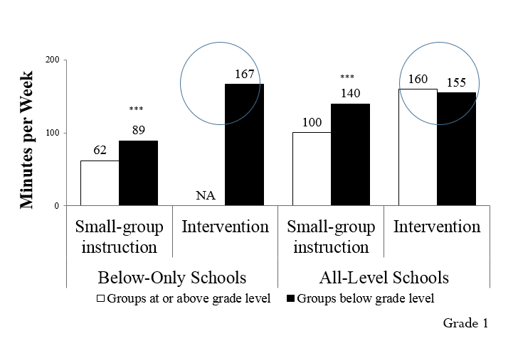
Variation in How Much Time Schools Spend on Intervention, and For Whom
Notes:
This is time above and beyond the whole-class time that all students receive equally.
However, this supplemental time is still a lower-bound for the contrast. Upper bound would be 297-95, if we believed that intervention time for AA students was not in addition to instruction time.
Similar intervention time may be related to providing intervention services during the core.
We see more time by reading level, regardless of whether for instruction or intervention alone, or for the total.
Below-Only: G1 mean ~= G3 mean
All-levels: G3 diff< G1 diff
Instruction time in all-level schools for AA ~= instruction time in below-only schools for SB/FB
Red circle indicates caution: intervention time for AA is associated with fewer groups ~500 than the number of groups providing the instruction time average ~1300 => transition to PER STUDENT
Below Only (Model I)
Instruction school n = 72;
time group n: AA=1,365, SB/FB=912;
Intervention school n =72;
time group n: SB/FB=1,085
All Level (Model II)
Instruction school n = 57;
time group n: AA=989, SB/FB=805;
Intervention school n =59;
time group n: AA=450, SB/FB=1,580;

Slide 12
No positive impacts of being assigned to receive intervention, for students near the eligibility threshold.
Grade 1
Grade 2
Grade 3
ECLS-K
Reading
Assessment
State reading achievement test
TOWRE2
TOWRE2
*
Significant at the 5% level. Equivalent to one-tenth of a year less learning.
Notes:
Appears to be a story by grade – something adverse in Grade 1.
the study is equipped to detect impacts on reading achievement that are as small as 0.15 to 0.16 for Grade 1, 0.17 for Grade 2, and 0.13 for Grade 3.
Sample size varies by grade.
Ranges from 112-127 schools, and 8,000 to 9,200 students.
Tests
ECLS-K:
Basic skills: print familiarity, letter recognition, sight vocabulary, decoding
Vocabulary knowledge: receptive vocabulary, vocabulary-in-context
Passage comprehension
TOWRE2—Sight Word Efficiency: focus on word reading fluency
Grade 1
Statistically significant and negative effect of assignment to Tier 2 or Tier 3 intervention services on the comprehensive reading measure for students whose ratings were around the cut point.
Negative but insignificant effect of receiving such interventions on reading fluency (TOWRE2-SWE) for these students.
P-value is just over the 0.05 threshold (0.057).
Grade 2
Positive but insignificant effect on second grader’s reading fluency (TOWRE2-SWE) for students at the margin of identification.
P-value is just over the 0.05 threshold (0.084).
Grade 3
Estimated impact on third grade reading achievement (state reading assessment score) is close to zero and not statistically significant.

Slide 13
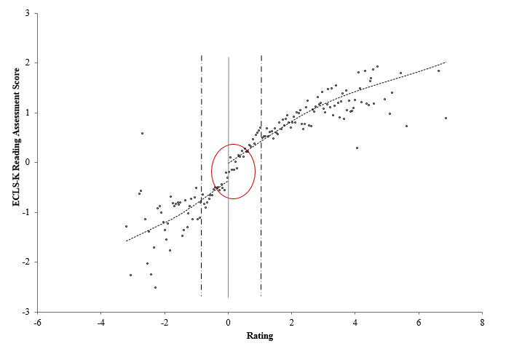
Grade 1 – negative impact in a Regression Discontinuity design

Slide 14
What the results do and do NOT tell us
We used a Regression Discontinuity design, not a randomized trial.
Therefore, these results apply only to students near the threshold of eligibility for reading interventions (usually Tier 2).
Findings at the threshold are relevant to expanding or reducing the number of students assigned to intervention. Recall that study schools have on average 40% of students in Tier 2 or 3.
The results do NOT mean that those interventions are ineffective for students at greater risk of reading difficulties (usually Tier 3).
The results do NOT mean that use of RtI practices or the framework as a whole is ineffective.

Slide 15
Variation in estimated impacts across schools is significant, but fewer positive outliers
Number of schools with positive impacts: 38 (4 are significant)
Schools
1 - 119
Number of schools with negative impacts: 81 (15 are significant)
Notes:
Not driven by outliers
There is significant variation in impact across schools. This is true for all outcomes.
Main impact results are consistent with these caterpillar figures.
Outliers aren't necessarily driving the main impact results.

Slide 16
Hypotheses: Why school practice variation may be related to impact variation
Use of single vs. multiple screening tests:
Which better identifies and matches students?
Proportion of students assigned to Tier 2 or 3:
Constrained resources per student vs. peer effects?
Proportion of students provided interventions during the reading block:
Diluted treatment differential
Whether interventions are provided to all reading levels:
Diluted treatment differential

Slide 17
Possible explanations for negative finding in Grade 1
Problem is identification
False or incorrect identification of students for intervention.
Systematic “noise” in the screening tests.
Problem is intervention
Mismatch between intervention approach or content and reading needs of students near the cut point.
Poor alignment between reading intervention and core reading instruction.
High opportunity cost of displacing core instruction with potentially lower-quality intervention
Notes:
Here are some ideas to start us off:
Our TWG and study team honed in on these possibilities
We know these issues are of interest to the field
Remind people that some things explain null findings, not negative findings.
Alignment issue unclear given that teachers worked as interventionists
We tested where there were differences

Slide 18
Potential mechanisms related to schools’ discretion
Tier 1 – missed opportunity:
By moving students into intervention, missed opportunity for Tier 1 to work.
Too much…
Over-identified – set the screening test cut score too high, too many students in intervention who could succeed otherwise with Tier 1 instruction alone.
Over-served – for some students, too much intervention, not enough instruction.
…Too soon:
In Grade 1, perhaps need more time in Tier 1 than in other grades to determine if students are at risk.
Consider alternate or more focused ways for schools to use discretion.

Slide 19
Future research topics, approaches to minimize variation between schools
How best to use assessments to decide who receives what?
How can schools best schedule interventions?
Intervention period
Pull-out vs. pull-in
Staggered schedule
What are the resource requirements of delivering interventions?
Cost of staff, time, well-aligned materials.
Coordination costs
Notes:
Under ESSA’s future accountability and assessment flexibility, match screening tests to outcome measures.

Slide 20
Acknowledgments
Institute of Education Sciences, NCEE
MDRC
SRI International
Instructional Research Group
Technical Working Group members
Nominated and participating districts and schools
Many research assistants and analysts
Please cite this report as:
Balu, Rekha, Pei Zhu, Fred Doolittle, Ellen Schiller, Joseph Jenkins, and Russell Gersten (2015). Evaluation of Response to Intervention Practices for Elementary School Reading (NCEE 2016-4000). Washington, DC: National Center for Education Evaluation and Regional Assistance, Institute of Education Sciences, U.S. Department of Education. http://ies.ed.gov/ncee.

Slide 21
Extra slides

Slide 22
Scope of the study
Large-scale study of tiered supports for reading, as implemented in the “real world”
Examine assignment mechanism: use of benchmark screening data to assign students to tiered services.
Answer a new, more narrow impact evaluation question:
What is the effect of assignment to intervention services for students just below the cut point, in grades 1, 2 and 3, compared to students just above the cut point?
Regression Discontinuity design that exploits the assignment mechanism and use of decision rules.
Examine variation in practice and in impacts for an unprecedented sample: 8,000-9,000 students.
Notes:
Real-world means no academic or program developer monitoring – lots of unplanned discretion Dimensions measured in earlier studies
Unusual scale of data collection

Slide 23
Higher Proportion of Impact Sample than Reference Sample Use Key Practices
Key RtI Practices | Impact Analysis Sample (screened) | Reference School Sample (sampled)
Average number of practices (out of 8) | 6.5 | 5.4
90-minute reading class (Tier 1) (%) | 69.7 | 68.2
Intervention for Tier 2 students three times a week (%) | 96.6 | 80.0
Intervention for Tier 3 students five times a week (%) | 67.6 | 47.1
Data staff available to assist teachers (%) | 88.3 | 72.1
Specialized reading staff available to assist teachers (%) | 69.0 | 55.5
Universal screening of all students twice a year (%) | 83.4 | 58.9
School designated steps for making decisions to help struggling students (%) | 94.5 | 87.9
Used data to monitor students, as part of determining special education eligibility (%) | 80.0 | 72.6
Tiers
Staff
Data
Note: The bolded rows indicate the difference between samples is statistically significant at the p ≤ 0.05 level.
Notes:
Bolded practices are significantly different.
From each of the 3 areas.

Slide 24
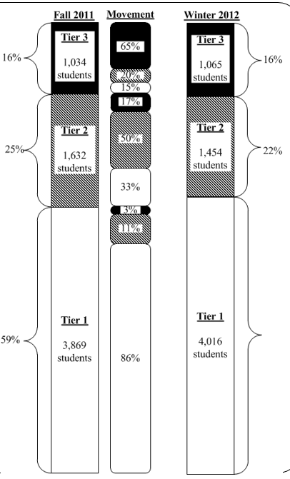
The majority of students are placed in Tier 1, and remain there.
Notes:
Despite variation in threshold scores and systems used, see consistency in overall pattern/distribution.
Students were placed in different tiers, so some sense of differences in need/risk.
Could be in these tiers for 6 weeks or longer. We asked for beginning of Fall and Winter, but not exact duration/ dosage because of reporting error

Slide 25
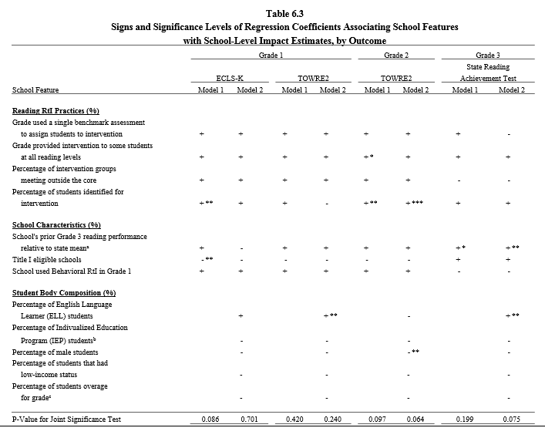
Associations between school characteristics and school level impact (1)

Slide 26
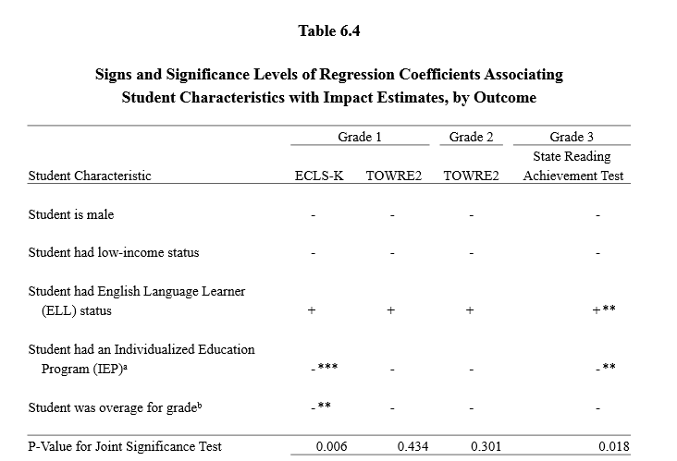
Association between student characteristics and impact findings (1)

Slide 27
Appendix 1: Validity of the RDD
Conducted validity checks focus on
the continuity of the rating variable at the cut point,
manipulation of the rating variable at the cut point, and
data heaping.
Various tests show no evidence of violation for RD assumptions

Slide 28
Appendix 2: Sensitivity Checks
Conducted analyses to assess whether main findings are sensitive to
Alternative bandwidth selections
Alternative model specifications (covariates, rating functional form, single instrument vs. multiple instruments)
Alternative sample specifications (outliers, students with zero ratings, schools with discrete ratings)

Slide 29
Limitations of the RD design
Noise in the rating variable (screening test)
Concerns about psychometric accuracy of some screening tests, especially at the cut point.
Random noise (incorrectly assigning Tier 1 to Tier 2 and vice versa) helps as we pool across sites. But systematic noise is problematic, especially within a school.
Crossovers and no-shows
Unclear why students did not end up where they should – is it professional judgment, clerical error, other

Slide 30
What the study does not evaluate (conclusions we cannot make):
Effectiveness of the RtI framework as a whole.
Impacts of RtI on identification of students with Specific Learning Disabilities.
Fidelity with which schools implemented the framework.
Effectiveness of specific Tier 2 or 3 reading intervention series.
Quality of instruction or intervention.
Notes:
Conclusions we cannot draw

Slide 31
Other studies find null effects, too.
Several studies of tiered practices found practice variation.
Mellard, McKnight, and Woods (2009); Vadasy, Sanders, and Tudor (2007)
RCT/QED Studies of Tier 2 interventions find mixed effects.
Of 12 studies of small group interventions in Grade 1, 11 had significant null effects.
Burns (2011); Case et al. (2010); Denton et al. (2010); Gilbert et al (2013); Kerins, Trotter, and Schoenbrodt (2010); Mathes et al. (2005); Vaughn et al. (2006); two studies in Wanzek and Vaughn (2008). Baker et al. (2015); Ebaugh (2000); Harn, Linan-Thompson, and Roberts (2008).
Notes:
Of 12 Grade 1 studies, only 4 had sample size>100.
None of these 27 studies examine “home-grown” or preexisting interventions.

