Slide 1
Preparing Culturally and Linguistically Responsive Educators: Rethinking Our Approach to Personnel Preparation
Dr. Edwin Achola, Dr. Vivian Correa, Dr. Tonika Duren Green, Dr. Kent Mcintosh
Moderator: Dr. Cathy Kea

Slide 2
Session Description:
This panel will examine how personnel preparation programs in special education, early intervention, and related services address issues of educator diversity and equity for students, and incorporate culturally and linguistically responsive practices in their efforts to prepare practitioners who are effective at supporting children with disabilities from historically marginalized families and diverse backgrounds. The panel will focus on evidence-based approaches to personnel preparation; feature personnel preparation programs using those strategies and practices and their results; and discuss how we might rethink our approach to personnel preparation of educators as a field.
Dr. Edwin Achola, Assistant Professor of Advanced Studies in Education and Counseling, California State University (edwin.achola@csulb.edu)
Dr. Vivian Correa, Professor of Special Education and Child Development, University of North Carolina Charlotte (vcorrea@uncc.edu)
Dr. Tonika Duren Green, Associate Professor of School Psychology, San Diego State University (tduren@mail.sdsu.edu)
Dr .Kent McIntosh, Professor, Special Education and Clinical Sciences, University of Oregon (kentm@uoregon.edu)
Moderator: Dr. Cathy Kea, Professor, Department of Curriculum and Instruction, North Carolina A&T State University(cdkea@ncat.edu)

Slide 3
Panel Questions
How are the innovative personnel preparation programs different from traditional programs when it comes to addressing issues of diversity? What evidence is there to support those innovative methods, strategies, and practices to personnel preparation?
What culturally responsive research-based practices show promise for improving outcomes for learners from diverse cultural and linguistic backgrounds and historically marginalized families?
How do we incorporate those practices into our personnel preparation programs? Specifically, …
How are key terms (e.g., culturally-responsive, multicultural issues, historically underrepresented) being defined?
What knowledge, skills, and dispositions do scholars need to be equipped with to identify diverse learners?
What standards are used to teach and measure outcomes in training programs?
What implications do the demographics of faculty and scholars have for personnel preparation programs? How might those considerations be addressed by program faculty?
Thinking systemically, what steps can we take as a field to advance these innovative, research-based practices? What would be the most impactful in advancing meaningful change?

Slide 4
Dr. Edwin Achola
Assistant Professor Of Advanced Studies In Education & Counseling
California State University—Long Beach

Slide 5
An Interdisciplinary Project to Promote Culturally Responsive Transition Policies, Planning, & Practices
California State University—Long Beach
Kristin Powers Ph.D. & Edwin Achola Ph.D.

Slide 6
Key Components of the Program
A cohort-based, interdisciplinary approach to training
Learning communities established in the form of five dyads
Each consists of a school psychology scholar and a special education scholar
Working together in a special education classroom (practica sites)
Project practica sites are CED high schools in the Long Beach Unified School District.
3. Transition Planning & Consultation skills:
Shared courses
Professional Conferences
Scholar support/mentoring
Seminars
4. Intercultural Competence

Slide 7
Recruitment
Cohort 1:
Existing Recruitment Framework: outreach to local colleges, program faculty, current students, website
A total of 10 students are currently participating in the project
5 of whom are in the school psychology program
5 of whom are in the special education credential program.
Psychology students: 48% are Ethnically diverse, 52% are bilingual, and 40% are male.
Special education credential students are 60% Ethnically diverse and 60% bilingual-all female.
Cohort 2 & 3:
On Campus: outreach to specific programs, CED faculty & students, partnerships with Africana Dept., student organizations
Off Campus: Community organizations, CED faculty & students, paraprofessionals

Slide 8
Key Components: Seminars
Grant seminar include:
(1) Group Debriefing
(2) Topics specific to diversity
(3) Topics related to transition planning
(3) Establishing and sustaining culturally congruent, evidence-based transition services.
(4) Opportunities for Research

Slide 9
Key Components: Transition Planning
Strengths-based family empowerment models Evidence-Based Transition Services:
Developing transition plans that incorporate promising interventions such as self-determination training
Implementation of targeted evidence-based interventions
Person-Family Centered Transition Planning:
Conducting community resource mapping
How to explore and utilize connections between child and family outcomes in order to develop meaningful ITPs
Recognizing current transition practices that alienate their intended audience
How to develop family-to-family networks
How to apply a flexible approach to transition planning
Systems change research and/or implementation science

Slide 10
Intercultural Competence
Research has addressed the need to develop intercultural competence in teachers, focusing on the importance of:
Relationships (Zaharna, 2009; Nwosu, 2009)
Identity (Kim 2009, Ting-Toomey, 2009),
Context (Moosmüller & Schönhuth, 2009; Medina-López-Portillo & Sinnegen, 2009)
Goals
Scholars to become successful intercultural mediators themselves
Ability to communicate effectively and appropriately in intercultural situations
Adaptations to transition curriculum

Slide 11
Intercultural Competence
Bennett’s Developmental Model of Intercultural Sensitivity (DMIS)
Competence orientations identified in the continuum
Denial
Polarization
Minimization
Acceptance
Adaptation

Slide 12
Hammer’s Intercultural Competence Model (ICM)
Bridges Across Difference
Deeply Comprehends Difference
De-emphasizes Difference
Judges Difference
Misses Difference
Transition stage between monocultural and intercultural mindset
Source: Reproduced from the Intercultural Development Inventory Resource Guide by permission of the author, Mitchell R. Hammer, Ph.D., IDI, LLC. Copyright 1998, 2003, 2007, 2012 Mitchell R. Hammer, IDI, LLC. All Rights Reserved.

Slide 13
Intercultural Competence
Focus of the grant:
Increasing cultural self-awareness;
Deepening understanding of the experiences, values, perceptions, and behaviors of people from diverse cultural communities; and expanding the capability to
Shift cultural perspective and adapt behavior to bridge across cultural differences
(Deardorff, 2006; Hammer, 2009a, 2010, 2011)

Slide 14
Intercultural Competence
Cultural self-awareness;
Complete a self-awareness survey; Adapted from Marx (2011) My Cultural Awareness Profile (MyCAP)
Sample Questions:
Everybody in the United States must learn English in order to be successful
To me race/ethnicity does not matter. Everybody should be treated the same regardless of their race/ethnicity
All children should be allowed to choose their future careers.
5 point Likert scale

Slide 15
Intercultural Competence
Outcomes:
Opportunity for scholars to reflect on their current knowledge, beliefs, and understandings
Opportunity to get to know scholars
Develop a plan to address gaps identified
Examples:
Join a student organization: African American
Attend cultural events organized by Cambodian American community

Slide 16
Intercultural Competence
We ask scholars to:
Provide accounts of specific situations or critical incidents that they encountered
Explain strategies they used to navigate these identified scenarios
What they perceive the outcomes were.

Slide 17
Intercultural Competence
Strategies for addressing Gaps:
Assessment:
Intercultural Development Inventory (IDI)
Qualitative interviews
Experiential learning: learning through field work and reflection
Guided mentorship & reflection on their ‘‘experiences’’ in another culture
Direct Feedback from instructors
Cultural mentoring: Group, Peer & Practitioners in schools

Slide 18
Challenges:
The mechanics and logistics of ensuring that students are placed—or, ‘‘immersed’’—within a suitable cross–cultural environment.
Professional Development for co-operating teachers
Engaging Administrators
Measuring Student Growth:

Slide 19
Dr. Vivian Correa
Professor of Special Education and Child Development University of North Carolina—Charlotte

Slide 20
Strategies For Preparing Early Childhood Special Education Teachers For Diversity
Notes:
“Preparing Culturally- and Linguistically-Responsive Educators: Rethinking our Approach to Personnel Preparation”
Vivian I. Correa
University of North Carolina at Charlotte
Possible sub-title -- Strategies For Preparing Early Childhood Special Education Teachers For Diversity
Most teacher education programs in early intervention and early childhood special education (EI/ECSE) have incorporated strategies for promoting cultural competence and culturally responsive practices. The focus of this panel presentation will address solutions for developing critical knowledge and attitudes in preservice EI/ECSE teachers. Examples of course design, service learning projects, and clinical field experiences addressing culturally and linguistically diverse populations will be describe.

Slide 21
How Prepared Are ECE Professionals to Work with CLD Children and Families? (Banerjee & Luckner, 2014)
52%
35%
Felt Training Did Not Address CLD or Was Ineffective
Did NOT Feel Knowledgeable
Notes:
Rasbida Banerjee, & John Luckner (2014). Training needs of EC professionals who work with children and families who are culturally and linguistically diverse. Infants and young children. 27, 43-59.
University of Northern Colorado, Greeley
(Participants were recruited in multiple ways to obtain a comprehensive sample. National early childhood organizations— Division for Early Childhood (DEC), International Society of Early Intervention (ISEI), and National Early Childhood Technical Assistance Center (NECTAC, now called ECTAC)— helped distribute the survey to their members via their listserv at no cost. The survey was distributed to approximately 800 ISEI members, 3,800 DEC members, and 1,800 NECTAC members. Although the purpose of the survey was to include participants who worked in EI/ECSE settings, these listservs included members who may have had a broader professional scope. A total of 574 early childhood professionals responded to the survey.
48% knowledgeable when working with CLD
65% training did address CLD
having an additional class on culture and working with students and families who are CLD,
providing instruction on differences, biases, and stereotypes, and
requiring a practicum experience in schools that serve children who are CLD

Slide 22
Strategies for Preparing Preservice Teachers
Standalone courses
Combined field experiences and coursework
Short- and long- term cultural immersion
Infusion across courses throughout the program
Correa, McHatton, McCray, & Baughan, 2014
Notes:
examine personal assumptions and biases
have knowledge of different cultural perceptions and practices;
work effectively with individuals of different backgrounds, cultures, languages;
value diversity and promoting tolerance and respect for others;

Slide 23
Lessons Learned on Standalone Courses
University of Florida
Correa, V. I., Hudson, R., & Hayes, M. T. (2004). Preparing early childhood special educators to serve culturally and linguistically diverse children and families: Can a multicultural education course make a difference? Teacher Education and Special Education, 27, 323-341.
Clemson University
Correa, V., Huber, J., Baughan, C.C., & Prince, A. (In Preparation). Three cohorts of preservice teachers: Perceptions on diversity at different stages following graduation.
Notes:
(over 10 years of teaching a Multicultural Education in ECSE course)
(2 years of teaching a Multicultural Education in ECSE course)

Slide 24
Sample Standalone Course Topics
Concept Map; Intro to MCE; Rationale; Cultural Identity Activity
Demographics and Definitions of MCE, culture, and diversity
Social Class Issues; Ethnicity and Race; Geography
Gender; Religion; Age
Exceptionality (Disproportionality Issue)
Anti biased Curriculum
Critiquing Multicultural Lesson Plans and Thematic Units
Second Language Acquisition in Young Children
Differences in Language Acquisition
Teachers’ Roles in Second Language Acquisition
Assessing ELL Students: Language Difference or Learning Disability?
Choosing multicultural materials for early childhood programs
SIOP Demonstration (Pearson Publishing)
Working with families
Notes:
Challenge in clemson, had to cover English Language Learners --
Challenge the pressure to cover more content in a limited degree program curriculum – ESOL certification and ECE and EI/ECSE

Slide 25
Percent of Time on Course Topics

Slide 26
Class Assignments
Concept Map (pre and post)
Culture Journey and EcoMaps (personal histories)
Childrearing Project
Book Report
Persona Doll Stories
Selecting and critiquing children’s books
Evaluating Multicultural Materials (Learning Safari)
Unit Plan Critique
Home visit with interpreter and reflection
Classroom Action Plan
Notes:
Beth Harry, Melanie
Simulations: Ba Fa Ba Fa; Poverty Simulations; survival dictionaries in Spanish and other languages.
Parents as Teachers now in UNCC

Slide 27
Assessing the Impact
Concept maps (pre-post)
Interviews (post course)

Slide 28
Results
Prior to the course
Valued MCE but had an abstract concept of it
Knew it was important to be self-aware
Defined diversity in limited terms
Correa, Hudson, & Hayes (2004)
Notes:
Pre post concept maps
Open ended paragraphs
Videotaped interviews

Slide 29
After the Course
Moved from abstract to practical application
Expanded definitions of diversity
Realized the teachers’ role in promoting diversity versus biases
Understood their own impact on their students and their classroom
Had an understanding of the funds of knowledge and the role of family/community
Correa, Hudson, & Hayes (2004)

Slide 30
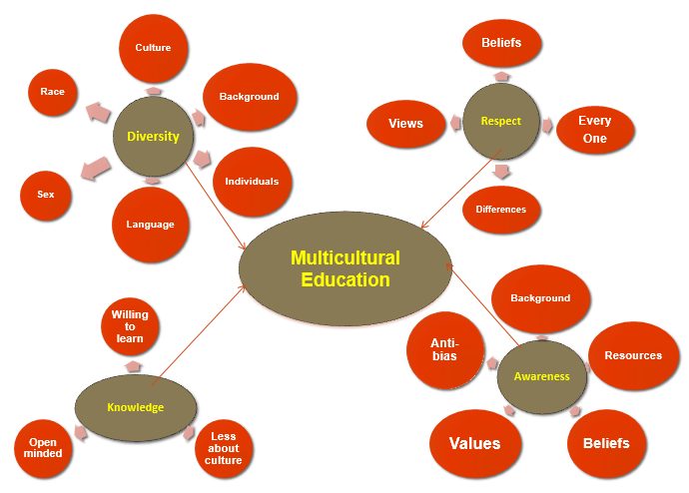
PRE CONCEPT MAP = 22

Slide 31
Anti-bias Toys
Different Ethnicities
Different Races
Classroom Materials
Diverse Dolls
Disabilities
Pictures
Diverse Foods
Support Development Of Native Language
Encourage boys and girls to play with all items
Diverse Gender Roles
Respect For Others
Influence Family Interactions
Curriculum
Language
Anti-bias
Diverse literature
View oneself as unique
Respect
Multicultural Education
Others’ Differences
Every individual has own culture
Family
Experiences
Anti-bias
Knowledge of own culture
Non-judgmental
Background
Cultural Biases
Become activists
Beliefs
Family
Religion
Community
Empathy
Persona dolls
Family make-up
Values
Go out in community
Language
Bring community into classroom
Sensitive issues
Friendship
POST CONCEPT MAP = 41

Slide 32
Student Interviews

Slide 33
Lessons Learned
Provide time for dialogue
Be prepared to support “tensions”
Consider the power of assignments
Teach activism and social justice
Focus on disability as diversity
Continue infusing content into other classes and practicum.
Notes:
Provide time for dialogue
Be prepared to support “tensions”
Consider the power of assignments
Teach activism and social justice, especially in early childhood
Focus on disability as diversity
Continue infusing “cultural” materials into other classes and practicum.

Slide 34
Follow–up with graduates

Slide 35
2 Years After Graduation: Competing Agendas
Novice Teachers are juggling a lot:
Pressure on achieving child outcomes
Finding appropriate ECSE curriculum
Political adjustment (School’s Culture)
Mentoring and induction year activities
Family involvement

Slide 36
3 Years After Graduation: Still Struggling
Idealism versus realism
Knowledge not grounded in experience
Strong and impressive recognition of MCE values

Slide 37
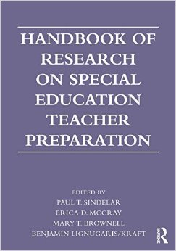
Handbook of Research on Teacher Education and Special Education (2014)
Chapter 12: Preparing Teachers To Work With Students From Diverse Backgrounds
Vivian I. Correa, Patricia Alvarez McHatton, Erica D. McCray, & Cynthia Coss Baughan

Slide 38
Recommendations for Faculty
Provide ongoing professional development activities
Find ways to engage faculty in self-reflection
Create doctoral seminars that focus on CRT/diversity and teacher education.
Encourage doctoral students to infuse CRT/diversity content in their co-teaching and college teaching internships.
Encourage faculty to infuse internet modules into course content
Notes:
Provide ongoing professional development activities for faculty (e.g., brown bag lectures, shared readings and discussion groups).
Find ways to engage faculty in self-reflection of values and beliefs so they become knowledgeable and less resistant or uncomfortable with diversity issues.
Create opportunities for faculty and doctoral students to interact with nationally renowned leaders in the field of CRT/diversity (e.g., webinars, college lecture series, conference presentations).

Slide 39
Teacher education programs must reposition “culture” at the center of all teacher preparation.
—Kea & Trent, 2013

Slide 40
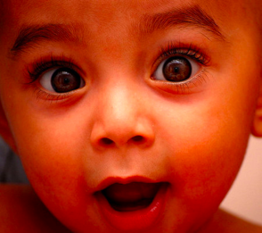
Muchas Gracias
Thank You
vcorrea@uncc.edu

Slide 41
Dr. Tonika Duren Green
Associate Professor Of School Psychology
San Diego State University

Slide 42
San Diego State University
School Psychology:
The Profession &
Our Multicultural School Psychology Program
Faculty: Tonika Duren Green, Director and Associate Professor, Colette Ingraham, Professor, Katina Lambros, Associate Professor, and
Carol Robinson-Zañartu, Emeritus Faculty
Notes:
Bryant

Slide 43
Distinguishing Characteristics of SDSU’s School Psychology Program
Culture-specific, multicultural, and cross-cultural content and processes throughout program
Diversity in our student cohorts
Faculty committed to social justice and educational equity.
Strong field experience sequence throughout each year in the program with about 2,000 hours in schools
Interdisciplinary courses and opportunities through a shared core curriculum with school counselors
Federally funded projects to support our students
Mentorship and Advising

Slide 44
Ecosystemic Program Perspective
There are NO problem children,
only problem situations.
These situations are a result of dysfunctional transactions and reciprocal determinism among, for example, children, teachers, and parents.
Culture is brought to the forefront as a base for hypothesis generation regarding the nature of the situation.
Assessment-for-Intervention is unified in response to person/situation characteristics.
Individuals as well as groups of individuals are viewed as open and modifiable systems.
Family
Community
School
Community
Child
Cultural
Ecology
Mainstream
Home
Notes:
Here is our program philosophy. Within our program we focus on 4 principles.
The School Psychology Program prepares school psychologists to be systems change agents in culturally diverse schools.
Ecological and systems perspectives by which to consider problem situations in the schools,
Cultural competencies to serve the multicultural populations of public schools
Knowledge and skills to serve both general and special education populations, and
Skills to function as advocates, change agents, and consultants in the schools, providing a broad range of culturally appropriate assessment-intervention services.

Slide 45
Diversity in Our Cohorts
Academic Year | # of Candidates Enrolled in the program | Females | Males | Ethnicity | # of Program Completers
2015–2016 | 51 | 40 | 11 | Euro Am–11 African Am–6 Latino–21 Asian/PI–7 Native Am–1 Multi–Racial–4 Other–1 | 11
2014–2015 | 49 | 37 | 12 | Euro Am–12 African Am–5 Latino–22 Asian/PI–4 Native Am–1 Multi–Racial–4 Other–1 | 10
2013–2014 | 45 | 34 | 11 | Euro Am–10 African Am–4 Latino–20 Asian/PI–6 Native Am–2 Multi–Racial–1 Other–2 | 9
2012–2013 | 41 | 32 | 9 | Euro Am–9 African Am–2 Latino–16 Asian/PI–8 Native Am–2 Multi–Racial–3 Other–1 | 10
*Other including students identifying as Indian and Middle–Eastern

Slide 46
How Do We Compare?
Notes:
In California’s public schools:
2.6 million (41%) speak a language other than English at home
Over 1 million English Language Learners (ELLs)
In San Diego’s public schools:
The majority speak a language other than English
The majority of ELLs are Spanish Speakers
Spanish Speakers are culturally diverse
One school - over 100 language groups
In SDSU’s School Psychology Program:
The majority of our students are proficient in English and another language(s): Spanish, Mandarin, Japanese, Tagalog, Taiwanese, Vietnamese, Korean, and Navajo

Slide 47
Fieldwork and Practica in Multicultural Schools
Each student completes a minimum of 850 hours of supervised practicum and field experiences before their final internship.
Internship is full-time, all year, and involves at least 1,200 hours of supervised professional practice in schools, as required by NASP.
Prior to graduation, each student completes over 2,000 hours of supervised school practice.
Notes:
Across California and the United States
Supervisors are ethnically and linguistically diverse and many are our grads
Pairing system that takes into account, personal needs, professional needs, language, culture, and gender

Slide 48
Specialized Grants
CLASS-EL, NAISC, CARES

Slide 49
Native American & Indigenous Scholars Collaborative (NAISC) 2014-2019
Commitment to Learn about and Serve Indigenous Youth and Communities
Weekly Seminar
Summer and Winter Institutes
Spring Immersion on Reservation
Weekly Fieldwork
Profession-Specific and Native American Professional Conferences
Financial Support
“Treat the earth well. It was not given to you by your parents, it was loaned to you by your children.”—Native Proverb
Notes:
Jarrett & Tiffany
Native Grant

Slide 50
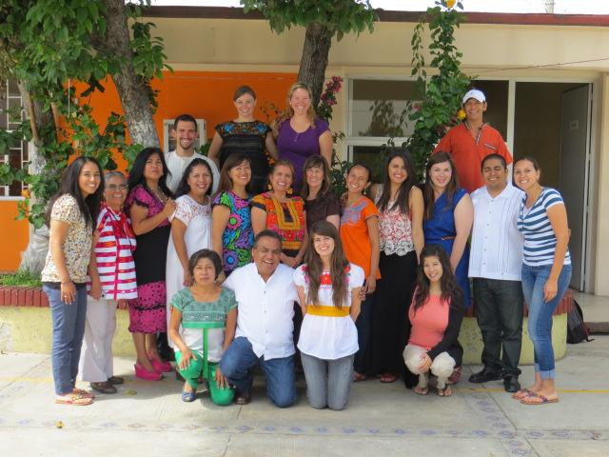
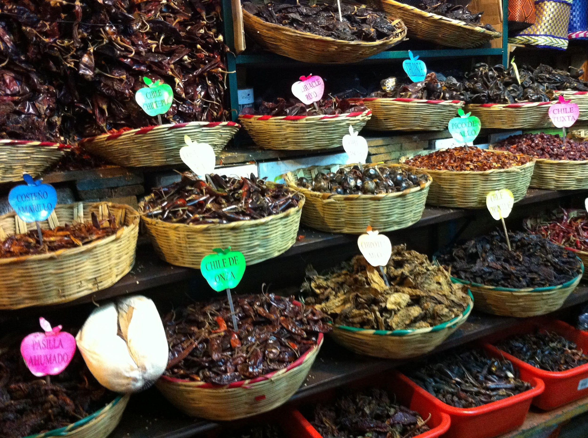
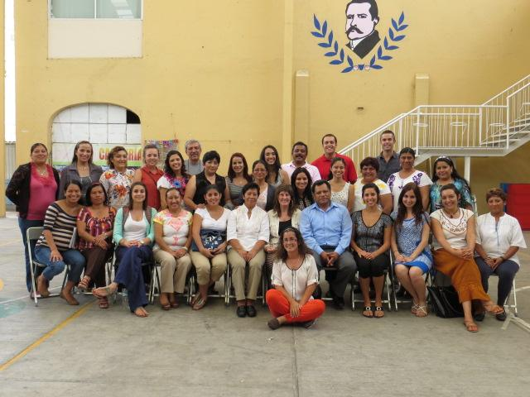
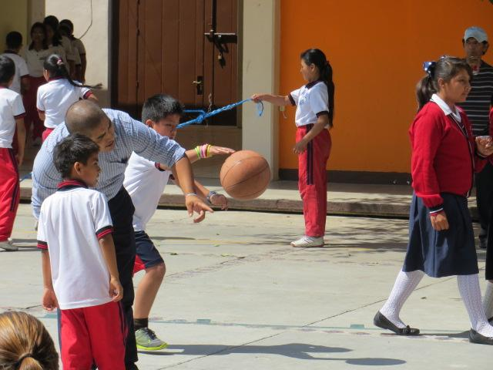
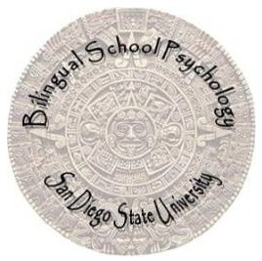
Cultural and Linguistic Advocates for Spanish Speaking English Learners (CLASS-EL)
Five year grant, 2012-13 through 2016-17
Prepare culturally competent Bilingual School Psychologist to better serve Spanish speaking population
Trainees receive a financial package
Bilingual school psychologists are not simply school psychologists who speak a language other than English; they must be experts at the interface of language, culture, and learning to effect change for SS-ELs
Notes:
AJ
Created in response to the exponential growth in the numbers of Spanish-speaking students with unmet needs
Recruit & prepare Spanish speaking school psychologists AND improve their Spanish skills & cultural competencies
Scholars learn through cross-cohort and cross-language/culture collaboration within the three different components

Slide 51
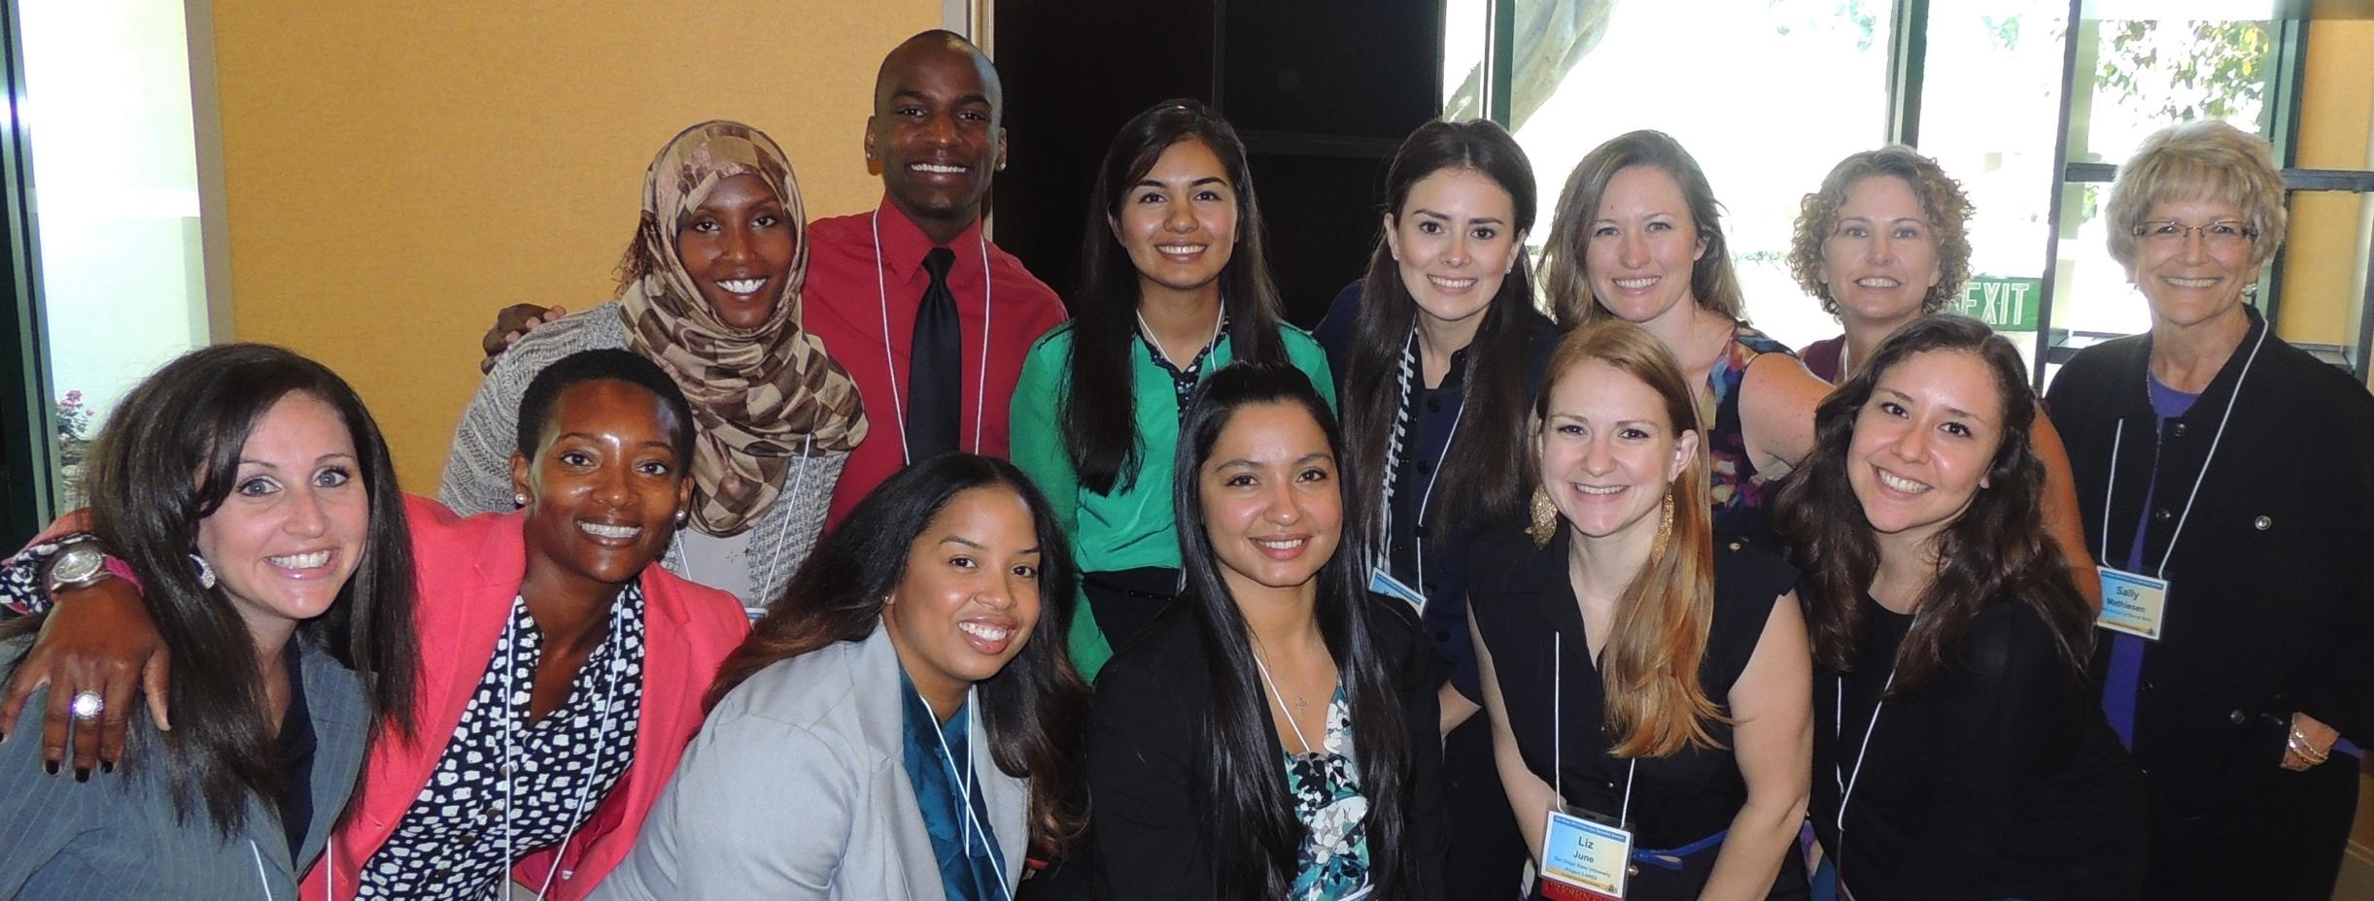
WHY WE DO IT: TRIPLE WHAMMY–Respond to the need to improve outcomes for children in foster care with disabilities from diverse backgrounds.
HOW WE DO IT: Interdisciplinary (SP, SC, SSW), CARES Seminars, Institutes, CASA Training, Fieldwork, & Coursework
Notes:
Jessie & DeAmonta

Slide 52
Mentorship
What is Mentorship? To instruct, counsel, guide (Blackwell, 1989); psychological and emotional support, degree and career support, academic subject knowledge support (Crisp, 2009); teaching, sponsoring, encouraging, counseling, and befriending (Davis, 2010)
Factory Model Mentorship
Effective Mentorship Practices: Village Approach and Transitional Cultural Framework of Mentoring (Kochan, 2013)
SDSU Mentoring and Advising Approaches
One Example: African American Mentoring Program

Slide 53
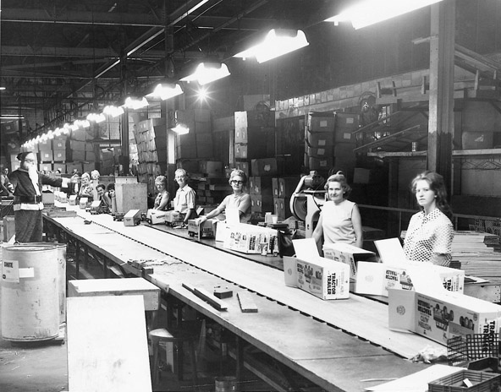
Types of Mentorship
Factory Model Mentorship versus Village Approach and Transitional Cultural Framework of Mentoring (Kochan, 2013)

Slide 54
SDSU Advising and Mentoring
Phase 1: Mentoring and advising before the admission process
Recruitment in undergraduate courses, Skype Meetings, Open House, Telephone Calls, Calls to Family Members, Peer Connection
Phase 2: Mentoring and advising during the application process
What do we have to offer?, Q&A with Faculty, Current Students, Program GA
Phase 3: Mentoring and advising after the interview process
Follow up phone call to get feedback about the process, answer additional questions about the program, peer or faculty connection and/or program GA connection

Slide 55
SDSU Advising and Mentoring
Phase 4: Mentoring and advising before entry into the program
SDSU advising selection process: Student select advisor (rank order process)
Phase 5: Mentoring and advising while in the program
Advisor and student meets regularly to discuss professional and personal goals and provide support as needed
AAMP Program
Phase 6: Mentoring and advising after graduation (ongoing)
Professional Development, Grads as Faculty and Supervisors

Slide 56
SDSU AAMP Mentoring Model

Slide 57
Sample Assessments for Excellent Outcomes
PRAXIS II: High scores compared to state and national averages
Evaluation of Competency Development: Supervisors report high levels of competency across all levels especially in the area of cultural knowledge
M.S. Project (Single Case-Design) and Internship Case Studies: Student demonstrate high levels of proficiency and implement interventions with successful outcomes
Internship Ed.S. Culminating Portfolio: Interns demonstrate high levels of proficiency across NASP Standards
Exit Survey: Students feel prepared in several areas of comprehensive school psychology. Used as a tool to improve program.

Slide 58
SDSU Graduates Live Our Vision!
We are leaders in the schools:
100% are employed as school psychologists or closely related positions
Over 20% are lead school psychologists or administrators of special education or pupil services
About 10% go on to complete their doctorates; some are now faculty members at other universities
Many of our graduates maintain involvement in our program as practitioner-faculty members and/or field supervisors
Notes:
Anabel (first 2 points)
Bryant (last 2 points)

Slide 59
Dr. Kent McIntosh
Professor, Special Education and Clinical Sciences University of Oregon

Slide 60
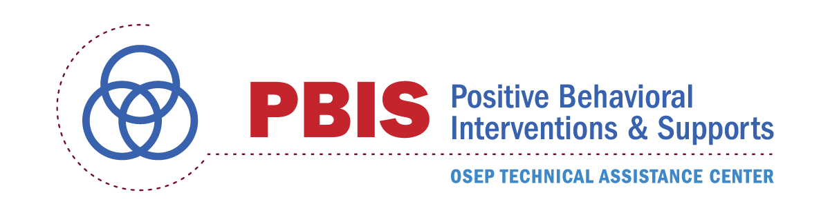
Acknowledgements
PBIS Center Disproportionality Workgroup
Timberly Baker
Aaron Barnes
Alondra Canizal Delabra
Yolanda Cargile
Erin Chaparro
Soraya Coccimiglio
Tai Collins
Bert Eliason
Erik Girvan
Steve Goodman
Clynita Grafenreed
Ambra Green
Beth Hill
Rob Horner
Don Kincaid
Milaney Leverson
Tim Lewis
Kent McIntosh
Kelsey Morris
Rhonda Nese
Vicki Nishioka
Heidi von Ravensberg
Jennifer Rose
Therese Sandomierski
Russ Skiba
Kent Smith
Keith Smolkowski

Slide 61
5–Point Intervention Approach
Use engaging academic instruction
Implement a culturally responsive, multi–tiered, behavior framework
Use disaggregated student data
Develop effective equity policies
Teach neutralizing routines to address implicit bias
PBIS Equity Webpage:
http://www.pbis.org/school/equity-pbis

Slide 62
2. Why start with a foundation of SWPBIS?
Proactive, instructional approach may prevent problem behavior and exposure to biased responses to problem behavior
Increasing positive student-teacher interactions may enhance relationships to prevent challenges
More objective referral and discipline procedures may reduce subjectivity and influence of cultural bias
Professional development may provide teachers with more instructional responses
(Greflund et al., 2014)
Notes:
Teach hidden curriculum – avoid assumicide
Ambiguity is disproportionality’s best friend
“You can’t punish skills into a child”

Slide 63
Effects of PBIS on Discipline Disproportionality
Vincent et al., 2011
Statistically significantly lower Black-White ODR disproportionality in 72 schools implementing SWPBIS than in 81 schools not implementing SWPBIS
Vincent et al., 2009
Decreases in ODRs seen across racial/ethnic groups in 69 schools implementing SWPBIS
Scott, 2001
Larger decreases in suspensions for Black students when SWPBIS implemented
McIntosh et al., 2014
Sustained decrease in suspensions over eight years of SWPBIS implementation in an Indigenous school

Slide 64
How Inviting Are We for All?

Slide 65
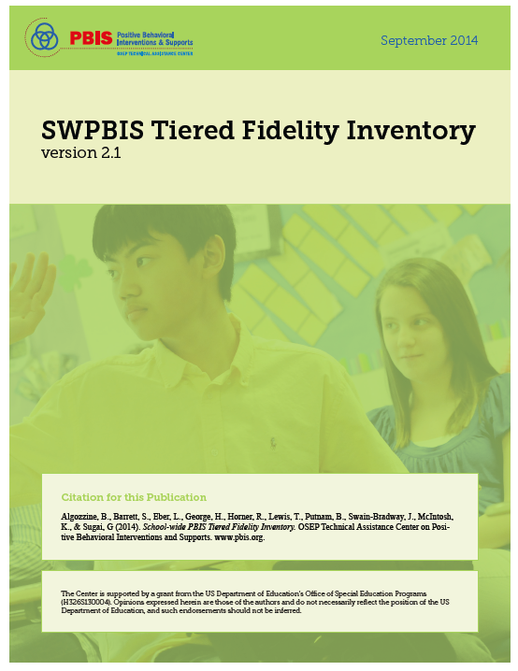
TFI Cultural Responsiveness Companion (Leverson, Smith, McIntosh, & Rose, in prep)
Aligned directly with SWPBIS Tiered Fidelity Inventory (TFI) Tier I Scale
http://www.pbisapps.org
https://www.pbisapps.org/Applications/Pages/PBIS-Assessment-Surveys.aspx#tfi

Slide 66
Student Input & Satisfaction Surveys
Notes:
Target shrinking
Expectations- where is it that students must be silent/not loud? It's a preference we have for a reason

Slide 67
Common PBIS Activity: School-wide Expectations Matrix
Clarify what is expected for students
Create consistency among staff
Reduce miscommunication
Make hidden curriculum visible
Focus on prosocial behavior

Slide 68
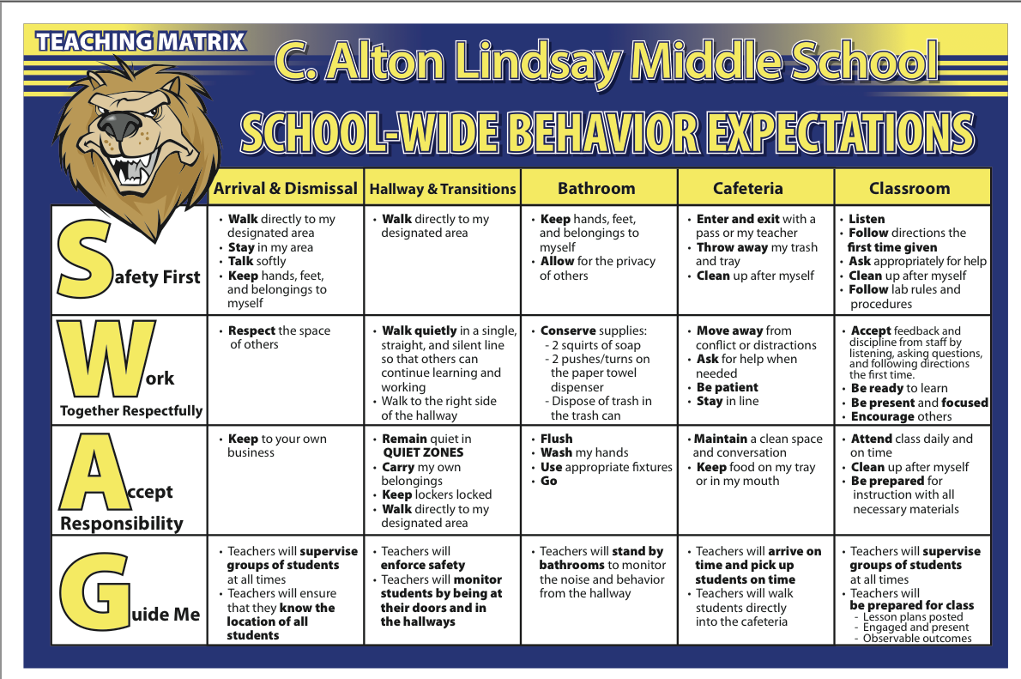
School Matrix

Slide 69
Culturally Responsive Adaptation: Personal Matrix
Aka “behavior dictionary”
Tool to assist in “code-switching”
The tweak:
Take school expectations and…
Add differences at home
Add differences in community

Slide 70
Personal Matrix
Expectation | At SCHOOL it looks like… | At HOME it looks like… | In my NEIGHBORHOOD it looks like…
Be Safe | Keep hands and feet to self Tell an adult if there is a problem
Be Respectful | Treat others how you want to be treated Include others Listen to adults
Be Responsible | Do my own work Personal best Follow directions Clean up messes

Slide 71
Personal Matrix (Completed)
Expectation | At SCHOOL it looks like… | At HOME it looks like… | In my NEIGHBORHOOD it looks like…
Be Safe | Keep hands and feet to self Tell an adult if there is a problem | Protect your friends and family Don’t talk back | Stick up for your friends Don’t back down Look the other way
Be Respectful | Treat others how you want to be treated Include others Listen to adults | Do exactly what adults tell you to do Don’t stand out Don’t bring shame | Text back within 30 seconds Be nice to friends’ parents Share food
Be Responsible | Do my own work Personal best Follow directions Clean up messes | Help your family out first Own your mistakes Share credit for successes | Have each other’s backs Own your mistakes Check in about what to do

Slide 72
Interpreting the Personal Matrix
Assess differences between school and other settings and ask:
Are the “different” school rules necessary for positive student development?
NO: Change the rules to align more with home and neighborhood
YES: Acknowledge explicitly and provide additional teaching, practice, and acknowledgment

Slide 73
Specific Expectation
During _________________ at school, the expectation is for me to _________________________.
At home this looks like… | At school this looks like… | Questions I have about how it looks at school…

Slide 74
Specific Expectation: Example
During independent seat work at school, the expectation is for me to work quietly by myself.
At home this looks like… | At school this looks like… | Questions I have about how it looks at school…
Get a snack Go to the kitchen table Follow the directions Ask my brother if I need help Go play when done | Sit at my desk Use a volume level of “1” Try every problem Work until the teacher says to stop | How do I know I’m doing it right? What do I do when I’m done?

Slide 75
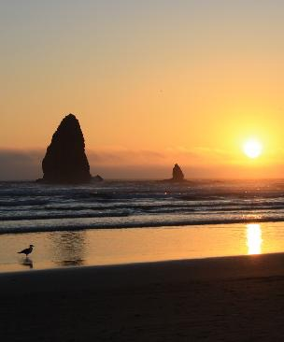
Contact Information
Kent McIntosh
Special Education Program
University of Oregon
kentm@uoregon.edu
Twitter: @_kentmc
Cannon Beach, Oregon
© GoPictures, 2010
Handouts: http://pbis.org

Slide 76
Dr. Cathy Kea
Professor, Department Of Curriculum & Instruction
North Carolina A&T State University

Slide 77
Children’s Defense Fund
Children of color constitute the majority of 1 & 2 year-olds in the U.S.
By 2019, children of color will be the majority of all children in the nation.
1 in 4 children in the U.S. speak a language other than English at home.
More than 9% of all children in U.S. classrooms are emergent bilinguals(Kena et al.,2014).
CDF, 2014

Slide 78
Cultural Competency
Becoming culturally competent is less of an option than in previous years (Ford & Kea, 2009).
Cultural competence is now a survival skill for educators.
How can educators’ being culturally competent decrease misunderstandings and clashes with, unnecessary referrals of and inappropriate special education identification and placement of those whose cultures are different from educators and decision makers? (Ford, 2012)

Slide 79
CRP Does Matter!!!
Do our preservice teachers understand their purpose as educators in the lives of children of color?
Do educators know how and understand the critical need to implement culturally responsive practices with children of color, families and in diverse communities?
How do we incorporate culturally responsive practices in our personnel preparation grants to challenge conceptions of knowledge?
When we consider that many of our preservice teachers have not experienced culturally responsive teaching in their own K-12 education, then it seems only logical and imperative that we offer such experiences to them (Jackson, 2009).

Slide 80
Diversity Infusion: From Coursework to Classroom
The current state of affairs calls for longitudinal qualitative and mixed method studies.

Slide 81
The Colorization of America: Our Future
U.S. public schools are more racially, ethnically, and linguistically diverse and different than ever before and [yet] the racial and ethnic demographics of educators remain relatively unchanged or stable. —(Ford, 2012)

