Slide 1
MTSS implementation: Perspectives from the National Center on Intensive Intervention
Allison Gandhi, Ed.D.
American Institutes for Research

Slide 2
National Center on Intensive Intervention
NCII’s mission is to build district and school capacity to support implementation of data-based individualization in reading, mathematics, and behavior for students with severe and persistent learning and behavioral needs.
2012-2016:
Intensive TA to 12 districts in 4 states
2016-2021:
Expand TA to focus on scale-up through building state and IHE capacity

Slide 3
NCII’s Approach
Data-Based Individualization (DBI): A systematic method for using data to determine when and how to provide more intensive intervention:
Origins in data-based program modification/experimental teaching were first developed at the University of Minnesota (Deno & Mirkin, 1977).
It is a process, not a single intervention program or strategy.
It is not a one-time fix, but an ongoing process comprising intervention and assessment adjusted over time.

Slide 4
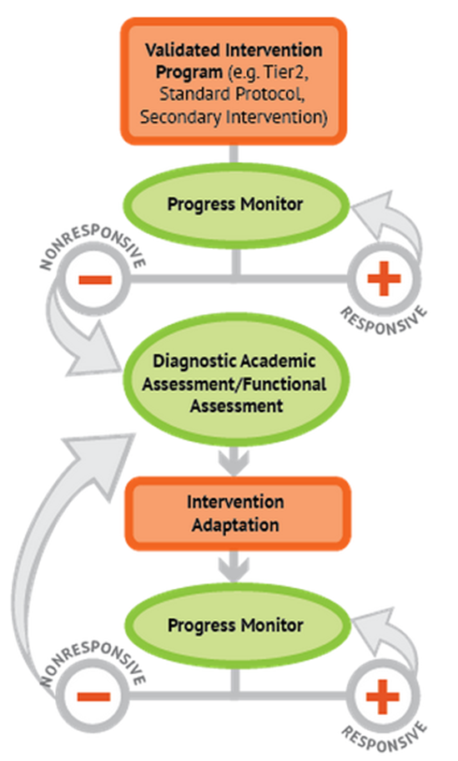
NCII’s Approach
DBI: Integrating data-based decision making across academics and social behavior

Slide 5
Lessons learned about MTSS
Reflects Learning from…
NCII Model Sites Report (Gandhi, Vaughn, Stelitano, Scala, & Danielson, 2015)
Formative evaluation of intensive TA sites
Related state and district implementation projects

Slide 6
Lesson #1: Successful implementation of intensive intervention is more likely to occur in schools that have a well-functioning MTSS in place
High-performing sites:
All were implementing RTI, PBIS, or both
Implementation sites:
Challenges implementing Tier 1 or Tier 2 made it difficult to train and coach staff on implementing DBI at Tier 3
Strong systems at Tiers 1 and 2 (e.g., data review meetings, accessibility to and training on use of progress monitoring tools, evidence-based interventions), facilitated implementation of Tier 3

Slide 7
Lesson #1: Successful implementation of intensive intervention is more likely to occur in schools that have a well-functioning MTSS in place
“Well-functioning” MTSS includes, but is not limited to…
Valid and reliable screening and progress monitoring procedures
Time for data review and planning
Schedule that includes time for intervention
Interventions aligned to student need
Staff and leadership commitment to implementation

Slide 8
Leadership is Critical for Successful MTSS
Establish vision and goals for implementation and sustainability
Promote staff buy-in
Make DBI relevant, shaping culture and expectations
Involve staff in decision making
Provide supporting structures and resources
Including assessments, interventions, professional development, staff time
Authority to address implementation challenges
Notes:
Shaping effective school culture for DBI often begins with administrators setting clear expectations that DBI is pivotal and necessary for meeting the needs of their students. Develop common language and knowledge about DBI, including assessment and intervention practices, so that staff can contribute to decision making.
Leaders also play an important part in setting up the logistical elements to support DBI implementation. Such elements include establishing measurable outcome goals; providing time in the schedule for meetings, assessments, instruction, and intervention; securing necessary resources; monitoring and evaluating; and asking tough questions.

Slide 9
Lesson #2: Students with disabilities must have access to MTSS at all levels of the system
Intensive Intervention
Students with disabilities
Receive services at all levels, according to need, including intensive intervention.
Targeted Level of Prevention
Universal Level of Prevention
Notes:
Policies and practices within schools should ensure that students with disabilities have access to intensive intervention. When students with disabilities do not respond to Tier 1 and Tier 2 supports, they must have access to intensive intervention if they require it.
Students may receive services at different levels of support in different areas. For example, a student with a learning disability in reading may need intensive intervention in reading while needing only core instruction in mathematics.

Slide 10
Lesson #2: Students with disabilities must have access to MTSS at all levels of the system
Common point of confusion
Special education viewed as separate from the MTSS system
Students with disabilities often cannot access intervention if they receive special education services
Begs the question…What is happening in special ed?

Slide 11
Lesson #3: Many schools struggle to distinguish Tiers 2 and 3, which impacts resource allocation and selection of evidence-based practices
Common Challenges at Tier 2
Confusing small group instruction within core with targeted intervention
Rush to “problem solving” rather than standard, evidence-based intervention (a.k.a. premature intensive intervention)
Poorly aligned interventions
Common Challenges at Tier 3 (Intensive Intervention)
Reinventing the wheel rather than working from evidence-based platforms
Adaptations focus on changes to dosage/placement, but are not linked to student data
Insufficient practice at making data-based intervention decisions

Slide 12
Characteristics of Intervention Levels/Tiers
 | Primary (T1) | Secondary (T2) | Intensive (T3)
Instruction/ Intervention Approach | Comprehensive research-based curriculum | Standardized, targeted small-group instruction | Individualized, based on student data
Group Size | Class-wide (with some small group instruction) | 3–7 students | No more than 3 students (ideally)
Monitor Progress | 1x per term | At least 1x per month | Weekly
Population Served | All students | At-risk students | Students with significant & persistent needs

Slide 13
Lesson #4: More work is needed to support schools in how to effectively integrate academic and behavioral intervention
Academic and behavior intervention teams often work in isolation
Often do not realize the extent to which one domain may be impacting the other
Staff expertise typically favors academic intervention, particularly reading
Fewer available behavior progress monitoring tools
Many schools do not see intensive behavior intervention as a major need, and so are slow to engage in implementation
Misperceptions about the legal ramifications of function-based behavior planning
(Kuchle, Zumeta Edmonds, Danielson, Peterson, and Riley-Tillman, 2015)

Slide 14
Lesson #4: More work is needed to support schools in how to effectively integrate academic and behavioral intervention
Reflects a need for…
Standing intervention teams to include staff with expertise in both academics and behavior
Professional development on function-based intervention and assessment…Delivered repeatedly and in different formats
Multiple opportunities for intervention teams to practice and receive feedback about how they use data to plan intervention for students with co-occurring academic and behavioral needs.

Slide 15
References
Berry Kuchle, L., Zumeta Edmonds, R., Danielson, L. C., Peterson, A. and Riley-Tillman, T. C. (2015), The Next Big Idea: A Framework for Integrated Academic and Behavioral Intensive Intervention[Special issue]. Learning Disabilities Research & Practice, 30, 150–158. doi: 10.1111/ldrp.12084
Deno, S. L. & Mirkin, P. K. (1977). Data-based Program Modification: A Manual. Reston VA: Council for Exceptional Children.
Gandhi, A.G., Vaughn, S., Stelitano, L., Scala, J., & Danielson, L. (2015). Lessons learned from district implementation of intensive intervention: A focus on students with disabilities. Journal of Special Education Leadership, 28(1), 39-49.

