Slide 1
CaPROMISE Initiative 2013 – 2018
Employment, Independence and Equality

Slide 2
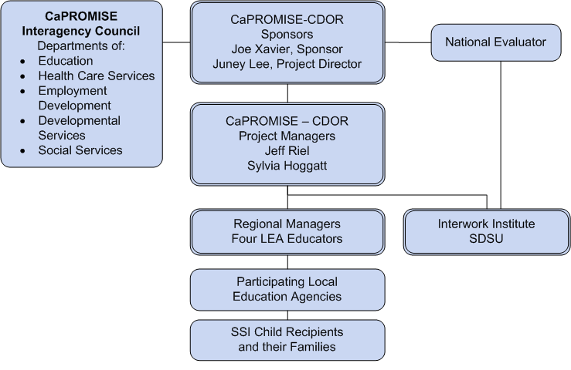
Structure for CaPROMISE

Slide 3
Interagency Council
Provide statewide input regarding systems and policies in implementation and execution of grant activities.
Review progress of the CaPROMISE grant in meeting its goals and objectives.
Address specific issues on grant implementation, execution, and coordination.
Encourage collaboration among partners at the local level.
Each partner will enter into an MOU with the DOR.

