Slide 1
Strange Bedfellows: Building and Maintaining Collaborations between, among, and within State agencies for PROMISE Grant partnerships

Slide 2
PROMISE, briefly
Improve provision and coordination of services (short term)
Improve educational attainment and employment outcomes (long term)
Youth ages 14-16 receiving Supplemental Security Income (SSI) and their families
Four federal agencies and four to six state agencies

Slide 3
Today’s Core Features
Strong and effective partnerships
Coordination of transition services/supports
Management of data collection/performance

Slide 4
Today’s Discussion
Small group discussions led by PROMISE
PROMISE to move discussion and provide some examples from collaboration to date
Not just talking about PROMISE, but issues in your home state/program
Two prompting questions and two looks at three PROMISE approaches

Slide 5
Barriers
What barriers have you encountered in gaining interagency collaboration?

Slide 6
State Partners

Slide 7
Local & Regional Partners
Schools
Disability Service Providers
Independent Living Centers
Literacy Zones
One Stop Centers
Benefits and Work Incentives Planners
Regional Parent Centers
Regional Transition Specialists and Transition Councils
State Agency, District Offices

Slide 8
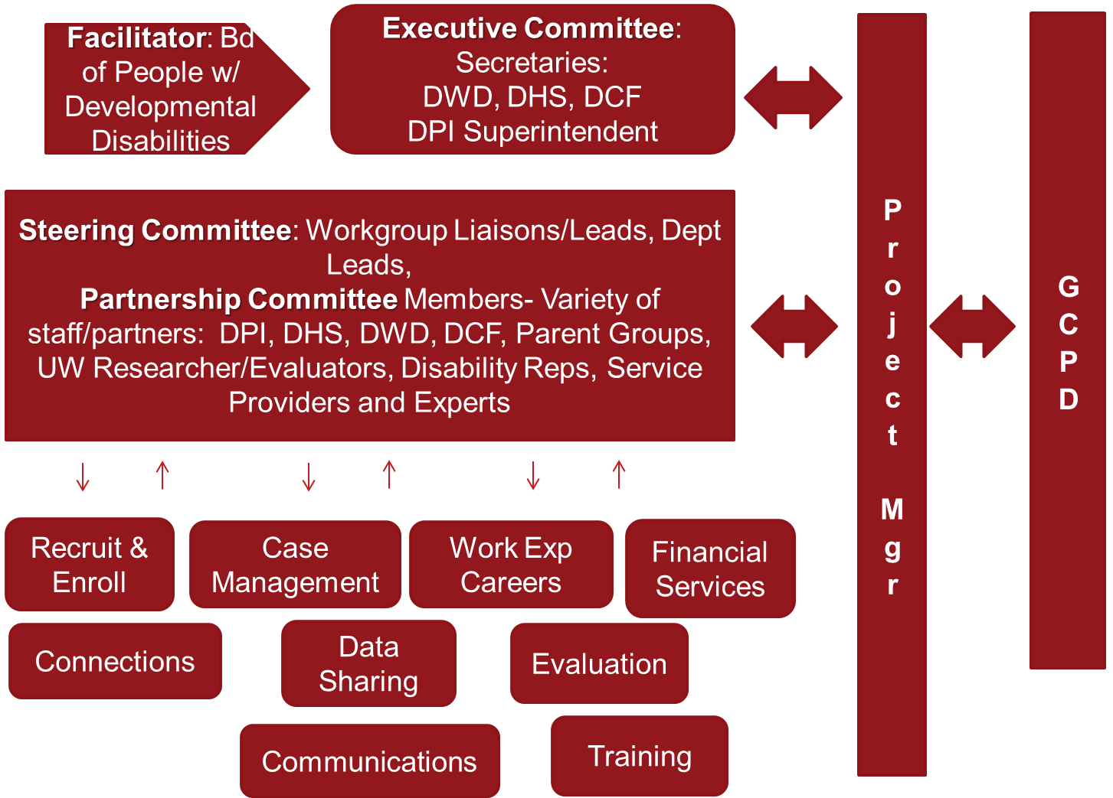
Wisconsin Promise Structure

Slide 9
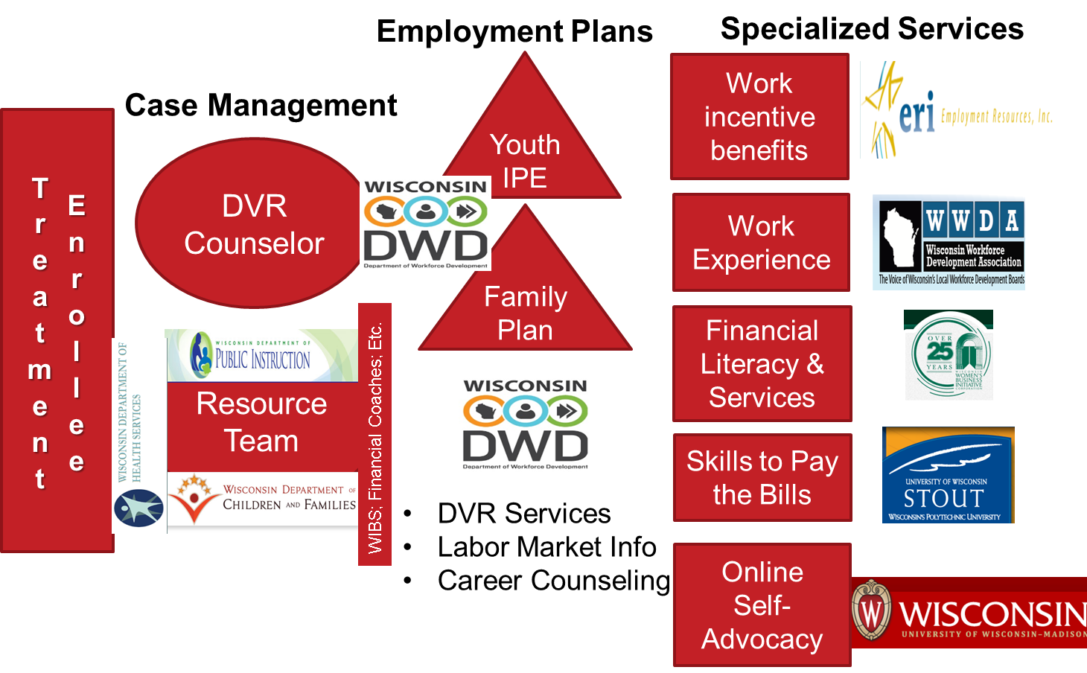
Division of Vocational Rehabilitation (DVR) Client Services Organizational Structure

Slide 10
ASPIRE Challenges
Six states, 42 state agencies, 49 tribes, innumerable community organizations
Communication
Decision making
Fidelity of implementation across six states
http://www.aspirewest.org

Slide 11
Steps to Mitigate Challenges
Communication – internal and external
Develop a communication plan and be flexible
Build informal relationships first and identify process for formal relationships
Recognize individuality and the strengths each person brings
Decision Making - internal
Everyone wants a say – listen to everyone
Some ONE must make a decision
Scopes of work for interventions
www.aspirewest.org

Slide 12
Encourage & Support
What have you done or do you think can be done to help encourage or support interagency collaboration?

Slide 13
The Management Structure
Stakeholder
NYESS Coordinating Council
Steering
State Agency Leads
Core
OMH/RFMH
Cornell
Steering Rep
Core Team

Slide 14
Approach to Collaboration
Continuous Quality Improvement framework – quality planning, quality control, and quality improvement
Participatory Action Planning using Concept Mapping
Bi-annual Learning Communities for sharing successes and discussing challenges
Measure collaboration using social networks framework

Slide 15
Wisconsin Promise Resource Team
Every youth enrolled in PROMISE will have a Resource Team comprised of at minimum: the youth, their family members, their PROMISE Coordinator (special DVR Counselor), and someone from their school.
Youth and families will help to identify important team members to help support them in their educational and career planning.
Youth involved in long-term care or mental health programs will likely include their case managers on the team. Work Incentives Benefits Specialists and Financial Coaches will also likely be team members.
Team members do not need to be paid or professionals and can be part of formal or informal supports.
Teams may have joint meetings or may communicate through other venues to align all plans and respective activities in support of the youth’s goals.

Slide 16
Data Sharing

Slide 17
Strategies to Encourage Collaboration
Coordinate ➔ Collaborate ➔ Partner
Identify partners
Make the time, seek to understand, respect
Build a relationship
Focus on shared mission
Define common goals
Communicate
www.aspirewest.org

Slide 18
CaPROMISE Initiative 2013 – 2018
Employment, Independence and Equality

Slide 19
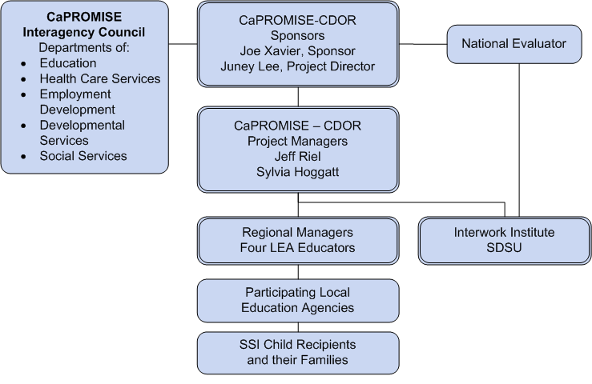
Structure for CaPROMISE

Slide 20
Interagency Council
Provide statewide input regarding systems and policies in implementation and execution of grant activities.
Review progress of the CaPROMISE grant in meeting its goals and objectives.
Address specific issues on grant implementation, execution, and coordination.
Encourage collaboration among partners at the local level.
Each partner will enter into an MOU with the DOR.

Slide 21
Thank you. Strange Bedfellows: Building and Maintaining Collaborations between, among, and within State agencies for PROMISE Grant partnerships

