Slide 1
grantee reporting requirements using the personnel development program data collection system (DCS) Dr. Bonnie D. Jones, OSEP Dr. Shedeh Hajghassemali, OSEP Ms. karen schroll, westat ms. amy bitterman, Westat
July 23, 2014
Notes:
The OSEP Personnel Development Program is one of the nation’s oldest and most visible Federal student scholarship programs, originating in 1958 under P. L. 85-926, the Education of Mentally Retarded Children Act, for training personnel to serve individuals with intellectual disabilities.
The need for well-prepared and skilled personnel to provide special education and related services to children and youth with disabilities and their families has remained consistent since the beginning of the Program.
The main objectives of the Personnel Development Program are to: 1) improve the curricula of OSEP-funded programs to ensure that personnel preparing to serve children with disabilities are knowledgeable and skilled in practices that reflect the current knowledge base; 2) increase the supply of teachers and service providers who are highly qualified for and serve in positions for which they are trained; and 3) enhance the efficiency of the expenditure of Federal dollars under the program.
Financial awards are made to IHEs through a competitive grant process, and the successful IHEs are required to use 65% of their budget to provide scholarships to students.

Slide 2
Purpose of the Presentation
To introduce the new data collection system and procedures for submitting data
To review Project Directors’ and scholars’ responsibilities with regard to the Personnel Development Program requirements, including Pre-Scholarship Agreements and Exit Certifications
To provide a live demonstration of the DCS

Slide 3
Grantee Reporting Requirements
Grantees previously provided information about funded scholars into online systems:
The Service Obligation Tracking System (SOTS)
The Scholar Data Report (SDR)
Will now enter all data into a single, online, web-based data collection system – the DCS. Data from the previous systems were merged into the DCS.

Slide 4
DCS: Data Collection Components
The DCS collects the following data:
Grantees upload signed Pre-Scholarship Agreements and Exit Certifications;
Grantees enter contact, demographic and training information about scholars;
Scholars will review and approve grantee entered training information;
Scholars enter employment information; and
Employers verify employment information.

Slide 5
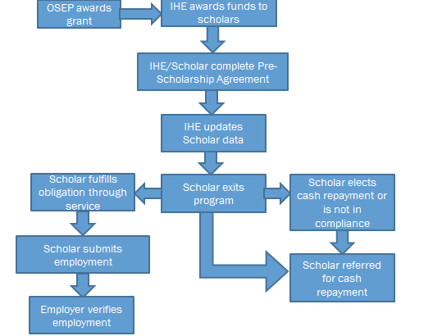
DCS: Data Collection Components (continued)

Slide 6
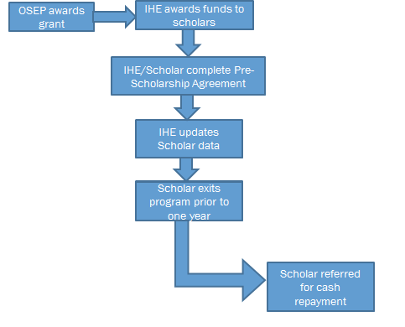
DCS: Data Collection Components (continued)

Slide 7
Grantee DCS Data Collection Components
Information grantees are responsible for collecting and entering into DCS:
Scholar contact information
Name
Date of birth
Social security number
Address, city, state, zip code
Email address (gmail, hotmail, or other non-IHE account)
Alternate contact information (a person provided by the scholar through which DCC may contact the scholar)

Slide 8
Grantee DCS Data Collection Components (continued)
Signed Pre-Scholarship Agreement (to be uploaded into DCS)
Information about training prior to entry into project training
Information about employment prior to entry into project training
Project training information
Employment during training
Program completion status
Service obligation information
Exit information
Exit Certification

Slide 9
Pre-Scholarship Agreements and Exit Certifications
According to Section § 304.23 of the 2006 Regulations grantees are required to provide scholars with Pre-Scholarship Agreements and Exit Certifications outlining the terms and conditions of the Personnel Development Program Grant funding
OSEP has developed standard Pre-Scholarship Agreements and Exit Certification templates which grantees must use
Notes:
OSEP developed standard pre-scholarship agreements and exit certification templates because in the past some scholars/obligees
were not been provided pre-scholarship agreements or exit certifications or the agreements/certifications were vague or inaccurate. Grantees are responsible for the accuracy and maintenance of these documents for funded scholars/obligees. To supplement the pre-scholarship agreements and exit certifications, grantees must also disseminate copies of the regulations/requirements and frequently asked questions (FAQs), to scholars/obligees.

Slide 10
Pre-Scholarship Agreements and Exit Certifications (continued)
The grantee and scholar complete and sign the Pre-Scholarship Agreement prior to enrolling/ receiving OSEP funds.
The Exit Certification is completed and signed by the grantee and scholar within 30 days after a scholar completes the grant training program or exits prior to completion.
A Pre-Scholarship Agreement and Exit Certification must be signed and uploaded into the DCS for all scholars.

Slide 11
Pre-Scholarship Agreements and Exit Certifications (continued)
For scholars enrolled in training in July 2013 and later, grantees must use the OMB approved versions of the forms found at https://pdp.ed.gov/OSEP/Home/Agreements/.
Forms that were used prior to July 2013 must reflect the requirements in the regulations and must be legally sufficient. We strongly encourage grantees who have been using IHE forms to use the OMB approved forms. All OSEP grants funded in FY 2012 and after must use the OMB approved forms.

Slide 12
Grantee Initial Reporting Requirements for DCS
Grantees must ensure all scholar information is entered into the new system for each grant by August 1, 2014.
Includes scholars who already graduated/completed the program or exited the program prior to completion.

Slide 13
Grantee Ongoing Reporting Requirements for DCS
Grantees must enter or update scholar contact and payback obligation information within thirty (30) days of:
Scholar enrollment;
Scholar changes in status; and
At the conclusion of the grant’s fiscal year.
The system will be available year round, 24 hours a day.

Slide 14
Data to be Entered by Scholars/Obligees
After the completion of one academic year of training scholars can begin fulfilling their service obligation through eligible employment.
Scholars enter
Name and contact information for employer
Employment position
Start and end dates
Whether the position is full-time or part-time
Training and related service areas utilized in the position
Information related to the eligibility of the position (e.g., percentage of time spent working with students with disabilities)
Whether he or she is considered highly qualified/qualified/fully certified in the position.
Notes:
Scholars/obligees are required to report their employment information annually

Slide 15
PDP Service Obligation
Scholars in the program receive grant funded training and are required to:
Complete a service obligation, or
Repay all or a part of the costs of such assistance.
In addition, scholars must report their employment information to OSEP.
Scholars who do not fulfill the terms of their service obligation must repay any funds including the scholarship, interest and collection costs.

Slide 16
Work-related Service Fulfillment
To fulfill their service obligation through paid employment:
At least 51% of the children the scholar is serving must be receiving special education services, or
The scholar must spend at least 51% of his/her time providing special education services to children, or
At least 51% of the scholar’s time must be spent performing work related to the training for which the scholarship was received.
Scholars must maintain two years of employment for every academic year of assistance received.

Slide 17
Fulfilling Service Obligation
Scholars will only receive credit for employment positions verified by their employer
Scholars will not receive credit for any employment positions held prior to the date of completion of one academic year
Scholars who exit a training program prior to its completion and have not finished at least one academic year of training will be referred for repayment to the Debt and Payment Management Group (DPMG) of ED

Slide 18
Data to be Entered by Employers
Employers review the employment data entered by the scholars to verify that it is accurate
If employers disagree with any information they can describe the reason for disagreement
After the employers have verified/disputed the employment information scholars are notified

Slide 19
How OSEP Uses the Data That Grantees Report
DCS
Allows OSEP to produce data for internal reports and program improvement activities, and monitor grant performance.
Ensures scholars are meeting service obligation requirements.
Provides data for GPRA program performance reporting.

Slide 20
Live Demonstration of DCS
We will now demonstrate the following activities in the DCS:
Logging in as a first time user and creating an account
Updating a grant and contact information
Adding a secondary user
Adding data for a scholar

Slide 21
Steps for Reporting Good Data
Notify scholars at the beginning of the program that they will be asked to provide test results and complete an Exit Certification.
Remind scholars via phone or email before they exit that they will be asked to provide test results and an Exit Certification.
Arrange and conduct exit interviews with each completing scholar

Slide 22
Steps for Reporting Good Data (continued)
Manage grant to ensure that all scholars will complete the program before the grant ends; enroll scholars with sufficient time, funding and support to complete within the grant period.
Leverage a one-time no cost extension to enable scholars to finish the program; request a second, no-cost extension if additional time is needed for scholars to finish the program
Notes:
Structure and manage your grant to ensure that scholars will have time to complete within the grant period. This might mean not providing funding to a new scholar in the final year of your grant.
OSEP does allow grantees to exercise a one-time no cost extension and may approve a second, no-cost extension to allows scholars additional time to complete training before the grant officially ends.

Slide 23
FY 2013 Priority Language
325D
(d,e) Ensure that all scholars recruited into the program can graduate from the program by the end of the grant’s project period.
325K
(d,2) Ensure that all scholars who enroll in the proposed project can graduate by the end of the grant project period.
Notes:
OSEP has emphasized the need for scholars to complete during the program in the official priorities. It is expected that you are doing everything you can to ensure scholars can complete before the grant ends.

Slide 24
Support for Grantees, Scholars, and Employers
Archived version of webinar trainings held in June/July for PDs and their staff available at https://pdp.ed.gov/OSEP/home/training
Users’ guides and video demonstrations (coming soon)
Updated FAQs
DCC HelpDesk:
Support available from 8 am to 8 pm ET, Monday through Friday
1-800-285-6276
serviceobligation@ed.gov
Notes:
ED has developed responses to questions frequently asked by Institutions of Higher Education, scholars, obligees, and employers regarding program regulations and requirements, and how to navigate DCS.

Slide 25
Questions and Answers
What follow-up training would be useful for you and your staff?
What other tools would be helpful to enable you to use the data reported to improve your program’s performance? What types of additional resources would help you enter reliable data?
What concerns do you have regarding the data collection process?

Slide 26
More Questions?
DCC HelpDesk
Support available from 8 am to 8 pm ET
Monday through Friday
1-800-285-6276
serviceobligation@ed.gov
https://pdp.ed.gov/OSEP

