Slide 1
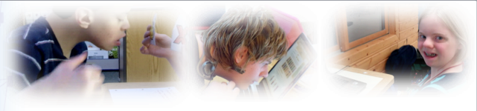
College and Career Readiness Instruction and Assessment for
Pre-intentional and Pre-symbolic Communicators
The present publication was developed under grant 84.373X100001 from the U.S. Department of Education, Office of Special Education Programs. The views expressed herein are solely those of the author(s), and no official endorsement by the U.S. Department of Education should be inferred.

Slide 2
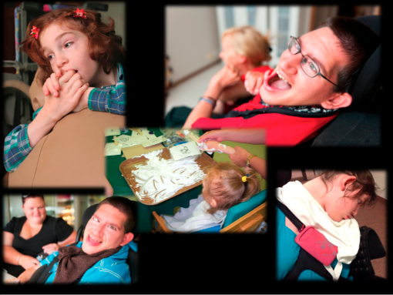
Photos of Preintentional Communicators

Slide 3
Pre-intentional and Pre-symbolic Communicators
The DLM First Contact Survey (n=46,161)
  24% use single words, signs, or symbols for a restricted range of communication purposes.
  9% cannot use words, signs, or symbols to communicate.
  3% exhibit no intentional communication.

Slide 4
DLM is committed to ensuring full participation and successful assessment of EACH student with significant cognitive disabilities, including those who are at the earliest stages of communication.

Slide 5
The Learning Maps

Slide 6
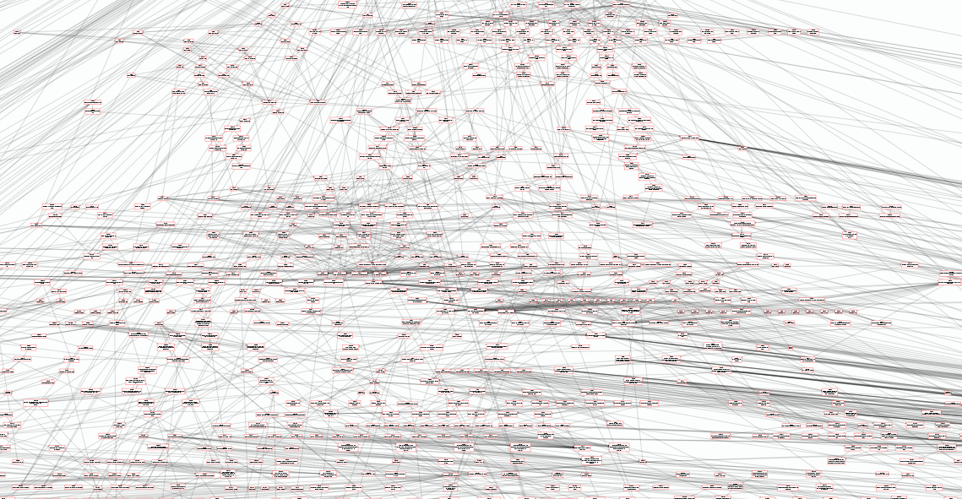
Learning Map Image
Notes:
Dynamic Learning Maps assessments are based on learning maps. These maps highlight multiple potential pathways students might follow to develop knowledge and skills in English language arts and math.

Slide 7
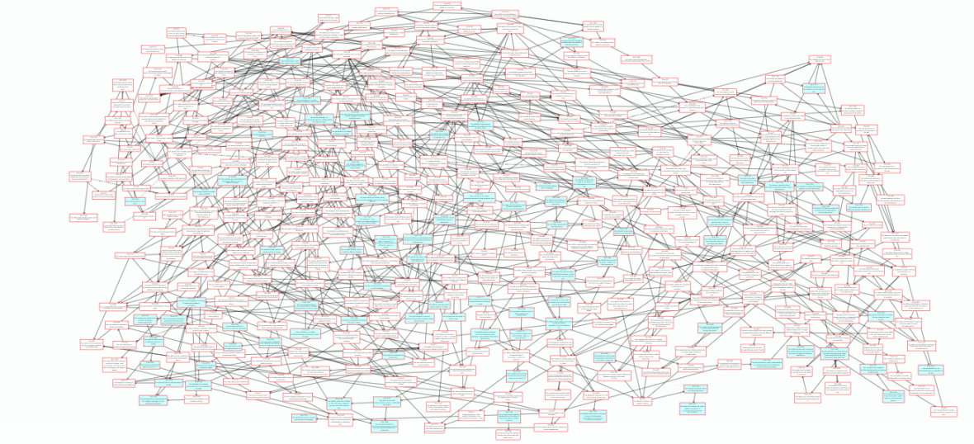
View of the Learning Map with Essential Elements Highlighted
Notes:
DLM uses Essential Elements which are specific statements of content and skills that are linked to grade level-specific expectations but designed for students with significant cognitive disabilities. The DLM Essential Elements are embedded in the learning maps. In this image of a small portion of the learning map, the Essential Elements are highlighted in green. The Essential Elements are the targets in the DLM assessment.

Slide 8
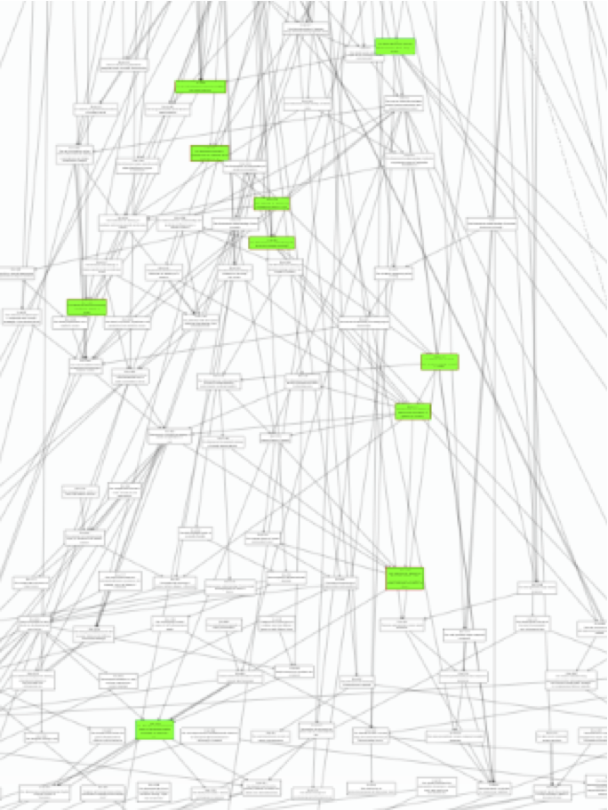
Closer View of the Learning Map with the Linkage Levels for a Single Essential Element Highlighted
Notes:
For each of the Essential Elements, 4 additional linkage levels have been identified in the learning map. These linkage levels serve as way-points building to and extending beyond the target Essential Elements.

Slide 9
DLM Linkage Levels
Initial Precursor
Distal Precursor
Proximal Precursor
Target
Successor
Notes:
The 5 linkage levels defined for each Essential Element being assessed in the DLM system are: the initial precursor, distal precursor, proximal precursor, target (which aligns directly with the Essential Element) and the successor (which extends upward toward the grade level standard). Linkage levels are identified by starting with the node or nodes in the learning map that most closely match the target Essential Element. Then, multiple pathways on the map are carefully inspected to identify nodes that link directly to the target but are precursors or successors to it.

Slide 10
Initial Precursor
Notes:
The initial precursor linkage node is the most relevant to today’s session. The nodes in the map that are identified as initial precursor nodes address foundational skills that align directly with the grade level targets. The name was selected because these items test skills that are at the beginning of the pathways toward the target skill reflected in the grade level Essential Element. Items developed at this initial precursor level typically reflect foundational nodes in the learning map. These early, foundational nodes connect directly back to the Essential Element through one or more pathways in the learning map. Items at the initial precursor linkage level are typically intended for students who do not yet have symbolic communication, and are usually administered by the teacher, who observes the student’s behavior as directed by the system, and then records responses in the system.

Slide 11
ELA.RL.3.3
Identify the feelings of the characters in a story
Notes:
Let’s examine a specific Essential Element to illustrate how this works. The Essential Element appears at the 3rd grade level and is linked to the 3rd grade standard in Reading Literature, Standard 3. The Essential Elements reads, “Identify the feelings of the characters in a story.”

Slide 12
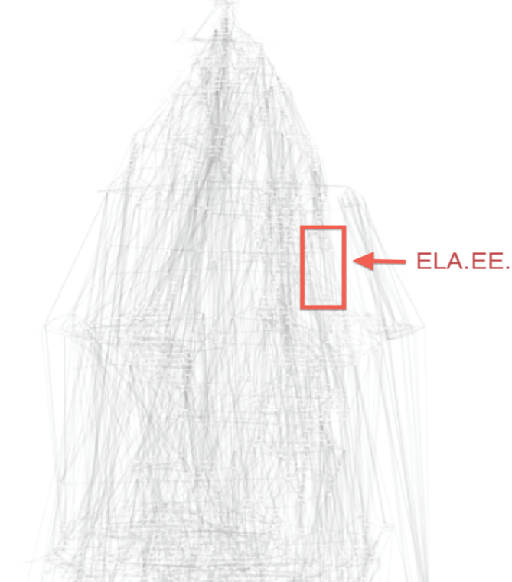
ELA.EE.RL.3.3 Identify the feelings of the characters in a story
ELA.EE.RL.3.3
Notes:
The section of nodes surrounding the target node is identified within the map.

Slide 13
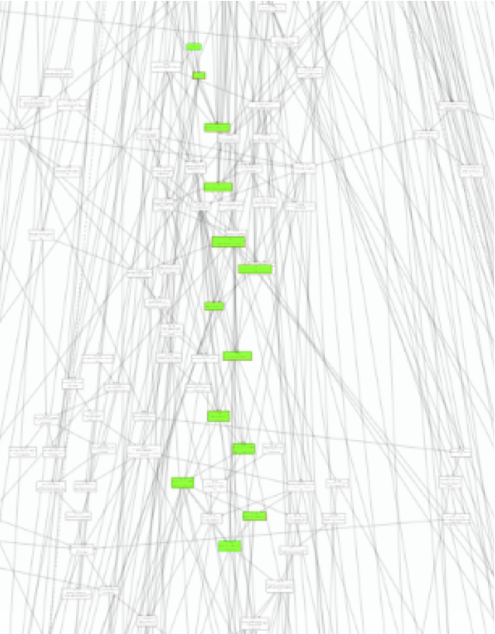
ELA.EE.RL.3.3 Identify the feelings of the characters in a story – closer view
Notes:
The possible precursor and successor nodes are then identified, and then they are carefully examined to determine which reflect the most critical cognitive shifts and junctions of the multiple pathways students might follow when moving toward the target.

Slide 14
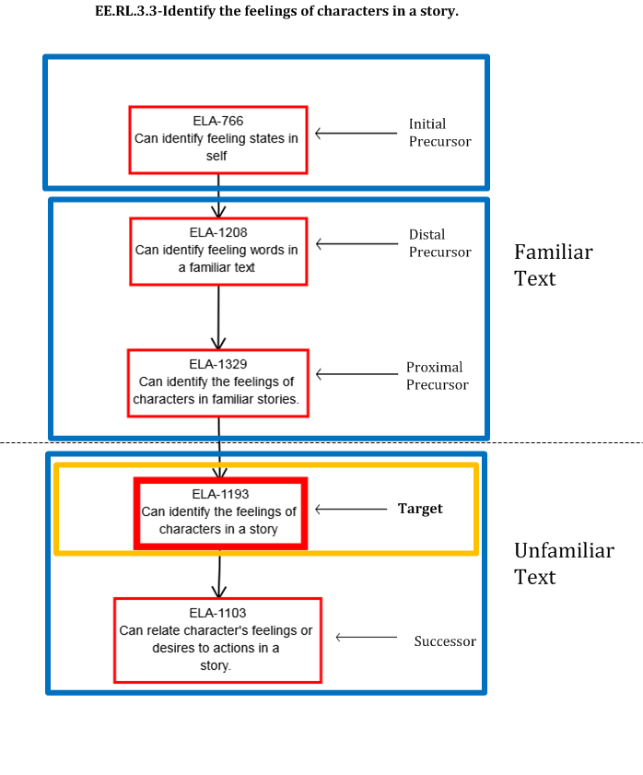
Feelings of Characters
ELA.EE.RL.3.3 Identify the feelings of the characters in a story
Notes:
Finally, a minim-map is created that specifically details the nodes that will be assessed at each linkage level.
Initial Precursor node: F-18 (supporting node); ELA-766
Distal Precursor node: ELA-1208
Proximal Precursor nodes: ELA-1329
Target nodes: ELA-1193
Successor node: ELA-1103
(Refer to the large handout)
SB: suggest that the text in the left side boxes refers to embedded items: “items embedded in text” or “items at conclusion”. Sometimes more than one item is written to a node, so maybe not indicate quantity of embedded items?

Slide 15
DLM’s Expanded Taxonomy of Cognitive Processes: Why
Webb’s (1997) Depth of Knowledge
  a 4-point scale often used in alignment studies
  not adequate for the cognitive processes exhibited by the full range of students who take AA-AAS.
Links for Academic Learning (Flowers, Wakeman, Browder, & Karvonen, 2009)
  Extended Bloom’s taxonomy to capture early intentional responses (attend) and collapse top end
  not adequate for students with preintentional and presymbolic communication.

Slide 16
DLM’s Expanded Taxonomy of Cognitive Processes
Pre-intentional
Attend
Respond
Replicate
Remember
Understand
Apply
Analyze
Evaluate
Create

Slide 17
DLM New Processes
Pre-intentional - Behavior reflects a general state but does not reflect intentional behavior. Intent is inferred by others.
Attend - Orients to objects, people or activity. Indicates selective attention to stimuli in the academic learning environment.
Respond - Intentional response using any mode of expression. Indicates joint attention to materials and activities in the academic learning environment.
Replicate - Performs rote task in familiar or practiced context.

Slide 18
Replicate and Remember
Replicate - Performs rote task in familiar or practiced context.
Remember - Retrieve relevant knowledge from long-term memory in a novel context.

Slide 19
Identifying the Best Place to Start: Initialization
Purpose: Use data from the First Contact Survey to create a systematic process to determine the linkage level at which individual students will enter the system for the first time.
Goal: Maximize the likelihood that the student will be successful with the first items without delivering items that are too easy.

Slide 20
Communication Initialization Flow Chart
C1
Yes
No
C2a
C3
No
C6
No
Initial
Yes
No
Yes
Yes
Target
C2b
C4a
C7a
Yes
No
No
Yes
No
Yes
Proximal
C2c
C4b
C7b
Target
Target
Yes
No
Yes
Yes
No
Proximal
C4c
C7c
Distal
Proximal
Yes
Yes
Distal
Distal
Notes:
Communication
C1. Does the student use speech to meet expressive communication needs?
Yes
No
C2. Choose the highest statement that describes the student's expressive communication with speech.
C2a. Regularly combines 3 or more spoken words according to grammatical rules to accomplish a variety of communicative purposes (e.g., sharing complex information, asking/answering longer questions, giving directions to another person).
C2b. Usually uses 2 spoken words at a time to meet a variety of more complex communicative purposes (e.g., obtaining things including absent objects, social expressions beyond greetings, sharing information, directing another person’s attention, asking/answering questions, and commenting).
C2c. Usually uses only 1 spoken word at a time to meet a limited number of single communicative purposes (e.g., refusing/rejecting things, making choices, requesting attention, greeting, and labeling).
C3. Does the student use sign language in addition to or in place of speech to meet expressive communication needs?
Yes
No
C4. Choose the highest statement that describes the student’s expressive communication with sign.
C4a. Regularly combines 3 or more signed words according to grammatical rules to accomplish a variety of communicative purposes (e.g., sharing complex information, asking/answering longer questions, giving directions to another person).
C4b. Usually uses 2 signed words at a time to meet a variety of more complex communicative purposes (e.g., obtaining things including absent objects, social expressions beyond greetings, sharing information, directing another person’s attention, asking/answering questions, and commenting).
C4c. Usually uses only 1 signed word at a time to meet a limited number of single communicative purposes (e.g., refusing/rejecting things, making choices, requesting attention, greeting, and labeling).
C5. (intentionally skipped for this process)
C6. Does the student use augmentative or alternative communication in addition to or in place of speech or sign language to meet expressive communication needs?
Yes
No
C7. Choose the highest statement that describes the student’s expressive communication with augmentative or alternative communication.
C7a. Regularly combines 3 or more symbols according to grammatical rules to accomplish the four major communicative purposes (e.g., expressing wants and needs; developing social closeness, exchanging information, and fulfilling social etiquette routines).
C7b. Uses 2 symbols at a time to meet a variety of complex communicative purposes (e.g., obtaining things including absent objects, social expressions beyond greetings, sharing information, directing another person’s attention, asking/answering questions, commenting).
C7c. Usually uses 1 symbol to meet a limited number of simple communicative purposes (e.g., refusing/rejecting things, making choices, requesting attention, greeting).
C8. If the student does not use speech, sign language, or augmentative or alternative communication, which of the following best describes the student’s expressive communication? Choose the highest statement that applies.
C8a. Uses conventional gestures (e.g, waving, nodding and shaking head, thumbs up/down) and vocalizations to communicative intentionally but does not yet use symbols or sign language.
C8b. Uses only unconventional vocalizations (e.g., grunts), unconventional gestures (e.g., touching mouth to indicate hunger), and/or body movement to communicate intentionally.
C8c. Exhibits behaviors that may be reflexive and are not intentionally communicative but can be interpreted by others as communication (e.g., crying, laughing, reaching for an object, pushing an object away).

Slide 21
Initial Precursor Assessment Items

Slide 22
Shared Reading

Slide 23
http://dlmpd.com/clds/instructional-resources/
Familiar Texts and Objects

Slide 24
Objects Called out in DLM™
1 object that is needed to study
1 object that is needed to eat
1 object that is needed to play games
3 objects that are unrelated to these activities

Slide 25
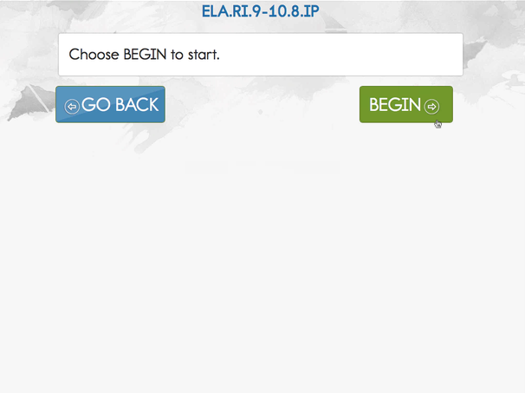
DLM KITE Log in page

Slide 26
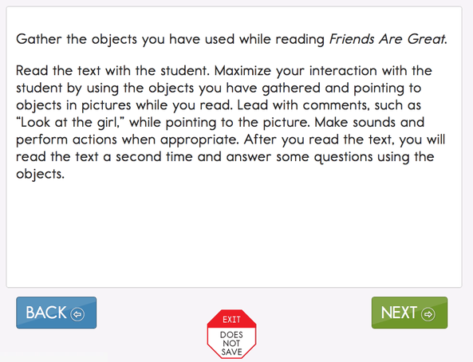
DLM Assessment Engagement Screen

Slide 27
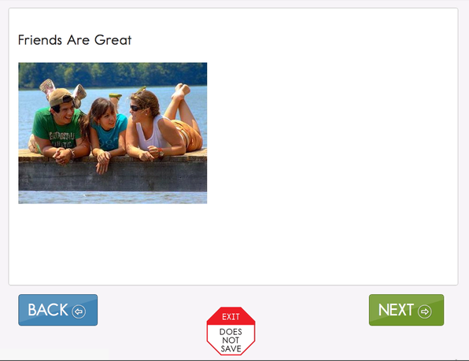
Title Page of Friends are Great Book from Released Testlet

Slide 28
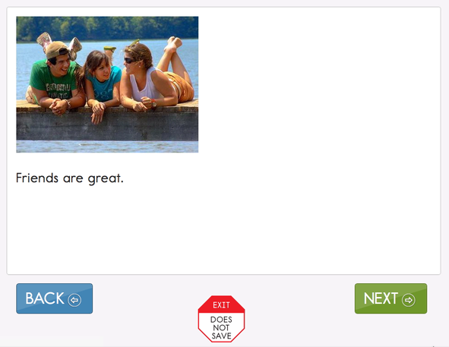
Page 1 of Friends are Great Book from Released Testlet

Slide 29
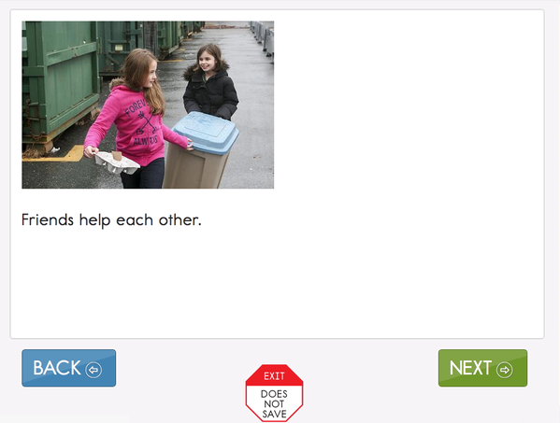
Page 2 of Friends are Great Book from Released Testlet

Slide 30
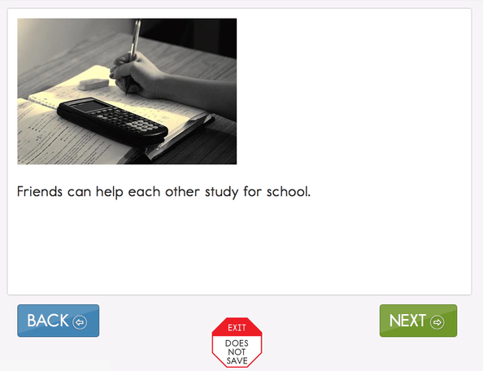
Page 3 of Friends are Great Book from Released Testlet

Slide 31
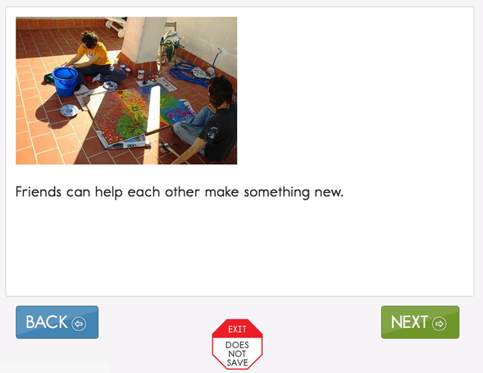
Page 4 of Friends are Great Book from Released Testlet

Slide 32
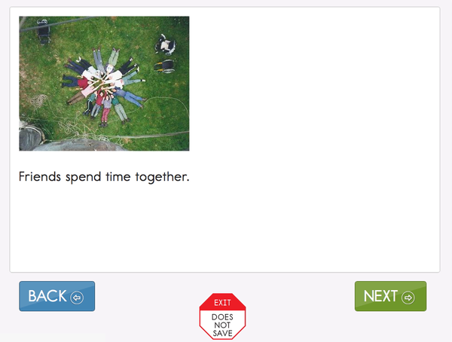
Page 5 of Friends are Great Book from Released Testlet

Slide 33
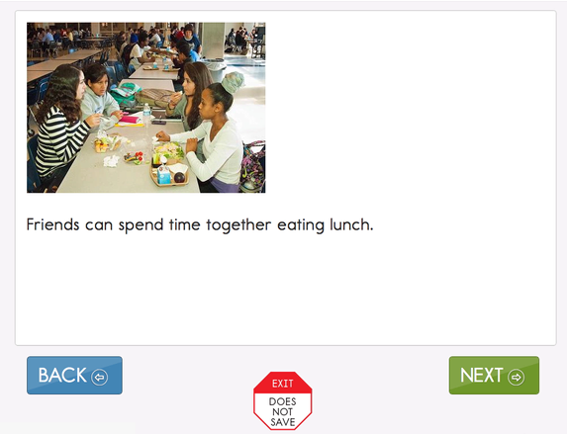
Page 6 of Friends are Great Book from Released Testlet

Slide 34
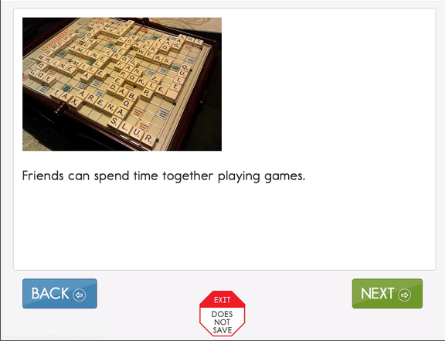
Page 7 of Friends are Great Book from Released Testlet

Slide 35
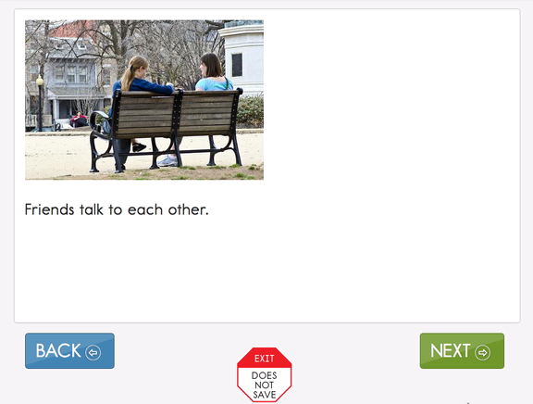
Page 8 of Friends are Great Book from Released Testlet

Slide 36
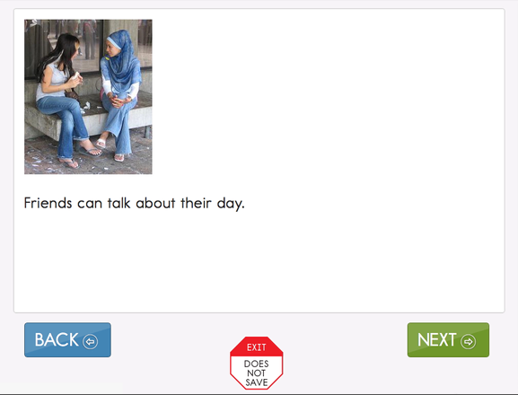
Page 9 of Friends are Great Book from Released Testlet

Slide 37
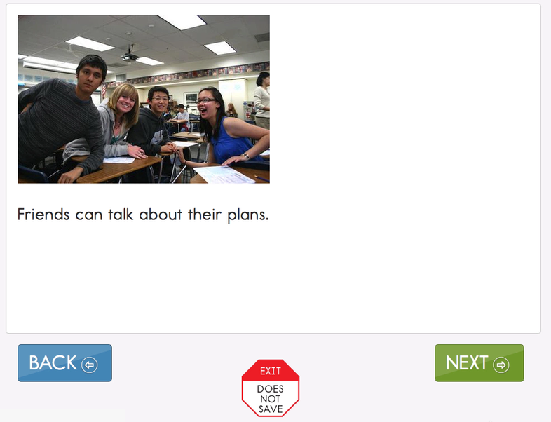
Page 10 of Friends are Great Book from Released Testlet

Slide 38
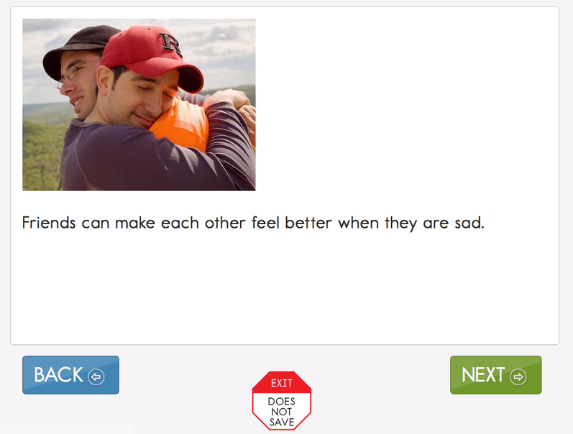
Page 11 of Friends are Great Book from Released Testlet

Slide 39
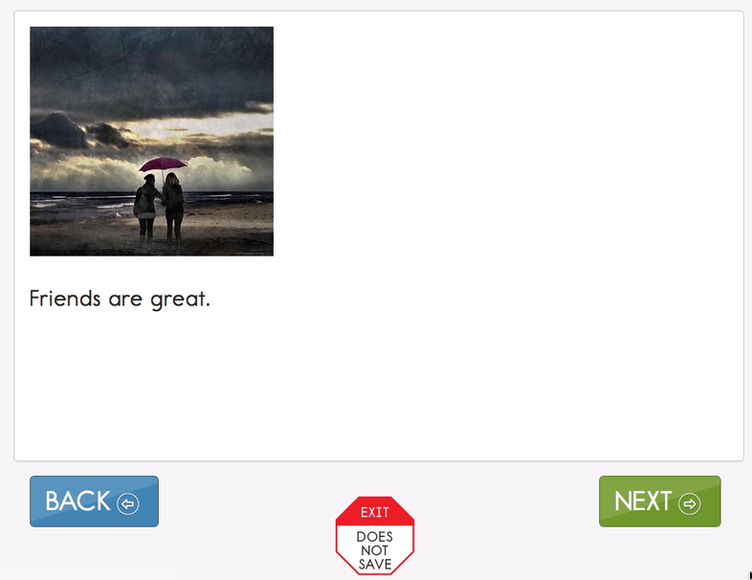
Page 12 of Friends are Great Book from Released Testlet

Slide 40
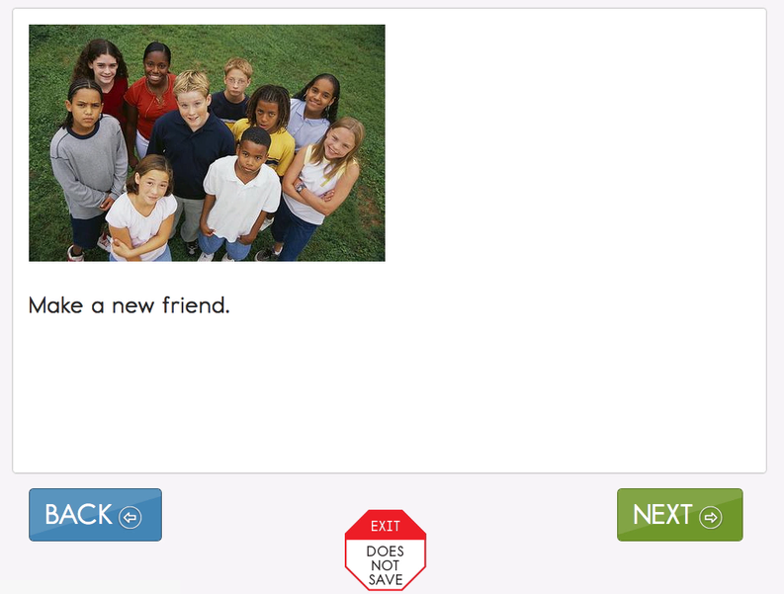
Page 13 of Friends are Great Book from Released Testlet

Slide 41
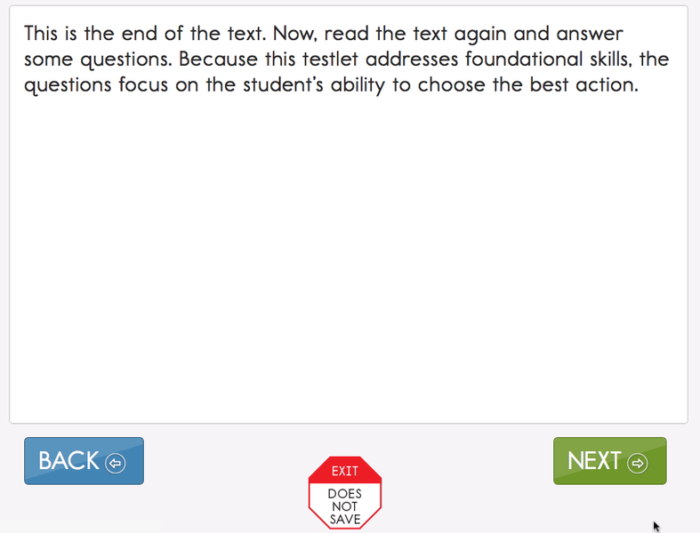
End of First Read Screen

Slide 42
Page 3 of Friends are Great Book from Released Testlet - Repeat

Slide 43
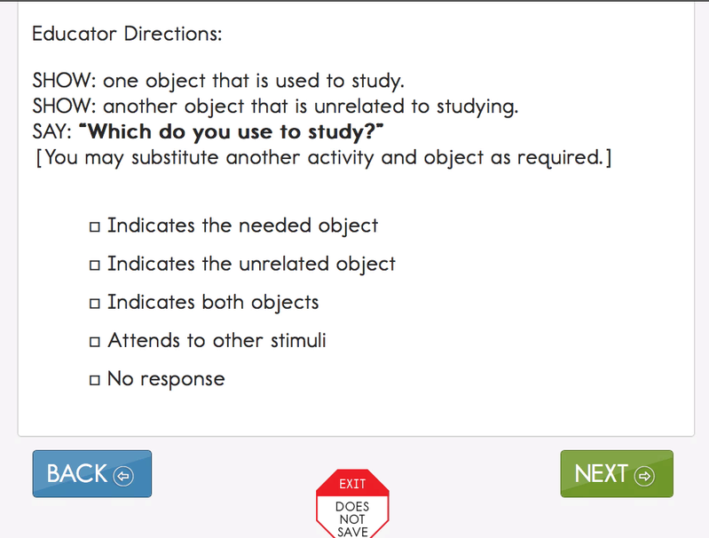
Educator Directions for first Item

Slide 44
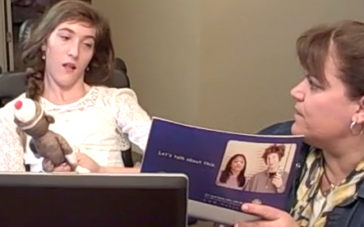
Photo of child responding to item 1

Slide 45
Educator Directions for item 2

Slide 46
Page 6 of Friends are Great book from Released Testlet - repeated

Slide 47
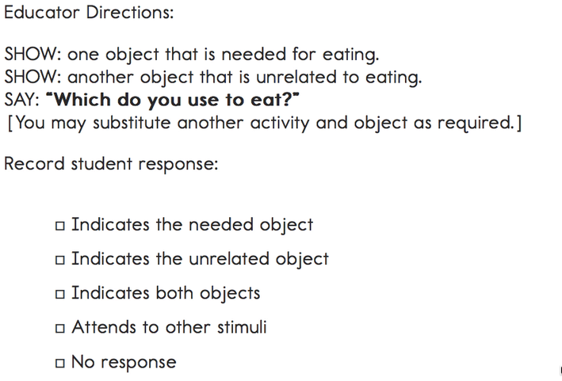
Educator Directions for Item 2 repeated

Slide 48
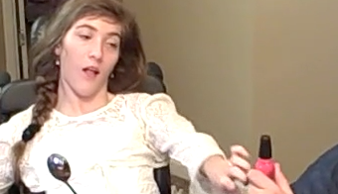
Photo of child responding to item 2

Slide 49
Educator Directions for Item 3

Slide 50
Page 7 of Friends are Great book from Released Testlet

Slide 51
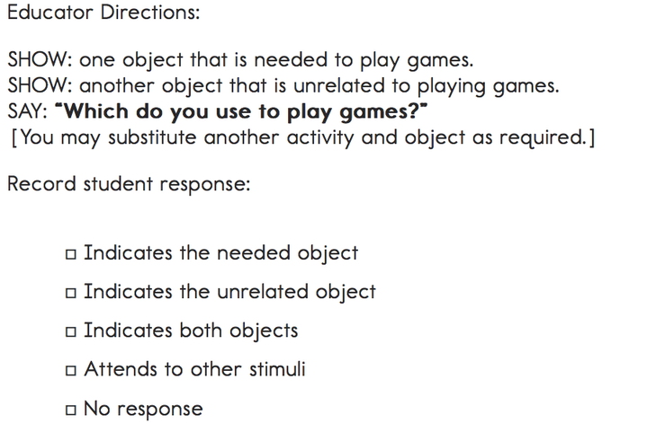
Educator Directions for Item 4

Slide 52
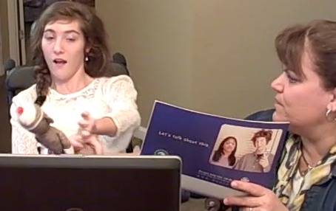
Photo of child responding to item 4

Slide 53
Educator Directions for item 4 - repeated

Slide 54
Systematically Support the Development of Symbolic Communication Over Time: Building a Core Vocabulary

Slide 55
Characteristics of a Core Vocabulary
Limited set of highly useful words
Words apply across settings
Vocabulary is made up primarily of pronouns, verbs, descriptors, and prepositions
Very few nouns are included in a core vocabulary
Consistent location of vocabulary

Slide 56
The DLM Core Vocabulary Selection Process
Review extant core vocabulary research
Review several existing core vocabulary sets
Determine U scores
Review vocabulary required for expressive use in the DLM Essential Elements
Development of a weighting system to prioritize words in order of utility

Slide 57
DLM Core Vocabulary Organization
DLM is creating systems with 4 symbols and 9 symbols per page x 10 pages
Systems grow within and across grades.
As locations are added to the core, the relative location of previous icons/messages stays the same.
Other organizations are being developed by teams and vendors across the country.

Slide 58

Systems that Grow with the Student
4 x10 Location Core

Slide 59

9 x10 Location Core

Slide 60
Discussion Questions

Slide 61
What local practices and systems are already in place to support students who are pre-intentional or pre-symbolic communicators?

Slide 62
What barriers are there to ensuring that students who are pre-intentional or pre-symbolic communicators receive instruction and participate in assessment aligned with college and career readiness?

Slide 63
How can we support the ongoing development of students who are pre-intentional or pre-symbolic communicators throughout their school career?

Slide 64
What strategies are working that move students from preintentional to intentional communicators in an academic context?

Slide 65
What strategies are working that move students to a larger set of symbols in an academic context?

Slide 66

Closing Slide with Logo
http://dynamiclearningmaps.org

