Slide 1
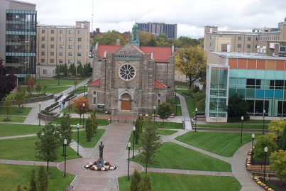
Educating Cooperating Teachers About Evidence-Based Practices
Marya Grande
Kelly Harper
Michele Marable
Canisius College
Buffalo, NY

Slide 2
JUSTICE Project Initiatives
Professional Development Series
Inquiry Project/Schoology
Mentoring Online Module for CTs
Inquiry Group
IRIS modules
Livescribe Training

Slide 3
IRIS Modules - Pilot
Paid CTs to complete certain IRIS Modules and submit assessment questions
Hoping that would result in different practices that our candidates would see
Worked with a principal who then offered the modules as PD 175 hours
Worked with the Buffalo Teacher Center to help set up the modules as summer professional development

Slide 4
Question #1
Have you tried or thought of compensating CTs for taking IRIS modules?

Slide 5
Mentoring Online Module
Outline of Training Topics:
Activity 1: An Introduction to the Cooperating Teacher Role
Activity 2: Understanding the Role of Mentor
Activity 3: Preparation and Welcoming
Activity 4: Communication and the Student Teacher Evaluation
Activity 5: Teacher Candidate Certification Requirements

Slide 6
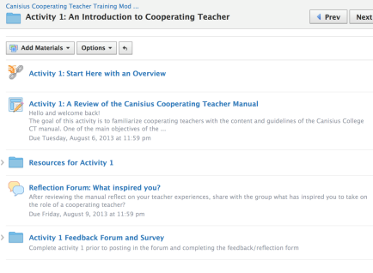
Mentoring Online Module (continued)
Structure of each activity
Overview
Activity Outline
Resources
Reflection Forum
Feedback Survey

Slide 7
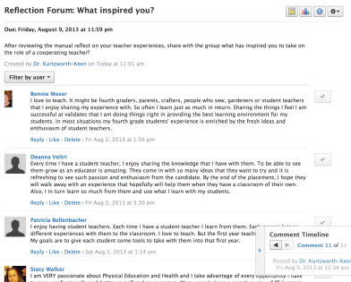
Mentoring Online Module (continued 2)
“Every time I have a student teacher, I enjoy sharing the knowledge that I have with them. To be able to see them grow as an educator is amazing. They come in with so many ideas that they want to try and it is refreshing to see such passion and enthusiasm from the candidate. By the end of the placement, I hope they will walk away with an experience that hopefully will help them when they have a classroom of their own. Also, I in turn learn so much from them and use what I learn with my students.” Quote from forum post

Slide 8
Next Steps for Module
Development of a TC Project
Planning is currently underway
Question #2
Have you used an online forum to communicate/train cooperating teachers?
What has been successful/unsuccessful?

Slide 9
Year 1 PD Series
Focused on several of our JUSTICE Project Elements
Universal Design for Learning
PBIS
Using Date to Make Decisions
EBP
Teaching Literacy
RTI
Culturally Relevant Teaching
Assistive Technology
Working with Families
Collaboration with Gen Ed
Teaching English Language Learners

Slide 10
JUSTICE PD Series: Year 1
Web 2.0 Applications: Engaging Students with High-Incidence Disabilities in the Classroom
Adjunct, Technology Teacher
Universal Design for Learning
JUSTICE Project Faculty

Slide 11
JUSTICE PD Series: Year 1 (continued)
Effective Communication: Helping Families of Children with High-incidence Disabilities and Professionals Work Together
Parent Network of Western New York
Peaceprints Project: Promoting PEACE and JUSTICE through EBPs in Literacy
Peaceprints/Western New York Writing Project

Slide 12
JUSTICE PD Series: Year 1 (continued 2)
RTI & Academics: Evidence-Based Interventions for Difficult-to-Teach Students
Jim Wright, Intervention Central

Slide 13
Summer Institute Year 1
CAST Summer Institute on Universal Design for Learning
We learned it is difficult to get everyone to attend when the PD is free?!? Lots of no-shows.

Slide 14
Question #3
How have you dealt with no-shows for free PD?
How do you entice teachers to participate?

Slide 15
Summer Institute Year 2

Slide 16
Professional Development Series
Partnered with Buffalo Teacher Center
Teachers received 1 district credit for attending entire series (6 sessions = 15 hours)
Participants had to complete a “project”
Invited all cooperating teachers (teacher candidates & faculty) to attend
Came up with topics with help from Advisory Council

Slide 17
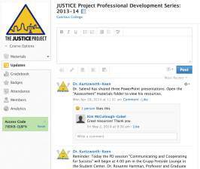
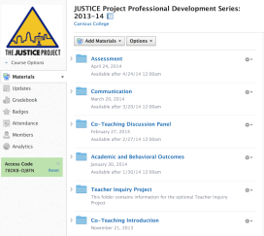
Schoology
The Schoology site made the materials and resources from each PD presentation available to attendees
Announcements were posted on the site throughout the year

Slide 18
Goal of PD Series
Increase the effectiveness of co-teaching practices in inclusive classrooms by providing a framework of topics that explore and address essential components of co-teaching.
Provide professional development that is aligned with evidence-based practices and UDL principles.
Examine research to identify and implement practical, evidence-based practices in inclusive classroom environments that benefit all learners.

Slide 19
Year 2: Co-Teaching
Integrated Co-Teaching: Roles & Responsibilities of the Co-teacher in Implementing & Planning for Instruction
District personnel
Improving Academic & Behavioral Outcomes in Inclusive Classrooms
Dr. Larry Maheady, SUNY Fredonia

Slide 20
Co-Teaching PD Series
Co-teaching Discussion Panel: How to Put Theory into Practice
Co-teachers from partnership schools
Communicating & Cooperating for Success in the Inclusive Classroom
Communication Faculty Member at College

Slide 21
Co-Teaching PD Series (continued)
Inclusive Classroom Assessments: Enhance & Document your Teaching Effectiveness and Your Students’ Learning
Dr. Spencer Salend, SUNY New Paltz
A Showcase of Teacher Inquiry & Research from Everyday Practice
Buffalo District Teachers

Slide 22
Inquiry Project & Showcase
JUSTICE (in collaboration with the Buffalo Public Schools) sponsored a PD session showcasing research projects from the participants of our PD series on co-teaching.

Slide 23
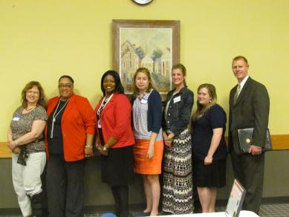
Inquiry Project & Showcase (continued)
Throughout the year, teachers developed inquiry studies that monitored student outcomes. Data collection methods were utilized to measure and analyze the use of instructional strategies within classrooms.

Slide 24
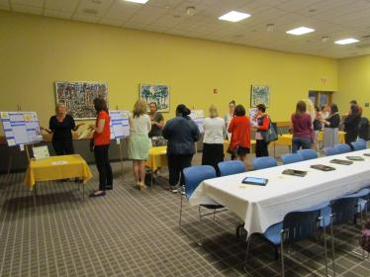
Inquiry Project & Showcase (continued 2)
During the Teacher Inquiry Showcase, teachers shared their inquiry research projects and discussed how the use evidence-based practices enhanced learning opportunities for their students.

Slide 25
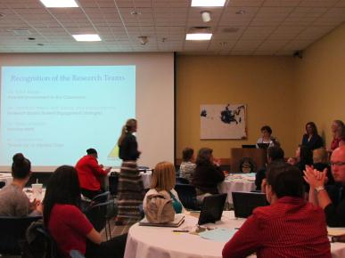
Inquiry Project & Showcase (continued 3)
An open gala poster session enabled attendees to learn about the research studies, ask questions, and engage in professional dialogue to develop a deeper understanding of how to embed practical, evidence-based interventions into their own everyday practices.

Slide 26
Lessons Learned
Teacher reflection:
“I attended this PD series with the three teachers that I co-teach with. This was beneficial on many levels. We would have discussions the following day to discuss what we learned and want to integrate into our planning. We were able to have very in-depth conversations about academic and behavioral outcomes using ideas and resources that we were presented with.”

Slide 27
Lessons Learned (continued)
Teacher reflection:
“The project was open ended so we were really able to focus on a project that fit our classrooms. It was beneficial to have the time to work with my co-teacher and reflect on the process with her.”

Slide 28
Lessons Learned (continued 2)
Teacher reflection:
“One of the co-teachers that I work with found this project to be helpful in a number of ways. Last year we identified an area that we wanted to focus on this year. The area of focus was academic conversations. Integrating more student talk and less teacher talk. This research project gave us an opportunity to focus on that particular area while developing lessons and skills on conversations within our classroom.”

Slide 29
Lessons Learned (continued 3)
Teacher reflection:
“I really like the project. I loved the ability to collect data, problem solve, analyze the data and implement a new strategy. The best part was that in the end the strategy did in fact achieve my goal which was to increase student involvement.”

Slide 30
Lessons Learned (continued 4)
Teacher reflection:
“Completing this project emphasized the need for research as part of practice. It helped me to buy in to changes that I need to make as an educator to benefit my students and my own practices.”

Slide 31
Lessons Learned (continued 5)
Teacher reflection:
“Through this JUSTICE project, I became a more confident educator and professional. I thrive on interacting with other people as well as continuing my education in every way that I can. I was thrilled last year when Canisius decided to begin the JUSTICE Project and I truly feel that it is incredibly beneficial to the professionals that attend and I only hope to see the program continue to grow year after year.”

Slide 32
Inquiry Future Plans
Inquiry Groups Established
Recent graduates and on-site mentors attend PD Series and identify areas of interest/present challenges
Professional Learning Communities (PLCs) formed among common interests
Conduct inquiry cycle to empower new teachers to find solutions and support each other

Slide 33
Year 3: ELLs and CRT
Embracing All Children: Addressing Cultural & Linguistic Diversity in our Schools
(Agenda is developing)

Slide 34
Jane Elliott – March 11, 2015

Slide 35
Livescribe Training
Presented this tool to district Special Education Director and staff
Designed a pilot to train teachers to use and then act as turnkey trainers for district

Slide 36
Livescribe as PD
At the end of their training, they will design a course which they can teach at the Teacher Center about how to use the Livescribe pen with a specific grade level/subject area.

Slide 37
Question #4
Have you had success partnering with a teacher’s center or a school district?
What were the keys to your success?

Slide 38
edTPA Training for CTs
Presented at all of our schools on edTPA requirements
Teachers were compensated
Reviewed what types of assistance were and were not allowed to teacher candidates.
“This is exactly what we are required to do as teachers. This is involved but this is very authentic.”

Slide 39
Question #5
How are you preparing your CTs for the edTPA?

Slide 40
For info please visit:
http://www.canisius.edu/justice/
Thank you!!

