Slide 1
Using Evidence Based Practices to Reform Teacher and Leader Education: Useful Tools and Resources in Action
U.S. Department of Education,
H325A120003

Slide 2
Today
Brief Overview of the Center
Innovation Configurations
Using the Evidence- In Action!
Networked Improvement Community
Discussion

Slide 3
CEEDAR Center
Leadership
Partners
Mary Brownell, Director
Paul Sindelar and Erica McCray, Co-directors
Meg Kamman, Project Coordinator
American Institutes for Research (AIR)
University of Kansas, Center for Research on Learning
Council of Chief State School Officers
New Teacher Center
Goodlad Institute for Educational Renewal at the University of Washington
Major organizations
Senior advisors
OSEP Project Officers: Dr. Bonnie Jones and Dr. David Guardino
OSEP Project Officers: Dr. Bonnie Jones and Dr. David Guardino
Notes:
I want to introduce some of the key people who are involved in the Center. AIR and KU. We also are working with the key professional organizations. New Teacher Center and Goodlad Institute for Educational Renewal. In fact, Lynn Holdheide and Amy Elledge, our colleagues from AIR, are joining us and may be helping to answer questions in the chat box.

Slide 4
CEEDAR Center
Funded by OSEP for five years
Cooperative Agreement with the University of Florida
Directed by Dr. Mary Brownell
Began Jan 1, 2013
Intensive technical assistance to 20 states (5 this year)

Slide 5
CEEDAR’s Mission
To create aligned professional learning systems that provide effective opportunities for teachers to master core and specialized instruction in inclusive settings—and for leaders to establish the conditions in schools that sustain high quality instruction—to enable students with disabilities to achieve college and career ready standards

Slide 6
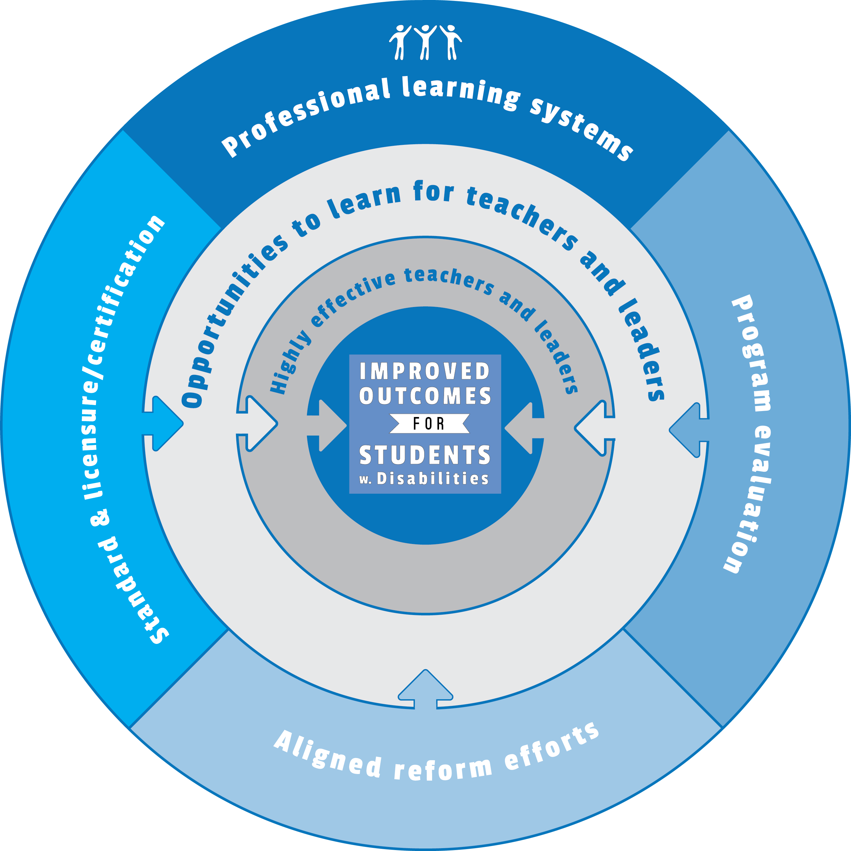
Our Approach
Notes:
To create aligned professional learning systems that provide teachers and leaders effective opportunities to learn how to improve and support core and specialized instruction in inclusive settings that enable students with disabilities to achieve college and career readiness standards

Slide 7
Key Assumptions

Slide 8
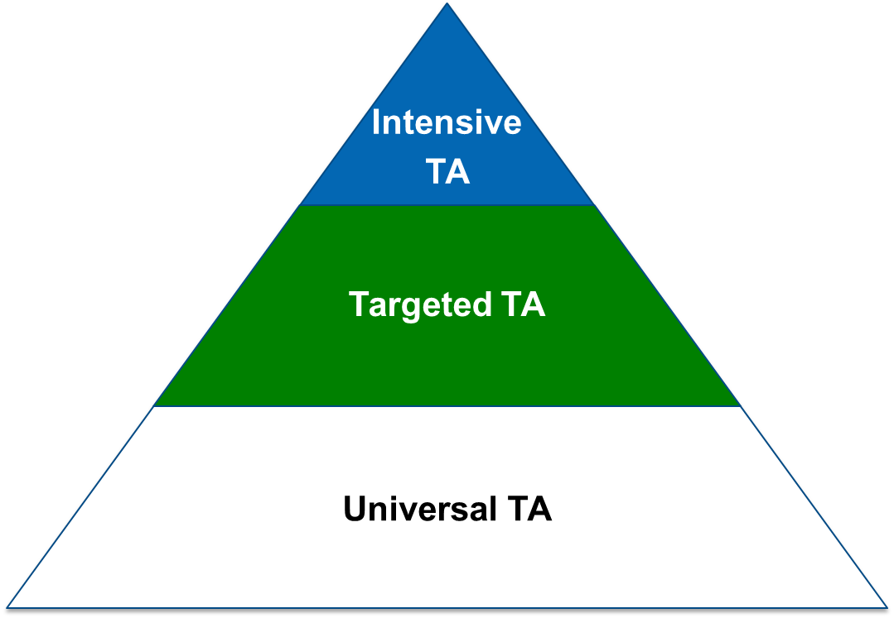
Technical Assistance (TA)
Notes:
We have accomplished our primary knowledge development phase and our efforts as a center is now focused on technical assistance through products and services developed based on the initial knowledge development work. As you can see in the triangle, we are engaged in U, Targ..and Int TA

Slide 9
O(TL)² Opportunities to Learn for Teachers and Leaders
Notes:
The interventions that are most likely to have the greatest impact on teachers’ knowledge and classroom instruction are those that are closest to their performance.

Slide 10
Highly Skilled Teachers
Extensive knowledge and skill
Collaborative skill
Notes:
It becomes obvious that teachers will need a substantial amount of knowledge to both understand how student learning progresses, what benchmarks students will need to achieve as they progress toward the standard and how to support learning when it is breaking down. Collaborative skill will be necessary for general and special education to work together.

Slide 11
How Will We Secure Such Extraordinary Teachers?
Notes:
Now that we have examined the sorts of demands placed on teachers helping students with disabilities achieve common core standards, We must ask ourselves what kinds of supports teachers will need in order to develop such expertise?

Slide 12
Effective Opportunities to Learn
Notes:
To ensure that teachers are highly effective, we need to maintain a laser like focus on their learning opportunities, the quality of those opportunities and what they afford teachers.
OTL is a construct from the student literature that focuses on the opportunities students had to learn the content standards students had to learn the standards represented on state standards

Slide 13
Opportunity to Learn
It is the degree to which teacher educators (both in IHEs and Schools) devote instructional time to helping teachers learn and effectively apply the necessary content and pedagogical approaches needed to help students with disabilities successfully achieve Common Core Standards.

Slide 14
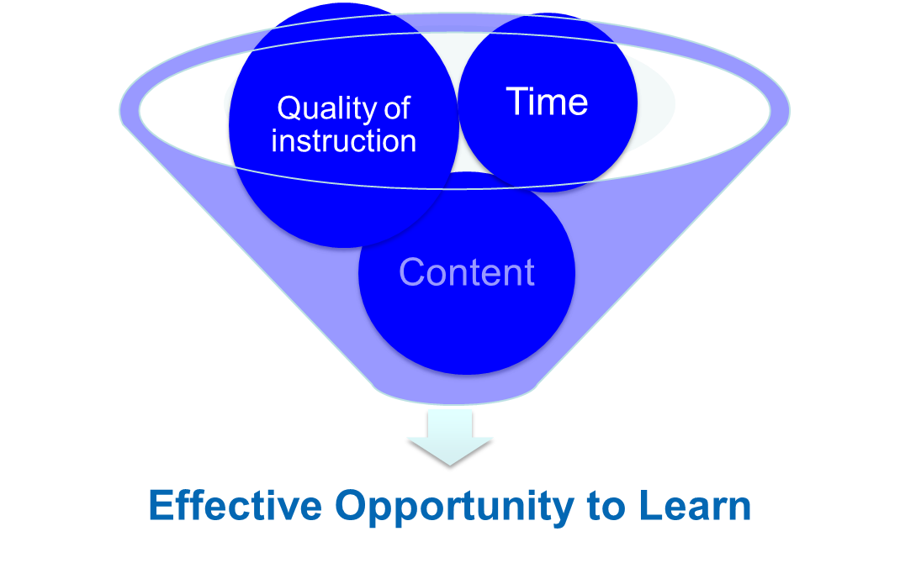
Main Ingredients
--Elliott, 2012; Kurz, 2011
Notes:
Three main features of OTL for students is also likely to be relevant for teachers---will address each one using the research in these separate areas.

Slide 15
Content Coverage
Subject matter knowledge
Knowledge of how students learn
Specific pedagogical practices for enacting content
--Ball, Thames, & Phelps, 2008; Brownell et al., 2007
Notes:
Research on expertise suggests that experts have well integrated knowledge bases. Evidence in mathematics and science and to a smaller degree reading (particularly the linguistic knowledge teachers have) is related to their effectiveness. Small body of research on teachers, compared to experts more generally, suggests that teachers know the content they are teaching, but they also know how to enact that content—mindful of the challenges students encounter in learning that content. Research by Hill, Ball, Phelps and a few others provide support for this point.

Slide 16
Content Coverage (continued)
Special education teachers must also have knowledge of intensive interventions
Notes:
Plus, special education teachers have to make some fundamental decisions about what to provide intensive intervention in, as she or he has limited time with the students.
In this situation, what might be the focus of intensive intervention?
Is this a concept about fractions that will be essential for the student to understand now and in future math classes?
For effective teachers, much of this recognition of what to do and how to act upon that recognition happens with fluency because of the practice they have had over time in recognizing patterns of performance and how to respond to those patterns.

Slide 17
Instructional Quality
Development of this knowledge should be based on well-founded theories of how expertise is developed in a particular domain
Notes:
The instructional quality with which content is presented also seems important for teachers. And instructional practices should be used that are well-founded in the evidence. The problem for teacher educators (whether they are in universities or schools) is that the knowledge underlying expertise is not really well understood and how to foster its development is also not well understood.

Slide 18
Instructional Quality (continued)
Novices need more direct guidance
More complex the skill, more practice is needed
Practice should be scaffolded
“High Fidelity Feedback” focused on critical features of performance
--Ericsson, Prietula, & Cokely, 2007; Kirschner, Sweller, & Clark, 2006; Showers & Joyce, 2002
Notes:
Novices need more direct instruction—this finding is well established in the literature on student learning and professional expertise. They have more difficulty learning if the essential features of what is to be learned are not made explicit.
More complex the skill to be learned, the more practice that is necessary. Feedback must focus on essential features of performance, which is why the person providing it needs to be knowledgeable. Achieving these conditions are difficult.

Slide 19
Time for Learning How to Teach
A well-defined topic, such as learning how to help students solve problems involving fractions, requires approximately 50 hours of professional learning time
--Yoon, Duncan, Lee, Scarloss, & Shapley, 2007
Notes:
Yoon and colleagues in the IES report found that the range was 30 to 83 hours. These were the mathematics studies that had a moderate effect on student achievement.

Slide 20
Using the Evidence: CEEDAR Tools

Slide 21
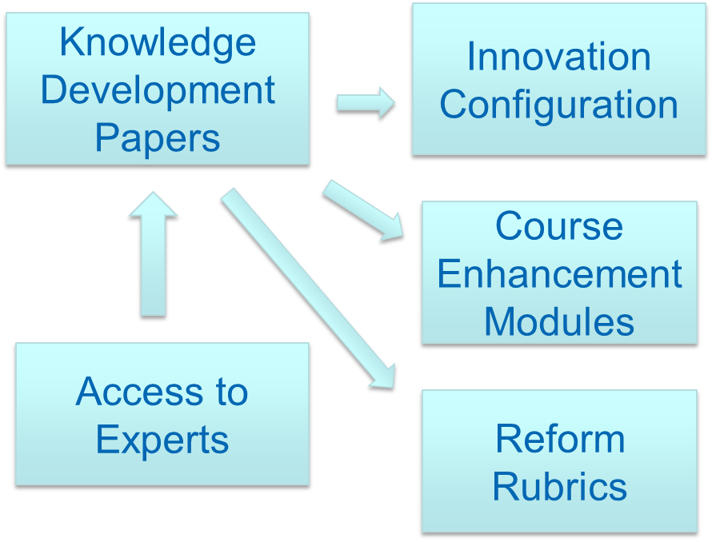
Focusing on the Evidence
Notes:
These focus on reform, policy and educator evaluation

Slide 22
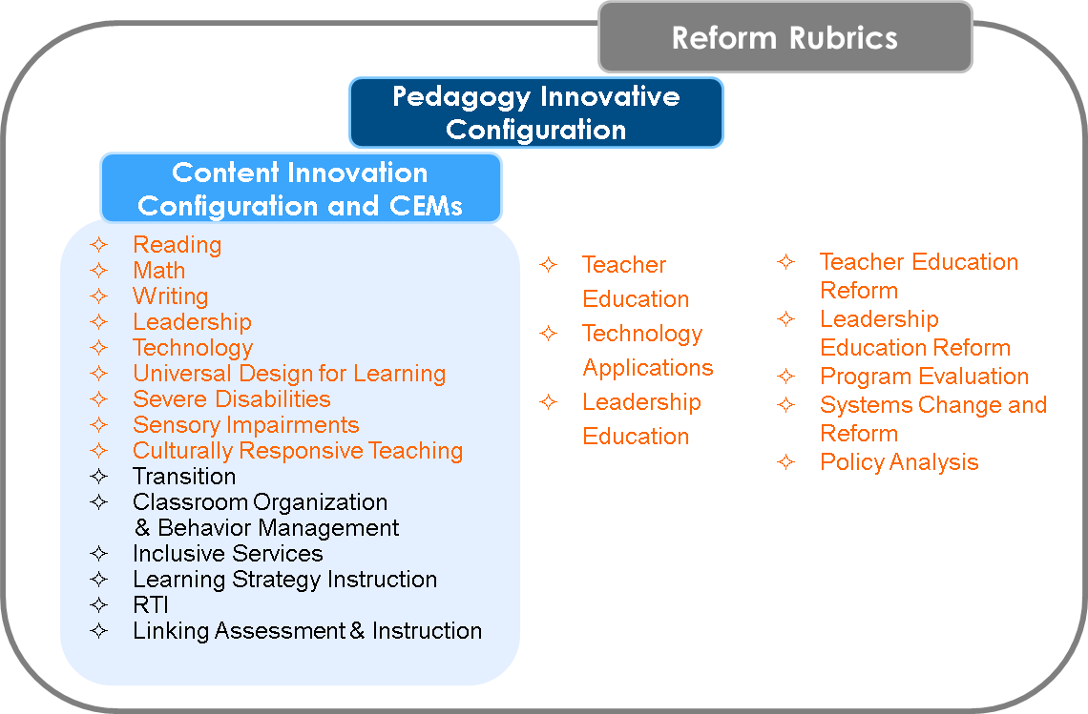
Providing Intensive TA: Tools
Notes:
In order to provide the more intensive TA we need specific tools…and this is really where you come in to help us. We will leverage resources that are already available, you will see there are 7 content Innovation Configurations that are already completed by NCCTQ. We will add another 6 in this area, and an additional three in pedagogy. Finally, we will help states with bigger reform issues with the 5 rubrics we will create.

Slide 23
Background on Innovation Configurations

Slide 24
What is an Innovation Configuration?
Used for more than 30 years in development and implementation of educational innovations and methodologies to:
Evaluate programs
Evaluate fidelity of implementation of educational interventions
Facilitate the change process

Slide 25
Innovation Configurations
ICs identify strengths and gaps within preparation programs and address:
What types of instruction and experiences do educators receive throughout their preparation and/or professional development that promote the use of evidenced-based instructional practices?
To what extent are education candidates provided an opportunity to apply these strategies with explicit feedback and sustained implementation and support to ensure fidelity?

Slide 26
Voices from the Field
Most of the 325T grantees utilized the ICs to examine their programs
Notes:
Insert videos of 2 people talking about how they used the IC’s. Mary Little? SUNY?
The SUNY folks are great and who were folks in CT mentioned were excellent champions of the ICs. Below is a link to a presentation:
http://education.ufl.edu/325t/files/2013/06/SUNYFredonia_052011.pdf
They also have example syllabi that were modified as a result of the IC work:
http://www.newpaltz.edu/prepforsuccess/resources.html

Slide 27
Project RAISE-UP Raising the Bar through Curriculum Enhancements
Dr. Kathleen Magiera
Dr. Rhea Simmons
State University of New York (SUNY)
at Fredonia
325T Program Improvement Grant

Slide 28
A 325T Grant Project RAISE-UP Redesigning and Improving Special Education – Undergraduate Program
GOAL: To redesign and improve SUNY Fredonia’s undergraduate teacher preparation program graduating highly qualified special education teachers.
Special education teacher preparation program approved by the New York State Education Department in 2007
Grant funded July, 2009 (Cohort 3)

Slide 29
Purpose of Grant
To enhance general education teacher preparation curriculum by strategically embedding special education content and knowledge supported by evidence-based practices into course syllabi throughout the curriculum
To enhance the collaboration skills of our program graduates to work with families of students with disabilities, educational professionals, and community services

Slide 30
State University of New York at Fredonia
Western most comprehensive college in New York State university system
located in most agricultural county in the state
5,000 students
20% of student body majors in Education
24 Faculty members in College of Education
Two departments in College of Education
Curriculum & Instruction
Language, Learning, & Leadership

Slide 31
Timeline for Major Project Activities
Fall 2009 - Adapt Holdheide and Reschly (2008) Innovation Configuration Tools (ICTs)
Spring 2010 - Pilot of ICTs with 10 College of Education syllabi
Fall 2010 - Analyze all College of Education syllabi
Spring 2011 - Embed IRIS Center materials and evidence-based practices within courses
May 2011 - Resubmit syllabi to OSEP for analysis

Slide 32
Year One Project Activities
Fall 2009 – Utilized OSEP’s 5 domains to develop overall program improvement roadmap
Certification
Organizational Structure & Instructional Delivery
Curriculum & Course Content
Student Support
Program Evaluation
Fall 2010 – Adapted Innovation Configuration Tools (ICTs)
January 2010 – Professional development for special and general education faculty via Winter Institute
Spring 2010 - Pilot of adapted ICTs with 10 course syllabi
Spring 2010 - Developed ICT for field experiences
Spring 2010 - Initial pilot of ICT for field experiences

Slide 33
IEP for the LRE
IEP (Inclusion, Evidence-Based Practices, & Partnerships) for the Least Restrictive Environment
Define inclusive practices using a common vocabulary throughout the teacher preparation curriculum
Embed evidence-based practices throughout the curriculum
Partner with rural school districts to locate more quality inclusive field placements

Slide 34
Selected Courses for Pilot
Piloted the process with a representative sample of 10 education courses from three categories :
Field-Based
Psychological Foundations
Methods
Conducted document review of student teaching handbook and evaluation forms

Slide 35
Spring 2010 Pilot Data
Two data sources :
Surveyed 10 faculty members (2 faculty members have terminal degrees in special education) about knowledge of inclusion, how to incorporate inclusion in coursework, and how to improve our teacher preparation program
Utilized adapted Inclusive Services ICT for 9 courses and adapted Classroom Management ICT for 1 course (relevant content) to review syllabi

Slide 36
Inclusive Services Adapted ICT Model
Degree of Implementation in Syllabi
Essential Components
for Syllabi
Inclusion Foundations
Inclusive Service Models
Collaboration
Access to General Education Curriculum
Learning Strategies
Family Involvement
Self-Determination for Students
No evidence in Syllabi
Mentioned in Syllabi
Required Readings on Topic in Syllabi
Required Readings and Project or Assignment or Test on Topic
Required Readings and Project or Assignment or Test on Topic and Supervised Practice

Slide 37
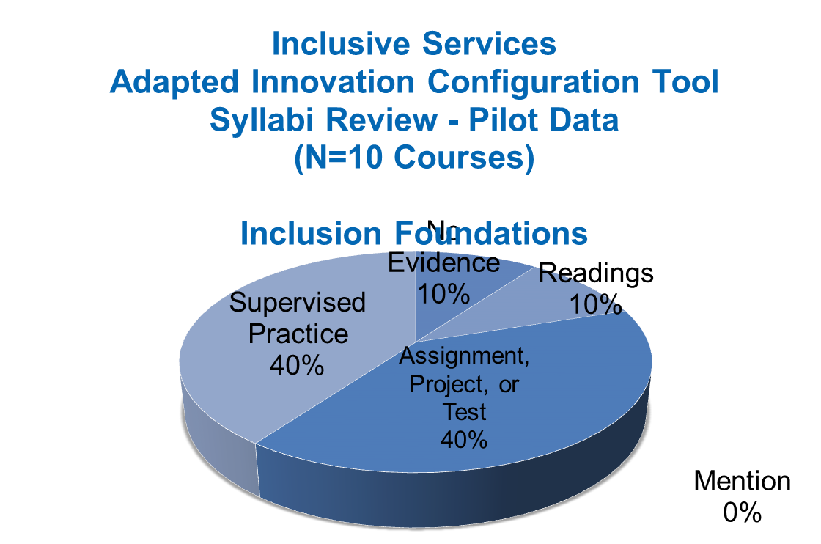
Pilot Data of Inclusion Foundations

Slide 38
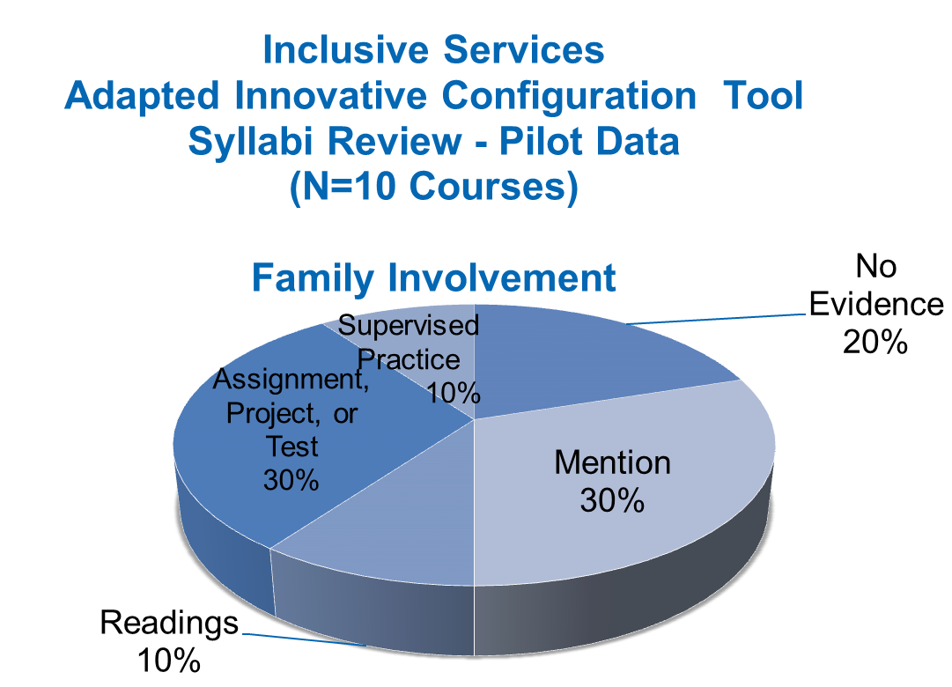
Pilot Data of Family Involvement

Slide 39
Use of the innovation configurations
Lessons Learned:

Slide 40
CEEDAR ICs
Expand on the initial ICs
and
Align courses with evidence-based knowledge and practice

Slide 41
NIC- CEM- IC Demo

Slide 42
Questions?

Slide 43
Disclaimer
The contents of this webinar were developed under a cooperative agreement from the U.S. Department of Education, H325A120003. However, those contents do not necessarily represent the policy of the U.S. Department of Education, and you should not assume endorsement by the federal government.

