Slide 1
Striving for Quality
Using continuous improvement strategies to increase program quality, implementation fidelity and durability
Steve Goodman
Director
Michigan’s Integrated Behavior and Learning Support Initiative (MiBLSi)
sgoodman@miblsimtss.org
Barbara Sims
Assoc. Director ▪ NIRN
Co-Director ▪ National SISEP Center
FPG Child Development Institute
barbara.sims@unc.edu

Slide 2
W. Clement Stone
“To solve a problem or to reach a goal, you don't need to know all the answers in advance. But you must have a clear idea of the problem or the goal you want to reach.”
W. Clement Stone

Slide 3
IMPROVEMENT CYCLES
Changing on purpose to support the new way of work

Slide 4
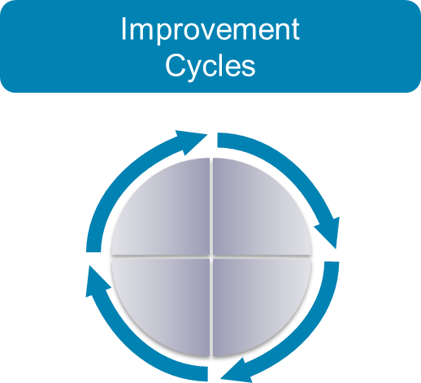
Improvement Cycles (continued)
Implications
Teams normalize implementation challenges through intentional use of data and Improvement Cycles

Slide 5
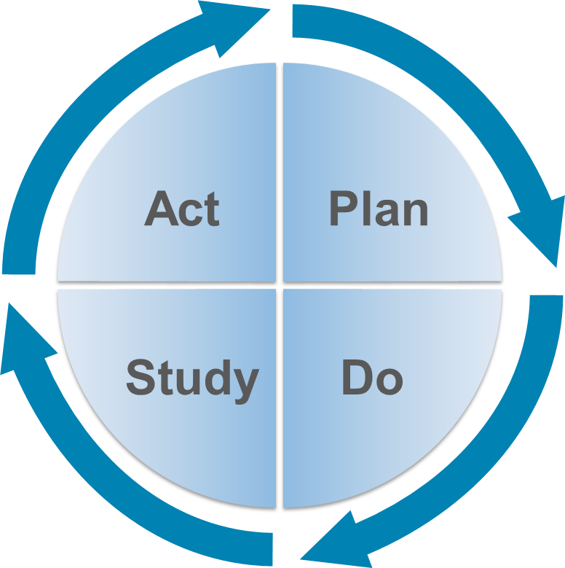
Improvement Cycles (continued 2)
PDSA
Notes:
5
Improvement Cycle
This image displays a representation of a Plan Do Study Act Improvement Cycle

Slide 6
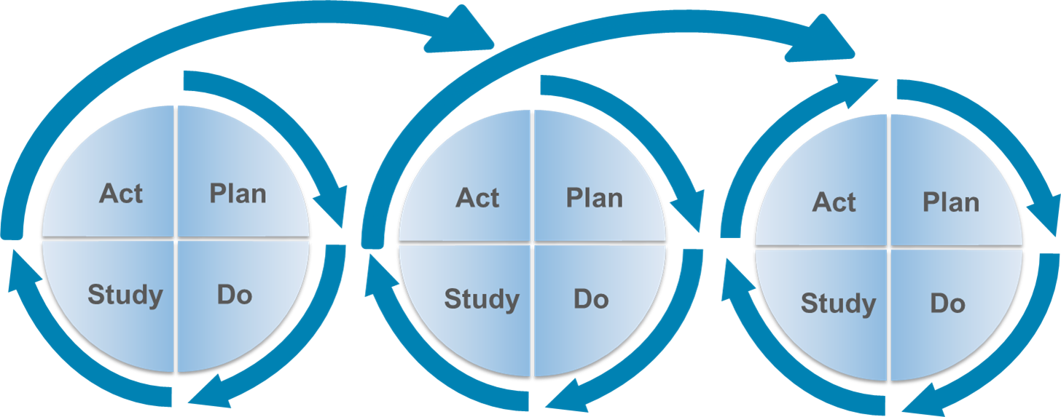
Improvement Cycles (continued 3)
Usability Testing
Notes:
6

Slide 7
Improvement Cycles (continued 4)
Usability Testing
Series of iterations with limited number of participants
Program
Program components
Implementation processes
Tests feasibility and impact in “real world” settings
Allows testing of both the intervention AND the system

Slide 8
Usability Testing
Components
Clearly defined program
Core Components
Indicators of Fidelity
Selection of initial implementers
Selection Criteria
Requisite variety
System components

Slide 9
Usability Testing (continued)
Components
Training
Just in time
Just enough
New knowledge vs. new skills
Data Collection
What information?
Reported to whom?
On what schedule?

Slide 10
Usability Testing (continued 2)
Components
Criteria for Success
Indicators for next iteration
Indicators for re-design
Program vs. system information
Next Iteration

Slide 11
Usability vs. Pilot Testing
Usability
Pilot
Clear description of the program
Trial and learning approach
Small number of participants with multiple iterations
Rapid cycle problem solving applied to typical program and system
Clear description of the program
Trial and learning approach
Special resources or settings
Sufficient number of participants and sufficient time to realize potential results

Slide 12
Usability Testing (continued 3)
Indications
Testing proposed improvement strategy
Initial implementation of new program
Initial replication of successful program
Scaling up

Slide 13
Usability Testing (continued 4)
Contraindications
Established programs at significant scale
Mandated numbers
Mandated/insufficient timelines

Slide 14
Usability Testing (continued 5)
Examples
Mandated literacy program
K-3 Formative Assessment
Michigan example

Slide 15
Rapid-Cycle Problem Solving
Description
Rapid-Cycle Problem Solving is a focused, iterative improvement process using Plan-Do-Study-Act to work out problems with initial implementation of a practice or to improve a practice that is in place.

Slide 16
Rapid-Cycle Problem Solving (continued)
Components
Assign Rapid-Cycle Problem Solving Leader
Create Team (Ad Hoc)
Apply a standard problem solving protocol
Focused version of Plan-Do-Study-Act cycle applied to rapid cycle problem solving
Evaluate
Apply learning

Slide 17
Rapid-Cycle Problem Solving (continued 2)
Problem Solving Protocol
Clarify and validate the problem
Decide what variable(s) to problem solve
Set improvement target
Generate possible solution to improve attribute(s)
Implement a solution
Evaluate if solution worked
Continue or expand process

Slide 18
Rapid-Cycle Problem Solving (continued 3)
Problem Solving Protocol
PLAN Do Study Act
1. Clarify and validate the problem
Use fidelity and outcome data to better understand the problem
Describe problem statements
Primary problem statement
Precision problem statement

Slide 19
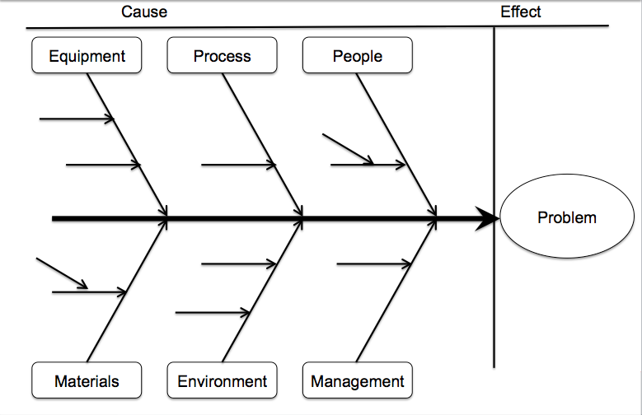
Fishbone Diagram

Slide 20
Six Causes of Staff Performance Problems
Lack of clear performance expectations and relevant feedback about the adequacy of your performance.
Lack of tools, resources, and materials to achieve performance goals
Lack of adequate incentives made contingent on performance.
Lack of training that matches the requirements of the job.
Lack of match between skills and job requirements.
Lack of motivation to perform job well.

Slide 21
Rapid-Cycle Problem Solving (continued 4)
Problem Solving Protocol
PLAN Do Study Act
2. Decide what variable(s) to problem solve
What change(s) do we want to test?
Timeliness
Accuracy
Quantity
Ease of use
Duration
Focus on what are the alterable variables within the setting
Notes:
Since the work is already taking place, focus on a few key variables that you might what to address to make it better

Slide 22
Rapid-Cycle Problem Solving (continued 5)
Problem Solving Protocol
PLAN Do Study Act
3. Set improvement target
Base on identified improvement variable(s)
Notes:
Since the work is already taking place, focus on a few key variables that you might what to address to make it better

Slide 23
Rapid-Cycle Problem Solving (continued 6)
Problem Solving Protocol
PLAN Do Study Act
4. Generate possible solutions to improve identified variable(s)
Link to data
Prioritize

Slide 24
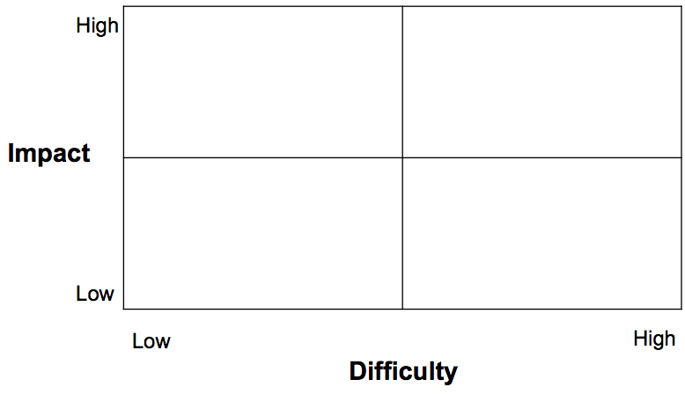
Rapid-Cycle Problem Solving (continued 7)
Problem Solving Protocol

Slide 25
Rapid-Cycle Problem Solving (continued 8)
Problem Solving Protocol
Plan Do STUDY Act
6. Evaluate if solution worked
Notes:
Since the work is already taking place, focus on a few key variables that you might what to address to make it better

Slide 26
Rapid-Cycle Problem Solving (continued 9)
Problem Solving Protocol
Plan Do Study ACT
7. Implement a solution
Adopt translate learning to larger organization
Revise/Modify based on learning
Try something different
Notes:
Since the work is already taking place, focus on a few key variables that you might what to address to make it better

Slide 27
Rapid-Cycle Problem Solving (continued 10)
Implications
Sometimes we just need to get started and then work to get better!
Beneficial strategy when the practices are already taking place and we need to work out problems before the extending to other settings or individuals.
Helps us to quickly detect, define and address new problems associated with the practices.

Slide 28
Rapid-Cycle Problem Solving (continued 11)
Indications
When just beginning a practice, process, program; to work out the “bugs”
When trying to improve a component or small
Testing or adapting a change
Implementing an improvement
Spreading the improvements to the rest of your organization

Slide 29
Rapid-Cycle Problem Solving (continued 12)
Contraindications
Applying Rapid-Cycle Problem Solving without leadership support.
Established programs at significant scale
Lack of team
Lack of focus through problem-solving protocol

Slide 30
Rapid-Cycle Problem Solving (continued 13)
Examples
Problem Oriented:
Generating more timely reports for monitoring progress of students who receive new curriculum and instruction
Incremental Improvement:
Improving the integration of meaningful parent input into the school-wide anti-bullying program.
Notes:
Since the work is already taking place, focus on a few key variables that you might what to address to make it better
Problem-solving during early efforts
Team Lead identified
Right people on the team
Time-limited to address the problem
Team disbands
Practice Improvement
On-going efforts to improve practices and competencies
Use data to achieve better outcomes for children and “embed” solutions

Slide 31
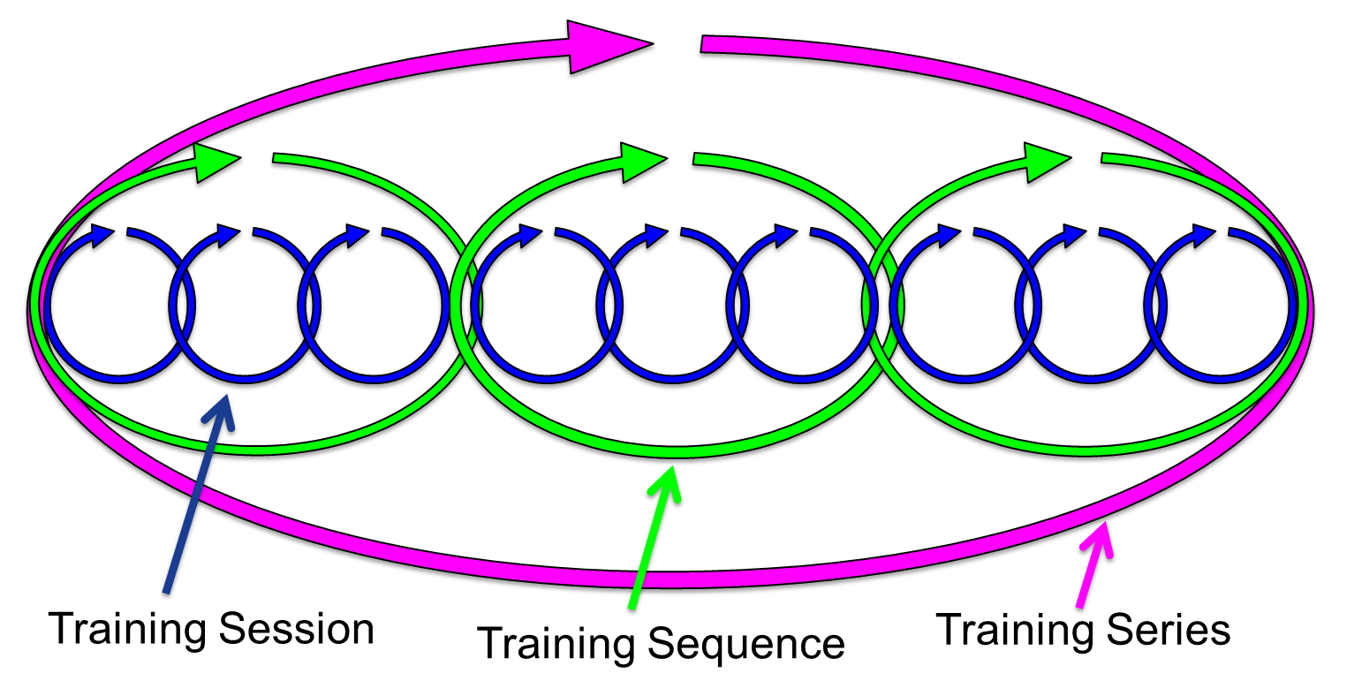
Rapid-Cycle Problem Solving (continued 14)
Examples

Slide 32
Through each replication, we become more clear in our implementation efforts.

Slide 33
Improvement Cycles: Comparison
 | Focus | Primary Point of Application | Cycle Duration | Utilization Group
Usability Testing | Small scale feasibility and ease of use | Before you get started | Rapid and short term | Development team and/or ad-hoc team
Rapid-Cycle Problem Solving | Small scale remediation of problematic variable(s) | Initial work | Rapid and short term | Ad-hoc team
Program-wide Improvement | Large scale focus or across systems | Established work | Slow moving and long term | On-going improvement team

Slide 34
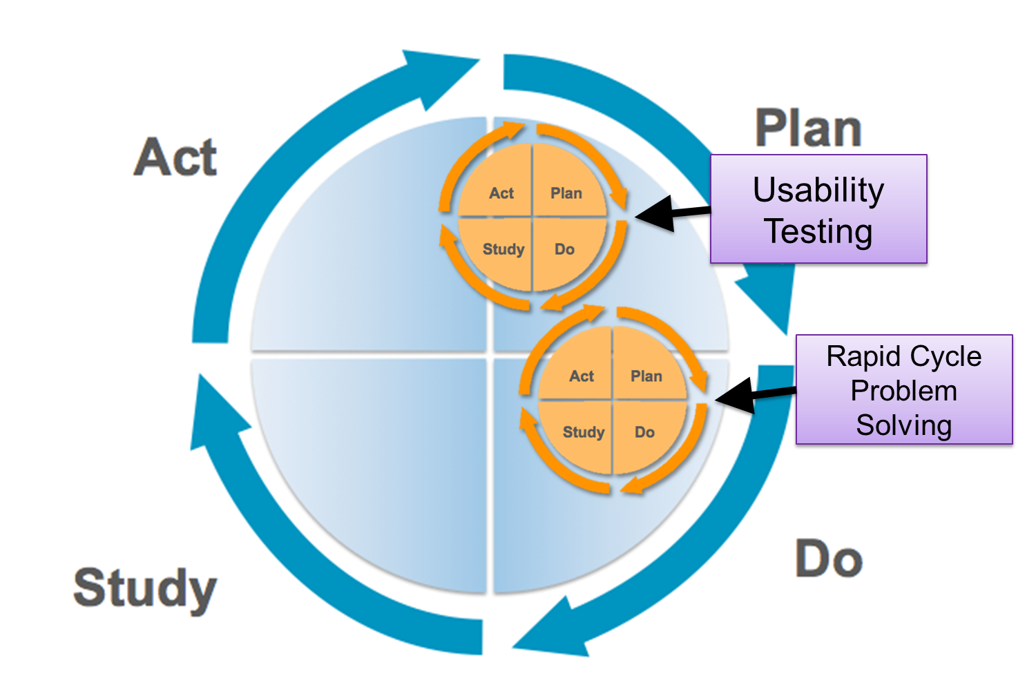
Representation of Usability Testing cycles

Slide 35
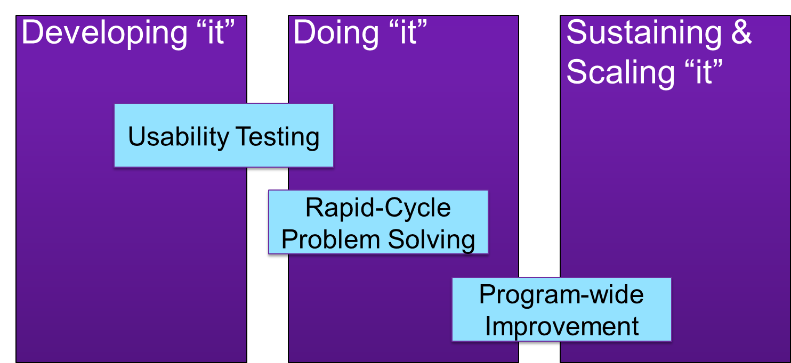
Summary

Slide 36
Summary (continued)
Iterative Improvement
Nimble
Quickly plan and make process changes
Iterative
Cycle after cycle
Responsive
Strategically apply the learning from the process

Slide 37
Stages of Implementation

Slide 38
“Key Aspects of Improvement”
“Many initiatives fail for lack of study and reflection on what is actually being done and what the results are from having done it. Observing, describing, and documenting are key aspects to a program improvement cycle, and particularly critical during the pilot phase when key functions of interventions are emerging.”
The Child Wellbeing Project, Improvement Cycle Tool

