Slide 1
Teaching & Testing Online
Patterns, Profiles and Personalization
Skip Stahl, Tracey Hall, CAST
Sean Smith, University of Kansas

Slide 2
The Center
KU Center for Research on Learning, CAST & NASDSE
Funded by Office of Special Education Programs
The Center’s focus:
Trends & Issues
Positive outcomes/negative consequences
Promising approaches
http://centerononlinelearning.org/

Slide 3
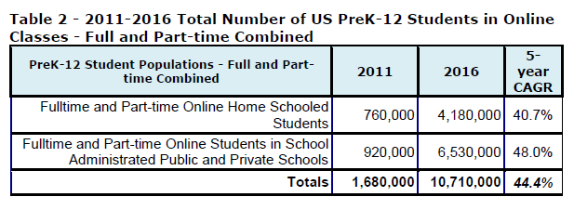
K-12 Enrollment
2016 projections:
6.53 million students in online learning
4.18 million homeschoolers online
10.71 million total.,18.0% of all US
Ambient Insight, 2013

Slide 4
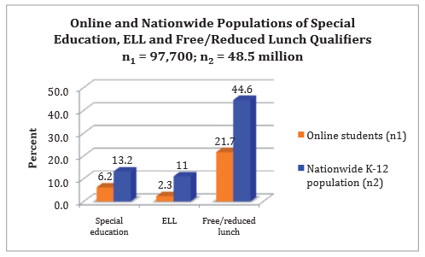
Who is Attending?
David Glick & Associates & iNACOL , August, 2011

Slide 5
NCES, 2011 Queen, B., and Lewis, L. (2011)
Queen, B., and Lewis, L. (2011)

Slide 6
Pivot Points
Measuring Student Outcomes

Slide 7
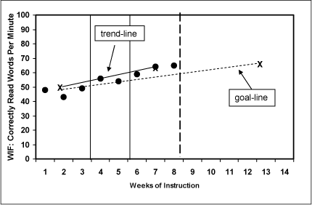
Assessment Categories
Progress Monitoring/Formative
(Assessment for learning)
National Center on Student Progress Monitoring

Slide 8
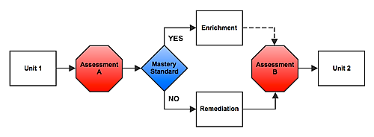
Assessment Categories (continued)
Mastery
(Assessment of learning)
realeducationreform.com

Slide 9
Assessment Categories (continued 2)
Summative
(Assessment of learning)
Encyclopedia of Educational Technology

Slide 10
Assessment item components
Tests are designed to:
Present information to stimulate the construct.
Interact with the information as the construct is operating
Produce a response which becomes a physical product

Slide 11
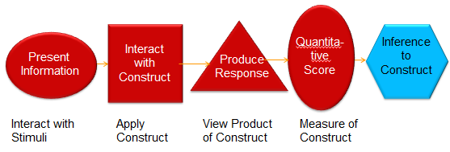
How Items Function
If a challenge or barrier exists at any of these levels, inference about the construct will fail. Russell, M. 2011

Slide 12
Assessment Impacts Instruction

Slide 13
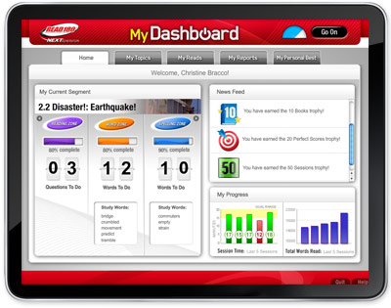
Progress Monitoring: Impact
K-12 Content/Learning Management Systems (CMS/LMS) can track student learning pathways, time on activity & achievement in real time.
Provides opportunity for course corrections at the point of instruction.

Slide 14
Mastery: Impact
CMS/LMS affordance & data fueling the precipitous increase in competency-based education.
“Student Centered” progression through levels, not grades.
Customized learning pathways for each student.

Slide 15
Summative: Impact
Increased attention on technology and digital media
Increased awareness regarding accessibility and accommodations

Slide 16
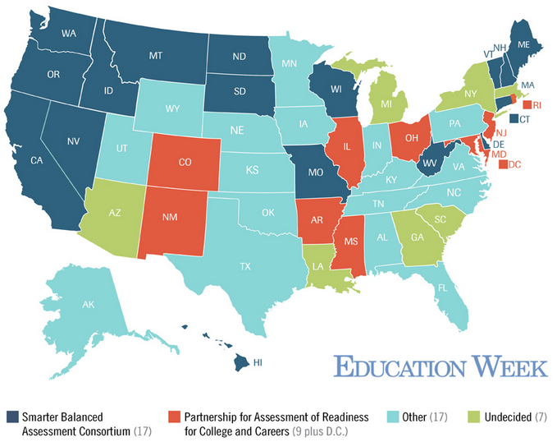
CCSS Summative Assessment
June, 2014

Slide 17
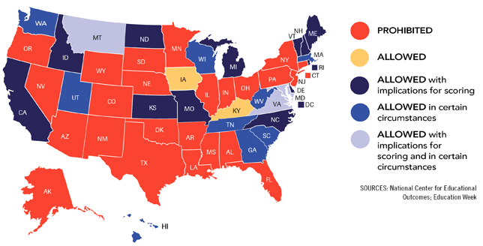
Read Aloud Accommodation

Slide 18
National CCSS Assessments
Summative
Summative
(Computer Adaptive)
Progress Monitoring/ Formative

Slide 19
Considerations
Item level KSA/construct relevance
Access supports provided to students during instruction should be available during assessment as long as they do not violate the construct(s) being assessed.
Accessibility supports versus scaffolds
Scaffolds (word prediction, spell checking, and browse-aloud tools, etc.) are common to digital learning environments – what is their role in summative assessments?

Slide 20
Considerations (continued)
Computer-Adapted testing & SWD
“…idiosyncratic responding in an adaptive setting can be disastrous in terms of arriving at a stable and accurate proficiency estimate”.
Stone & Davey, ETS 2011
Student Profile
..tells the delivery system what the needs are for specific users
Accessible Portable Item Profile (APIP), IMS Global, 2014

Slide 21
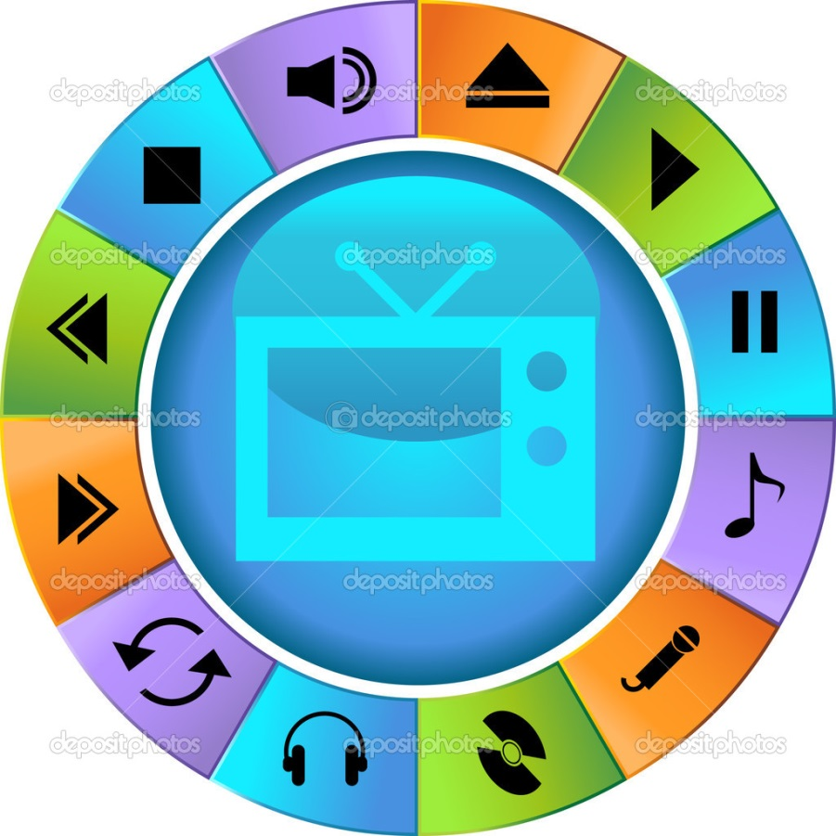
Personalization

Slide 22
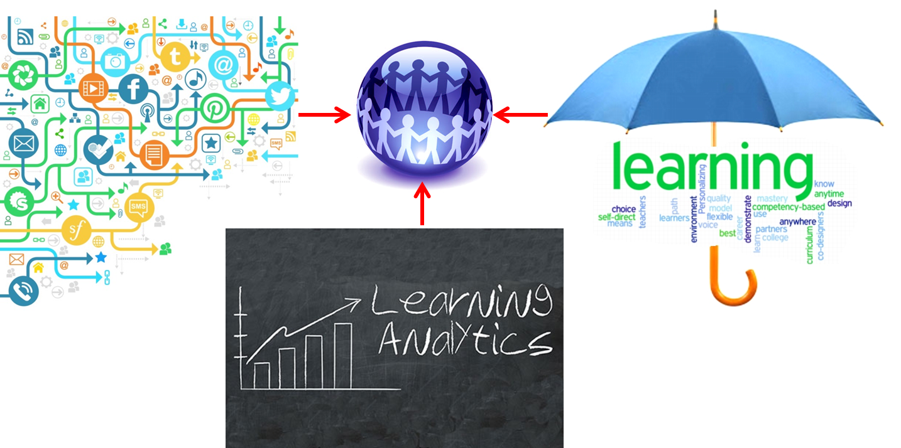
Personalization (continued)
Data + Analytics = Personalization

Slide 23
Personalization (continued 2)
Data = logon/logoff; dwell time, wayfinding, past/current achievement
Analytics = collection, analysis & reporting of data for customization, prediction & personalization
Student Centered Learning = situated, progressive, generative, self-paced & competency-based

Slide 24
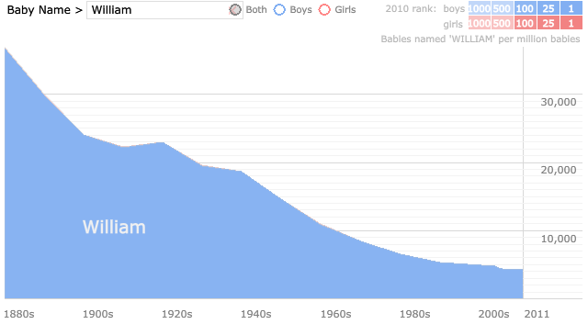
Personalization (continued 3)
Big Data + Analytics = Student Centered Learning
Baby Name Voyager http://www.babynamewizard.com/voyager#

Slide 25
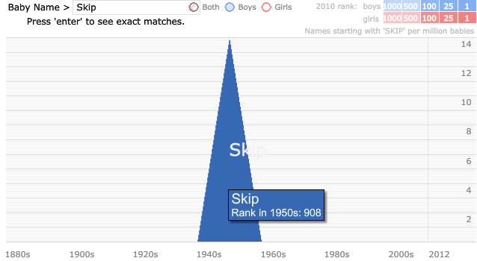
Personalization (continued 4)
Big Data + Analytics = Student Centered Learning
Baby Name Voyager http://www.babynamewizard.com/voyager#

Slide 26
Personalization (continued 5)
Big Data + Analytics = Student Centered Learning

Slide 27
Personalization (continued 6)
CMS/LMS provide real-time usage & achievement data previously unavailable
Aggregated achievement data correlated to attendance, homework completion, teacher observation, etc. can be helpful in predicting outcome patterns
Student-centered instruction aligns with competency-based models since grade level achievement markers are insufficiently granular
Lessons learned from IEP implementation can benefit student-centered models

Slide 28
Personalization: Pivot Points
Grade-based
academic achievement
Time based
Accountability
Achievement
Outcomes
Standards aligned
Competency-based academic achievement
Levels
Progressions
Mastery
Proficiency aligned

Slide 29
Personalization: Pivot Points (continued)
Assessment authenticity can be improved in a digital environment by combining:
Embedded progress Monitoring/Formative
Embedded Interim/Benchmarking
High Stakes/Summative
Real time data
Predictive analytics
Personalization
Notes:
arrow connector
Arrow connecting Embedded progress Monitoring/Formative to Real time data, predictive analytics and personalization.
Arrow connecting Embedded Interim/Benchmarking to Real time data, predictive analytics and personalization.

Slide 30
On the Horizon
Student Profiles
Knowledge gained from the PARRC & SBAC assessments re: Accessible Portable Item Profile (APIP)
Competency-based education
Student-centered; personalization, mastery-based
Growing awareness of need for national accessible learning content guidelines

Slide 31
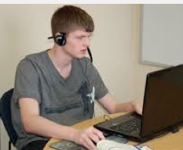
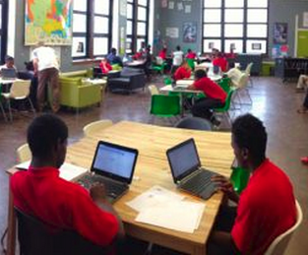
Current Research Projects
Developing effective social skills
Access and supports for reading online: ASR, Vocabulary, Graphic displays
Refine, implement, and determine the promise of a personalized blended learning environment for SWD

Slide 32
Social Skills

Slide 33
Elements of a Social Story
Goal – Help change or moderate a student’s behavior – school/home/community
Written in first person and in the present tense…Today I am going to the library with my class…
Descriptive sentences addressing the “W” (who, what, when, where, why)
Sense of perspective – what he/she should think or feel.
Action sentence stating desired behavior – I walk quietly to the library…

Slide 34
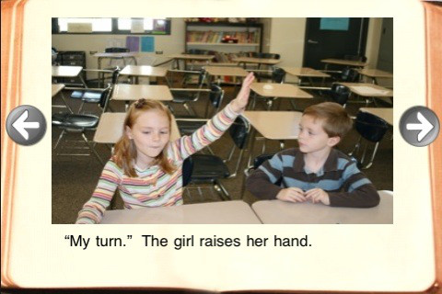
Turn Taking

Slide 35
Cardboard box

Slide 36
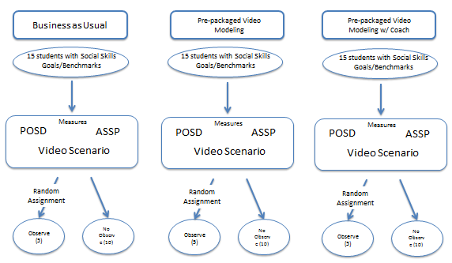
Social Skills Study Design
Random Assignment to three conditions - 45 Students with Social Skills Goals/Benchmarks
Pre-Post Measures/Observations

Slide 37
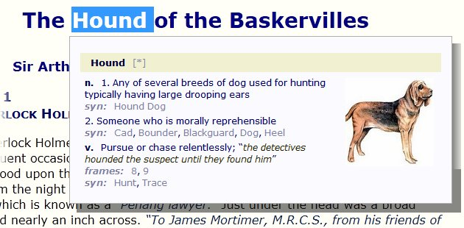
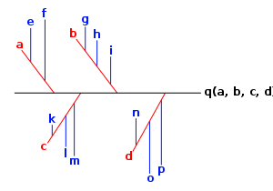
Online Reading Supports
Audio Assisted Reading
Vocabulary supports
Graphic displays

Slide 38
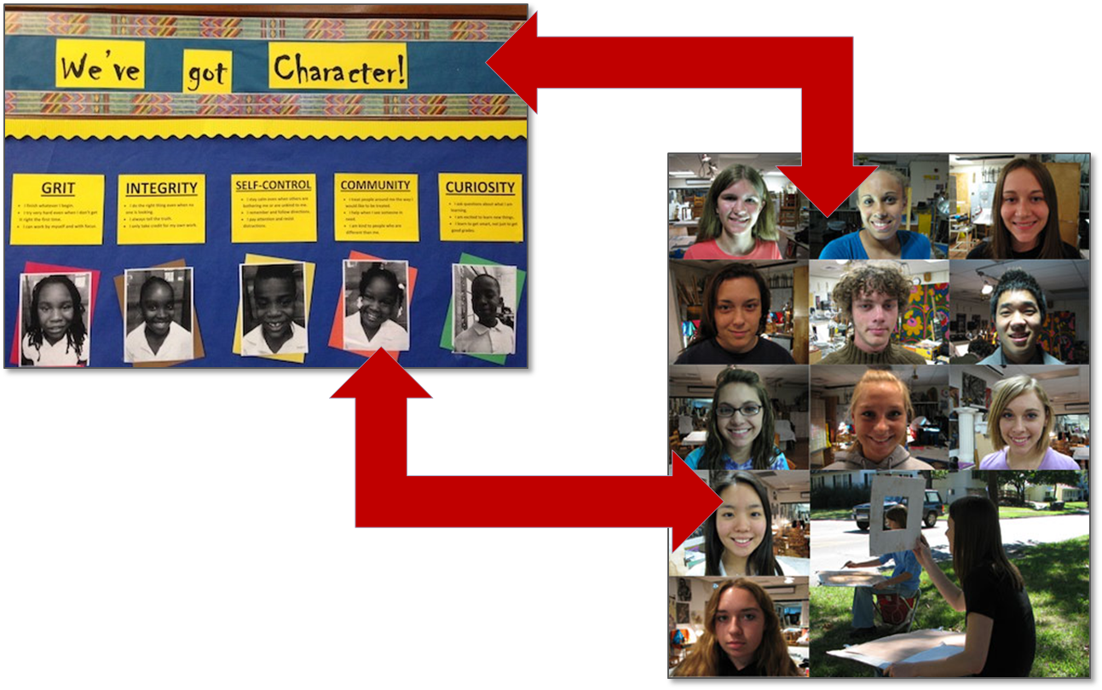
Personalization/Self-regulation

Slide 39
To reach the Center
Visit us at: centerononlinelearning.com
Contact us at: info@centerononlinelearning.org
Follow us on Twitter at: @OnlineCenter1

