Slide 1
Collaborative and Participatory Approach to Quality Preparation for Interveners: Development, Delivery and Sustainability of Training Modules
Amy T. Parker, Ed.D. & COMS
Coordinator of Professional Development and Products, National Center on Deaf-Blindness
Ritu Chopra, Ph.D.
Executive Director, The PARA Center, University of CO, Denver
Beth Kennedy, M.Ed.
Project Director, DeafBlind Central: Michigan’s Training & Resource Project

Slide 2
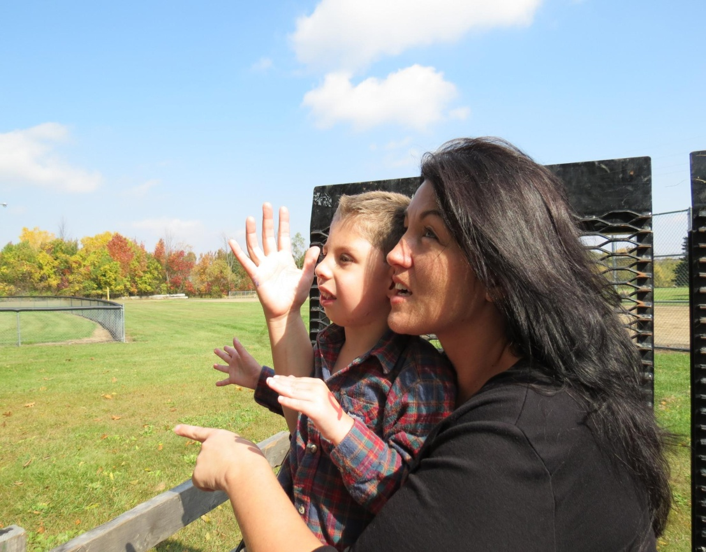
Rationale from National Consortium on Deaf-Blindness Recommendations for Improving Intervener Services
Goal 2- Training & Support
Establish a strong national foundation for intervener training and workplace supports.
Recommendation 3- Develop a national open-access training resource that aligns with the CEC's Knowledge and Skills Competencies

Slide 3
Participatory Approach to Module Development
Rooted in respect for the community's knowledge
Modules that "give voice" in creation and evaluation of the resource
A respected method in international curriculum development (Taylor, 2004; Reyes, 2011)
By design, can incorporate the perspectives and knowledge of different experts who have "walked the path"- families, teachers, interveners, faculty, administrators, consumers & researchers
A synthesis and action based model

Slide 4
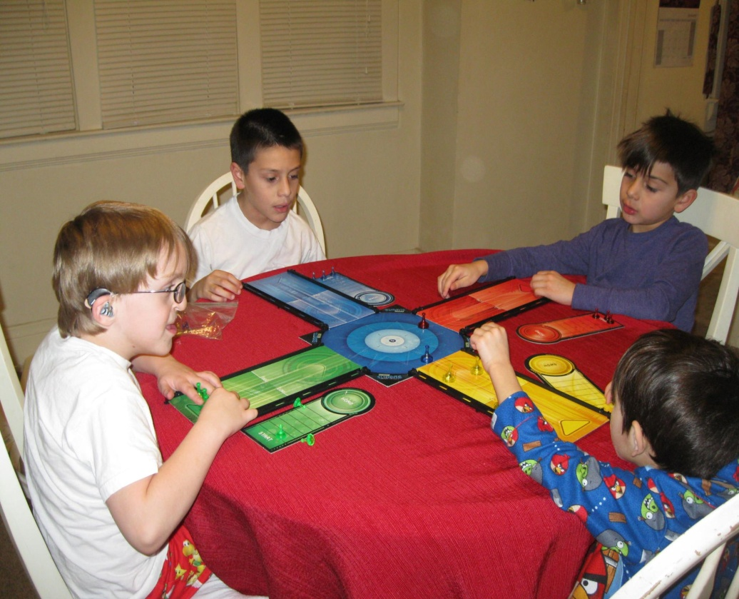
OHOA Participatory Method of Creation
Advisory Committee
Module Leads
Module Contributors
Field Participants
Field Reviewers
Expert External Advisor/Reviewers
State Adopters- Early Use of First Modules

Slide 5
External Expert Advisors' Counsel
Advisors
PAR²A Center- University of Colorado Denver
IRIS Center
Vanderbilt University
Perkins School for the Blind
input from other experts- Dr. Charity Rowland
Collective Advice
Design for adult learners
Incorporate case based teaching- practical examples
Sequence the learning path
Offer reflection opportunities
Build for "scalability"- adoption
Build for a portfolio, credits or CEU process for adult learners

Slide 6
Further planning and consultation from Chopra & Sobel, PAR²A Center
ADDIE [Analysis, Design, Development, Implementation, Evaluation]:
A model for instructional design
Analysis Phase: Who is the audience; What are the learning needs; Identification of constraints
Design/Development Phase: Analyze subject matter in depth; Identify objectives and competencies (skills, knowledge, attitudes, etc.) to be achieved: Identify a sequence to meet these objectives: Create learning scenarios for each subject objective; Identify kinds of learning materials and tools needed; Delivery considerations (platform accessibility, logistical details)
Implementation Phase: Launch training to key stakeholders, use it
Evaluation Phase: Identify methodologies to evaluate project, build measurement tools, monitor implementation, and plan for analysis to prioritize revisions/ Evaluation is ongoing throughout the entire process

Slide 7
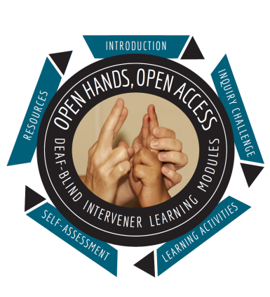
OHOA Module Learning Path
Introduction- an opener to the main module themes
Inquiry Challenge- a practical problem
Learning Activities- Content and Assignments- sequenced learning path
Self-Assessments- could serve as a rubric for grading
Resources and References
Based on expert advice- Chopra & Sobel

Slide 8

Accessibility Considerations:
Use of a Moodle 2.23 Management System
Consultation with the Carroll Center for the Blind
Consultation with DiCapta
Consultation with Described Captioned Media Program
Consultation with JKP Interpreting
Tech and Access Partnerships resulted in:
A more accessible JW Media player
Captioned and described video clips
Modules beginning to be translated into Spanish
Accessible text for all module materials

Slide 9
Let the Interveners Explain
The following sheds light on the need for these modules:
Clip of two interveners describing their work

Slide 10
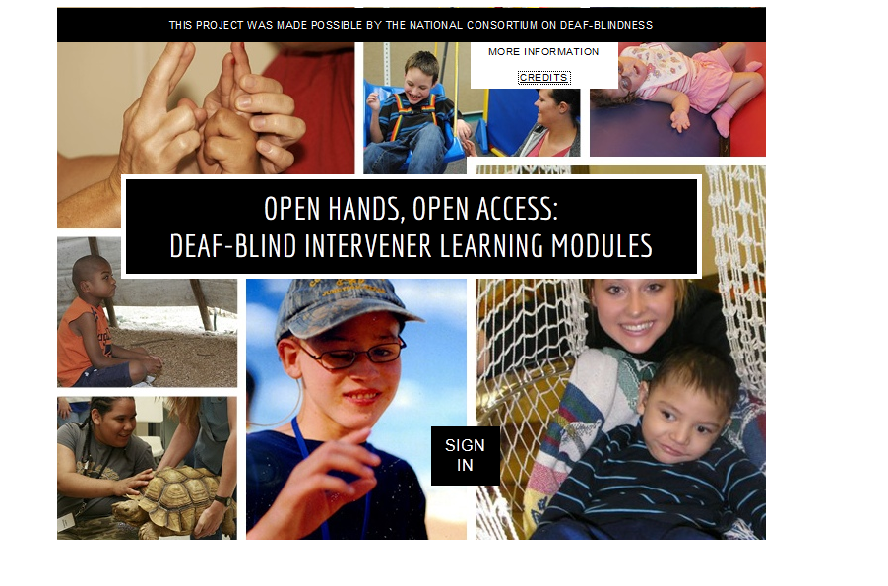
Module Homepage

Slide 11

Module 1: An Overview of Deaf-Blindness and Instructional Strategies
Summary of Learning Outcomes:
Identify important facts that can be learned from the National Child Count
Understand the importance of gathering information about a student's etiology
Recognize that deaf-blindness is a disability of access to information that results in significant challenges in interactions and learning
Describe key instructional principles and strategies that are effective
Provide examples of the array of supports and resources on deaf-blindness

Slide 12
Field Tested
February-April, 2013
1. An Overview of Deaf-Blindness and Instructional Strategies
2. The Sensory System, The Brain, and Learning
3. The Role of the Intervener in Educational Settings
4. Building Trusting Relationships and Positive Self Image
November, 2013-March, 2014
5. Availability for Learning
6. Understanding Communication Principles
7. Emergent Communication
8. Progressing from Non-Symbolic to Symbolic Communication and Complex Language

Slide 13
Field Testing
September- December, 2014
9. Routines As a Framework for Teaching
10. Concept Development and Active Learning
11. Intervener Strategies
January-March, 2015
12. Maximizing Vision and Hearing
13. Calendars
14. Orientation and Mobility Part 1
September, 2015
15. Self-Determination
16. Social Skills and Peer Relationships
17. Collaborative Teaming and Family Partnerships
18. Orientation and Mobility Part 2

Slide 14
Initial Implementation by State Partners
State Adopter | Purpose of Adoption | Approximate # of People Served
Illinois | Build awareness and knowledge | 53
Virginia | Build awareness, prerequisite to some technical assistance (TA) | 70
California with Montana and Idaho | Training teams, providing outreach, Offering course credit | 12
Washington | Providing distance TA and outreach | 27
Georgia | Raising awareness and supporting program development | 15+
New York and Vermont | Training teams and providing TA | 22+

Slide 15
Discussion Questions
Take a moment to review the data from the field test and early adopters (see handout).
Discuss participatory approaches for working with stakeholders as a way to address the need for standards based materials.
Discuss the use of traditional preparation approaches as one form of sustainable partnership with states and the role of professional development models with teams. How does each support quality?
How may we use such collaboratively produced online materials within diverse local systems to create sustainable approaches to preparing interveners?

