Slide 1
Closing the Research-to-Practice Gap through Teacher Preparation
Marcy Stein, University of Washington Tacoma
Diane Kinder, University of Washington Tacoma
Bill Rasplica, Franklin Pierce Schools

Slide 2
Overview
Introduction – Project Overview
Coursework
Fieldwork in Partner Schools
Benefits & challenges for university/school partnerships
Barriers to accurate evaluation of teacher preparation programs

Slide 3
Project Overview
325T Grant: Project RTI
Purpose:
This project will review and redesign the existing dual-track teacher certification program at the University of Washington, Tacoma to better prepare, retain, and support highly-qualified special education teachers who will receive dual licensure in general and special education.

Slide 4
Project RTI Objectives
Objective 1: Restructure coursework so that all course content is evidence-based and aligns with NCLB, IDEIA, CEC and WA state requirements.
Objective 2: Restructure fieldwork to establish a residency program with a [side by side] coaching component to be implemented during the candidate’s initial year of the dual track program.
Objective 3: Develop an on-the-job induction program with a mentoring component to be implemented during the candidate’s initial year of teaching [and second year of graduate school].

Slide 5
Project RTI Objectives
Objective 4: Design and/or improve technically sound formative and summative evaluations of applicants, teacher candidates, and graduates, including candidate’s implementation of technically sound evaluation of K-8 student performance.
Objective 5: Develop collaborative partnerships with The Goodlad Institute for Educational Renewal, other national centers (IRIS), state agencies (OSPI and PSESD), and local school districts including Chief Leschi School.

Slide 6
Teacher Preparation for Closing the Research-to-Practice Gap: Coursework
Initial Changes During Planning Year
Course sequence
Coordination with EdTPA

Slide 7
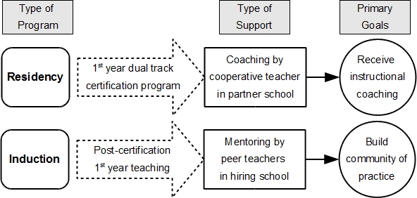
Teacher Preparation for Closing the Research-to-Practice Gap: Fieldwork

Slide 8
Partner Schools
Selection procedure
Personnel
Organization

Slide 9
Partner School Demographics High Needs and High Achievement
 | 2011-12 | 2012-13 | 2013-14 | WA Average 2013-14
Average percent of children receiving FRPM | 65 % (30-91%) | 79% (61-91%) | 74% (58-88%) | 46%
Ethnic diversity: Non-White | 52% | 67% | 59% | 41%
Schools of Distinction | 2011 Central Avenue | 2012 Central Avenue, Gildo Rey, Pioneer | 2013 Gildo Rey, Liberty Ridge
Washington Achievement Awards |  |  | 2014 Central Avenue, Gildo Rey, Christensen

Slide 10
Franklin Pierce Schools
7,600 students
8 elementary schools
2 middle schools
2 high schools
Alternative programs
72% Receive Free and Reduced Lunch
2 schools with over 90%
30 Languages
30% Mobility Rate
12.2% Receive Special Education Services
NO Priority, Focus or Emerging Schools

Slide 11
Franklin Pierce Schools…
School | Achievement
Brookdale Elementary | High Progress in Math
Central Ave. Elementary | English Language Acquisition 4 Time School of Distinction
Christensen Elementary | Reading and Math Growth English Language Acquisition
Elmhurst Elementary | English Language Acquisition
James Sales Elementary | School of Distinction
Harvard Elementary | School of Distinction
Franklin Pierce High School | High Progress

Slide 12
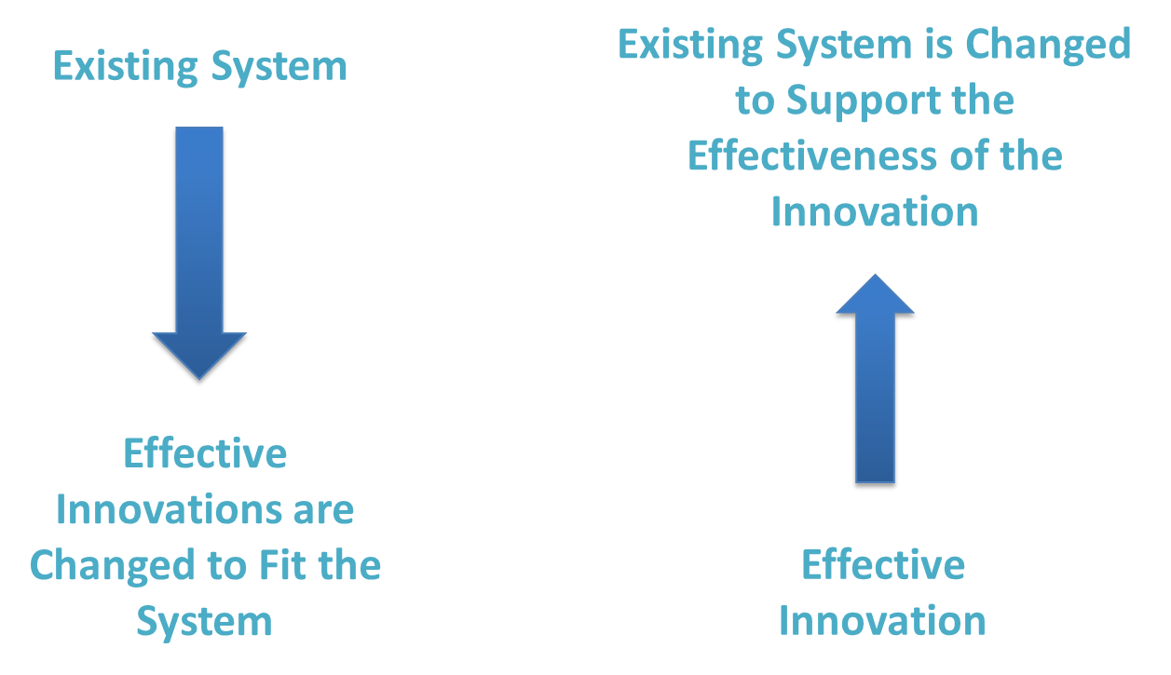
Moving the Indicators
Fixsen et al. 2005

Slide 13
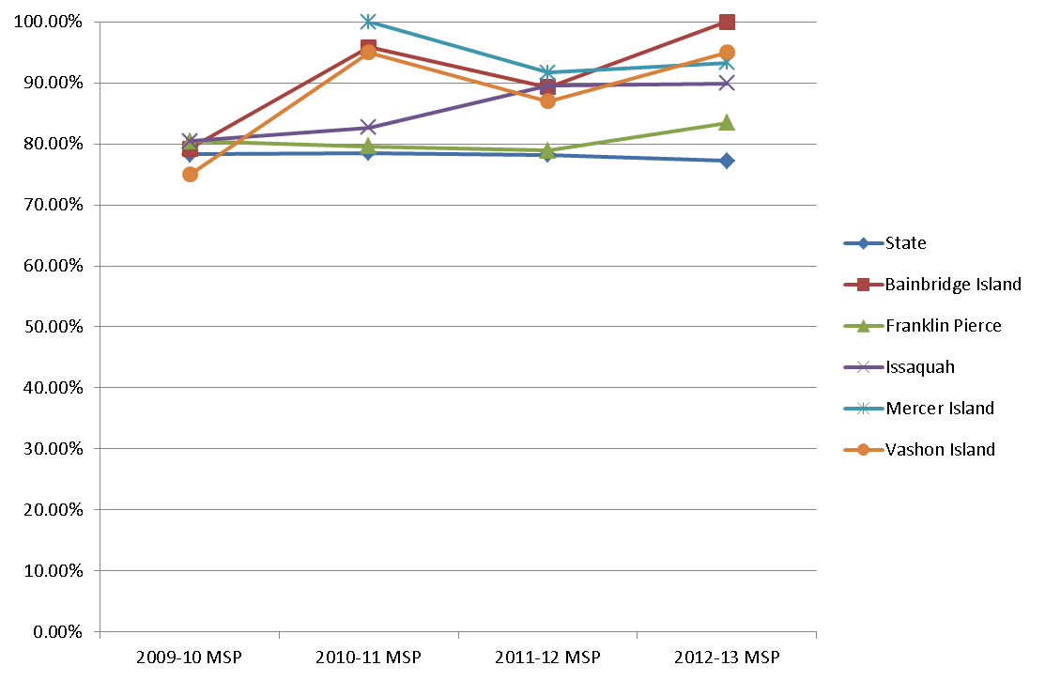
Percent of 4th Graders in Special Education Meeting Reading Standard – 2009-2013

Slide 14
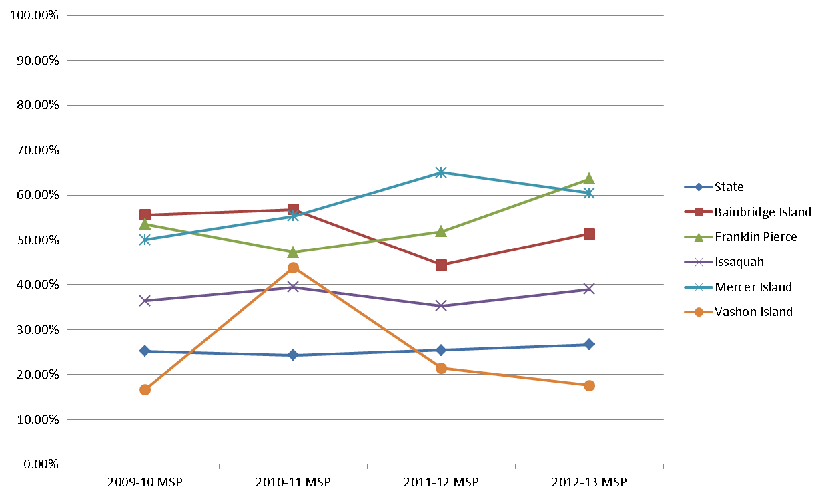
Percent of 4th Graders in Special Education Meeting Math Standard – 2009-2013

Slide 15
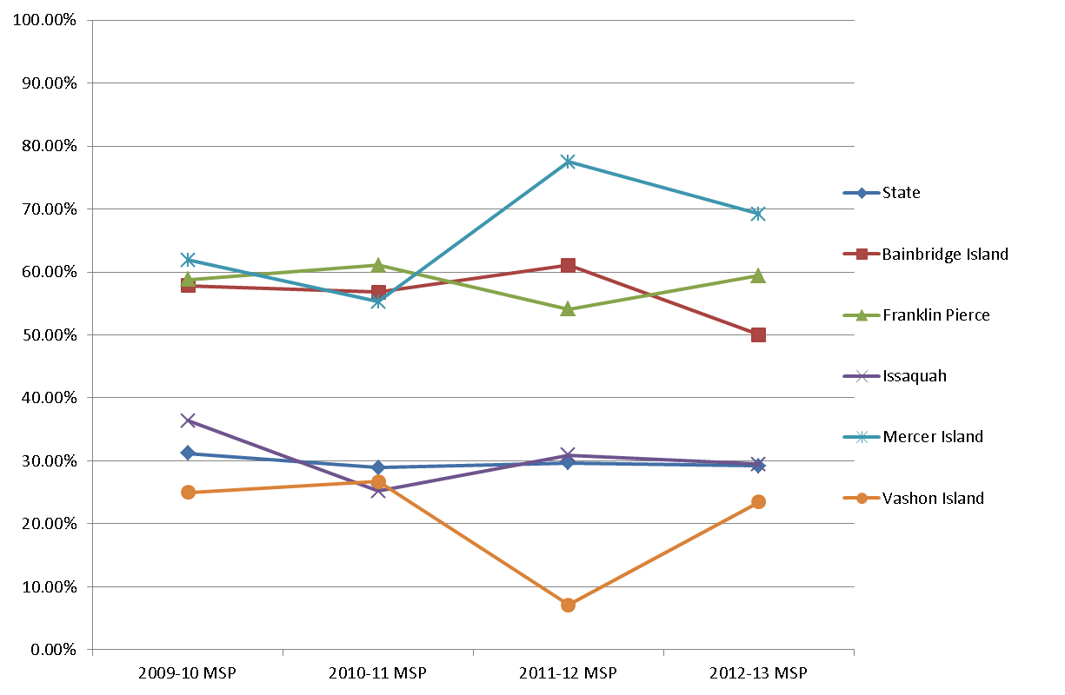
Percent of 4th Graders in Special Education Meeting Writing Standard – 2009-2013

Slide 16
Benefits and Challenges of University/School Partnerships
Benefits to University
Coherence Coherence Coherence
Collaboration on coursework changes
Useful leverage from the community
Collaboration in hiring expert university instructional coaches

Slide 17
Benefits and Challenges of University/School Partnerships (continued)
Benefits to School District
Coherence Coherence Coherence
Support from university professors for implementation of RTI
Keithley math example
Shared professional development opportunities
Randy Sprick, Mark Shinn, Daniel Willingham
Hiring Advantage

Slide 18
Hiring Data
 | 2012 Cohort | 2012 Cohort | 2013 Cohort | 2013 Cohort | 2014 Cohort
 | No. | Percent | No. | Percent
In Partner Districts (percent of those teaching in the area) | 13 of 33 | 39% | 9 of 19 | 47% | 7 of 10 (70%) of currently hired
High Poverty Schools (76-100 % FRPL) | 6 | 19% | 6 | 32%
Moderate Poverty Schools (51-75 % FRPL) | 20 | 65% | 9 | 47%
Average Income (40-50% FRPL, WA average = 46%) | 2 | 6% | 2 | 10%
Above Average Income (less than 40% FRPL) | 3 | 10% | 2 | 10%

Slide 19
Benefits and Challenges of University/School Partnerships (continued 2)
Challenges Inherent in Partnerships
Communication
Inappropriate use of teacher candidates (as paras)
Coordination and balance among:
General and special education placements
Full-time student teaching in spring and testing
Both K-8 spring testing and EdTPA
Sustainability

Slide 20
Barriers to Accurate Evaluation of Teacher Preparation Programs
Time constraints
Access to K-8 student data and comparison data
First grade DIBELS data
Coordination between preparation and the EdTPA

Slide 21
Current Evaluations
Principal Satisfaction with Partnership
Employer Satisfaction with Partnership
Teacher Candidates Satisfaction
Both year 1 and year 2
EdTPA

Slide 22
Principals’ Evaluation of Partnership Satisfaction
From 1-5: 1=“Did not achieve”; 3=“Satisfactory”; 5=“Completely achieved” | Mean
Interns received a realistic experience of teaching | 5.0
Interns had opportunities to experience and to apply research to practice | 5.0
Partnership has become a model program for teacher preparation | 4.2
Interns had a stronger experience compared to interns of other programs | 4.6
Partnership has produced well-prepared teachers | 4.6

Slide 23
Principals’ Evaluation of Partnership Satisfaction (continued)
From 1-5: 1=“Did not achieve”; 3=“Satisfactory”; 5=“Completely achieved” | Mean
Communication between our school and UWT was effective | 4.8
School refined or developed implementation of RtI | 4.4
Students were helped by having additional support from UWT interns | 5.0
Partnership has provided increased professional growth opportunities for our current teachers | 4.0
Able to access an increased pool of well-prepared teacher candidates | 4.4
What percentage of UWT interns would you be enthusiastic about hiring if you had an opening? | 53% (range 25-75)

Slide 25
From Our Responsibility, Our Promise: High quality [teacher] preparation programs have several characteristics that make a difference in the candidates that they produce for the teaching profession. They are designed such that school districts have a significant role . . .These partnerships are critical to the success of preparation programs, and preparation programs should be held accountable for how well they address the needs of schools and help improve PK-12 student achievement and growth. (2012, Our Responsibility, Our Promise: Transforming Educator Preparation and Entry into the Profession: A Report by the CCSSO, p. 10 [formatting ours])

Slide 26
Among the Recommendations for Educator Preparation Programs
Clinical practice in all licensure area programs should begin early and include
i. Clear and rigorous clinical training expectations that build the link between
theory and practice. (See Note 2 at the end of this report.)
ii. More school-based models of preparation, such as residency models; school- university professional development school partnerships for teachers, especially in high-need communities; and residency components for principals.
iii. Collaboration with school-based partners regarding the criteria for selection of school sites, effective clinical personnel, and site-based supervising
personnel. These partnerships create stronger programs and learner- andschool- ready candidates.
iv. Selection of trained school-based clinical faculty who are knowledgeable and supportive of the academic content standards for students. School-based
clinical faculty should be trained in supervision, oriented to the supervisory
role, and evaluated and recognized as effective teachers.

Slide 27
Discussion Question
At the request of OSEP, the primary discussion question for this session is:
“…how to do professional development schools with effective university/school partnerships.”

