Slide 1
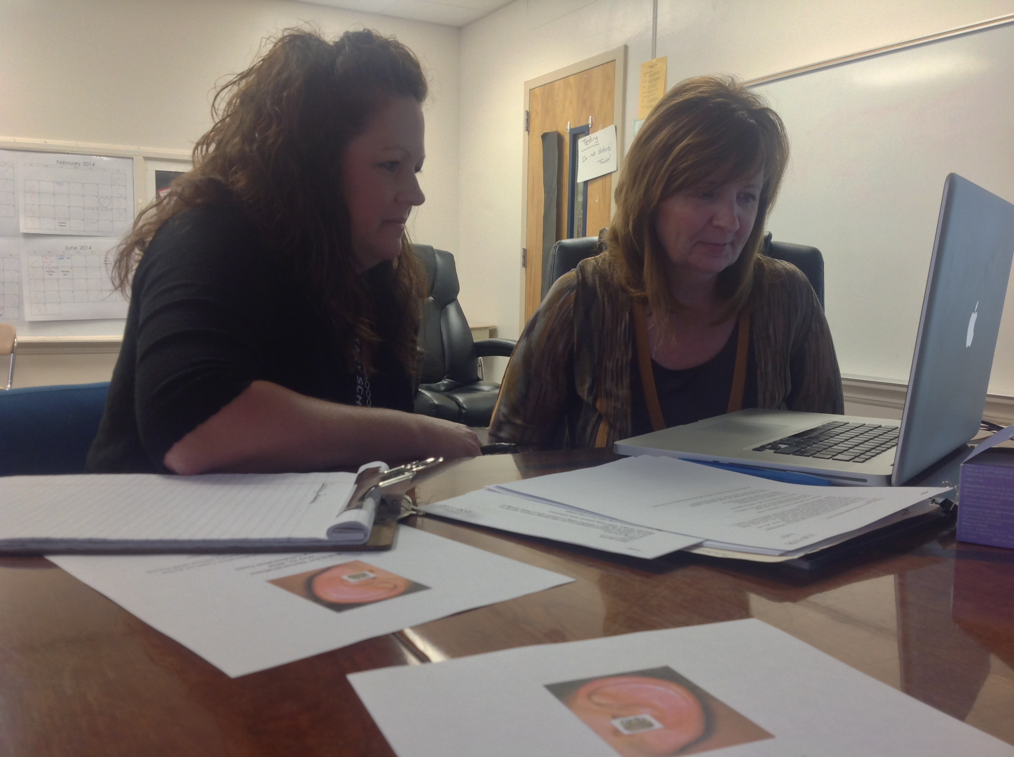
Quad-level Engagement: Leveraging Partnerships That Support Change in School and Statewide Professional Development Practices

Slide 2
Advance Organizer
Essential Question 1
Essential Question 2
Essential Question 3

Slide 3
In this session…
Presenters describe the North Carolina State Improvement Project Coaching Collaborative –an innovative partnership between a university discretionary leadership development project, schools, districts, and SEA staff.
Representatives from each system tell about working collaboratively to implement technology enabled coaching initiatives and support school and statewide professional development efforts.

Slide 4
Rationale
Cultivating effective teachers requires job embedded professional development –including coaching. Joyce and Showers (2002) found traditional techniques (e.g., demonstrations) had an effect size (ES) of 0.0 on transfer of training. When coaching was added the ES increased to 1.42.
More recently, Rock et al. (2014) reported longer-term benefits of technology enabled coaching, such as teachers’ continued use of evidence-based practices and increased student engagement.
Drawing on tenants of Fullan’s (2006) tri-level engagement, our quad-level variation includes alignment on four levels (i.e., schools, districts, states, and universities) to foster “permeable connectivity”, create change in professional development practices, and improve student outcomes.

Slide 5
Essential Question 1
How are university, local school districts, and State personnel working together in your State to implement technology enabled coaching that supports school and statewide professional development efforts?

Slide 6
SEA Perspective
Formed partnership with UNC-G expert in field
Developed process to identify LEAs with strong implementation drivers
Targeted best practice sites for usability testing
Exposed all LEAs to resources, frameworks, technology options, but promoted autonomy
Notes:
Heard SPDG webinar where Dr. Rock presented her research and kept her in mind, connected to form partnership
Leadership, Organization and Competency
Engaged these four in intense professional development accompanied by funding, (and all other LEAs in online modules & network meeting, technology resource sharin)g with planned rollout and expansion based on what was learned this from these four this first year
Meeting LEAs “where they are” with their implementation of coaching, providing support and information through the NC SIP website

Slide 7
LEA Perspective – District Level
K-12 Initiative
General Education
Special Education
Elementary, Middle, & High Schools
Training all coaches
Curriculum Technology Coordinators (K-5)
One per school
Curriculum Coordinators (6-12)
One per middle/high zone

Slide 8
LEA Perspective – Building Level
Operationalizing “Coaching”
Modeling in CCS
Shift from former CC/CTC role
CMS School Improvement Plan
Literacy Interventions
Classroom Management

Slide 9
IHE Perspective
Created collaborative partnerships at multiple levels to proactively build capacity in technology enabled coaching to support adoption and ongoing use of evidence-based and best practice
Used federally funded grant goals and resources to establish and maintain partnerships
Notes:
Collaborative partnerships at multiple levels = Fullan’s change knowledge (i.e., tri level engagement). Tri-level reform or engagement requires thinking beyond changing individual schools or entities.
Tri level reform or engagement requires two components:
Focus on internal development, while simultaneously:
Seek connections with other levels
We expanded Fullan’s tri level notion of reform, which focused on State, District, & School/Community to include IHEs.
The goal of tri or quad level engagement is to create more than alignment across and between levels, Rather it is to achieve permeable connectivity – i.e., greater interaction, communication, and influence across and between the levels. In terms of change, the drivers are not only top down, but also bottom up.
Fullan defined capacity as new knowledge, skill, and ability.

Slide 10
Essential Question 2
How can NC’s Coaching Collaborative model, featuring quad-level engagement, help others implement technology enabled coaching that supports school and statewide professional development efforts in systematic and sustainable ways?

Slide 11
SEA Perspective (continued)
Built on foundations of Evidence Based Practices
Met the LEAs ‘where they were’ in their development of coaching installation
Based decisions for plans on data collected
Used ‘lessons learned’ to move forward with additional best practice sites
Notes:
NOTE: MAY WANT TO INCLUDE THE SLIDE OF CONCENTRIC CIRCLES THAT DEPICTS THE PROCES WE ENGAGED IN TO DETERMINE SITES WHO PARTICIPATED IN THE COACHING COLLABORATIVE.
As a gateway for participation, we were guided by demonstrated strength in the implementation drivers, hospitable environments for the work utilizing the data gathered during the LEAs annual developmental review
Assigned SEA regional consultants to facilitate and engage with LEAs in the process of developing their plans for installing coaching
LEA teams determined the direction and focus based on a variety of data sources – surveys, teacher needs, etc.

Slide 12
LEA Perspective – District Level (continued)
Professional Development
Local
State
University
Formalized, Systematic Process
Supported by DPI and University
LEA Autonomy
“CCS Coaching Model”

Slide 13
LEA Perspective – Building Level (continued)
Focused
Reading Foundations
Teachers at Multiple Ability Levels
Formalized
Process
Paperwork

Slide 14
IHE Perspective (continued)
Listened and review a decade’s worth of previous change efforts
Relied on NIRN model as a guide
Adopted a top down and bottom up strategic plan
Generated and co-constructed technology enabled and traditional resources to build coaching capacity

Slide 15
Essential Question 3
What tools (e.g., National Implementation Research Network [NIRN]) and tactics have you used among partners to ensure systematic and sustainable implementation of technology enabled coaching that supports school and statewide professional development efforts? How have you measured effectiveness? What are ideas for collecting outcome data across partners, projects, and states?

Slide 16
SEA Perspective (continued 2)
Used the annual developmental review
Assessed strengths demonstrated in the integrated and compensatory implementation drivers (leadership, competency, organization)
Created logic models for both Evidence Based Practice focus areas
Notes:
NOTE: SHARE LOGIC MODEL FOR BOTH READING AND MATH
Developed process to ascertain capacity for the work and how to measure the outcomes

Slide 17
LEA Perspective – District & Building Level
Systematic, Collaborative Approach
CCS Coaching Program Logic Model (plan & evaluate)
CCS Coaching Manual (explicit purpose & process)
Getting “real” with technology
Swivl
Bluetooth
Virtual Communication

Slide 18
IHE Perspective (continued 2)
Aimed for flexibility within structure
Guided by Project LINK-2-LEAD logic model as well as the interface with LEA and SEA logic models (e.g., shared goals, outcomes, evaluation tactics)
Engaging in ongoing discussion and collaboration with partners regarding measurement and evaluating efffectiveness

Slide 19
Concluding Thoughts
Streamline and Focus
Possibility Mindset vs. Barrier Mindset
Plan Systematically & Put Faith in Change/Research Literature
Synthesize Professional Development
Embrace Autonomy
Make use of existing resources and seek new sources/partnerships to build capacity

Slide 20
Contact Information
Marcia L. Rock, Ph.D. (mlrock@uncg.edu)
Paula Crawford, Ed.D. (Paula.Crawford@dpi.nc.gov)
Dr. Amy Jones (asjones@clevelandcountyschools.edu)
Morgan Blanton (mblanton@clevelandcountyschools.org)

