Slide 1
The Federal Investment in Personnel Preparation for Special Educators: Exploring Our Past, Present and Future
Katharine Shepherd, University of Vermont
Jane West, consultant to TED, HECSE, AACTE
Suzanne Robinson, University of Kansas

Slide 2
Objectives
Participants will:
1. Gain an understanding of the history and impact of the federal investment in personnel preparation for special education teachers and leaders.
2. Discuss key issues related to the past, present and future of the federal investment, including:
The continued need for the federal investment
Strategies for communicating information around the need to support funding for personnel preparation
Key funding areas and strategies for the future

Slide 3
Overview of Federal Investment Document
Collaborative effort by the Personnel Improvement Center of NASDSE, CEC, TED, HECSE
Traces the history of OSEP’s Discretionary/Competitive Grants Program in Personnel Preparation;
Provides descriptions of model programs and national centers;
Outlines the impact of the personnel preparation programs on school and institutional capacity; and
Makes recommendations for the future of this critical federal investment.

Slide 4
The Federal Investment: 4 Major Areas of Impact
1) Improving the number and quality of special education teachers and leaders prepared through the personnel preparation programs;
2) Enhancing the organizational capacity of schools and institutions of higher education throughout the country;
3) Ensuring high quality of the research being conducted and disseminated by faculty and graduates of these programs; and
4) Improving the lives of children and youth with disabilities and their families.

Slide 5
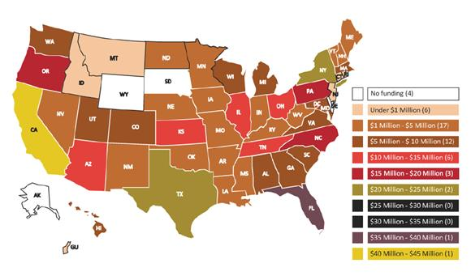
IDEA Personnel Preparation Program: Recent Investments 2008-2012

Slide 6
Distribution of Federal Investment by State (2008-2012)
No Funding | $1-$5 million | $5-$10 million | $10-$15 million
Alaska | Arkansas | Alabama | Arizona
Delaware | Hawaii | Colorado | Illinois
South Dakota | Indiana | District of Columbia | Kansas
Wyoming | Iowa | Georgia | Ohio
 | Kentucky | Maryland | Tennessee
 | Louisiana | Massachusetts
< $1 million | Maine | Michigan | $15-$20 million
Connecticut | Minnesota | South Carolina | North Carolina
Guam | Mississippi | Utah | Oregon
Idaho | Missouri | Virginia | Pennsylvania
Montana | Nebraska | Washington
New Jersey | Nevada | Wisconsin | $20-$25 million
Rhode Island | New Hampshire |  | New York
 | New Mexico |  | Texas
 | North Dakota |  | $35-$40 million
 | Oklahoma |  | Florida
 | Vermont |  | $40-$45 million
 | West Virginia |  | California

Slide 7
Impact of the Investment
Improving the number and quality of special education teachers and leaders prepared through the personnel preparation programs

Slide 8
Impact…
Enhancing the organizational capacity of schools and institutions of higher education throughout the country

Slide 9
Impact… (continued)
3. Ensuring that high quality research is being conducted and disseminated by faculty and graduates of these programs

Slide 10
Impact… (continued 2)
4. Improving the lives of children and youth with disabilities and their families who benefit from services provided by high quality teachers and leaders

Slide 11
Discussion
1. Along with these perceived positive outcomes, there is a perception that a continuation of the federal government’s investment is still an area of need.
What factors may be contributing to the need for continuation of the federal investment?

Slide 12
Discussion (continued)
2. How can the viewpoints of various constituencies (e.g., families, special education teachers and leaders, faculty in higher education institutions, etc.) inform conversations among decision makers around the future of the federal investment in personnel preparation?

Slide 13
Discussion (continued 2)
3. The evolution of the federal investment suggests priorities for funding have shifted over time.
What key areas should be considered in future federal investments? What are the challenges associated with ensuring adequate funding for Part D of IDEA?

Slide 14
Thank You!
For more information, please see the Federal Investment document:
Burke, P.J., Kleinhammer-Tramill, J., Robinson, S., Rock, M., Rude, H., Shepherd, K., Smith, D., Gillespie, P., Muller, E., and Reder, N. (2013). The federal investment in personnel preparation for special educators. Alexandria, VA: NASDSE, Personnel Improvement Center.
To download this document, click here:
http://www.nasdse.org/publications-t577/the-federal-investment-in-personnel-preparation-fo.aspx

