Slide 1
Young Offender Perspectives: What’s on their minds about a Successful Re-Entry

Slide 2
Taking Responsibility
“To keep me out of trouble? It’s not really their responsibility, it’s mine…Myself. Just doing what I gotta do like follow through with my goals, not get side-tracked with all the stuff that can bring me down. I know it’s going to be really hard.”
Unruh, et. al., 2009

Slide 3
Employment
“I know I need a job and I struggle to find one but I can’t keep it. It's hard; so there ain't no motivation there.”
Unruh, et. al., 2009

Slide 4
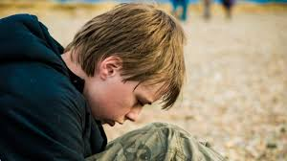
Pro-Social Activities
“[My] job keeps me
busy. A lot of us if we
really get bored, we
just don’t have nothing
to do, we look for
negative things to do. So anything, work,
extracurricular –going to the gym, lifting
weights, to keep our minds on positive stuff.”

Slide 5
Family
“ [You need family] to give you the love and the attention that you need along with opportunities and the security, ya know? I think if I would have had that, then I would have changed a long time ago and I wouldn't have had to go through all that."
Unruh, et. al., 2009

Slide 6
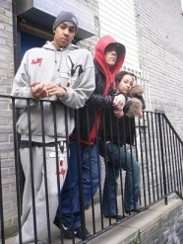
Independent Living
“[I will need help] making my own food and like just going outside, being in public, job applications . . . just simple things. They’re going to be hard . . . like even doing my own clothes, it’s going to be hard ‘cause I haven’t done it in a long time.”

Slide 7
Independent Living (continued)
"Yeah I want to go somewhere where I can learn how to live man. I'm not going to learn how to live here, I'm going to learn how to be institutionalized.”
Unruh, et. al., 2009

Slide 8
Community
"If you put me personally right back into the same community that I was in, I probably wouldn't stay there. I'd leave probably because people…involved in gangs and drugs and things, they're going to have fear going right back into that community 'cause they're going to have fear of running into problems especially if they want to get help. And when I move [back], what if somebody see me and try to shoot me or something.’”
Unruh, et. al., 2009

Slide 9
Family (2)
I’ll need support from my family [when I get out]– for them to be stable enough so I don’t have to worry about other things like taking care of where I’m going to sleep, where I’m going to eat that night; just so I know that things are set and I won’t have to worry about those things.

