Slide 1
Making A Map: Finding My Way Back (MAP)
Partners with the University of Minnesota are:
Ramsey County Community Corrections, Volunteers of America; St. Paul Public Schools, Twin Cities metropolitan area postsecondary programs, and the Minnesota Department of Employment and Economic Development (DEED)

Slide 2
A Three State Collaboration on Community Re-entry of Juvenile Offenders with Disabilities
University of Minnesota, David Johnson
Arizona State University: Sarup Mathur
University of Oregon: Deann Unruth

Slide 3
Major Objectives
Develop reintegration planning
Implement Check & Connect;
Implement a personalized approach and strategies to support youth’s development of specific goals;
Conduct a comprehensive; and
Create a sustainable model through extensive interagency collaboration

Slide 4
The Reintegration Strategic Planning Toolkit
Developed by ICI and the Minnesota Department of Education (MDE) in 2006
Structure was based a prototype developed by ICI & the National Alliance for Secondary Education and Transition (NASET)
NASET Transition Toolkit for Systems Improvement.

Slide 5
Reintegration Toolkit provides: a technically-sound process with specific tools that support:
interagency team development;
individual and team needs assessment;
consensus-building and priority-setting;
data and resource mapping;
development of action plans focused on 4 needed improvements in system and youth outcomes; and
6) a continuous, outcome-oriented evaluation to monitor progress toward results and to guide decision-making.

Slide 6
Check & Connect
C&C consists of 4 key components:
A mentor who works with students & families for a minimum of 2 years;
Regular checks, utilizing data schools already collect on students’ school adjustment, behavior, & educational progress;
Timely interventions, driven by data, to reestablish & maintain the student’s connection to school & learning and to enhance the student’s social & academic competencies; and
Engagement with families.

Slide 7
Transition Skill Development
Using the Expanding the Circle curriculum with four structured components:
Exploration of “self” interests, aptitudes, and values;
Development of non-academic skills(e.g.: decision-making, self-advocacy, problem-solving, diversity awareness, goal setting, organization, and communication);
Exploration of postsecondary and career
Options;
Development of a personal profile for the future.

Slide 8
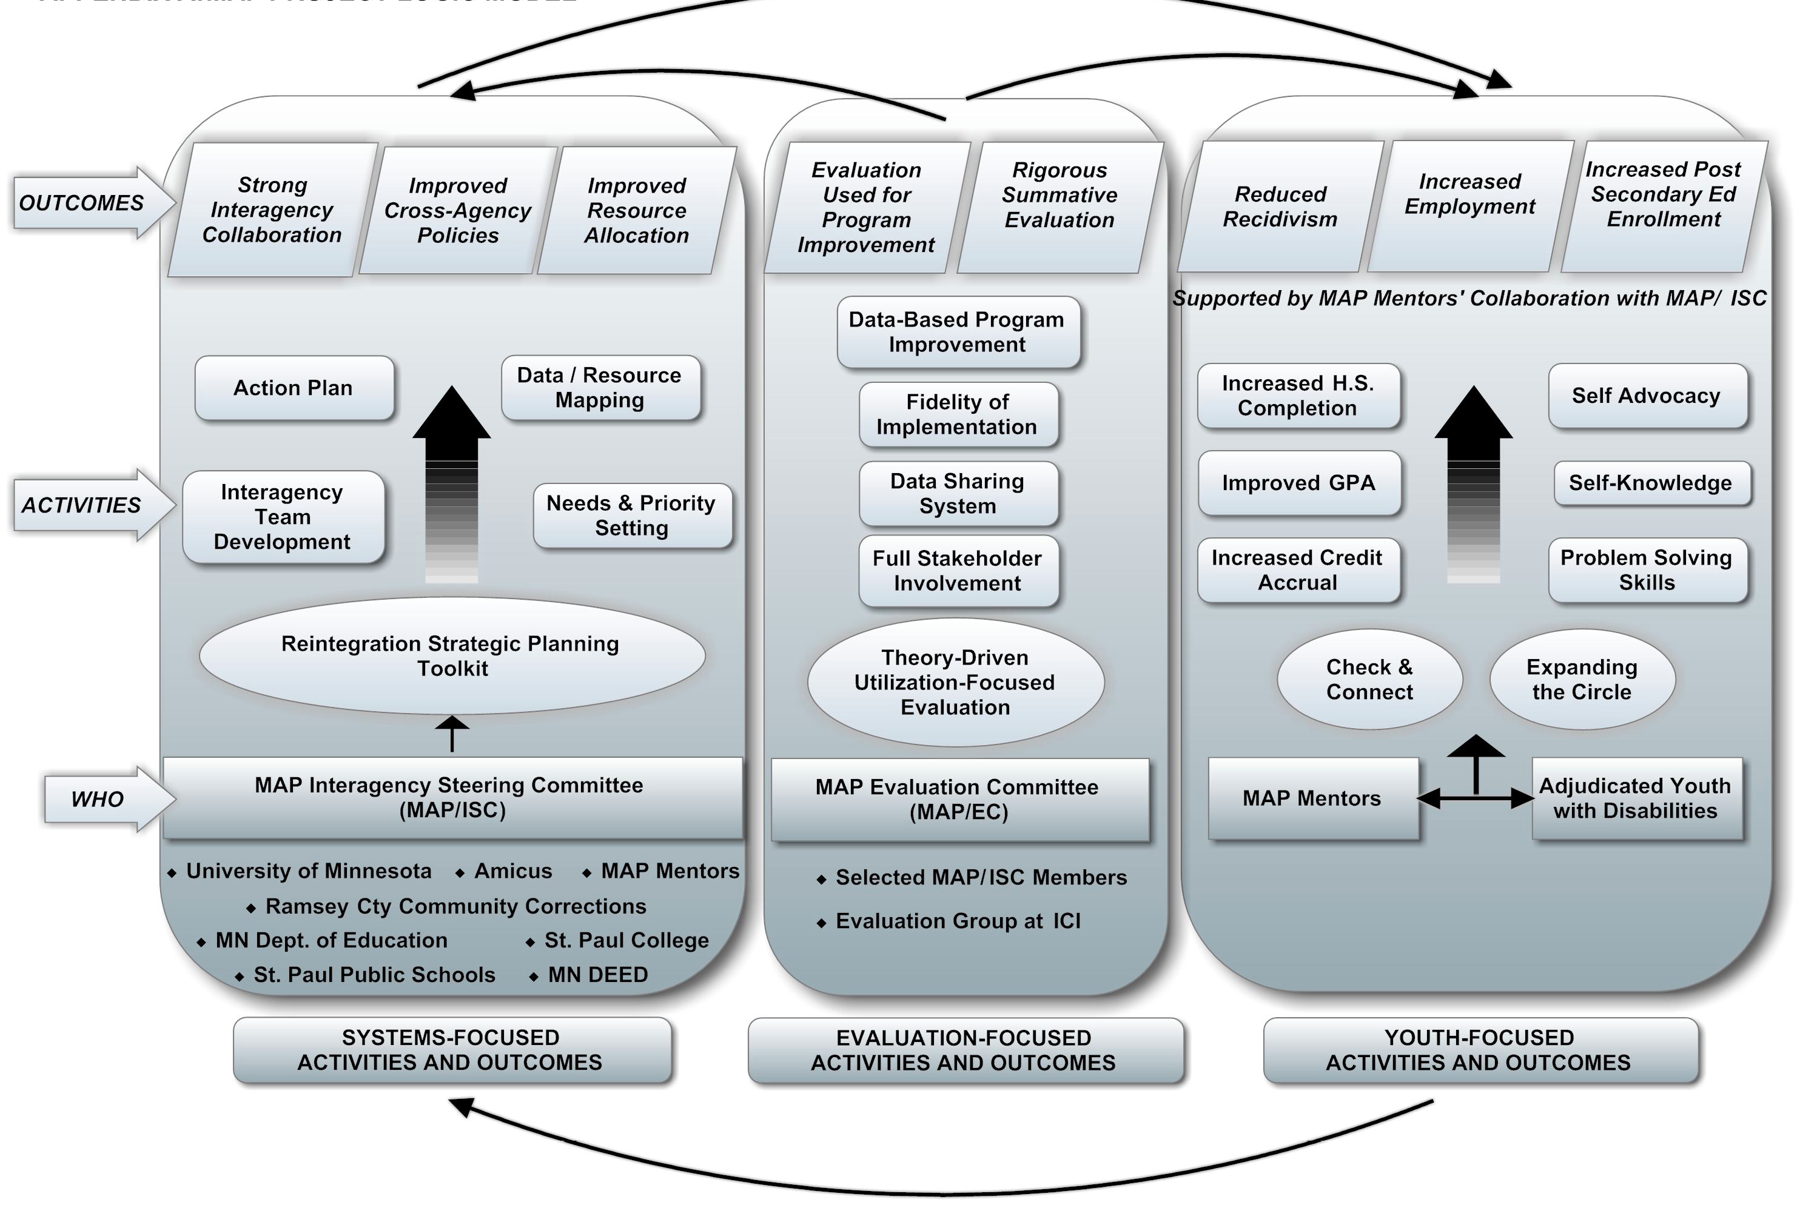
Logic Model for the MAP Project

Slide 9
So, How Are We Doing So Far?

Slide 10
Strategies Teaching Adolescent Young Offenders to Use Transition Skills:
Project STAY OUT
Deanne Unruh, Ph.D.
Miriam Waintrup, M.Ed.
University of Oregon

Slide 11
Project Purpose
Build community capacity to serve young offenders with disabilities by providing training and professional development to 3 school districts and communities - Woodburn, Helensview (Portland), and Eugene
Develop curriculum and training materials to support transition-related special educators in a young offender’s reentry into their home schools, employment, and community living.
Embed evidenced based practices-Motivational Interviewing and Cognitive Behavioral Therapy-into the young offender community reentry training structure

Slide 12
Strategies Teaching Adolescent Young Offenders to Use Transition Skills
Multi Agency Collaboration within each community:
  School District
  Oregon Youth Authority/County Detention Services
  Oregon Vocational Rehabilitation Services (OVRS)
  Workforce Investment Board
  Addiction & Mental Health Services (DHS division)
Provision of facility-to-community transition services for incarcerated youth with disabilities (SPED or mental health disorder)
Key staff person: Transition Specialist or special education case worker
Works closely with POs, OVRS counselors, and other community agencies

Slide 13
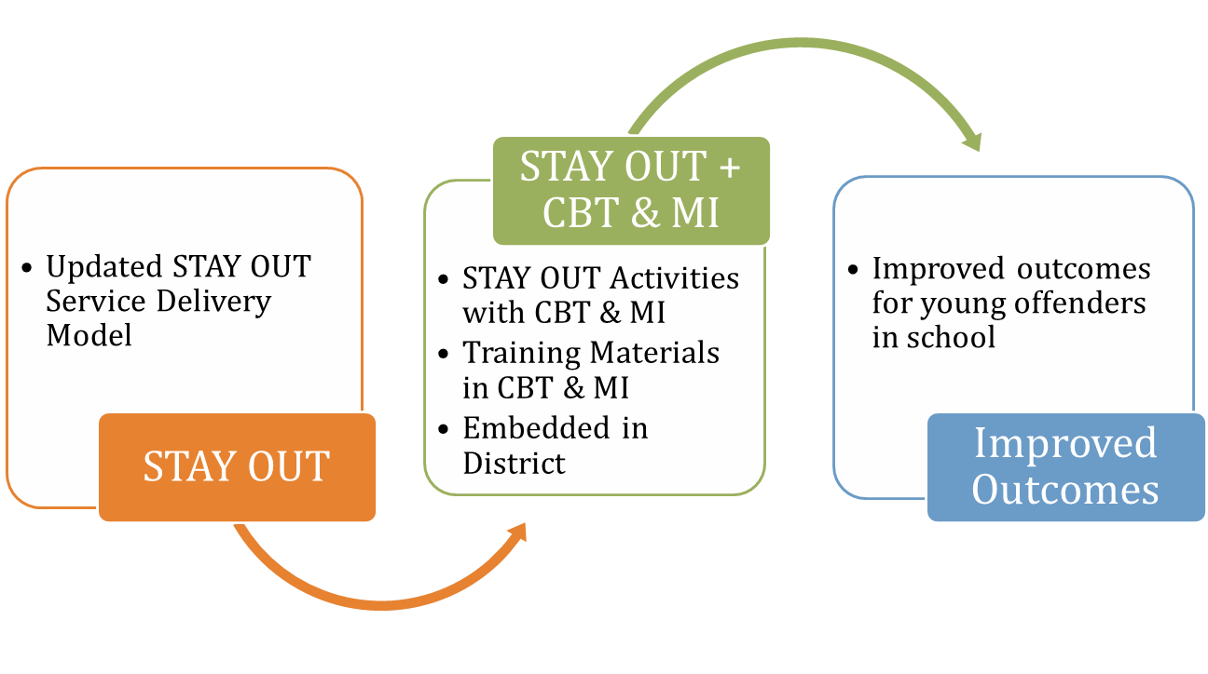
STAY OUT Logic Model

Slide 14
The Role of the Transition Specialist
Goal setting (through MI strategies)
Service delivery
Ongoing support
Resource Broker
Notes:
Goal setting: self determination
Service delivery: Individualized education & employment placement, Support youth in obtaining and maintaining their own jobs
Ongoing support: maintaining education and/or employment placement, additional support services needed (mental health, alcohol & drug services, family counseling, independent skill development, appropriate use of leisure time)
Collaboration with agencies!

Slide 15
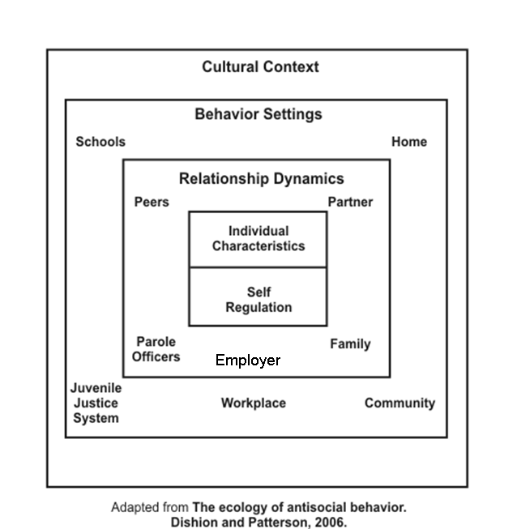
Ecology of Transition Needs for Juvenile Offenders with Disabilities
Interaction dynamics between the individual and various relationships across behavioral settings

Slide 16
Essential Features of STAY OUT
Individualized to unique needs of youth
Competitive Employment
Flexible Education Opportunities
Targeted Social Skill Training
IMMEDIATE access to age appropriate and culturally appropriate services (e.g., behavioral health, VR, WIA, etc.)
Adapted from Bullis & Cheney, 1999

Slide 17
New Features
To utilize existing special education staffing (either transition specialist or SPED case manager)
Increase expertise of these staff for strategies to include needed community agencies targeting youth involved in JJ system
Train identified SPED staff in Motivational Interviewing & Cognitive Behavioral Therapy strategies
Inclusion of new planning and progress measures: TAGG (Martin, et al.,) & SSIS (Gresham & Elliott)

Slide 18
Why Motivational Interviewing?
Evidence-based practice for treatment of young offenders
Effectively used with young offenders
Focuses on Change Behavior
Youth-Centered to support Self-Determination skill development
Focuses SPED transition planning around strengths, needs, interests of youth

Slide 19
Focused Implementation Needs
Defining eligibility and referral process of youth
Educating all community partners
  JJ 101/SPED 101/VR 101/Family 101
Continued training/development of MI for transition planning
Building capacity differently for each community based on need

Slide 20



Project RISE
Re-entry, Intervention & Support for Engagement
Bridging the Gap Through Community Engagement

Slide 21
Project RISE 1
What it does:
  Project RISE focuses on developing a model for successful reentry of youth with disabilities from the Arizona Department of Juvenile Corrections back into schools, employment, and community programs.
    Personalized transition plans
    IEP review
    Extensive community collaboration
    Individualized case management throughout the clients time in secure care as well as during transition to the community

Slide 22
Project RISE 2
Who it serves:
  Project RISE is committed to providing comprehensive transition services and continued support to identified youth that meet the following criteria:
    Youth currently in secure care at the Arizona Department of Juvenile Corrections
    Youth with an active IEP (Individual Education Plan)
    Youth ages 8-18
    Youth returning to Maricopa County

Slide 23
Project RISE 3
Client Data:
Client | AMS | HS Diploma | GED | Attending Community High School | Working | Pending Adult Court | Pending Guardian Approval | Discharged Successfully | ICE detainer | Moved out of county | Return to care
1 | X | X |  |  | X |  |  | X
2 | X |  | X |  | X |  |  | X |  | X
3 | X |  | X |  | X |  |  | X
4 | X |  | X |  | X |  |  | X
5 | X |  | X |  |  |  |  | X
6 | X |  |  |  |  |  |  | X
7 | X |  |  | X |  |  |  |  | X
8 | X |  |  |  |  |  |  |  |  | X | X
9 | X |  |  | X
10 | X |  |  | X
11 | X |  |  | X
12 | X |  |  | X
13 | X
14 | X |  |  |  | X
15 | X
16 | X |  |  |  |  |  | X
17 | X |  |  |  |  |  | X

Slide 24
Project RISE 4
Client Data:
Client | AMS | HS Diploma | GED | Attending Community High School | Working | Pending Adult Court | Pending Guardian Approval | Discharged Successfully | ICE detainer | Moved out of county | Return to care
1 | X | X |  |  | X |  |  | X
2 | X |  | X |  | X |  |  | X |  | X
3 | X |  | X |  | X |  |  | X
4 | X |  | X |  | X |  |  | X
5 | X |  | X |  |  |  |  | X
6 | X |  |  |  |  |  |  | X
7 | X |  |  | X |  |  |  |  | X
8 | X |  |  |  |  |  |  |  |  | X | X
9 | X |  |  | X
10 | X |  |  | X
11 | X |  |  | X
12 | X |  |  | X
13 | X
14 | X |  |  |  | X
15 | X
16 | X |  |  |  |  |  | X
17 | X |  |  |  |  |  | X

Slide 25
Project RISE 5
Preparing The Youth for Community Engagement:
  Assist the youth with vocational assessments and classes while in secure care
    Assist the youth with the preparation of a resume and interview skills
    Discuss and research vocational/educational opportunities
    Assist the youth with the Merging Two Worlds (M2W), life skill/transition based curriculum
  Attend all Individual Education Plan, Multi-Disciplinary Team and Child and Family Team meetings
    Ensure that the client is aware of their accommodations and that all IEP’s are current and appropriate
    Ensure that all other stakeholders are aware of the clients transition plan and are prepared to support that transition
  Create a comprehensive, client driven individualized transition plan
    Assist the client in creating a transition plan that includes realistic objectives and takes into consideration any barriers that may exist

Slide 26
Project RISE 6
Preparing The Youth for Community Engagement:
  Collection and preparation of all educational and transition documents
    Ensure that the clients school transcripts and any other necessary documents are immediately available or received in a timely manner.
  Upon release, assist with school enrolment, job placement and life skill trainings
    Accompany the youth to enroll in school
    Assist the youth with job applications and interviews
    Identify and make available any life skill trainings that might be beneficial to the youth
  Continue to consistently support the client in the community until they turn 18.5
    Provide consistent, reliable support for the client during the transition process
    Assist the youth in navigating any barriers that may arise during the transition process

Slide 27
Project RISE 7
Preparing The Community To Engage Our Youth:
  Creating Community Partnership and Support
    Allows us to educate the community organizations and stakeholders in the overall concept of transitioning youth with disabilities
    Allows the stakeholders to become more aware of the needs of the youth that they will be receiving
    Allows the stakeholders to identify any barriers to services that might exist and adjust their organizations practices to meet the needs of our youth
    Allows all parties involved to be on the same page and gives all of us the ability to speak the same language

Slide 28
Project RISE 8
Preparing The Community To Engage Our Youth:
  Project RISE Community Partners:
    Tolleson Union High School District (SPED)
    Phoenix Union High School District (SPED)
    Mesa Public Schools (SPED)
    Austin Center for Exceptional Students (ACES)(SPED)
    Goodwill of Central AZ (Career Centers)
    Phoenix Job Corps (Transitional living/Career)
    AZ Department of Economic Security/ Child Protective Services
    Salt River Accelerated Learning Academy (SPED)
    Boys & Girls Clubs of the East Valley (Youth Development/Life Skills)
    Boys & Girls Clubs of Greater Scottsdale (Youth Development/Life Skills)
    Mission Academy/ROP (SPED)
    Maricopa County Human Services Department/Workforce Connections (Career/Life Skills)
    Mesa Community College (Career/Postsecondary Ed.)
    Estrella Community College (Career/Postsecondary Ed.)
    East Valley Technical Institute (EVIT) (Career/ Technical)

Slide 29
Project RISE 9
Preparing The Community To Engage Our Youth:
  Expert Community Panel/Advisory Board
    Allows us to gather feedback and guidance from professionals who are considered experts in their respective fields
    Gives us the opportunity to hear the opinions and perspectives from a wide range of community organizations and stakeholders.
    Allows us to interact with representatives from key areas of the transition process who have the ability to influence change within their organizations

Slide 30
Project RISE 10
Preparing The Community To Engage Our Youth:
    Surveys and Focus Groups
      Gives us input and feedback from a wide range of stakeholders
      Allows us to identify discrepancies between policy and reality
      Gives stakeholders an opportunity to give honest opinions in a safe environment
      Allows us to identify common areas of concern that we can target for change

Slide 31
Project RISE 11
Green = Community Partners
Yellow = CPS/HSD
Red = ADJC ED/Admin
Blue = ADJC Parole/Transition
1. Interagency Collaboration
Indicator | Always Evident = 3 | Usually Evident = 2 | Seldom Evident = 1 | Not Evident = 0 | Didn’t Know
1.1 Procedures and interagency agreements are established with appropriate agencies. | Community Partners | ADJC ED/Admin | ADJC Parole/Transition |  | Community Partners
 | Community Partners | CPS/HSD |  |  | Community Partners
 | Community Partners | ADJC Parole/Transition |  |  | CPS/HSD
 | ADJC ED/Admin |  |  |  | CPS/HSD
1.2 Timely transfer of all appropriate youth records occurs between releasing and receiving programs. | ADJC ED/Admin | Community Partners | ADJC Parole/Transition |  | Community Partners
 |  | Community Partners |  |  | Community Partners
 |  | Community Partners |  |  | CPS/HSD
 |  | CPS/HSD |  |  | CPS/HSD
 |  | ADJC ED/Admin |  |  | ADJC Parole/Transition
1.3 All involved agencies are aware of the youth’s needs and of the services that each agency is providing to meet those needs. | Community Partners | Community Partners | Community Partners |  | Community Partners
 |  | Community Partners | CPS/HSD |  | CPS/HSD
 |  | CPS/HSD | ADJC Parole/Transition
 |  | ADJC ED/Admin
 |  | ADJC ED/Admin
 |  | ADJC Parole/Transition
1.4 Communication occurs regularly between agencies. | Community Partners | Community Partners | CPS/HSD | CPS/HSD
 | CPS/HSD | Community Partners | ADJC Parole/Transition
 |  | Community Partners
 |  | Community Partners
 |  | ADJC ED/Admin
 |  | ADJC ED/Admin
 |  | ADJC Parole/Transition

Slide 32
Project RISE 12
Advisory Board Focus Groups:
    Sample Focus Group Questions
1) Identify the departmental processes that you consider to be ‘”high quality” in regards to transitioning youth.
2) What are the barriers that currently hinder the transition process?
3) Describe your understanding of how IEP’s are identified, updated and complied with.
4) What is the single biggest challenge in regards to successfully transitioning youth from your agency?
5) What is your definition of “community engagement” in regards to the juvenile transition process?

