Slide 1
SWIFT Center
SCHOOLWIDE INTEGRATED FRAMEWORK FOR TRANSFORMATION

Slide 2
Welcome OSEP Conference Participants

Slide 3
Essential Presentation Questions
Why is it imperative that students with disabilities be included in whole school reform efforts?
What are the key research-based domains and features of a fully inclusive school?
How can schools eliminate silos and unify efforts to meet the needs of all students?

Slide 4
SWIFT is
A national K-8 center focused on providing academic and behavioral support for all students, including students with disabilities and those with the most extensive needs
A partner with the whole school community in positively transforming the learning outcomes for all students
The largest grant ever to promote educational systems change for ALL students
Notes:
Bronwyn will start the All Means All video ☺

Slide 5
Why is it imperative that students with disabilities be included in whole school reform efforts?
30 years of research tells us that students with and without disabilities do better when they learn together and are well supported.
The time is NOW to realize these positive outcomes for ALL students.

Slide 6
SWIFT Mission
To assist districts, schools, families, and communities engagement in a transformational process to achieve equity and excellence for all students.
Excellence as determined by measurable student social and academic gains
Equity as defined by the measurable capacity of each school to deliver the intensity and range of supports to meet the needs of each student and extending to their family and community
All is defined as the measurable integrated active engagement of all students and their families in the learning process.

Slide 7
From Silos to SWIFT SWIFT unifies the strengths of general and special educators by supporting them in working in concert with one another teaching grade level curriculum

Slide 8
SWIFT Goals
Goal 1: Identify and examine six Knowledge Development Schools using rigorous evaluation measures and field assessments to determine the unique features of effective inclusive schoolwide reform.
Goal 2: Recruit, select and provide intensive technical assistance to four states, with four districts per state, to build capacity to install SWIFT in 64 schools.
Goal 3: Build capacity to sustain SWIFT schools and extend SWIFT practices to additional schools within implementing districts.
Goal 4: Implement a system to support multi-level state leadership and coordination to scale up SWIFT.
Goal 5: Establish and disseminate a national Knowledge Bank on schoolwide inclusive reform.

Slide 9
What are the key research based domains and features of a fully inclusive school?
Think, pair, share with your neighbor and identify the most essential features of a fully inclusive school.

Slide 10
SWIFT in 60 Strong and Positive School Culture

Slide 11
SWIFT Domains and Features

Slide 12
SWIFT in 60 Trusting Community Partnerships

Slide 13
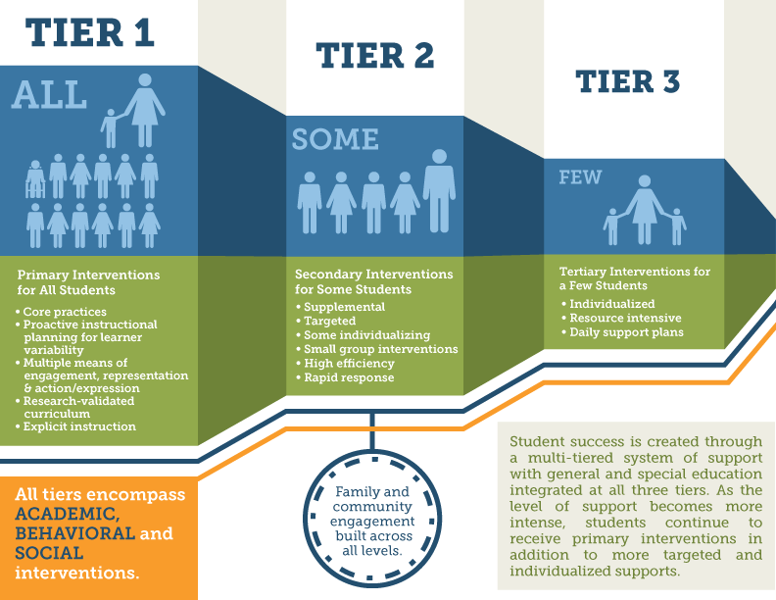
SWIFT and MTSS

Slide 14
SWIFT Products
SWIFT Progress on Products

Slide 15
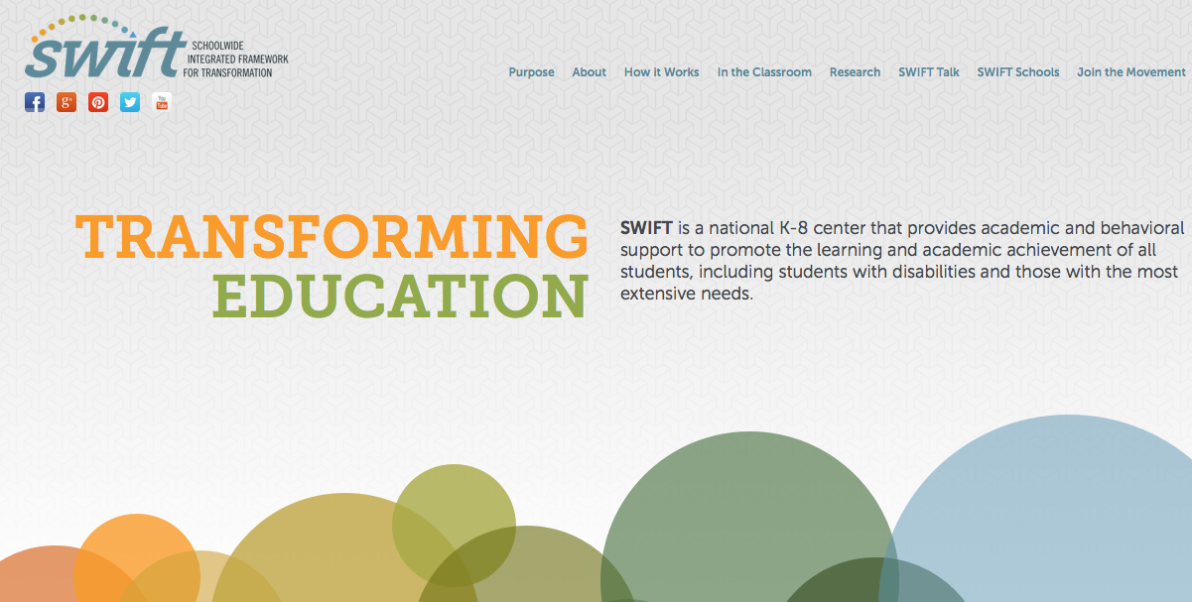
Swiftschools.org

Slide 16
SWIFT Field Guide
Offers administrators, educators, families, and community members tools to transform schools
Provides guidance for teams to address leadership and teacher support systems, evidenced-based instruction, organizational structures, and family and community engagement
Is easily accessible and portable

Slide 17
SWIFT Fidelity of Implementation Tool (FIT)
A tool used to examine progress on the implementation of the critical features of SWIFT
Contains categories of essential SWIFT practices and specific indicators leading to schoolwide inclusive transformation
Informs the SWIFT Technical Assistance Team to best focus supports

Slide 18
SWIFT Fidelity Integrity Assessment (FIA)
Same conceptual structure as SWIFT-FIT
Progress-monitoring measure to assess progress and plan short-term action steps related to SWIFT implementation
Used by a trained school leadership teams every 6 to 8 weeks; 15 to 20 minutes to complete
Results guide immediate next steps for promoting SWIFT implementation

Slide 19
How can schools eliminate silos and unify efforts to meet the needs of all students?

Slide 20
For Additional Information Contact
Robin Gingerich
Project Coordinator
National Center on School-Wide Integrated Framework for Transformation: The SWIFT Center
University of Kansas |
Wakarusa Research Facility
1315 Wakarusa ,Lawrence, KS 66049-3830
℗ 785.864-6844| (f) 785.331-2380
swift@ku.edu

Slide 21
Thank you for your time
Mary C. Schuh, Ph.D.
Mary.schuh@unh.edu
The National Center on Schoolwide Inclusive School Reform (The SWIFT Center) produced the data for this presentation under U.S. Department of Education, Office of Special Education Programs Grant No. H325Y120005. OSEP Project Officers Grace Zamora Durán and Tina Diamond served as the project officers. The views expressed herein do not necessarily represent the positions or policies of the Department of Education. No official endorsement by the U.S. Department of Education of any product, commodity, service or enterprise mentioned in this publication is intended or should be inferred. This product is public domain. Authorization to reproduce it in whole or in part is granted.

