Slide 1
Alternate Assessment Data in Support of Local Decision Making
Neal Kingston and Meagan Karvonen
Center for Educational Testing And Evaluation
Emily Thatcher
Iowa Department of Education
The present publication was developed under grant 84.373X100001 from the
U.S. Department of Education, Office of Special Education Programs. The views
expressed herein are solely those of the author(s), and no official endorsement
by the U.S. Department should be inferred.

Slide 2
Past and Future
History of scores available for alternate assessments
Previous focus groups on operational AA-AAS score reports
Cooperative agreement requires us to…

Slide 3
Today’s Session
Provide brief DLM overview
Describe DLM scores and other data sources
Describe one state’s plans for helping teachers use data
Seek input on uses of data, facilitators and barriers to data use

Slide 4
Background on DLM

Slide 5
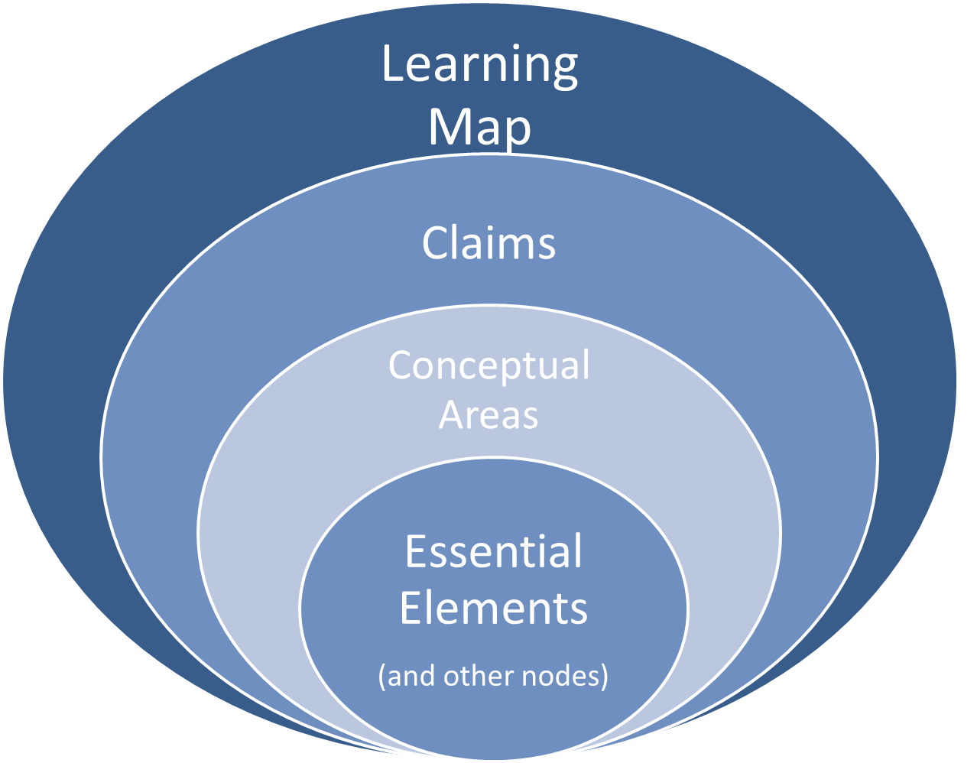
Learning Maps

Slide 6
Example for English Language Arts
Common Core State Standard
Essential Element
RL.6.2 Determine a theme or central idea of a text and how it is conveyed through particular details; provide a summary of the text distinct from personal opinions or judgments.
EE.RL.6.2 Determine the theme or central idea of a familiar story and identify details that relate to it.
Notes:
Sue

Slide 7
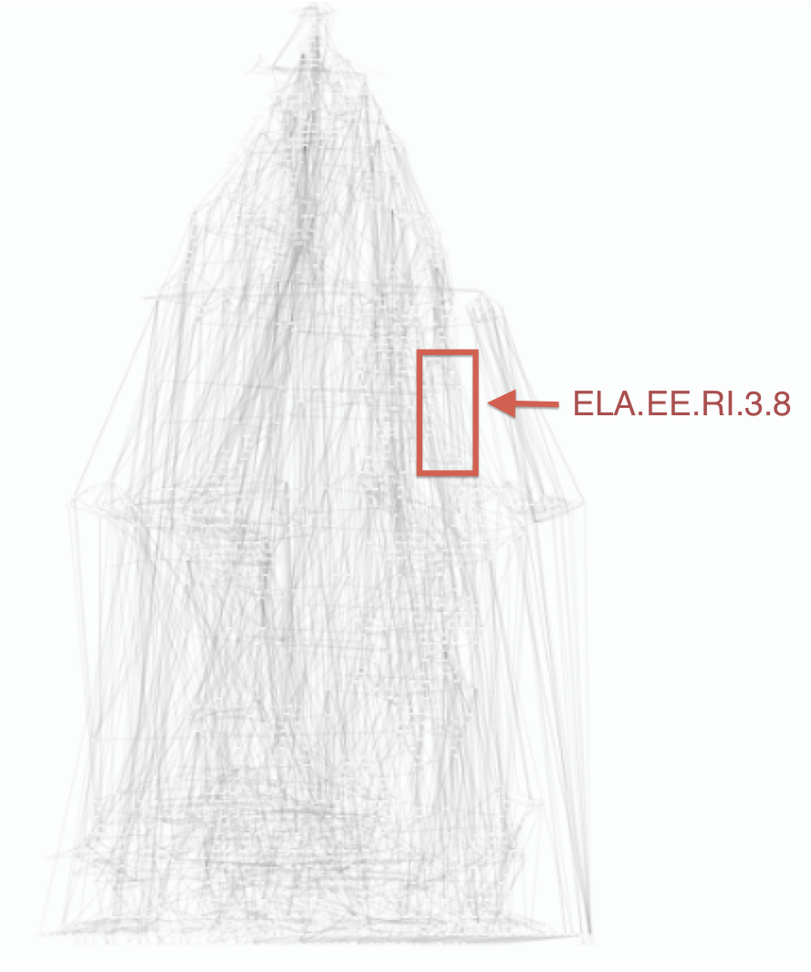
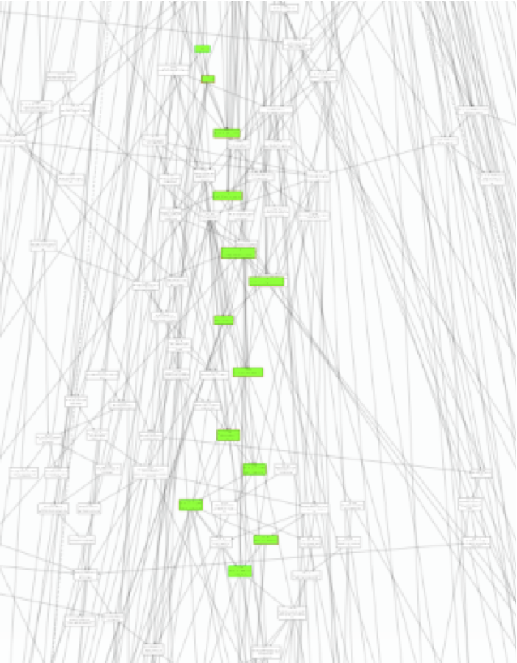
Identify two related points the author makes in an informational text

Slide 8
Testlets in Linkage Levels

Slide 9
DLM Approach to Scoring
Probability of mastery for each node
Combined into judgments about mastery of linkage level, EE, and overall subject
Growth during the year

Slide 10
Data Available in DLM

Slide 11
DLM Goals for Score Reports
Scores should convey real meaning to parents
Information should be actionable by educators and parents
(And we still need to meet score requirements for accountability)

Slide 12
Performance Profile Part 1: Overall Results

Slide 13
Performance Profile Part 2: Conceptual Areas

Slide 14
Performance Profile Part 3: Narrative

Slide 15
Growth Profile Part 1: Overall Results

Slide 16
Growth Profile Part 2: Conceptual Areas

Slide 17
Learning Profile
Shows the levels mastered within each Essential Element and the Target
Shows every Essential Element assessed that year

Slide 18
Progress Report
Available when the teacher assesses throughout the year
Can be produced at any time – not just at the end of a marking period
Similar to year-end mastery report

Slide 19
Sample Progress Report
Yellow = current instructional focus
Green = mastered skills

Slide 20
Other Data Available for Program Improvement & Monitoring
All accessibility tools and supports chosen by the teacher
Enabled by PNP
Delivered outside the system
First Contact
Communication
Prior academic performance
AAC device use
Etc

Slide 21
Supporting Teachers’ Use of Data in Iowa

Slide 22
Statewide System of Integrated Support Significant Disabilities State leadership Team

Slide 23
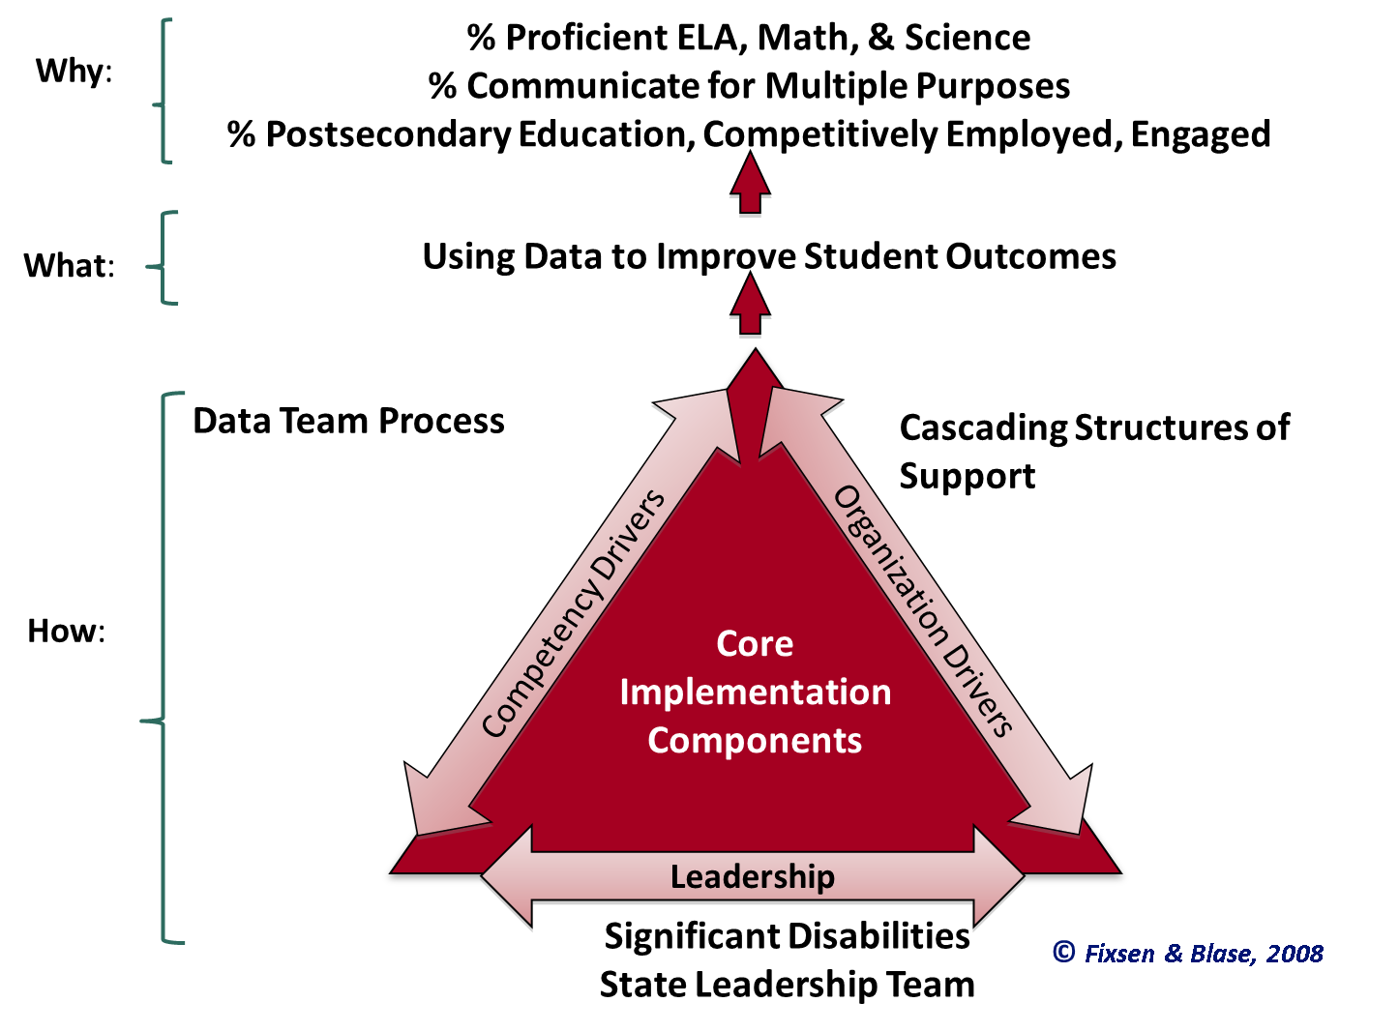
Implementation Components
Notes:
Defining Desired Outcomes

Slide 24
Cascading Structures of Support Use of Data
Developed & Compiled by members of the MI SISEP Team (Steve Goodman & Beth A Steenwyk)
OSEP Directors Conf 7/20‐22/2009

Slide 25
Performance Profile New Learning
Part I: Overall Results
Moving Beyond Status to Growth
Comparison
Part II: Conceptual Areas
Understanding the relationship between the Learning Maps & Essential Elements
Part III: Narrative
Using this information to support the development of IEP goals

Slide 26
Data Team Process
Learning Goal
Understand how to use data to improve my instruction
Success Criteria -“I Can”…
Use the Data Team Process
Change practice to improve student outcomes

Slide 27
Discussion with Audience

Slide 28
Questions for Discussion
What local practices and systems must be in place to support the effective use of alternate assessment data for instructional and program improvement?
What are some potential barriers to teachers’ use of DLM assessment data, and how might those be overcome?
Are there other potential uses of the data we have described?

Slide 29
THANK YOU!
For more information, go to: www.dynamiclearningmaps.org
The present publication was developed under grant 84.373X100001 from the
U.S. Department of Education, Office of Special Education Programs. The views
expressed herein are solely those of the author(s), and no official endorsement
by the U.S. Department should be inferred.

