Slide 1


Planning for Success:
Using Implementation Data to Action Plan for Full and Sustained Implementation
Barbara Sims
Caryn Ward
National SISEP Center
National Implementation Research Network
Frank Porter Graham Child Development Institute
University of North Carolina at Chapel Hill

Slide 2
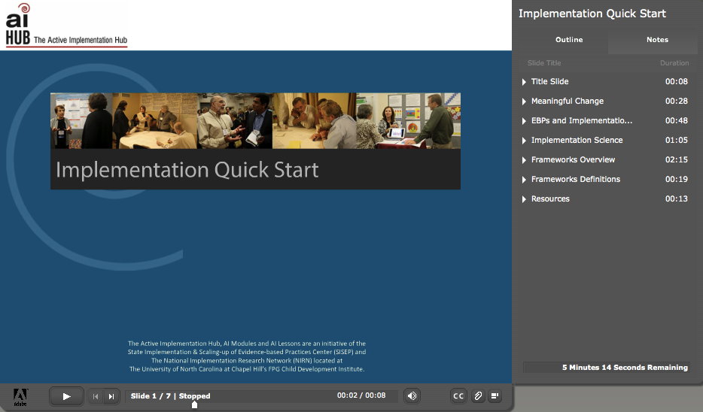
Implementation Quick Start

Slide 3
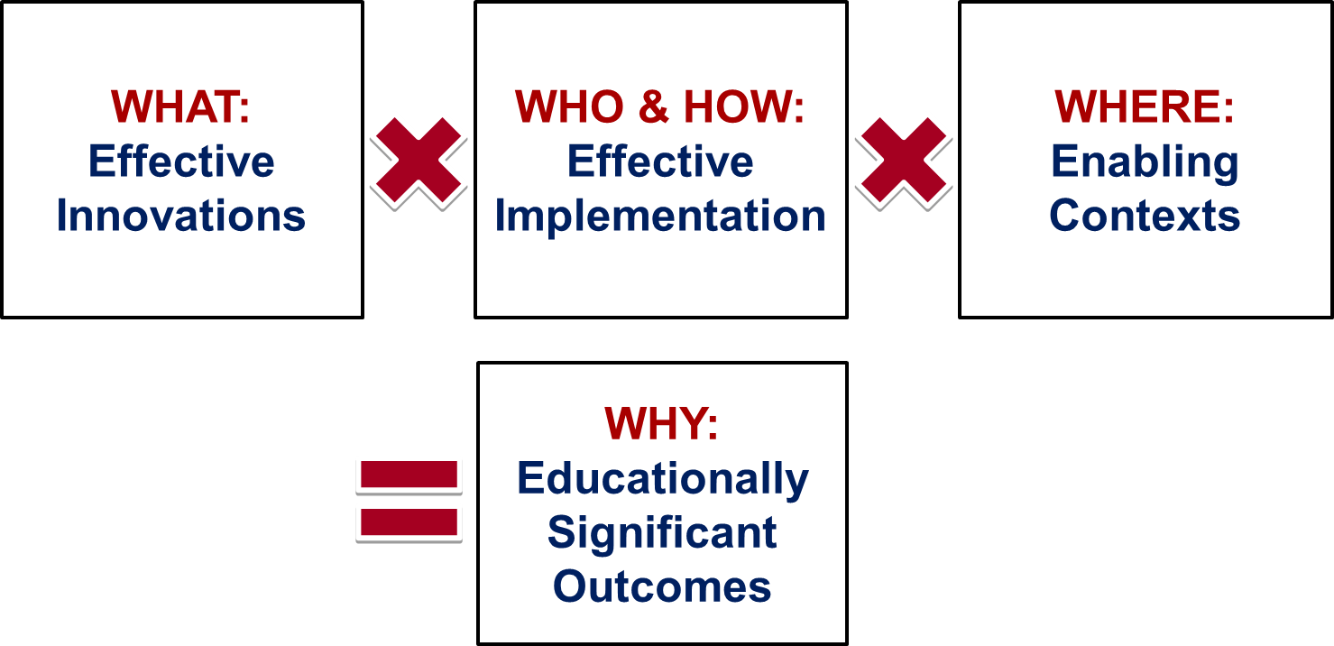
Formula for Success
Notes:
© 2012 Dean Fixsen and Karen Blase, National Implementation Research Network

Slide 4
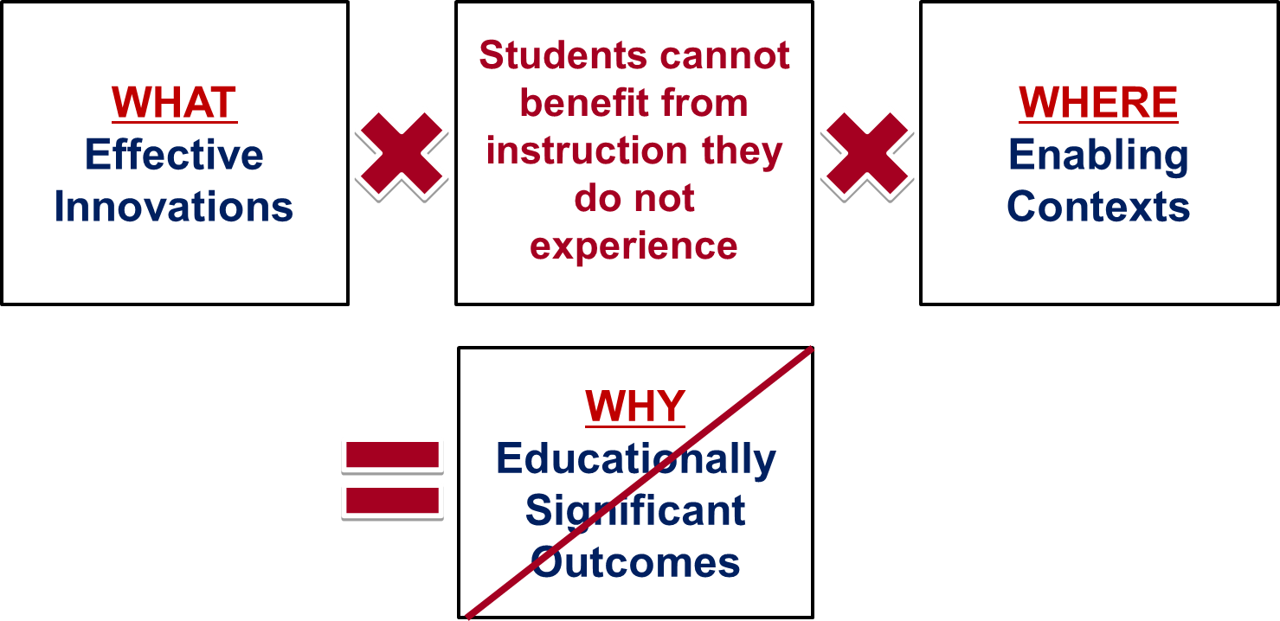
Formula for Success (continued)
Notes:
© 2012 Dean Fixsen and Karen Blase, National Implementation Research Network

Slide 5
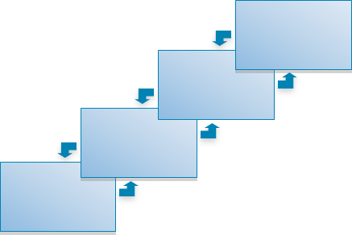

IMPLEMENTATION TEAMS
Organized, expert assistance to develop and sustain an accountable and effective structure

Slide 6
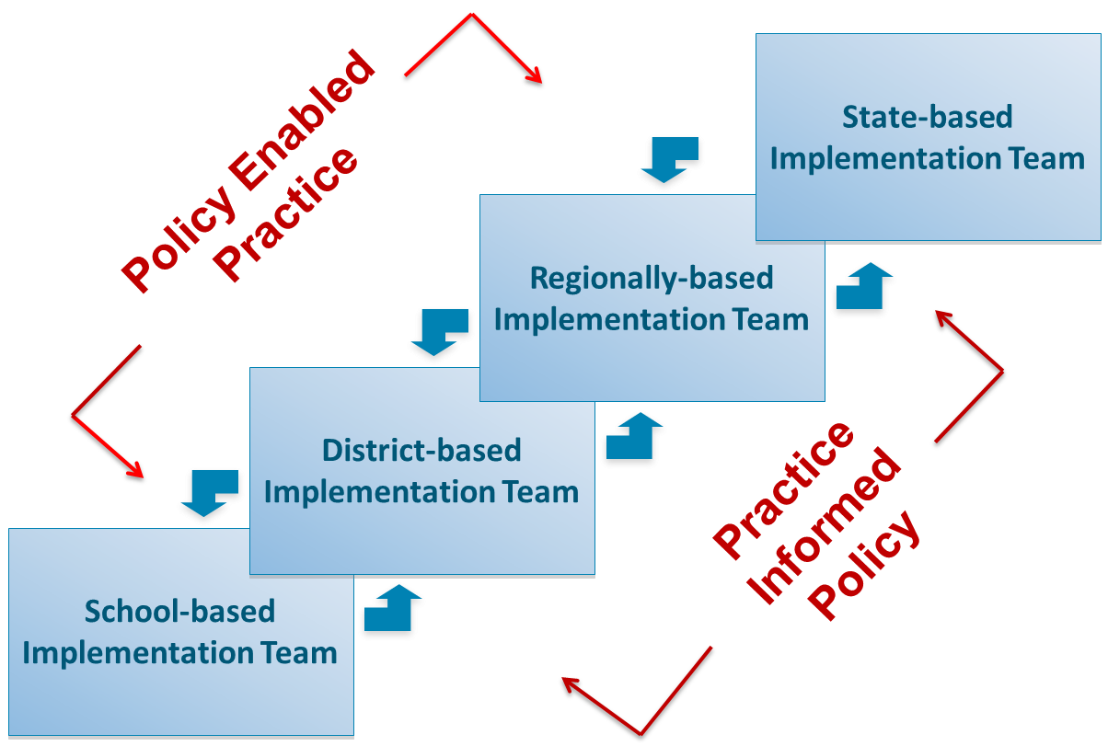
Linked Team Structures
Implementation Teams

Slide 7
Cascading Model
 |  |  |  | Quality Instruction | Student Outcomes
 |  |  | Implementation Team Supports | Quality Instruction
 |  | School Leadership | Implementation Team Supports
 | Enabling District Context | School Leadership
Enabling State Context | Enabling District Context

Slide 8
Students
Cascading Logic Model
SISEP Assessments
Population | Intervention Strategies (WHAT) | Intervention Outcomes
Students | Educators skillfully implement evidence-based intervention strategies. | Socially significant improvements in academic, social, emotional or behavioral outcomes for students.

Slide 9
Educators
Cascading Logic Model
SISEP Assessments
Population | Intervention Strategies (WHAT) | Intervention Outcomes
Students | Educators skillfully implement evidence-based intervention strategies. | Socially significant improvements in academic, social, emotional or behavioral outcomes for students.
Population | Implementation Strategies (HOW) | Implementation Outcomes
Educators | Provision of skillful, timely training, coaching, and performance assessments in supportive administrative environments organized by building and district leadership | Educators skillfully implement evidence-based intervention strategies.

Slide 10
Cascading Logic Model
Population | Intervention Strategies (WHAT) | Intervention Outcomes
Students | Educators skillfully implement evidence-based intervention strategies. | Socially significant improvements in academic, social, emotional or behavioral outcomes for students.
Population | Implementation Strategies (HOW) | Implementation Outcomes
Educators | Provision of skillful, timely training, coaching, and performance assessments in supportive administrative environments organized by building and district leadership | Educators skillfully implement evidence-based intervention strategies.
Schools and Districts | Systemic professional development leadership and planning to ensure high quality, consistent training and coaching through the use of fidelity and outcome data, and the development of facilitative administrative practices and policies to support implementation | Provision of skillful, timely training, coaching, and performance assessments in supportive administrative environments organized by building and district leadership

Slide 11
Schools, Districts, Regions and States Cascading Logic Models
Population | Implementation Strategies (HOW) | Implementation Outcomes
Schools and Districts | Systemic professional development leadership and planning to ensurSce high quality, consistent training and coaching through the use of fidelity and outcome data, and the development of facilitative administrative practices and policies to support implementation | Provision of skillful, timely training, coaching, and performance assessments in supportive administrative environments organized by building and district leadership
Regions and States | Common mission for professional development Formal structures created to build policy–practice feedback loops Review of funding streams to support new functions and relationships Collaborative partnerships to build professional development system infrastructure Fidelity and outcome data systems developed and maintained | Systemic professional development leadership and planning to ensure high quality, consistent training and coaching through the use of fidelity and outcome data, and the development of facilitative administrative practices and policies to support implementation

Slide 12
SISEP Center Logic Model
Population | Implementation Strategies (HOW) | Implementation Outcomes
Regions and States | Common mission for professional development Formal structures created to build policy–practice feedback loops Review of funding streams to support new functions and relationships Collaborative partnerships to build professional development system infrastructure Fidelity and outcome data systems developed and maintained | Systemic professional development leadership and planning to ensure high quality, consistent training and coaching through the use of fidelity and outcome data, and the development of facilitative administrative practices and policies to support implementation
SISEP Center | Increase knowledge of evidence-based implementation supports for evidence-based practices in SEAs, LEAs and TA Centers Provide resources and TA to establish implementation infrastructures in SEAs and LEAs Provide resources and assessment tools to measure fidelity and implementation outcomes | Common mission for professional development Formal structures created to build policy–practice feedback loops Review of funding streams to support new functions and relationships Collaborative partnerships to build professional development system infrastructure Fidelity and outcome data systems developed and maintained

Slide 13

Try It Now!
Assessing Implementation
Identify 2-3 indicators to help monitor the work of these teams
Monitoring Implementation Progress
Notes:
13

Slide 14
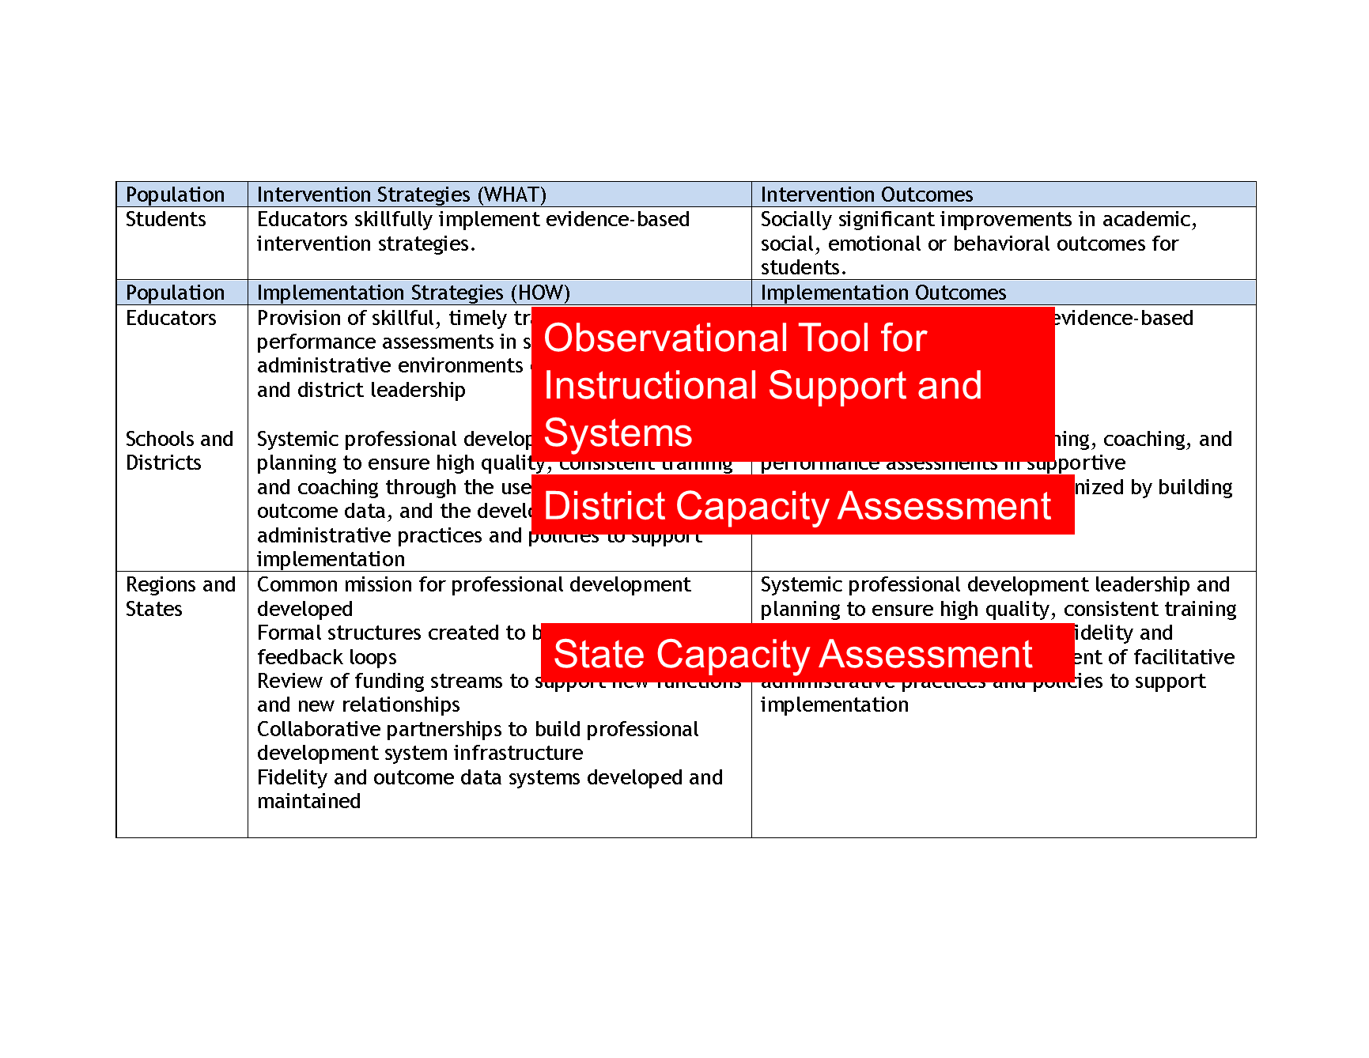
Tools and Assessments

Slide 15
State Capacity Assessment (SCA)
Purpose:
  Measure of state and regional capacity for implementation of evidence-based practices and other effective innovations
  Provides a structured process for the development of a State Capacity Action Plan
Administration:
  Completed by State Management Team/Implementation Team
  2x a year
Notes:
Additional purposes to note (took off because of too much text):
Provides other State Education Agency (SEA) teams with information to monitor progress towards state capacity building goals
Supports a common infrastructure for implementation of effective education for students
Other notes on administration:
SISEP administrator (onsite or virtual)
SISEP Onsite facilitator
Simultaneously voting

Slide 16
SCA Scoring key
All Scaling Capacity Items scored using the following format.
Fully In Place | 2 points | - All dimensions of element adhered to and evidence available to support this rating
Partially In Place | 1 point | - Some dimensions of element adhered to and/or some dimensions attended to - Action Planning occurs with these elements
Not in Place | 0 points | Element not adhered to Action Planning occurs with these elements or teams may not be developmentally ready to implement this component

Slide 17
State Capacity Assessment: SMT Section

Slide 18
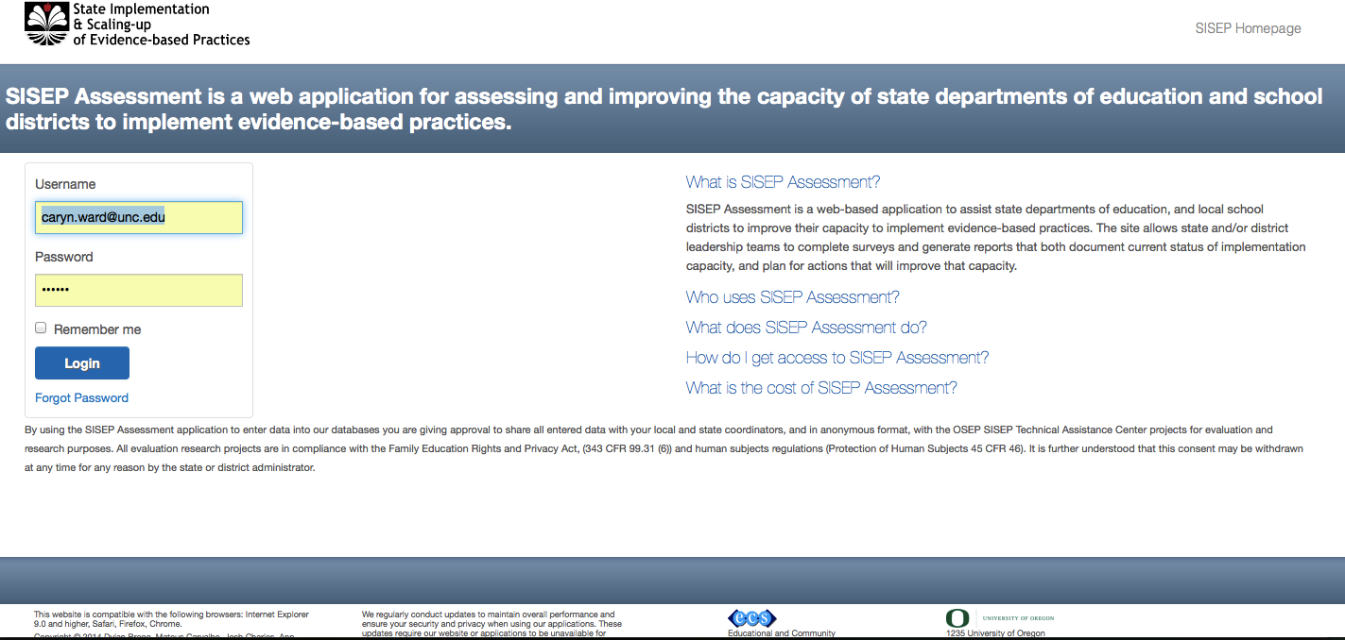
SISEP.Org

Slide 19
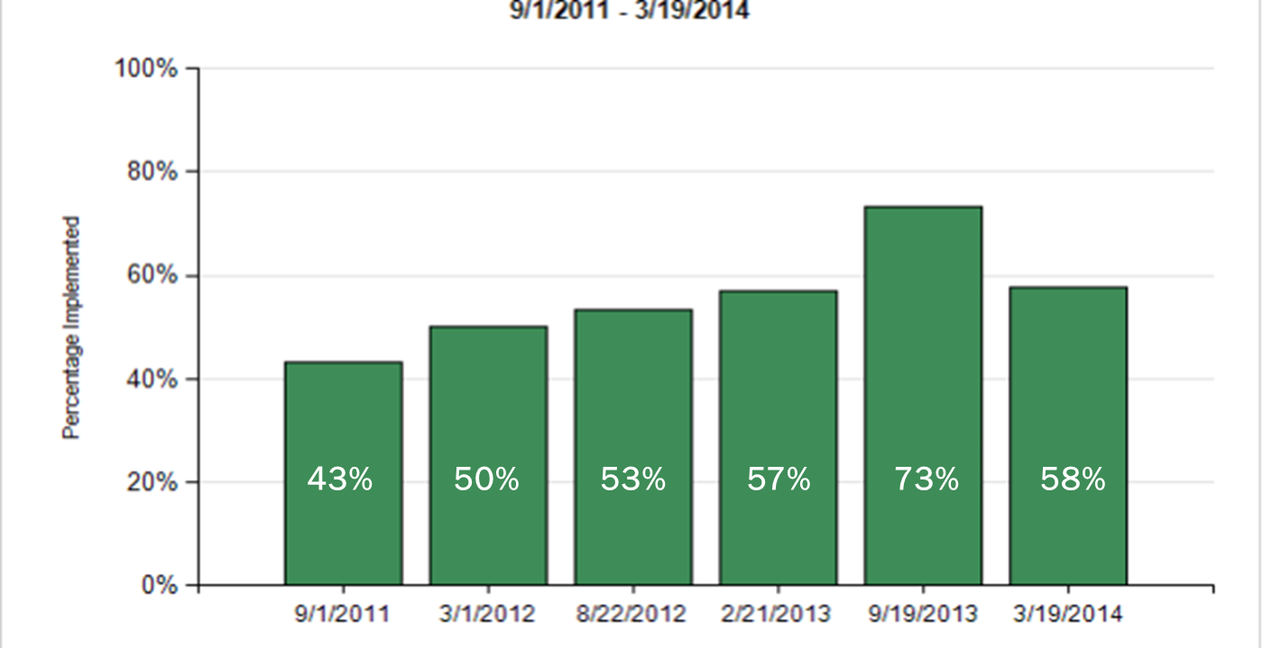
SCA Results: Total Score

Slide 20
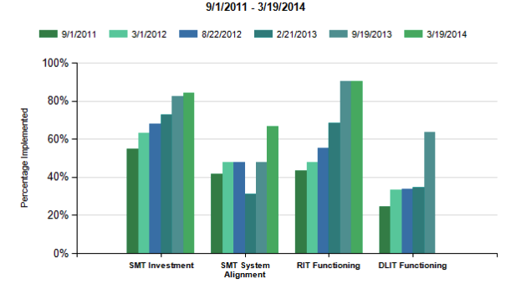
SCA Results: SubScale

Slide 21
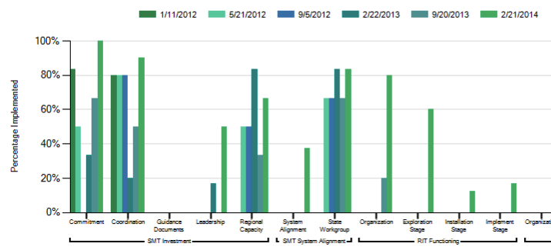
SCA Results: Sub-Subscale

Slide 22
Next Step – Action Planning
Review Items with scores of 0 and 1
Identify several items for action planning that may be completed within the next 3 months
  Look for Quick wins
  Define the Action
  Determine:
    Who is responsible
    When it will be accomplished
    Progress monitoring schedule for problem solving

Slide 23
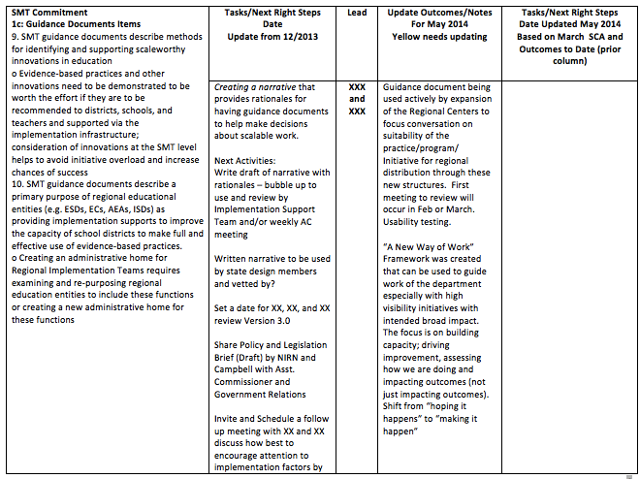
Sample Action Plan

Slide 24
District Capacity Assessment (DCA)
Purpose:
  Measure of the capacity for implementation of effective innovations in schools, districts, and regions in the state
  Provide a structured process for the development of a District Capacity Action Plan
Administration:
  Completed by District Implementation Team
  2x a year
Notes:
Notes on administration:
Utilizes simultaneous voting
Takes on average about 1.5 – 2 hours to administer

Slide 25
DCA Screenshot

Slide 26
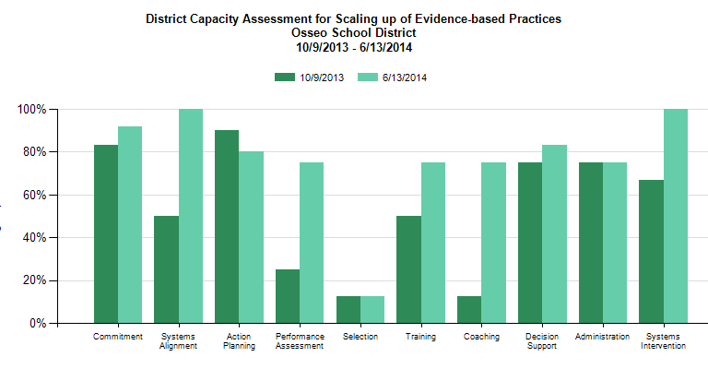
DCA Results

Slide 27
Observation Tool for Instructional Supports and Systems (OTISS)
Purpose:
  Measure of the quality of systems and supports available to help teachers use best practices for instruction
  Implementation Team accountability
  NOT teacher accountability

Slide 28
OTISS: Development
Hattie (2009) meta-meta-analysis
Select instruction practices
  Evidence-based (demonstrated to improve student outcomes)
  Observable in a 10-minute segment of instruction
  Not event/time related (any 10-minute segment)
  Content Free
  Applicable to any grade level

Slide 29
OTISS Screenshot

Slide 30
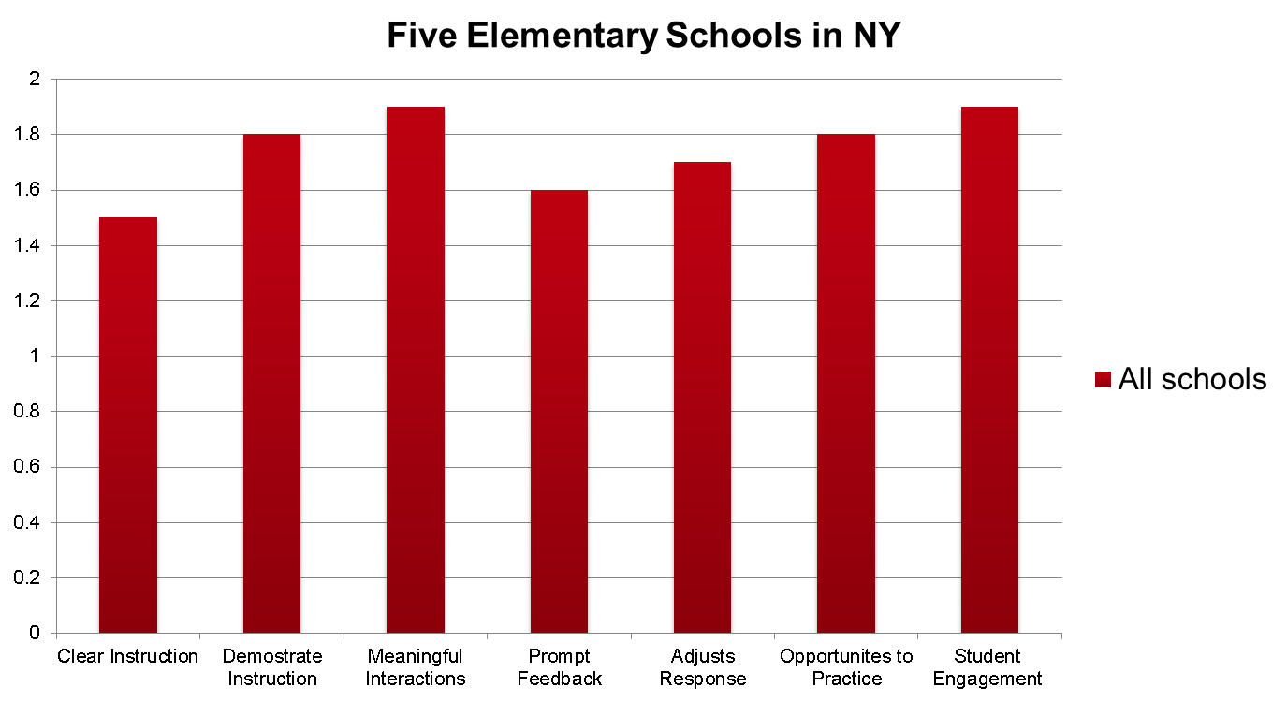
OTISS Usability Testing Data
(all schools)
Notes:
30
Deming, W. E. (1986). Out of the crisis. Cambridge, MA: MIT Press.
Shewhart, W. A. (1931). Economic control of quality of manufactured product. New York: D. Van Nostrand Co.
Shewhart, W. A. (1939). Statistical method from the viewpoint of quality control: Dover Publications.
Nielsen, J. (2000). Why you only need to test with 5 users. Retrieved April 22, 2007, from http://www.useit.com/alertbox/20000319.html.
Rubin, J. (1994). Handbook of usability testing: How to plan, design, and conduct effective tests. New York: John Wiley & Sons.
Fixsen, D., Blase, K., Metz, A., & Van Dyke, M. (2013). Statewide implementation of evidence-based programs. Exceptional Children (Special Issue), 79(2), 213-230.

Slide 31
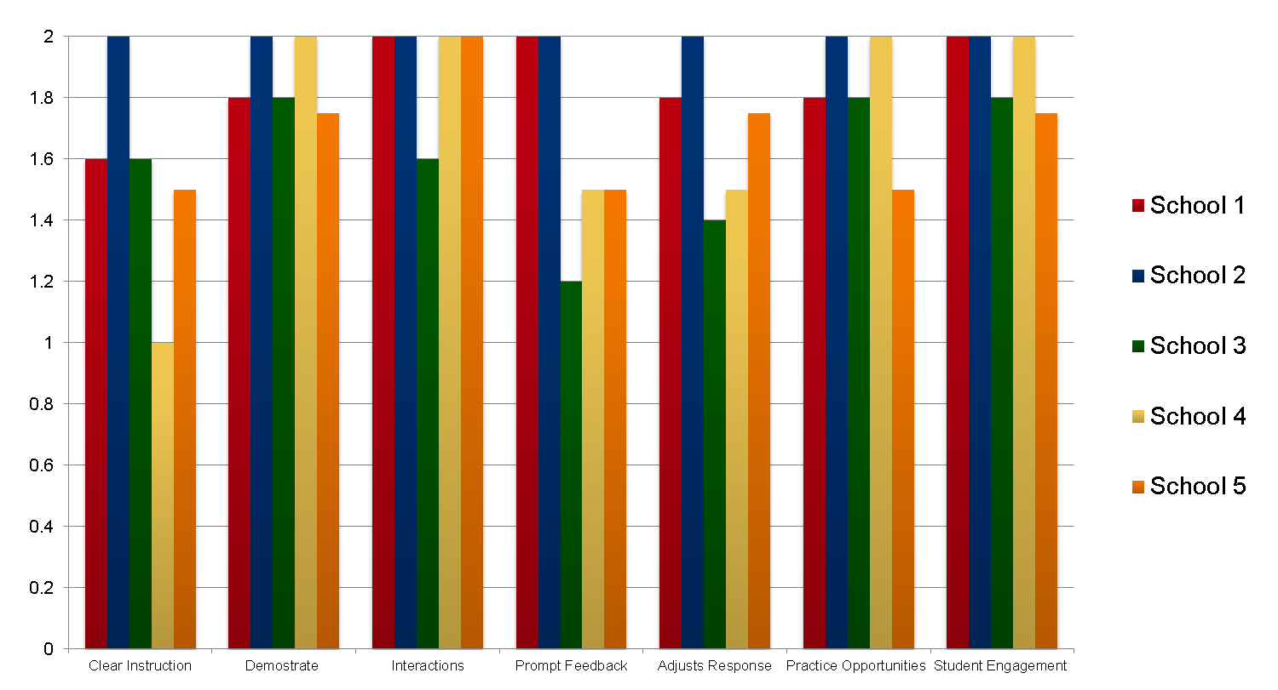
OTISS Usability Testing Data
(by school)
Notes:
31
Deming, W. E. (1986). Out of the crisis. Cambridge, MA: MIT Press.
Shewhart, W. A. (1931). Economic control of quality of manufactured product. New York: D. Van Nostrand Co.
Shewhart, W. A. (1939). Statistical method from the viewpoint of quality control: Dover Publications.
Nielsen, J. (2000). Why you only need to test with 5 users. Retrieved April 22, 2007, from http://www.useit.com/alertbox/20000319.html.
Rubin, J. (1994). Handbook of usability testing: How to plan, design, and conduct effective tests. New York: John Wiley & Sons.
Fixsen, D., Blase, K., Metz, A., & Van Dyke, M. (2013). Statewide implementation of evidence-based programs. Exceptional Children (Special Issue), 79(2), 213-230.

Slide 32
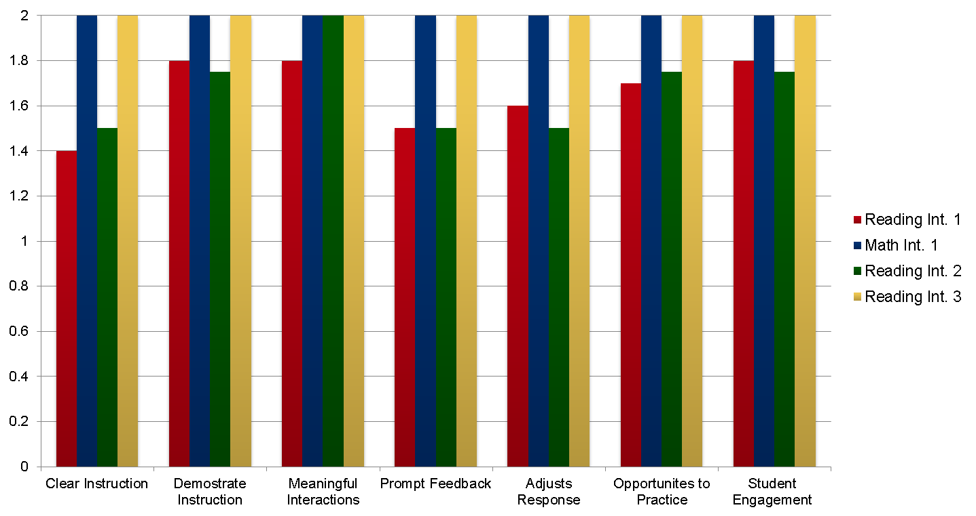
OTISS Usability Testing Data
(by intervention)
Notes:
32

Slide 33
Cascading Model & Measures
Student outcomes (monthly data)
OTISS (every teacher, 3x semester)
DCA (2-3X a year)
RIT (SCA: 2X a year)
SMT/STS (SCA: 2X a year)
Notes:
33

Slide 34
Try It Now!
(continued)
Action Planning
&
State Capacity Assessment
Utilizing the provided sample results of the SCA, identify at least 2-3 next steps.
Using Data for Action Planning
Notes:
34

Slide 35
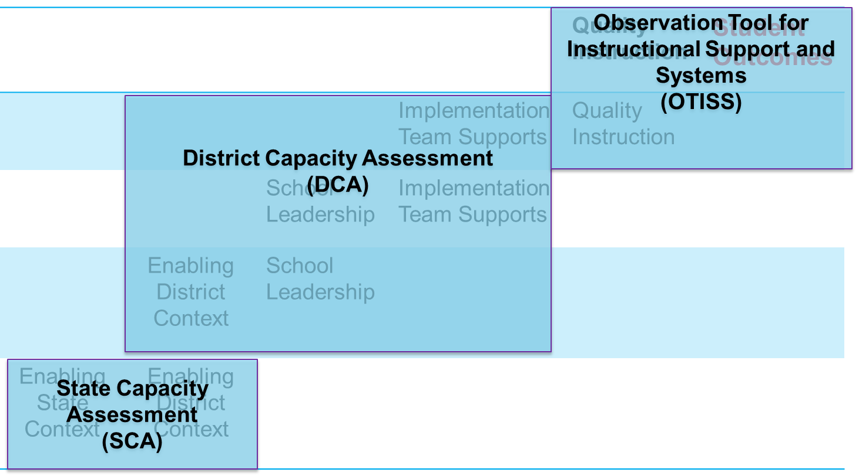
Cascading Logic Model:
Putting it all together

Slide 36
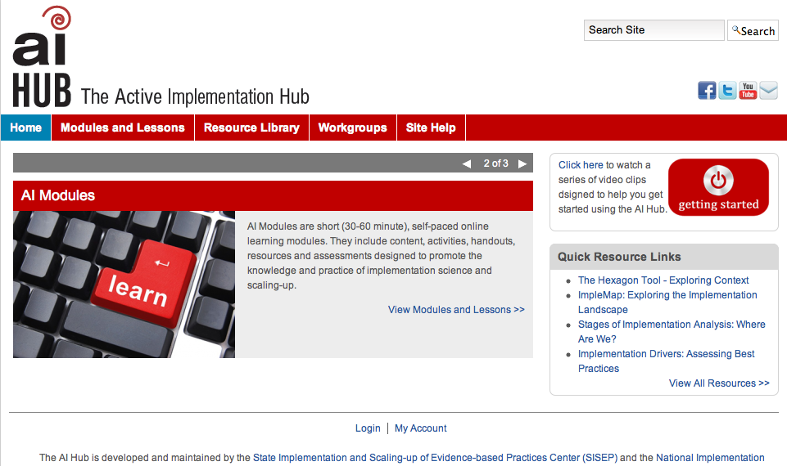
The AI Hub

Slide 37


Get Connected!
http://www.scalingup.org
For more on Implementation Science
http://nirn.fpg.unc.edu
http://www.globalimplementation.org
SISEP
@SISEPcenter
Notes:
37

Slide 38

For More Information
Barbara Sims
  919-843-8751
  barbara.sims@unc.edu
Caryn Ward, Ph.D.
  919-843-5787
  caryn.ward@unc.edu
Frank Porter Graham Child Development Institute
University of North Carolina
Chapel Hill, NC
http://nirn.fpg.unc.edu/
http://www.scalingup.org
http://implementation.fpg.unc.edu
Frank Porter Graham Child Development Institute
University of North Carolina
Chapel Hill, NC
http://nirn.fpg.unc.edu/
http://www.scalingup.org
http://implementation.fpg.unc.edu
Notes:
38

Slide 39

GIC 2015
Dublin, Ireland

Slide 40

©Copyright Dean Fixsen and Karen Blase
This content is licensed under Creative Commons license CC BY-NC-ND, Attribution-NonCommercial-NoDerivs. You are free to share, copy, distribute and transmit the work under the following conditions: Attribution — You must attribute the work in the manner specified by the author or licensor (but not in any way that suggests that they endorse you or your use of the work); Noncommercial — You may not use this work for commercial purposes; No Derivative Works — You may not alter or transform this work. Any of the above conditions can be waived if you get permission from the copyright holder.
http://creativecommons.org/licenses/by-nc-nd/3.0

