Slide 1
DEC Recommended Practices: Building the Evidence Base for our Practice
Mary McLean, Ph.D.
University of Wisconsin-Milwaukee
Rashida Banerjee, Ph.D.
University of Northern Colorado

Slide 2
Agenda
I. Historical Context
Process for Updating the DEC Recommended Practices
III. Discussion

Slide 3
Historical Context

Slide 4
DEC Recommended Practices: Historical Context (1991)
PL 99-457 (1986) and PL 102-119 (1991)
Services mandated for infants, toddlers and preschoolers with disabilities
No national standards of practice
IDEA and many state statutes created access to services for young children with disabilities and their families but did not assure quality of services

Slide 5
Historical Context, cont.
DEC as a professional organization
Responsibility to address quality of services provided
Research established importance of EI/ECSE and practices that improve outcomes for children
Many programs, practices, tools available through federal research and development efforts
DEC had recently established an Executive Office

Slide 6
DEC Recommended Practices #1 1991
Process
Identified major “strands” of practice, strand leaders, focus groups at DEC conference in St. Louis
Recommended practices by strand, conducted field validation (800 people)
Result - 415 Recommended Practices – 14 strands

Slide 7
1991 Criteria for Selecting Practices
Research-based or values-based
Family-centered
Compatible with a multicultural perspective
Cross-disciplinary
Developmentally/chronologically age appropriate
Principle of normalization

Slide 8
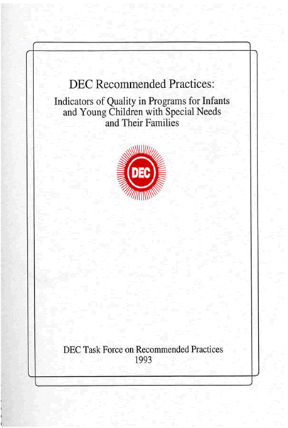
The Recommended Practices in 1993
Notes:
The intent and hope of all individuals participating in this process is that the list recommended practices that follows will provide guidance in developing or evaluating programs for infants and young children with special needs and their families. Furthermore, it is hoped that issues raised during this process will provide a stimulus and focus for future research. These recommended practices reflect the state of the art of EI/ECSE as it exists today. What is state of the art today may be archaic five years from now. Only a continuing process of revoiiew and revision will maintain the quality of a set of indicators that essentially defines the field. Therefore, with this work we hope that we have begun a process which will involve periodic and continual review and discussion of recommended practice for our field

Slide 9
First version of DEC Recommended Practices Book

Slide 10
DEC Recommended Practices #2 1998
Purpose: to update and improve the process for identifying Recommended Practices
Received field-initiated grant from OSEP
Established Team:
David Sexton, Pat Snyder, Marcia Lobman, Bruce Thompson, Sam Odom, Mary McLean, Phil Strain, Susan Sandall, Barbara Smith

Slide 11
Improving the Processes for Identifying Practices
Extensive review of peer reviewed, data-based literature: 1022 articles reviewed in 48 journals!
Coded by methodology using defined coding criteria and training for coders
Group quantitative, single-subject experimental, correlational, descriptive, qualitative, and mixed-method designs
Focus groups of researchers and stakeholders including family members, practitioners, administrators
Synthesized and syncretized findings from literature review and focus groups
Conducted field validation (800 people)
All practices validated as recommended practice
Discrepancy between should be practice and how often seen in practice

Slide 12
Results
240 practices – 7 strands
36% (86) based on professional knowledge/expertise and consensus views
64% (154) supported by empirical literature as well professional knowledge/expertise and consensus views

Slide 13
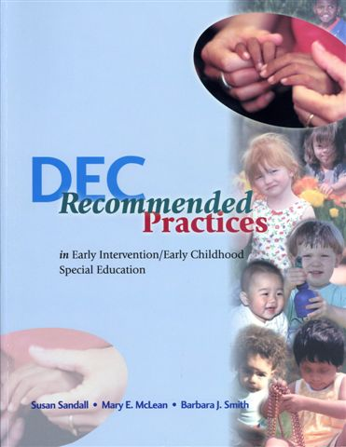
2000 Version

Slide 14
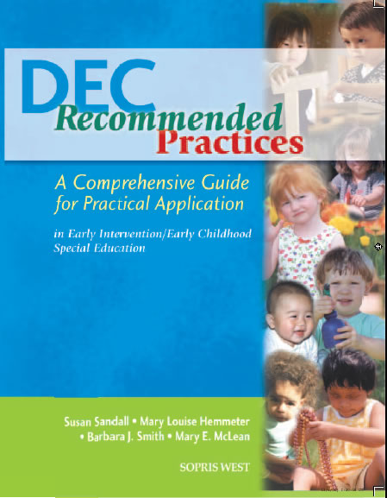
2005 Version

Slide 15
Process for Updating the DEC Recommended Practices
2012 – present
Thanks to Dr. Pat Snyder for her summary of the process leading to the new set of DEC Recommended Practices: Slides 15-27

Slide 16
Updating DEC RP: Timelines and Milestones
2011
DEC Board appoints workgroup to advise about whether and how to update RPs
Workgroup (Carta, Hebbeler, Snyder) provides written recommendations to DEC Board about updating RPs
2012
DEC conducts survey to gather input from field and holds series of forums about updating RPs
DEC shares results of survey about updating RPs
ECTA/DEC collaborate with support from OSEP to update RPs
DEC gathers input from wide range of stakeholders about utility of RP and implementation issues

Slide 17
Updating DEC RP: Timelines and Milestones (continued)
Early 2013
DEC Recommended Practices Commission appointed (13 members)
Mid 2013 2014 and
Ongoing
Iterative processes used to produce revised set of RPs
Action plan and timeline to guide Commission activities
Commission confirms parameters to inform RP revisions
RP topic leads/workgroups established and given parameters – liaisons to topic leads/workgroups from Commission
Validation of evidence “nominated” in support of revised set of RPs
Field input survey – late 2013/early 2014
March 2014 – “Finalize” revised set of RP
Continue processes to identify and validate evidence in support of revised set of RP and regular review and update of RPs
Support implementation in collaboration with ECTA and others

Slide 18
WHAT: Revision and Validation of Division for Early Childhood (DEC) Recommended Practices
Use systematic processes to revise the practices and increase their implementation and widespread use in collaboration with ECTA
Narrow existing list of 240 practices and revise practice statements as appropriate
Set of explicit parameters and criteria

Slide 19
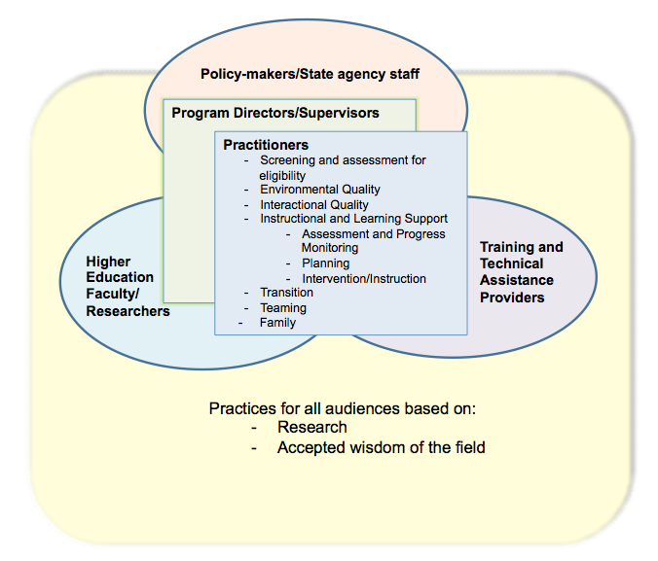
Framework, Parameters, and Key Working Definitions

Slide 20
Definitions
Practice, practitioner, research-based practices
Topic area definitions
Environmental features
Interactional practices
Instructional practices
Transition practices
Assessment practices
Family practices
Teaming and collaboration practices
Leadership practices

Slide 21
Parameters for Revised RP
Population: young children, birth-5 (through kindergarten), who have or are at-risk for developmental delays and disabilities; not limited to those eligible for IDEA services (e.g., children with severe challenging behavior)
Consider current set of DEC Recommended Practices (2005)
Build on, but not duplicate, practice guidelines or standards for typical early childhood settings (e.g., developmentally appropriate practice - DAP)
“Essential,” “biggest bang,” or high leverage/impact practices
Not disability specific
Supported by research, which may include existing published syntheses
Represent the breadth of each identified topic area
Observable
Can be delivered in all settings including natural/inclusive environments
Written from the perspective of being implemented by practitioners
Written in active voice
Written with consistent specificity

Slide 22
WHO: RP Revisions
Commissioners & Liaisons
Barbara Smith, Pam Winton
Kathy Hebbeler & Chelsea Guilllen
Lori Meyer & Tricia Catalino
Judy Carta*
Pat Snyder* & ML Hemmeter*
Susan Sandall*
Kathy Hebbeler & Mary McLean*
Judy Swett & Rashida Banerjee
Pam Winton & Chelsea Guillen
Topic Workgroup Leads
Leadership and Administration
Environmental Practices
Rena Hallam
Interactional Practices
Jeanette McCollum
Instructional Practices
Ilene Schwartz & Juliann Woods
Transition Practices
Beth Rous
Assessment Practices
Jane Squires & Steve Bagnato
Family Practices
Carol Trivette
Teaming and Collaboration
M’Lisa Shelden
* = Evidence Validation & Gap Analysis Subgroup

Slide 23
WHO: Additional Support
Dale Epstein – ECTA Support to Commission
Betsy Ayankoya – ECTA Support to Commission
Evidence Validation
Carl Dunst – ECTA/Evidence Validation & Gap Analysis
Phil Strain – ECTA/Evidence Validation & Gap Analysis
Alissa Rausch – ECTA/Evidence Validation
Glen Dunlap – ECTA/Evidence Validation & Gap Analysis
Carol Trivette – ECTA/Gap Analysis
Lori Roggman – Gap Analysis
Mary Beth Bruder – Gap Analysis
Amy Santos – Gap Analysis

Slide 24
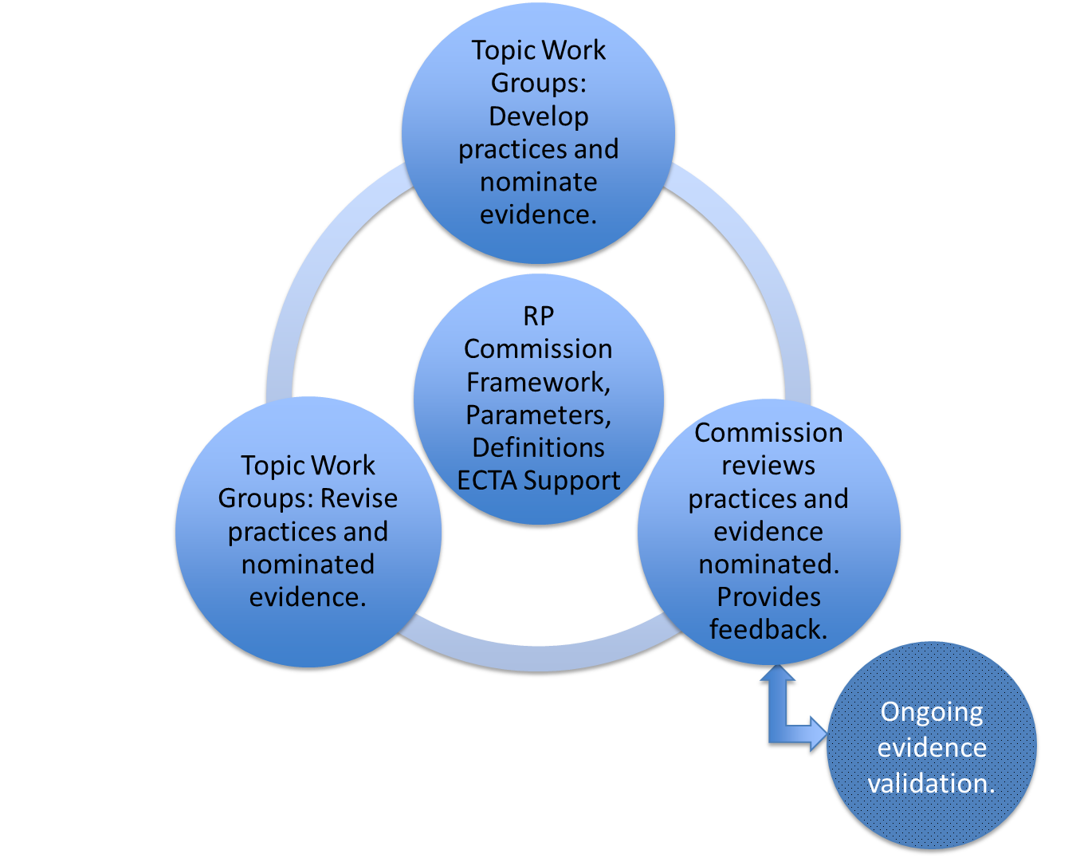
HOW: Iterative Cycles

Slide 25
Nominating and Validating Evidence
Topic groups nominated evidence in support of revised practices
Commission, validation subgroup, and gap analysis group used systematic processes to validate that nominated evidence supported the revised practices

Slide 26
Evidence Validation Activities
Part I – Align Previous Evidence with Revised RPs
Obtain database for the empirical literature used to inform the current set of RPs (i.e., practices from 2000; 2005)
Align relevant studies from this database with the proposed RPs (“Cross-walk” document)
Confirm alignment and examine interrater agreement

Slide 27
Evidence Validation Activities (continued)
Part II – Validate Nominated Evidence for Revised RPs
Purpose: Ascertain if studies cited as evidence for effectiveness of RP demonstrate the practice or aspects of the practice associated with discernable outcomes or benefits for children, families, or practitioners
Nominated evidence part of evidence validation if include description or analysis of relationship between an intervention variable and one or more dependent (outcome) variables
Intervention variable = intentionally planned and implemented or naturally occurring interventions
Categorize type of evidence that supports each RP
Gap analysis group
Validate nominated evidence using systematic coding framework
Identify evidence “gaps” for revised RPs to inform future systematic evidence reviews and research agendas in the field
Notes:
Conduct an initial gap analysis by reviewing evidence/citations provided for each RP by topic workgroups and validate the evidence cited supports each RP using systematic procedures

Slide 28
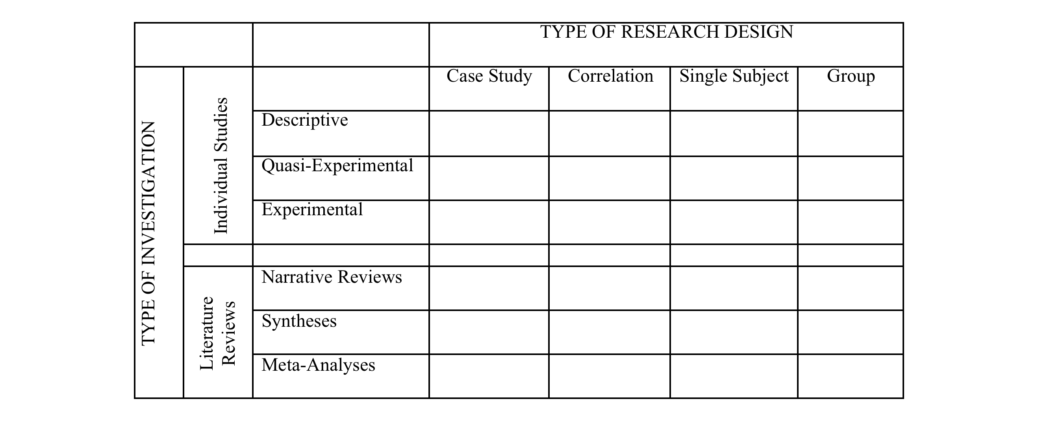
Coding Framework* for Validating Evidence
*Developed by C. Dunst (2013, December) and adopted by RP Commission (2014, January)

Slide 29
Field Input Survey Dec. 18 to Feb. 3
Each practice had the following queries:
“I understand the content of the practice as written.”
(5 pt scale)
“I believe this practice is important enough to be a
recommended practice.” (5 pt scale)
Additional comments:
Any additional practices that should be included:

Slide 30
I understand the content of the practice as written
Leadership - 4.64
Assessment - 4.59
Environment - 4.62
Family - 4.64
Instruction - 4.51
Interaction - 4.55
Teaming/Collab - 4.54
Transition - 4.43

Slide 31
I believe this practice is important enough to be a Recommended Practice
Leadership - 4.65
Assessment - 4.56
Environment - 4.63
Family - 4.60
Instruction - 4.50
Interaction - 4.64
Teaming/Collab - 4.57
Transition - 4.63

Slide 32
Developing an Ongoing Process
The DEC Recommended Practices Commission will undertake the development of an ongoing process for updating and validating the DEC Recommended Practices. A web-based system will be considered.

Slide 33
Examples of Web-Based Systems
National Professional Development Center on ASD
http://autismpdc.fpg.unc.edu/content/briefs
American Speech Language Hearing Association
http://www.asha.org/Members/ebp/default/

Slide 34
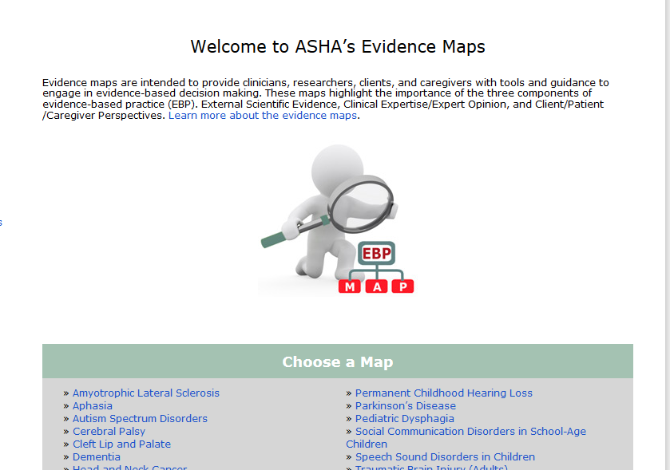
ASHA’s evidence maps

Slide 35
Discussion

Slide 36
Discussion Question #1
1) What comments or questions do you have about the process that was followed for updating the DEC Recommended Practices?

Slide 37
Discussion Question #2
2) What ideas do you have for facilitating the use of the updated practices?

Slide 38
Discussion Question # 3
3) What ideas or suggestions do you have for developing an ongoing system for updating and sustaining the DEC Recommended Practices?

Slide 39
Summary
Final comments
Thanks for your interest in DEC’s Recommend Practices
Recommended Practices -2014
http://www.dec-sped.org/recommendedpractices

