Slide 1
Transforming
Stakeholders’ Roles:
Universal Design for Learning and the Process
of Research in Development
July, 2014
David H. Rose, Ted Hasselbring,
Gabrielle Rappolt-Schlichtmann, and Samantha Daley

Slide 2
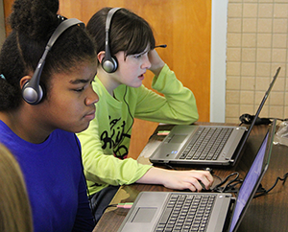
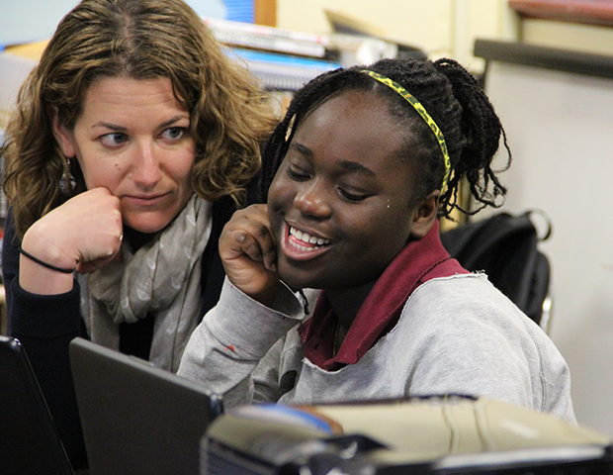
National Center on the Use of Emerging Technologies to Improve Literacy Achievement for Students with Disabilities in Middle School

Slide 3

UDL = Access to Learning
Emotional strain, negative emotions about reading,
and low motivation for reading
Authentic, Valuable and
Relevant Experiences
Access to High Interest,
Age Appropriate Texts
Productive Challenges
Around Text
Comprehension Strategies
Ubiquitous Independent
Practice Across the
Curriculum
Notes:
91% of eighth-grade students with disabilities performed at or below the basic level in reading, with 60% performing below basic (NAEP, 2013)
The statistic that grabbed our attention in thinking about this development effort --
Most students with learning disabilities experience significant social and emotional strain in school, hold negative emotions about reading, and exhibit low motivation for reading including text avoidant behavior
Motivation for reading, [background knowledge, effective use of strategies, and word knowledge] seem to contribute much more strongly to literacy outcomes than word recognition or reading fluency per se.
Lack sufficient knowledge about text conventions and structures & Do not have access to or flexible use of appropriate text comprehension strategies
4. Reading comprehension strategy instruction yields relatively large on literacy outcomes ITEM 4&5

Slide 4
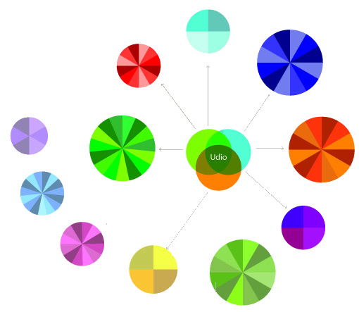
Goals & Approach
Notes:
Create conditions that catalyze ubiquitous practice with text across the curriculum by fostering a passionate interest and investment in reading for students who have traditionally been uninterested in, or disenfranchised by, traditional classroom literacy practices.
Provide opportunities for authentic, valuable and relevant experiences with text that are UDL – “just right” reading instruction around text comprehension strategies including self questioning, reflection, monitoring understanding, and active processing of meaning from text.

Slide 5
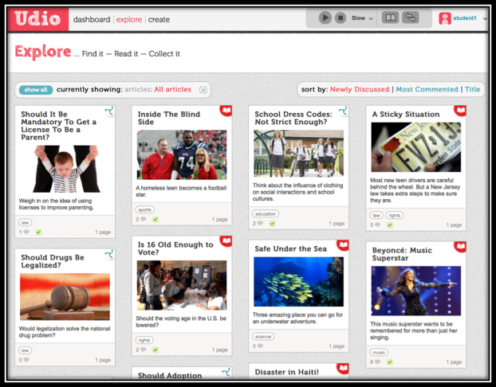
Overview

Slide 6

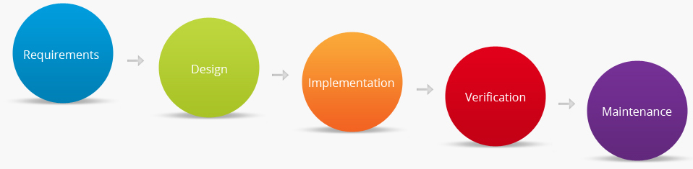
Transforming Roles: A Paradigm Shift

Slide 7

What is Agile?
The story of the two pyramid builders.
Source: John Mayo-Smith, Information Week magazine http://is.gd/DzULAa

Slide 8

Waterfall

Slide 9
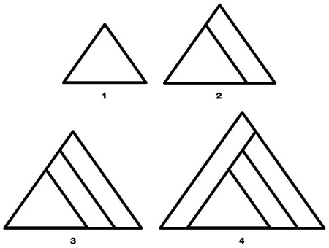
Agile

Slide 10
Compare
Waterfall Process
Fixed time
Fixed budget
Fixed scope and requirements
Hard to deal with uncertainty of estimates
Hard to deal with uncertainty of requirements
No way to take advantage of learning as you go
Agile Process

Slide 11
Compare —Waterfall and Agile
Waterfall Process
Fixed time
Fixed budget
Fixed scope and requirements
Hard to deal with uncertainty of estimates
Hard to deal with uncertainty of requirements
No way to take advantage of learning as you go
Agile Process
Variable scope, evolving requirements
Expect time estimates to be
uncertain
Welcome changes in
requirements
Encourage learning as you go: continuous improvement
Fixed time
Fixed budget

Slide 12
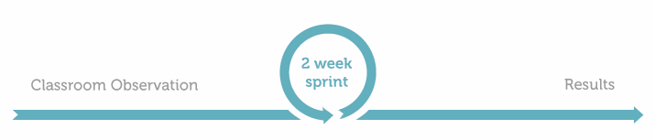
Agile & Design-Based Research
Action
We had students try to create a review of an article they’d read by using Glogster—visually rich and easy-to-use blog software for kids. They were instantly hooked and engaged with creating reviews.
Observation
Distracted in the design details, however, they spent most of their time adjusting the visual aesthetics and layout, and got very little actual writing done.

Slide 13
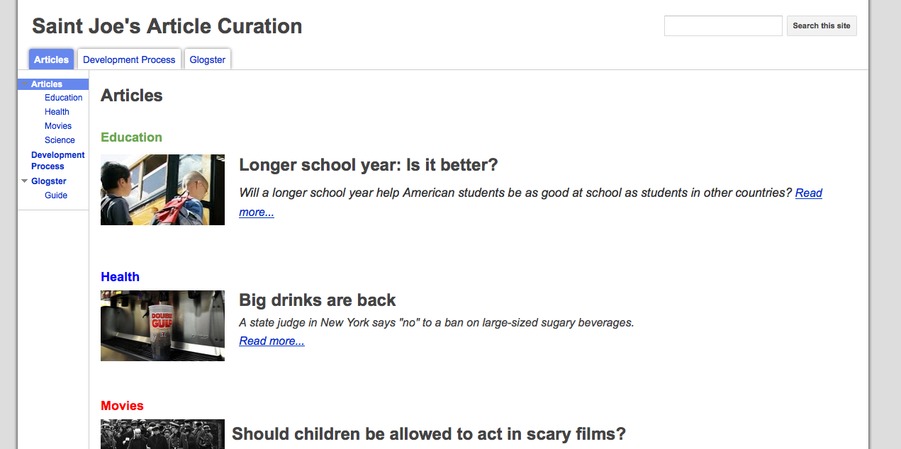
Designing Projects—Articles
Goal: Provide students with means to interact deeply with text by composing a project based on articles.
Sprint #1: What happens when we ask students to compose projects using readily available tools?

Slide 14
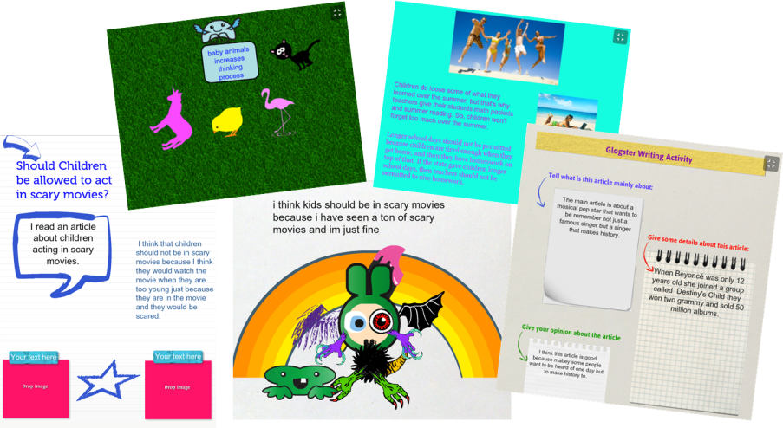
Designing Projects—Reviews
Sprint #1: What happens when we ask students to compose projects using readily available tools? Creating reviews in Glogster.

Slide 15
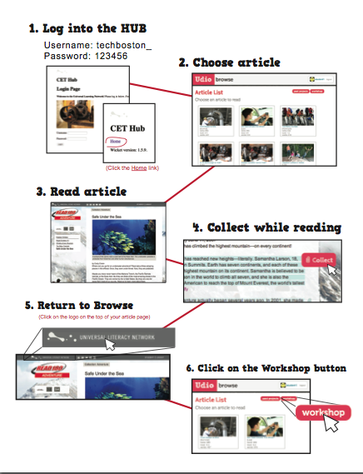
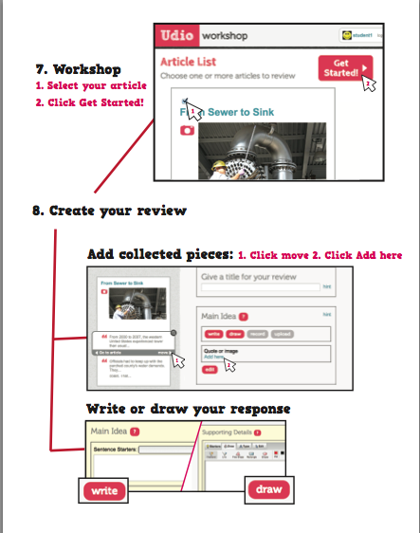
Designing Projects—Flow
Sprint #2: How does the flow work in a Udio prototype?

Slide 16
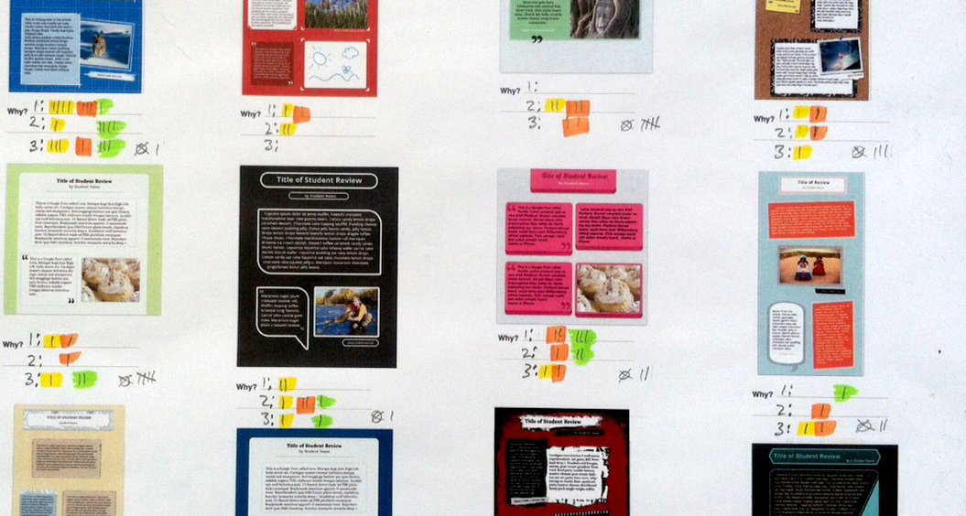
Designing Projects—Styles
Sprint #3: What designs should be available?

Slide 17
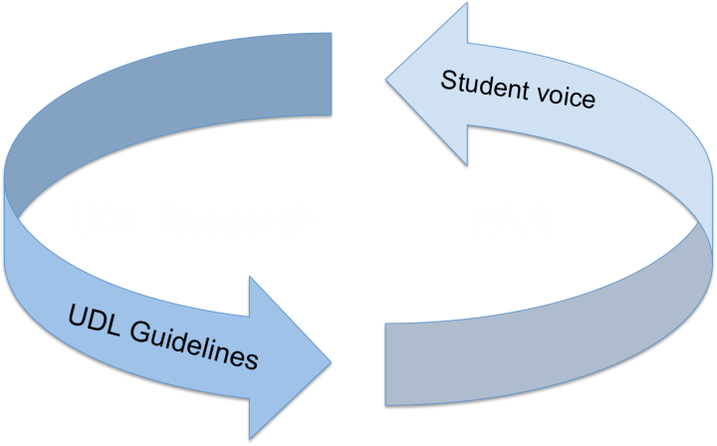
Inclusive Research

Slide 18
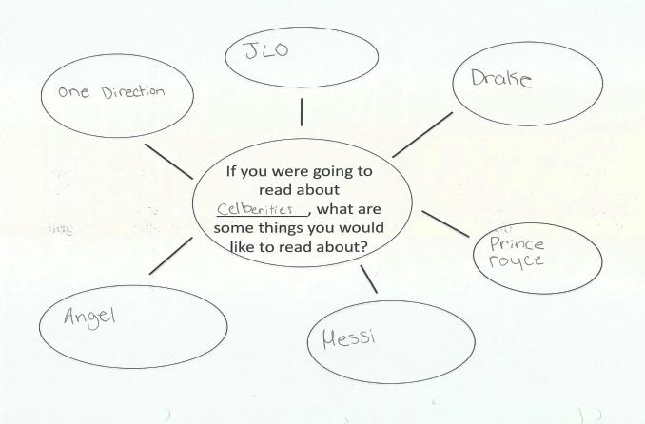
Students as Partners

Slide 19
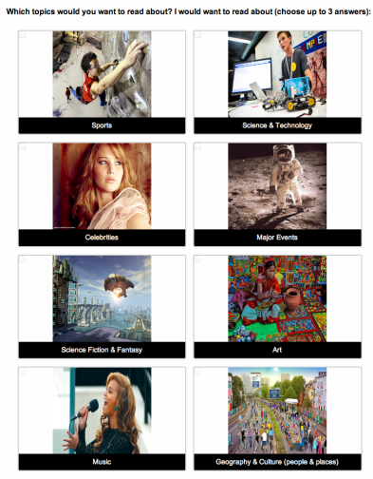
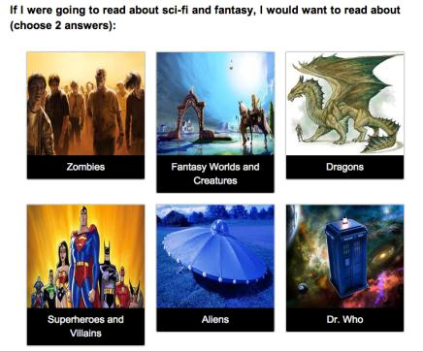
Creating the Content

Slide 20
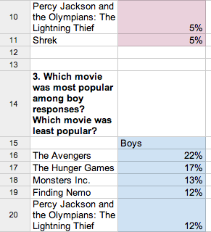
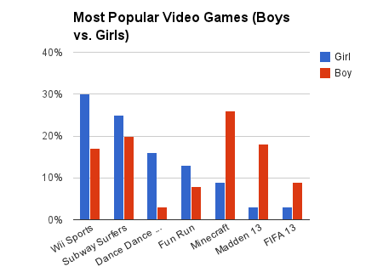
Doing the Analysis

Slide 21
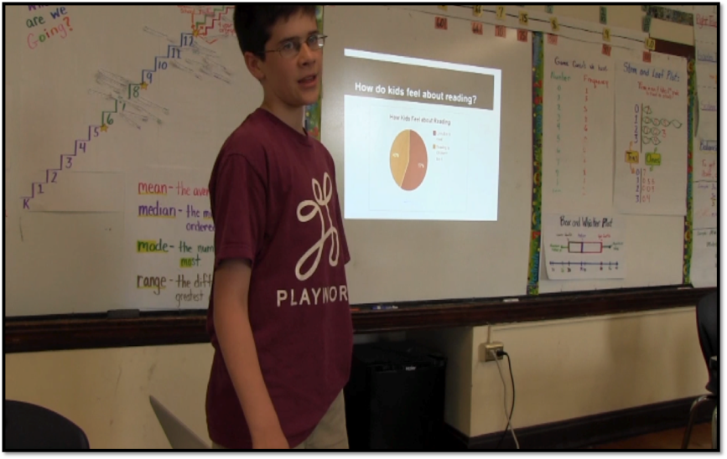
Sharing the Results
Notes:
1. Explain that they will see 3 different kids and one Go Animate presentation (an option we made available for those who felt uncomfortable presenting)
2. Prime the audience to listen for the results (instead of me telling you)

