Slide 1
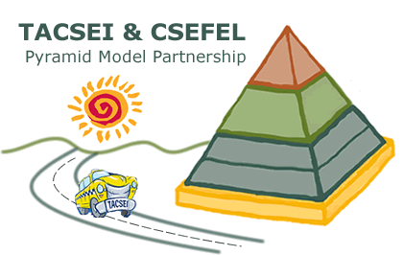
Promoting Social Emotional Competence in All Young Children Through Collaboration
Barbara J. Smith, Ph.D.
University of Colorado Denver
OSEP, July, 2014

Slide 2
2002: The Problem
Concerns about increases in children’s challenging behavior; #1 PD issue
Growing awareness of the relationship between social emotional development and school readiness
Myriad of approaches; lacking comprehensive models or agreement on “what works”

Slide 3
The Center on Social and Emotional Foundations for Early Learning (CSEFEL) funded by Head Start and Child Care, DHHS
www.vanderbilt.edu/csefel

Slide 4
Technical Assistance Center on Social Emotional Intervention (TACSEI) funded by OSEP (Center on Evidence-based Practices: Young Children with Challenging Behavior) Technical Assistance Center on Social Emotional Intervention (TACSEI)

Slide 5
National Collaboration
CSEFEL & TACSEI Partnership!
National Partner Organizations

Slide 6
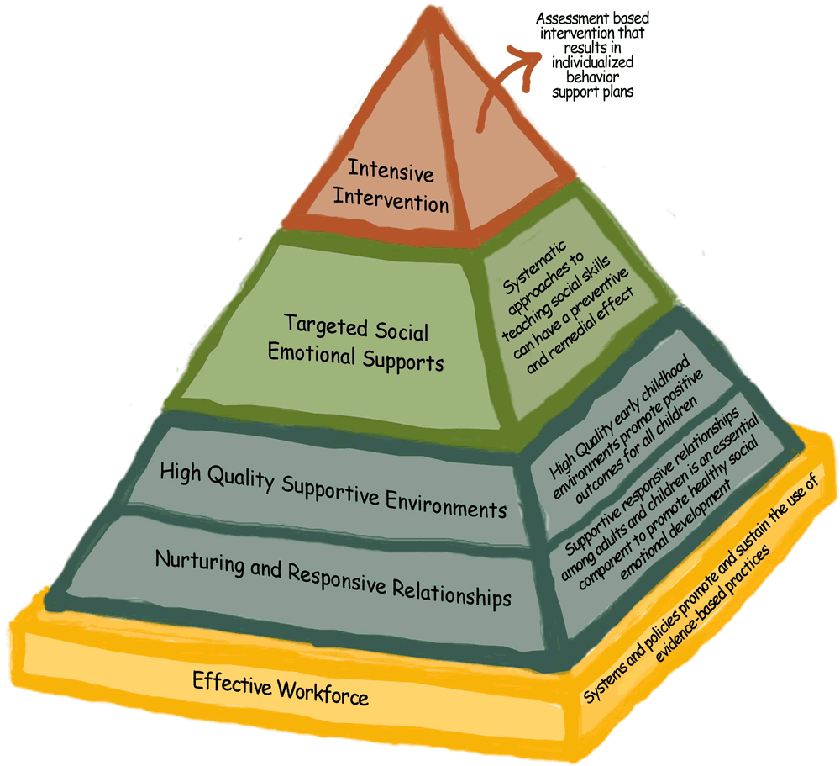
Shared Conceptual Framework: Pyramid Model for Promoting Social and Emotional Competence in Infants and Young Children

Slide 7
National Primary Partners: Shared Message
Division for Early Childhood
of the Council for
Exceptional Children (DEC)
National Association for
Bilingual Education (NABE)
National Head Start
Association (NHSA)
National Association of State
Directors of Special Education
(NASDSE)
National Association of Child Care Resource
& Referral Agencies (NACCRRA)
IDEA Infant and Toddler Coordinators
Association (ITCA)
National Association of State Mental Health Program Directors (NASMHPD)
National Association for the Education of Young Children (NAEYC)
Parent Advocacy Coalition for
Educational Rights (PACER)
IDEA 619 Consortium
Notes:
We not only partner with each other, but also with these important national associations, in bringing you the promotion, prevention, and intervention framework of the Pyramid Model. These organizations are responsible for working with us to bring you this Institute. Leaders from many of our partner associations are here and I would like to recognize them.
Sarah Mulligan, From DEC is here. Sarah, can you stand. In addition to being one of our national partners…DEC does all of the logistics for this event and participates with us in planning the program.
Amy Mazur, from the National Association of Bilingual Education, is here. Amy and NABE have been essential partners as we see to ensure that our approaches and practice reach all children
Amanda Lowe, from the National Association of State Directors of Special Education, is here and represents special education program administrators
Erin Kinavey, of the Infant Toddlers Coordinators Association, works with us to bring the message of the Pyramid Model to state Part C services
Roy Praschil, from the National Association of State Mental Health Program Directors, has assisted us in developing partnerships with state mental health programs and promoting access to early childhood mental health services
Peter Pizzolongo, from the National Association for the Education of Young Children, is here representing NAEYC who has been our partner for the last 10 years. We treasure our relationship with NAEYC and the ability to reach so many early educators through their vast membersip
I want to welcome Judy Swet from the Parent Advocacy Coalition for Educational Rights. PACER and the TA alliance support the national network of parent information centers that help families of children with disabilities gain the information and skills need to support their children’s development and success in school
And we have Maria Synodi, who is representing the IDEA 619 Coordinators Consortium. This is a group of tireless state leaders who provide leadership to special education services for preschool age children

Slide 8
Shared Commitment to TRUE & Intentional Collaboration!
What made a meeting not worth your time?
What made a meeting worth your time?

Slide 9
Shared TA Model: Collaborative Capacity Building
Cross-agency Collaborative State Team:
Collaboratively build infrastructure to implement, scale-up and sustain Pyramid Model practices with fidelity across systems
Accept the collaborative decision making model
Cross-agency Master Cadre of Trainers and Coaches
Pyramid Model demonstration sites with collaborative leadership teams

Slide 10
State Collaboration
CSEFEL States: CA, CO, HI, IA, MA, MD, NC, NE, TN, VT, WI
TACSEI States: AK, MN, NV, WV
Collaborative State Day at the Annual National Training Institute in Florida

Slide 11
“Co-Labor”
Collaboration is a process put into place for an intended outcome
Collaboration is NOT the end it’s the means
Collaboration is only as good as the process that is designed to support the interaction of the people who are supposed to engage in “co-labor”
The collaboration meeting is the “co-labor” “work environment” and therefore, needs to be facilitative of the work to be done

Slide 12
What is the “Work Environment”?:
Establish common ground: vision, language, shared understanding on current context (challenges/resources)
Attend to effective meeting logistics that promote effectiveness, efficiency and ownership/buy-in:
frequency, length, convenience of meetings
ground rules
action oriented
Activities that promote shared decision making and ensuring all voices are heard and appreciated
Provide resources (FTE, time, adm. Support)

Slide 13
What Works: Collaboration/Teaming
Collaboration and collaborative leadership requires:
objective facilitation; adm. support (time, etc)
effective meeting strategies that promote shared decision making, all voices are heard and appreciated, and trust
shared vision about goals
shared ground rules
action oriented

Slide 14
Written Shared Ground Rules
No more than 15 & No representatives
Support decisions made in your absence (!)
Stable attendance
Decision-making (modified consensus: with changes can agree to publicly support decisions)
Communication rules (one at a time, respectful disagreement, etc.)
Celebrate!

Slide 15
Evaluate the Collaboration
Process:
Team meeting evaluations (were objectives met, was the meeting worth your time, how was your participation?)
Outcomes:
Action Plans; infrastructure, policies, etc
Outcomes for children, families and programs

Slide 16
State Collaboration Outcomes
15 State Teams working on scale-up and sustainability:
continuing the collaborative team for up to 10 years!
funding
policies
Staffing
Data collection
embedding the Pyramid work within on-going initiatives
establishing a “home” for the sustained effort, e.g. within an existing program; creating a new “center” across state systems
SHARED OWNERSHIP!

Slide 17
Lessons Learned
Our collaboration approach works!
It takes HARD WORK, COMMITMENT and RELATIONSHIPS=attending to the “work environment”
Collaboration
Collaboration helps sustain and scale-up
Notes:
17

Slide 18
Sustaining Collaboration
The Pyramid Model Consortium
(http://www.pyramidmodel.org/)

Slide 19
Current Collaborations
Sustaining and Scale-up:
15 CSEFEL & TACSEI States
Implementation:
9 NEW States & 3 countries

