Slide 1
Can We Get There From Here? :
A Critical Look at the Provision of Intensive Interventions
George Sugai, Co-director, Positive Behavioral Intervention and Supports Center
Rod Teeple, MTSS Coordinator & School Psychologist, Grand Haven Area Public Schools
Rebecca Zumeta, Deputy Director, National Center on Intensive Intervention
OSEP Project Directors’ Meeting
July 22, 2014

Slide 2
Today’s Presentation
Intensive intervention: What is it and who needs it?
Academic issues
Social behavior issues
Implementation lessons from Grand Haven, MI
Recommendations
Time for discussion

Slide 3

What Is Intensive Intervention?
Intensive intervention addresses severe and persistent learning or behavior difficulties. Intensive intervention should be
Driven by data
Characterized by increased intensity (e.g., smaller group and expanded time) and individualization of academic instruction and/or social behavior supports

Slide 4

Who Needs Intensive
Intervention?
Students with disabilities who are not making adequate progress in their current instructional program
Students who present with very low academic achievement and/or high-intensity or high-frequency behavior problems (often those with disabilities)
Students in a tiered intervention system who have not responded to secondary intervention programs delivered with fidelity
Notes:
Note for second bullet:
The decision to move a student directly to an intensive intervention should be made on an individual and case-by-case basis. In most cases, data should be collected over time to help demonstrate that the student’s low achievement/behavior challenges are both significant AND persistent.

Slide 5



Why Do We Need
Intensive Intervention?
Low academic achievement
Dropout rates
Arrest rates
Notes:
Achievement: 2013 National Assessment of Educational Progress (NAEP) data showed 7 to 16 percent of students with disabilities (SWDs) scored “Proficient” or above across reading and mathematics at Grades 4 and 8.
Dropout: Students with disabilities are more likely to drop out of high school than the general population (Aud et al., 2012; Planty et al., 2008).
Arrest: Twenty-three percent of young adults with disabilities have been arrested at least once, approximately twice the rate of youths in the general population (Sanford et al., 2011)

Slide 6


Why Do We Need
Intensive Intervention? (continued)
More Help
Validated programs are not universally effective programs; 3 to 5 percent of students need more help (Fuchs et al., 2008; NCII, 2013).
More Practice
Students with intensive needs often require 10–30 times more practice than peers to learn new information (Gersten et al., 2008).

Slide 7
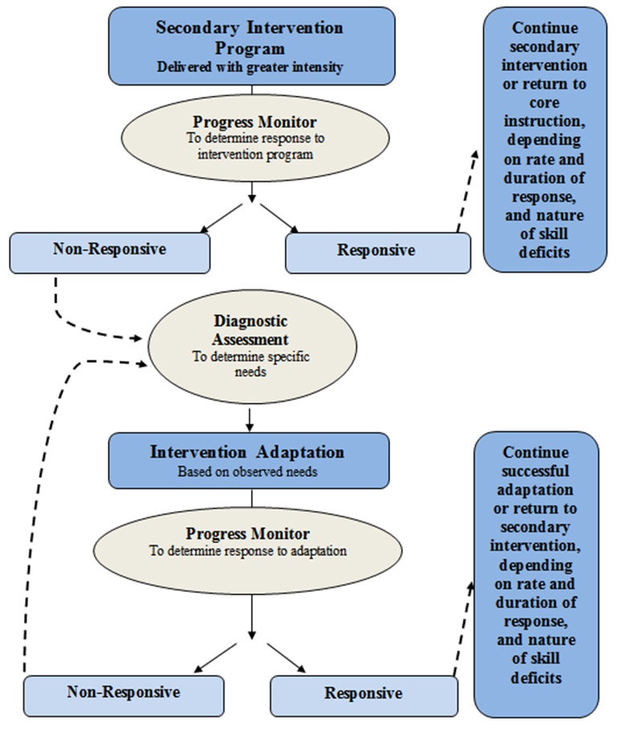
NCII’s approach:
Data-Based Individualization
Notes:
NCII uses this graphic to illustrate the progression of DBI. We begin with a secondary intervention program, delivered with greater intensity, and progress monitor to determine the student’s response. If the student is responsive, then we can continue the current intervention or consider reducing intensity as goals are met (depending on the rate and duration of response and nature of skill deficits). If the student is not sufficiently responsive, then we gather additional information through informal diagnostic assessment, which identifies student needs to guide intervention adaptations. We continue progress monitoring to make decisions about whether the student is responding to the adapted intervention (NCII, 2013).

Slide 8

Academic Issues
Knowledge and skills are necessary, but not sufficient
Confusion about the role of special education
Embedding intensive intervention within broader systems change
Defining implementation fidelity and evidence
Linear implementation of MTSS

Slide 9
#1: Knowledge and skills are necessary, but not sufficient
Getting beyond “programs”
Collection and appropriate use of data
Access to skilled interventionists
Professional development opportunities for staff to improve skills
Time to collaborate and plan

Slide 10
#1: Knowledge and skills are necessary, but not sufficient
Non-Negotiables | Negotiables
Staff Commitment
Principal Intervention staff Special educators | Specific intervention staff involved (e.g., reading specialists, social workers) in training and planning activities
Student Plans
Accurate student data Goal(s) for the intervention Timeline for executing and revisiting the plan | Content Area(s) Number of student plans Grade level(s)
Student Meetings
Data-driven Time to meet Structure | Frequency Schedule Team members
Progress Monitoring Data for Intensive Intervention
Valid, reliable tool Data are graphed Collected at regular intervals | Choice of tool Use of progress monitoring data at other tiers
Students with Disabilities (SWDs)
SWDs must have access to intensive intervention | Who delivers intervention for SWDs Inclusion of students with and without IEPs

Slide 11

#2: Confusion about the role of special education
Special education separate from MTSS/RTI/PBIS
Inability of students with disabilities to access intensive intervention services in many schools
Avoiding referral because general education intervention services “are better than what s/he would get in special ed.”
Uncertainty about when/how identification occurs

Slide 12
#3: Embedding intensive intervention within broader systems change
“We can’t afford to focus on a small number of kids.”
“Our data system won’t let us enter progress monitoring data.”
“But we have to teach the standards.”
“We don’t have time—we have to do teacher evaluation.”
Intensive Intervention
“We’re not allowed to use interventions because of Common Core.”
“We don’t progress monitor kids once they are in special ed.”

Slide 13

#4 Defining implementation fidelity and evidence
At both system and student level
Intervention delivery
Appropriate assessment to validate individual interventions
Follow-through on student plans

Slide 14

#5: Linear implementation of MTSS
“If we wait for Tiers 1 and 2 to be perfect before implementing intensive intervention, we may be waiting forever.”

Slide 15
Social Behavior issues

Slide 16
Intensive Interventions: Behavior
OSEP Project Directors’ Conference
July 22 2014
George Sugai
OSEP Center on PBIS
Center for Behavioral Education & Research
University of Connecticut
June 30 2014
www.pbis.org www.cber.org
10:30-12:00
Notes:
The purpose of this session is to emphasize the connections among school climate, behavior support, and academic success by considering the core features of MTSS. Emphasis will be on the fundamentals related to leadership, theory of action, teaching practices, data-based decision making, culture and context, and tiered systems

Slide 17

PBIS
www.pbis.org
Presentations

Slide 18
PURPOSE
PURPOSE
Review “lessons” about intensive behavior interventions in context of MTBF, &
Outline considerations for future research & implementation

Slide 19
PROGRESS
PROGRESS
MTSS/MTBF
Academic-behavior connections
Universal screening
Function-based support
Data based decision making
School mental health
Others….

Slide 20
Shaping of MTSS
Prevention & Intervention
* Positive behavior support
* Early literacy instruction
* Curriculum-based assessment
* Direct instruction
* Function-based support
* Precision teaching
* Problem solving consultation
Response-to-Intervention
* Universal screening
* Continuous progress monitoring
* Continuum of evidence-based practices
* Implementation fidelity
* Team driven leadership & coordination
* Data-based decision-making
Multi-Tiered Systems of Support
* Multi-tiered behavior framework
* School climate & positive discipline
* School mental health
* Interconnected systems
* Implementation science

Slide 21
Effective Organizations
GOAL to create safe, respectful, effective, & relevant social culture where successful teaching & learning are possible & prosocial behaviors are promoted at ALL LEVELS of CONTINUUM
Common Language
MTSS &
School
Climate
Common Experience
Common Vision/Values
Quality
Leadership

Slide 22
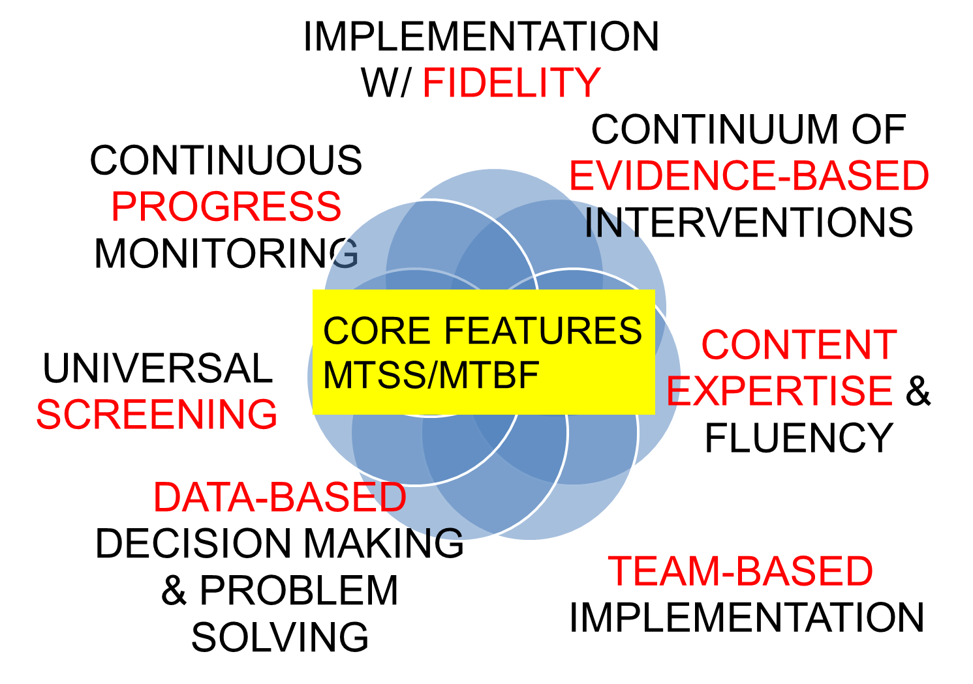
CORE FEATURES
MTSS/MTBF

Slide 23
FBA/BIP Elements & System
*Response class
*Routine analysis
*Hypothesis statement
*Alternative behaviors
*Competing behavior analysis
*Contextual fit
*Strengths, preferences, & lifestyle outcomes
*Evidence-based interventions
Problem Behavior
Functional Assessment
*Implementation support
*Data plan
Team-based
Behavior competence
Intervention & Support Plan
*Continuous improvement
*Sustainability plan
Fidelity of Implementation
Impact on Behavior & Lifestyle

Slide 24
INTENSIVE INTERVENTION CONSIDERATIONS – 5 Steps
INTENSIVE INTERVENTION CONSIDERATIONS
1. Defendable Theory of Action & Logic Model
2. Establishing & Sustaining High Quality Local Behavior Competence
3. Establishing & Sustaining Procedural Routines
4. Professional Development
5. Culture & Context

Slide 25
INTENSIVE INTERVENTION CONSIDERATIONS – Expanded
INTENSIVE INTERVENTION CONSIDERATIONS
1. Defendable Theory of Action & Logic Model
2. Establishing & Sustaining High Quality Local Behavior Competence
3. Establishing & Sustaining Procedural Routines
3a. Meeting agenda
3b. Data systems for progress monitoring
4. Professional Development
3c. Fidelity monitoring
2a. Conducting meetings
2b. Establishing data systems
2c. Developing & monitoring assessment & intervention plans
2d. MTBF/MTSS
1a. Understanding
1c. Assessment
1d. Analysis & evaluation
1b. Practice selection
4a. Pre-service
4b. In-service
4c. Leadership
4d. Multi-disciplinary
4e. Implementation fidelity
5. Culture & Context
5a. Individual & collective learning history
5b. Data driven decision making
5c. Person-centered, strength-based processes

Slide 26
INTENSIVE INTERVENTION CONSIDERATIONS – Step 1
INTENSIVE INTERVENTION CONSIDERATIONS
1. Defendable Theory of Action & Logic Model
1a. Understanding
1c. Assessment
1d. Analysis & evaluation
1b. Practice selection

Slide 27
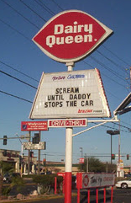
INTENSIVE INTERVENTION CONSIDERATIONS - Negative Reinforcement

Slide 28
Theory of Action
Theory of Action
“Roadmap” that (a) charts causal pathway between strategies needed to answer specific question & to achieve desired outcomes (i.e., “To address X, we must do Y.”) & (b) is based on set of underlying & supporting testable hypotheses (i.e., “addressing X with Y will produce Z.”) (aka logic model).

Slide 29
Behavior analytic approach
George's
Theory of Action
Biology is important
Behavior is learned
Behavior & environment are functional related
Behavior is lawful, therefore understandable & influence-able
Adjust environment to influence & teach behavior
Behavior Analytic Approach
Setting Conditions | Antecedents | Behaviors | Consequences
Notes:
My work is based on THEORETICAL FRAMEWORK called BEHAVIOR ANALYSIS,
And it serves as the FOUNDATION FOR OUR PBIS THEORY OF ACTION.
We emphasize the above points in our work

Slide 30
Coercive Cycle
Non-compliance & non-cooperation
SCHOOL:
Negative School climate
Reactive management
KID:
Negative School Climate
Informal social skills instruction
Poor implementation fidelity of effective practices
Inefficient organization support
Poor leadership preparation
Non-data-based decision making
Inefficient, ineffective instruction
Disrespect
Teasing, harassment, & intimidation
Disengagement & withdrawal
Nonattendance, tardy, & truancy
Violent/aggressive behavior
Littering, graffiti, & vandalism
Substance use
Exclusionary disciplinary practices
Negative adult role models

Slide 31
Positive Reinforcement Cycle
Positive > negative contacts
KID:
Positive School Climate
Compliance & cooperation
SCHOOL:
Positive School Climate
Respect & responsibility
Positive peer & adult interactions
Engagement & participation
Attendance & punctuality
Anger & conflict management
Safe & clean environment
Healthy food & substance use
Self-management behavior
Predictable, consistent, & equitable treatment
Challenging academic success
Adults modeling expected behavior
Recognition & acknowledgement
Opportunity to learn
Safe learning environment
Academic & social engagement

Slide 32
How to jumpstart change?
(-)
S.C.
(+)
student behavior
(+)
S.C.
(-)
student behavior
(-)
S.C.
(+)
S.C.
??????
??????
??????
??????
Positive
Reinforcement
Cycle
Coercive
Cycle

Slide 33
INTENSIVE INTERVENTION CONSIDERATIONS – Step 2
2. Establishing & Sustaining High Quality Local Behavior Competence
2a. Conducting meetings
2b. Establishing data systems
2c. Developing & monitoring assessment & intervention plans
2d. MTBF/MTSS
INTENSIVE INTERVENTION CONSIDERATIONS

Slide 34
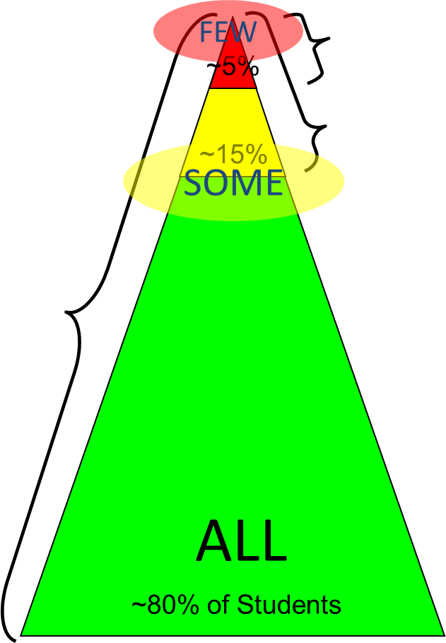
CONTINUUM OF
SCHOOL-WIDE
INSTRUCTIONAL &
POSITIVE BEHAVIOR
SUPPORT
Tertiary Prevention:
Specialized
Individualized
Systems for Students with High-Risk Behavior
CONTINUUM OF
SCHOOL-WIDE
INSTRUCTIONAL &
POSITIVE BEHAVIOR
SUPPORT
Secondary Prevention:
Specialized Group
Systems for Students with At-Risk Behavior
Primary Prevention:
School-/Classroom-
Wide Systems for
All Students,
Staff, & Settings

Slide 35
CORE FEATURES:
School-Wide PBS (Tier 1)
CORE FEATURES:
School-Wide PBS (Tier 1)
Behavior purpose statement
Set of positive expectations & behaviors
Procedures for teaching SW & classroom-wide expected behavior
Continuum of procedures for encouraging expected behavior
Continuum of procedures for discouraging rule violations
Procedures for on-going data-based monitoring & evaluation
Leadership team

Slide 36
CORE FEATURES
Targeted PBS (Tier 2)
CORE FEATURES
Targeted PBS (Tier 2)
Behavior expertise
Increased social skills instruction & practice
Increased adult supervision
Increased opportunity for positive reinforcement
Continuous progress monitoring
Increased precorrection
Team & data driven

Slide 37
CORE FEATURES
Intensive PBS (Tier 3)
CORE FEATURES
Intensive PBS (Tier 3)
Behavior expertise
Functional Based Behavior Support Planning
Wraparound Supports & Culture Driven Person Centered Planning
Comprehensive School Mental Health Supports
Continuous progress monitoring, positive reinforcement & adult supervision
Increased precorrection
Multi-disciplinary Team & data driven

Slide 38
INTENSIVE INTERVENTION CONSIDERATIONS – Step 3
INTENSIVE INTERVENTION CONSIDERATIONS
3. Establishing & Sustaining Procedural Routines
3a. Meeting agenda
3b. Data systems for progress monitoring
3c. Fidelity monitoring

Slide 39
Basic MTBF Implementation Framework
Regional/State Leadership
Internal Coaching Support
School Behavior Team
Student Benefit
  SWPBS practices, data, systems
  Policy, funding, leadership
  1 & 3 yr. action plan
  Data plan
  Leadership
  SWPBS
  CWPBS
  Small group
  Individual student
  Academic
  Expectations & routines
  Social skills
  Self-management
District Behavior Team
School Staff
External Coaching Support
Team Support

Slide 40
Where are you in implementation process?
Adapted from Fixsen & Blase, 2005
✔EXPLORATION & ADOPTION
✔INSTALLATION
✔INITIAL IMPLEMENTATION
SUSTAINABILITY & CONTINUOUS REGENERATION
We think we know what we need, so we ordered 3 month free trial (evidence-based)
Let’s make sure we’re ready to implement (capacity infrastructure)
Let’s give it a try & evaluate (demonstration)
That worked, let’s do it for real (investment)
Let’s make it our way of doing business (institutionalized use)
FULL IMPLEMENTATION

Slide 41
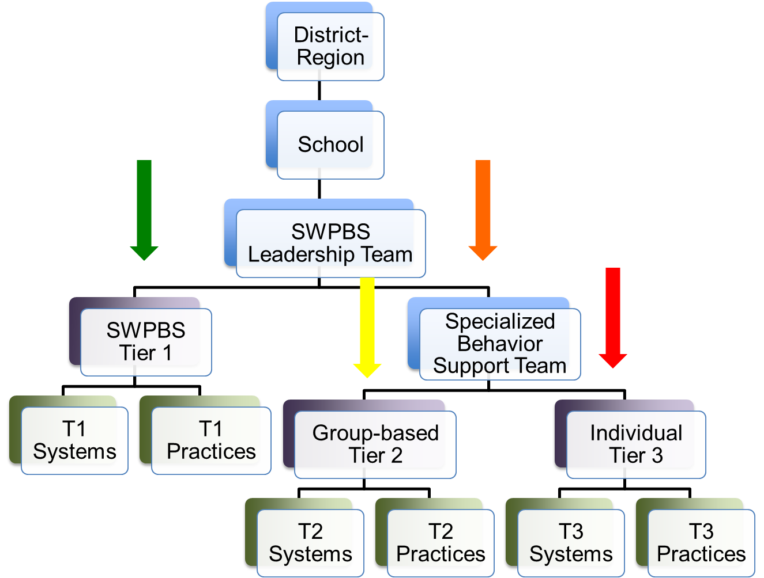
District-Region

Slide 42
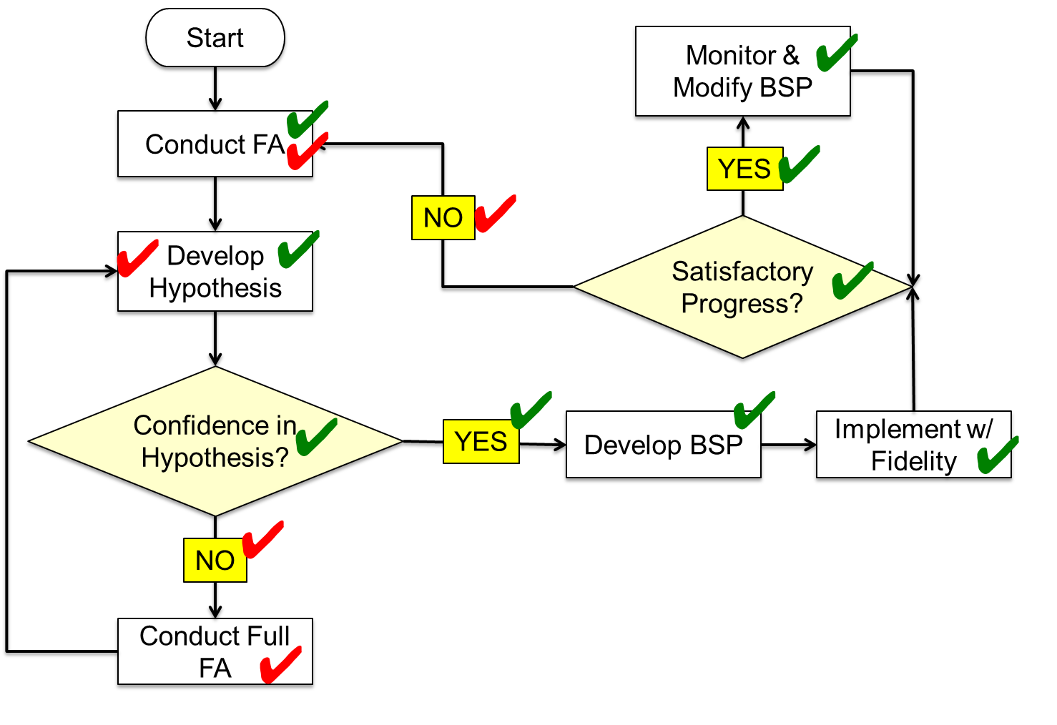
Start

Slide 43
INTENSIVE INTERVENTION CONSIDERATIONS – Step 4
INTENSIVE INTERVENTION CONSIDERATIONS
4. Professional Development
4a. Pre-service
4b. In-service
4c. Leadership
4d. Multi-disciplinary
4e. Implementation fidelity

Slide 44
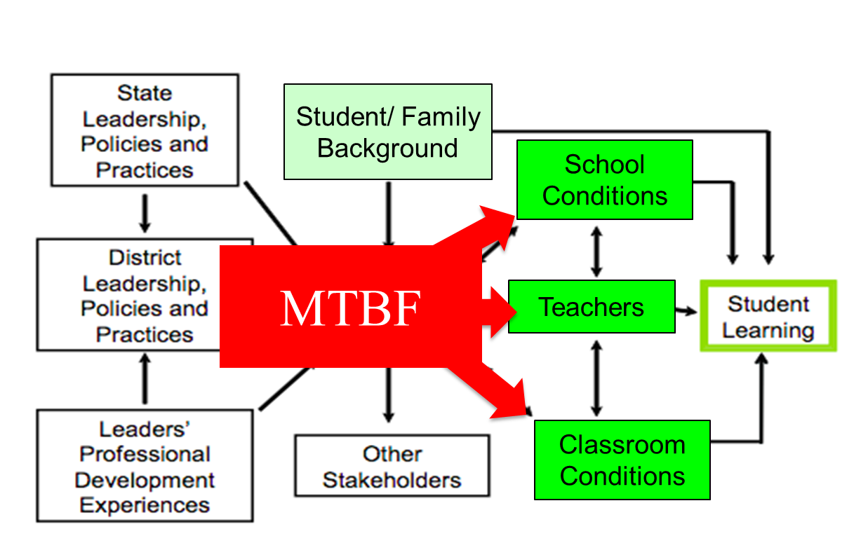
Factors Directly & Indirectly Contributing To Student Learning
Louis, Leithwood, Wahlstrom, & Anderson (2010).

Slide 45
INTENSIVE INTERVENTION CONSIDERATIONS
INTENSIVE INTERVENTION CONSIDERATIONS
5. Culture & Context
5a. Individual & collective learning history
5b. Data driven decision making
5c. Person-centered, strength-based processes

Slide 46
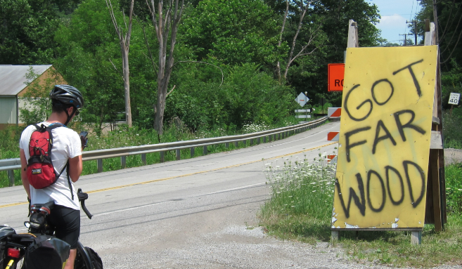
“How far away is the wood, Dad?”
Maryland
Considering Culture, Context, & Learning History

Slide 47
Culture =
Flexible, dynamic, & changed/shaped over time & across generations & setting.
Group of individuals
Overt/verbal behavior
Shared learning history
Differentiates 1 group from others
Predicting future behavior
Collection of learned behaviors, maintained by similar social & environmental contingencies
Sugai, O’Keeffe, & Fallon 2012

Slide 48
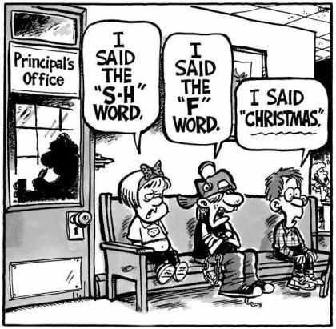
Potential for cultural exchange & conflict
Student
Teacher
Administrator
Family
Community

Slide 49
Considerations
1. School establishes policy for norm violating behavior
2. Kid caught engaging in norm-violating behavior
3. Educator opts to complete discipline referral
4. Administrator opts to formalize incident
ODR Data Point
4 considerations!

Slide 50
ESTABLISHING CONTINUUM of SWPBS
ESTABLISHING CONTINUUM of SWPBS
TERTIARY PREVENTION
SECONDARY PREVENTION
PRIMARY PREVENTION
Notes:
This TIERED LOGIC can be illustrated by a schools that has ALIGNED its BEHAVIOR SUPPORT INTERVENTIONS OR PRACTICES BY THREE GENERAL TIERS
TIER 1 PRACTICES ARE FOR ALL STUDENTS ACROSS ALL SCHOOL SETTINGS
TIER 2 PRACTICES ARE FOR STUDENTS WHO REQUIRE SUPPLEMENTAL SPECIALIZED (SMALL GROUP) SUPPORTS
TIER 3 PRACTICES ARE HIGHLY SPECIALIZED AND INTENSIVE FOR INDIVIDUAL STUDENTS.
It is important to notice that these practices are
SMALL IN NUMBER
CONCEPTUALLY ALIGNED
AND WOULD HAVE DATA RULES FOR MOVEMENT UP AND DOWN THE CONTINUUM

Slide 51
Message
Message
We have need, enthusiasm, & practices; however, we need to improve precision, explicitness, & fluency of our local implementation capacity

Slide 52
PROGRESS
PROGRESS
MTSS/MTBF
Academic-behavior connections
Universal screening
Function-based support
Data based decision making
School mental health

Slide 53
INTENSIVE INTERVENTION CONSIDERATIONS – Step 5
INTENSIVE INTERVENTION CONSIDERATIONS
1. Defendable Theory of Action & Logic Model
2. Establishing & Sustaining High Quality Local Behavior Competence
3. Establishing & Sustaining Procedural Routines
4. Professional Development
5. Culture & Context

Slide 54
Intensive Intervention Considerations Overall View
Intensive Intervention Considerations
Defendable Theory of Action & Logic Model
Establishing & Sustaining High Quality Local Behavior Competence
Establishing & Sustaining Procedural Routines
Meeting agenda
Data systems for progress monitoring
Professional Development
Fidelity monitoring
Conducting meetings
Establishing data systems
Developing & monitoring assessment & intervention plans
MTBF/MTSS
Understanding
Assessment
Analysis & evaluation
Practice selection
Pre-service
In-service
Leadership
Multi-disciplinary
Implementation fidelity
Culture & Context
Individual & collective learning history
Data driven decision making
Person-centered, strength-based processes

Slide 55
MTSS & Kid Benefit
Supporting Important Culturally Equitable Academic & Social Behavior Competence
OUTCOMES
Supporting Culturally Knowledgeable Staff Behavior
Supporting Culturally Valid Decision Making
SYSTEMS
DATA
PRACTICES
Vincent, Randall, Cartledge, Tobin, & Swain-Bradway 2011; Sugai, O’Keeffe, & Fallon, 2012ab
Supporting Culturally Relevant Evidence-based Interventions
Notes:
CULTURE is one our major considerations, and CULTURAL INFLUENCE is reflected in high attention toward
CULTURAL EQUITY of expectations
CULTURAL VALIDITY of data
CULTURAL RELEVANCE of practices
CULTURAL KNOWLEDGE of implementers

Slide 56
MTBF
Basic
“Logic”
Cultural/Context Considerations
Maximum
Student
Outcomes
SYSTEMS
DATA
Start w/ effective, efficient, & relevant, doable
PRACTICES
Implementation
Fidelity
Training
+
Coaching
+
Evaluation
Prepare & support implementation
Improve “Fit”
Notes:
I LOVE This animation! Very cool!!!

Slide 57
references
Barrett, S., Eber, L., & Weist, M. (Eds.) (2014, Advancing education effectiveness: Interconnecting school mental health and school-wide positive behavior support. OSEP Technical Assistance Center on Positive Behavioral Interventions and Supports. University of Oregon, Eugene.
Evans, S. W., Stephan, S. H., & Sugai, G. (2014). Advancing research in school mental health: Introduction of a special issue on key issues in research. School Mental Health, 6, 63-67.
Horner, R. H., Sugai, G. Todd, A. W., & Lewis-Palmer, T. (1999-2000). Elements of behavior support plans: A technical brief. Exceptionality, 8, 205-216.
Ingram, K., Lewis-Palmer, T., & Sugai, G. (2005). Function-based intervention planning: Comparing the effectiveness of FBA indicated and contra-indicated intervention plans. Journal of Positive Behavior Interventions, 7, 224-236.
Sugai, G., & Horner, R. H. (1999-2000). Including the functional behavioral assessment technology in schools (invited special issue). Exceptionality, 8, 145-148.
Sugai, G., Horner, R. H., Dunlap, G., Hieneman, M., Lewis, T. J., Nelson, C. M., Scott, T., Liaupsin, C., Sailor, W., Turnbull, A. P., Turnbull, H. R., III, Wickham, D. Reuf, M., & Wilcox, B. (2000). Applying positive behavioral support and functional behavioral assessment in schools. Journal of Positive Behavioral Interventions, 2, 131-143.
Sugai, G., & Lewis-Palmer, T. (Eds.) (2004). Invited special Issue: Function-based assessment. Assessment for Effective Instruction, 30.
Sugai, G., & Lewis-Palmer, T. (2004). Overview of function-based approach to behavior support within schools (invited special issue). Assessment for Effective Instruction. 30, 1-6.
Sugai, G., Lewis-Palmer, T., & Hagan-Burke, S. (1999-2000). Overview of the functional behavioral assessment process. Exceptionality, 8, 149-160.
Sugai, G., & Stephan, S. (2014). Considerations for a school mental health implementation framework. In S. Barrett, L. Eber, & M. Weist (Eds.), Advancing education effectiveness: Interconnecting school mental health and school-wide positive behavior support (pp. 18-33). OSEP Technical Assistance Center on Positive Behavioral Interventions and Supports. University of Oregon, Eugene.

Slide 58

Advancing education effectiveness

Slide 59
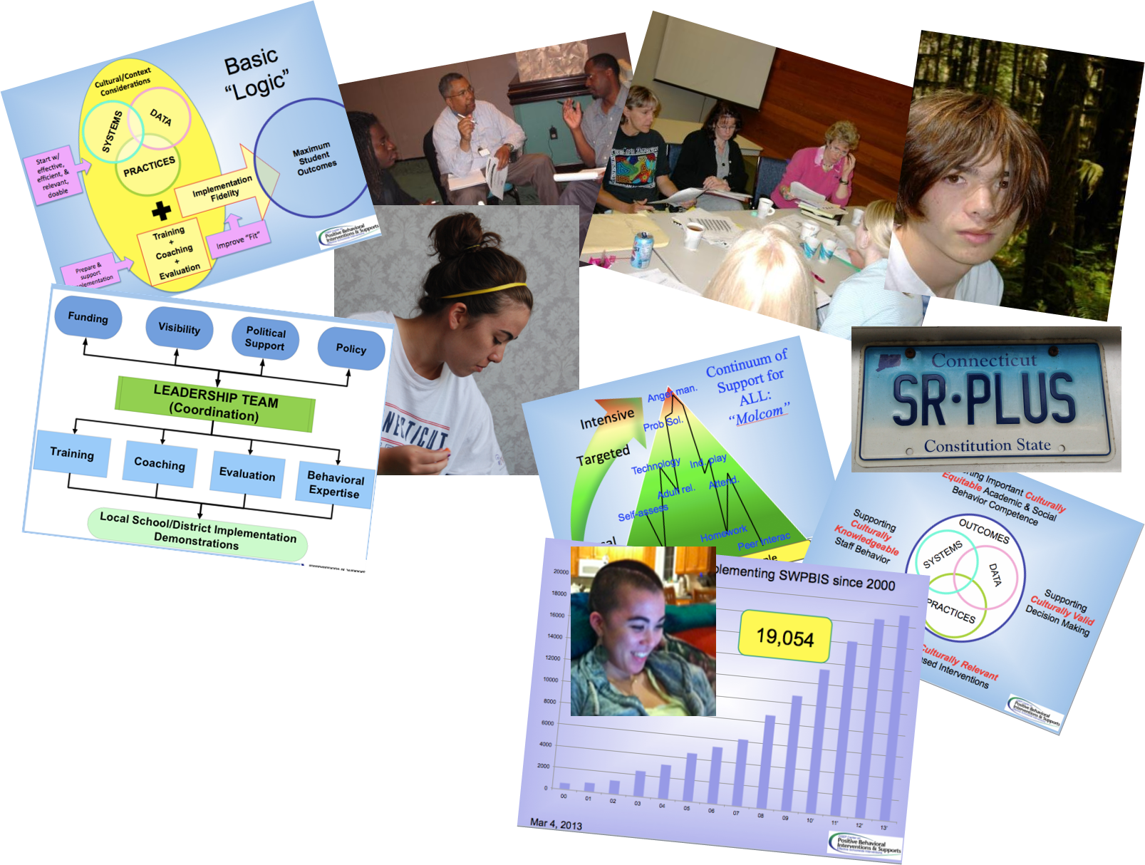
pictures
Lewistj@missouri.edu
RobH@oregon.edu
George.sugai@uconn.edu
www.pbis.org

Slide 60
Grand Haven’s Experience

Slide 61

Grand Haven

Slide 62
Grand Haven Area Public Schools
Approximately 6,000 students
100 square miles
Mix of populations
  semi-suburban
  small town
  rural
7 elementary schools
1 intermediate school
1 junior high school
1 high school
Two elementary buildings involved in state RTI pilot grant in 2000 (MiBLSi)
Gradually moved all elementary schools and intermediate school through grant process
Many gains with Tier I and II
Still not reaching students with the most intensive needs, both in and out of special education programming

Slide 63

Systems Challenges - Resources
Resources (number of intervention providers, consumables needed, technology based interventions)
Funding issues with at-risk grants

Slide 64
Systems Challenges - Scheduling
Scheduling for core and for intervention time
Starting with tier two and leaving no time in schedule to advance
Specials schedule (art, music, PE) set by district, often later in the summer

Slide 65
Systems Challenges – Decision Making
Unclear decision making power. District administration, principal, intervention provider
Tier 3 in name only or very protocol based

Slide 66
Implementation Challenges - Beliefs
Belief systems challenge both systems
  Labeling Tier III students as “lifers” versus providing interventions to accelerate achievement
  Rewards versus intrinsic motivation
  Holistic instruction vs individual skills, such as phonics

Slide 67
Implementation Challenges - Behavior
Academic interventions have set blocks of time and staff attached...behavior does not
Behavior has potential to escalate quickly

Slide 68
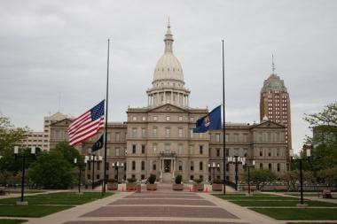
State Challenges
Despite strong MiBLSi system in Michigan, lack of:
  Clear mandate in state rules or policy
    - No required implementation standards
    - No accountability system for MTSS

Slide 69

Actions - Data
Rely on data to make decisions
Assistance to staff for understanding data

Slide 70
Actions - Funding
Dual funding for special education itinerant & teaching staff
  - Allowed greater flexibility to see students

Slide 71
Actions – Planning at District Level
  Realign resources, plan schedules earlier, consider tiers ahead of time, build in flexibility
  PBIS implementation written as a board of education goal

Slide 72
Discussion Questions
In your experience, what barriers prevent schools from delivering intensive interventions?
In your experience, what facilitates high fidelity implementation of intensive interventions & maximum student benefit?
How might national, state, or regional TA entities help support schools & districts improve their capacity to implement intensive interventions?
Based on this discussion, what are your recommendations & comments regarding policy, research, & practice with respect to implementation of intensive interventions?

Slide 73
References
Aud, S., Hussar, W., Johnson, F., Kena, G., Roth, E., Manning, E., Wang, X., & Zhang, J.. (2012). The condition of education 2012 (NCES 2012-045). Washington, DC: U.S. Department of Education, Institute of Education Sciences, National Center for Education Statistics. Retrieved from http://nces.ed.gov/pubs2012/2012045.pdf
Fuchs, L.S., Fuchs, D., Powell, S. R., Seethaler, P. M., Cirino, P. T., & Fletcher, J. M. (2008). Intensive intervention for students with mathematics disabilities: Seven principles of effective practice. Learning Disability Quarterly, 31, 79–92.
Gersten, R., Compton, D., Connor, C. M., Dimino, J., Santoro, L., Linan-Thompson, S., & Tilly, W. D. (2008). Assisting students struggling with reading: Response to intervention and multi-tier intervention for reading in the primary grades. A practice guide (NCEE 2009-4045). Washington, DC: U.S. Department of Education, Institute of Education Sciences, National Center for Education Evaluation and Regional Assistance. Retrieved from http://ies.ed.gov/ncee/wwc/PracticeGuide.aspx?sid=3
National Center for Education Statistics. (2013). The Nation’s Report Card: A first look: 2013 mathematics and reading (NCES 2014-451). Washington, DC: U.S. Department of Education, Institute of Education Sciences. Retrieved from http://nationsreportcard.gov/reading_math_2013.

Slide 74
References Continued
National Center on Intensive Intervention. (2013). Data-based individualization: A framework for intensive intervention. Washington, DC: U.S. Department of Education, Office of Special Education.
Planty, M., Hussar, W., Snyder, T., Provasnik, S., Kena, G., Dinkes, R., KewalRamani, A., & Kemp, J. (2008). The condition of education 2008 (NCES 2008-031). Washington, DC: U.S. Department of Education, Institute of Education Sciences, National Center for Education Statistics. Retrieved from http://nces.ed.gov/pubs2008/2008031.pdf
Sanford, C., Newman, L., Wagner, M., Cameto, R., Knokey, A.-M., & Shaver, D. (2011). The post-high school outcomes of young adults with disabilities up to 6 years after high school. Key findings from the National Longitudinal Transition Study-2 (NLTS2) (NCSER 2011-3004). Menlo Park, CA: SRI International. Retrieved from http://www.ies.ed.gov/ncser/pubs/20113004/pdf/20113004.pdf

Slide 75
Contact
Contact
George Sugai
sugai.george@gmail.com
Rod Teeple
teepler@ghaps.org
Rebecca Zumeta
rzumeta@air.org

