Slide 1
Effective Teacher Preparation
Starts with Effective Teaching:
Strategies from Cognitive Psychology about Learning and Memory
Carolyn Dufault, Ph.D.
Sheri Berkeley, Ph.D.
Mary Brownell, Ph.D.
Moderator: Heather Hayes, Ph.D.
Notes:
Welcome!
HH
Introduce participants briefly
Carolyn
Sheri
Mary
Goals and Agenda overview

Slide 2
Agenda
Goals
Provide information about current research on the science of adult learning and memory.
Discuss practical, evidence-based strategies to improve pre-service teachers’ retention and application of information learned in their special education university coursework.
Discuss/explore barriers to strategy implementation. Generate ideas and suggestions for how the field of special education can inform the field of cognitive psychology.
Carolyn
Sheri
Mary
Active Discussion
Notes:
General story line:
What do we know about learning and memory in the classroom (adults)? (Carolyn) One aspect is metacognition.
We’ll turn for a moment to learn about what children with disabilities know about knowing. (Sheri)
Now, let’s consider what we can do to enhance learning and memory among our pre-service teachers…including exploring ways to apply knowledge, and potential barriers of training experts in changing environments (e.g., field placements). (Mary)

Slide 3

The Science of Adult Learning
Carolyn Dufault, Ph.D.
Education Specialist
Washington University School of Medicine

Slide 4
The Science of Adult Learning
Notes:
Cognitive Scientists/Psychologists who focus on learning and memory investigate and identify the basic building blocks of learning, mostly through experimental investigations in the laboratory (with “educationally relevant materials) and some classroom experiments – though true experiments in the classroom are difficult to do (for many reasons).
This diagram includes just some of the areas where the research is most developed, but this list is by no means exhaustive. Other Cog science research on on learning include:
Attention
Visualization
Multimedia learning
Time of day effects
Interleaving
And more!

Slide 5
The Science of Adult Learning (continued)
Notes:
Today’s Focus is on three topics with best set of evidence and options for transfer from lab to practice of teaching: Retrieval Practice, Metacognition, and Spacing. Will talk about the first two as a set and then spacing.
But first….

Slide 6

First, a trip to the bookstore…
Notes:
Let’s start with a trip to the Bookstore!
MANY, MANY great summer reading options on the topic of today’s panel. Usually save references for the end, however I would like to introduce them to you today early and often so that you know where to find this information (and share it with your colleagues!) going forward. (Also would like to show how much popular interest there is right now in this topic help sort out some of the signal from the noise with a review of “best-bet” high-quality resources…)
(Brookline Booksmith, Brookline, MA, Photo source: http://fitmamaeats.squarespace.com/home/book-review-chicken-soup-for-the-soul-say-hello-to-a-better.html)

Slide 7
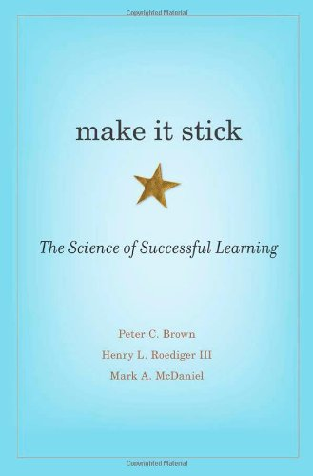
Book about learning
Notes:
Published March 2014
Peter C. Brown is a writer and novelist in St. Paul, Minnesota.
Henry L. Roediger III is James S. McDonnell Distinguished University Professor of Psychology at Washington University in St. Louis.
Mark A. McDaniel is Professor of Psychology and Director of the Center for Integrative Research on Cognition, Learning, and Education (CIRCLE) at Washington University in St. Louis.

Slide 8
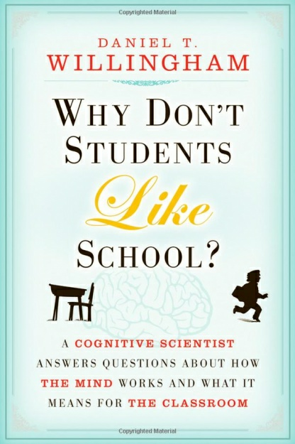
Book about learning (continued)
Notes:
Published March 2010
For more information,
http://www.danielwillingham.com/

Slide 9

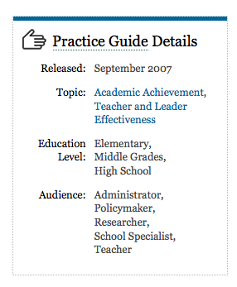
IES practice guide about learning
Notes:
PDF available at:
http://ies.ed.gov/ncee/wwc/pdf/practice_guides/20072004.pdf

Slide 10
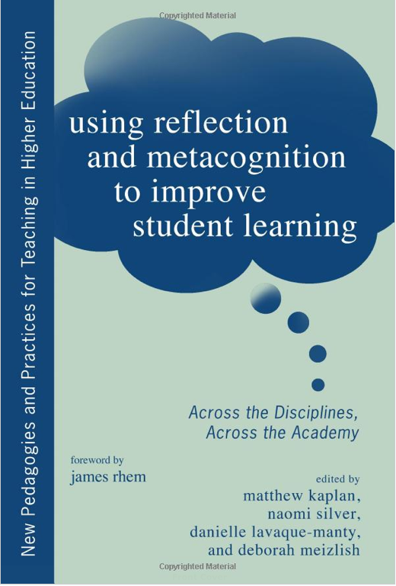
Book about learning (continued 2)
Notes:
Published April 2013
http://www.amazon.com/Reflection-Metacognition-Improve-Student-Learning/dp/1579228259

Slide 11
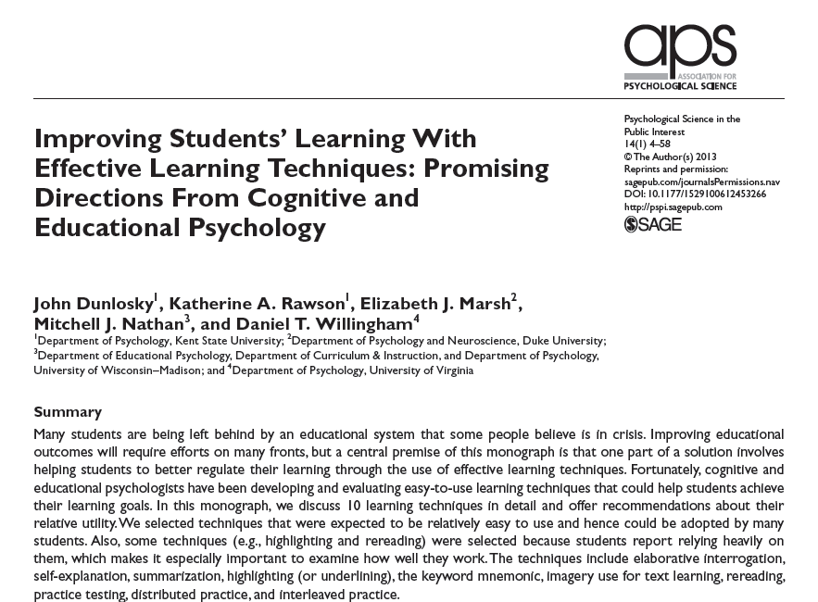
Article about learning
Notes:
Dunlosky, J., Rawson, K. A., Marsh, E. J., Nathan, M. J., & Willingham, D. T. (2013). Improving Students’ Learning With Effective Learning Techniques Promising Directions From Cognitive and Educational Psychology. Psychological Science in the Public Interest, 14(1), 4-58.

Slide 12

Book about learning (continued 3)
Notes:
Published January 2014 – FREE e-book from the APA!
http://teachpsych.org/ebooks/asle2014/index.php
The first of the two books comes with a somewhat daunting title:
Applying Science of Learning in Education: Infusing Psychological
Science Into the Curriculum. Edited by Victor A. Benassi, Catherine
E. Overson, and Christopher M. Hakala, the book was published in
January by the American Psychological Association’s Society for
the Teaching of Psychology. The society and the book’s editors
wanted to make the research widely available to academics, so
they have published it as a free e-book.

Slide 13
Pop Quiz!
I just reviewed six suggested resources that you may want to use to learn more about the science of adult learning.
1. What were the titles?
2. How many titles are you likely to recall in 20 minutes? In two days? In two months?
Notes:
If you took notes, try to recall them without looking down at anything you wrote.
Ask again at the end of the talk…(my section or full presentation?)

Slide 14
The Science of Adult Learning 2
Notes:
Cognitive Scientists/Psychologists investigate the core cognitive elements of learning by understanding how biology produces behavior.
The cognitive pscy
I would like to give you a sense of the perspectives that cognitive psychology has to offer
These are just some of the areas where the research is most developed, but this list is by no means exhaustive
Cog science research on many other topics including:
Attention
Visualization
Multimedia learning
Time of day
Interleaving
And more!

Slide 15
Retrieval Practice in the Lab
Participants - 80 Purdue University undergraduates
Materials - A 276-word science text on Sea Otters
Design – Four learning condition groups:
  Group 1 - Study once (read passage once)
  Group 2 - Repeated study (read passage four times)
  Group 3 - Concept mapping (generate graphical scheme)
  Group 4 - Retrieval practice (free recall content of passage)
At time of learning: Prediction of retention after one week
Final Test: 1 week delay – Fact and Concept questions
Karpicke and Blunt, Science, 2011
Notes:
Participants – 80 Undergrads participated for course-credit
Materials –Text on Sea otters (same used by Roediger and Karpicke, 2006): “Two prose passages were selected from the reading comprehension
section of a test-preparation book for the Test of English as a Foreign Language (TOEFL; Rogers, 2001). Each passage covered a single topic (‘‘The Sun’’ and ‘‘Sea Otters’’), and each was divided into 30 idea units for scoring purposes. The passages were 256 and 275 words in length, respectively.
Design – Four learning conditions (20 unique participants in each condition).
Procedure – Participants were told they would “read and study” a science text. – all read passage for single 5 minute period
Study Once: 5-min period to read the passage
Repeated Study: 5-min period to read the passage, then 3 additional 5-min study periods (total of 4 times reading the passage) – 1 minute break between periods
Concept Mapping: 5-min period to read the passage, then participants received directions about producing concept maps, had 25 minutes to create map (allowed to look at example concept map and the passage)
Retrieval Practice: 5-min period to read the passage, then told to recall “as much of the information from the text as they could, in any order they chose”. Typed responses in a blank box on a computer screen. Participants then reread the passage for another 5 mins, and recalled again for 10 mins.
NOTE: Learning times were identical in the concept map and retrieval practice conditions.
TEST questions: Verbatim and Inference questions were both short answer (paper-and-pencil test) – all completed within 15 minutes (21 possible points –14 from verbatim questions and 4 from the inference questions)

Slide 16
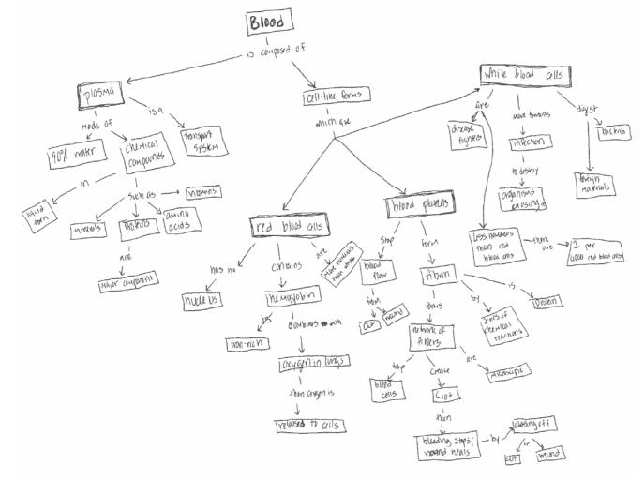
Concept Mapping vs.
Retrieval Practice
Karpicke & Blunt (2011)

Slide 17
Repeated Study vs.
Concept Mapping vs. Retrieval Practice
Karpicke & Blunt (2011)

Slide 18
Metacognitive Predictions
Karpicke & Blunt (2011)
Notes:
Participants were asked to predict how much of the material they would remember in one week (an aggregate judgment of learning). They made their predictions using an 10-point scale (0%, 10%, 20% ... 80%, 90%, 100%).

Slide 19
Retrieval Practice in Medical Teaching
Participants – 40 Washington University Medical Residents
Materials – Interactive teaching sessions on Status Epilepticus (SE) and Myasthenia Gravis (MG)
Design – Two counterbalanced groups:
  Group 1 – Quizzes on SE, Read review sheets on MG
  Group 2 – Quizzes on MG, Read review sheets on SE
  Quizzing and rereading at intervals of 2 weeks
  Final Test at 6 months after initial teaching session => Conceptual short answers
Results: Final Test scores were 13% higher for quizzed material
Larsen, Butler, Roediger, Medical Education, 2009
Notes:
SE = Statusepilepticus, MG= Myasthenia gravis

Slide 20
Feedback enhances retrieval effect
Related findings
Feedback decreases the amount of incorrect information that students “learn” from multiple choice tests (Butler and Roediger 2008)
Feedback dramatically improves subsequent performance on questions that students initially get incorrect (Butler and Roediger 2008; Butler, Karpicke and Roediger 2008)
Feedback improves subsequent performance on questions that students initially get correct, especially when they report low confidence in their answers (Butler and Roediger 2008; Butler, Karpicke and Roediger 2008)

Slide 21
Why does Retrieval Practice work?
Aids in the development of an “organizational retrieval structure”.
Improves and sharpens the quality of cues used to retrieve relevant information.
Should retrieval practice be used in class, outside of class, or both?
New ways to use retrieval practice in the classroom?
Notes:
“Cues solve the retrieval quandary by triggering the information
needed in a given situation. When we encode information,
such as a name, we link it to other information that
is present at the time—a face, a person’s appearance, where
we’re standing when we are introduced. Provided with the
right set of cues, we can retrieve that person’s name.Without
those cues, we are at a loss. That’s why we all experience the
unsettling situation from time to time of vaguely knowing
that we know”

Slide 22
Metacognition – what is it?
Metacognition – Thinking about thinking
  “Metacognition refers to one’s knowledge concerning one’s own cognitive processes and products or anything related to them.”
Reflection – May constitute a moment or type of metacognitive activity – and often used synonymously with metacognition.
Flavell, 1976
Notes:
Mention CBLO goal about self-assessment --- Ask how many have explicit learning objectives related to this type of goal,
How about unstated but hoped-for objective?
Structure of talk today:
First I would Tell you a little bit about how cogniive sciencitist, educuational reasearchers, and educations think about and research metacogntion. There are a few broad, frameworks that are worth mentioning to help guide our converstation and simply as a way into a topic, that while everyone agrees is important, can quckly get murky – Thniking about thinking…about thinking…gah.
Next, I would like to give you three brief examples of how metacog has been considered in the classroom across different difciplines – which I hope will show that these ideas are broadly applicable and that you may find something to borrow in your own field.
Wrap up with a brief discussion of metacog in th classroom, hear if there are ways you have or will use these ideas going forward.
Finally, I will leave you with set of references and resources for future reading that will be available when the slides are sent out from each of the talks following the symposum day.

Slide 23
Metacognition Framework

Slide 24
Critical Thinking and Metacognition
Classroom Study
Classroom Study: Introductory Biology Course
  Duke University undergraduates: “Critical Thinking in Biology” module
  Students’ learning objectives:
    Describe a strategy for approaching scientific questions
    Describe the structure of exam questions that address critical thinking (CT)
    Apply improved understanding to new CT exam question
    Analyze own answers – and those of peers – to identify weaknesses in critical thinking
  Lemons et al., 2013

Slide 25
Metacognitive Lab Module Design
Step 1: Analyze structure of scientific questions
  Take-home genetics assignment:
  Set of progressively more complex questions
    First, foundational knowledge (correctly read a genetic pedigree, understand key genetic terms.)
    Next, apply knowledge to determine inheritance patterns and to formulate an argument to explain observed pattern
  Assignment included guiding material on how to answer the questions.
  Students were given information about why and how to connect foundational knowledge to higher-order reasoning.
  Lemons et al., 2013

Slide 26
Metacognitive Lab Module Design (continued)
Step 2: Analyze structure of answers to scientific questions
  Students evaluated essays of varying quality with a set of guiding questions.
    “Many students presume that a best response strategy is to relate everything they know about a subject figuring the odds of getting the right answer will improve with increasing amounts of text.”
  Students then evaluated their own essays with same guiding questions.
  Lemons et al., 2013

Slide 27
Metacognitive Lab Module Design (continued 2)
Step 3: Apply and transfer understanding to a new scientific problem
  Answered new question about genetic drift and scrub jays in the United States.
  Exchanged answers for peer-evaluation of responses with a rubric.
  Promoted metacognitive awareness of difference between content knowledge and correct reasoning.
  Lemons et al., 2013

Slide 28
Metacognitive Lab Module Design (continued 3)
Step 4: Reflection on classroom exercise
  Structured discussion about strategies:
    “How did you approach answering the questions you were given in class today? Could you have found the answers in a textbook?”
    “What are some of the thinking skills you had to use while you were answering the questions?
    “Did you need to recall information, explain, apply, analyze, or evaluate?”
  Lemons et al., 2013

Slide 29
Critical Thinking and Metacognition
Key Findings and Lessons Learned
Key Findings and Lessons Learned:
  Compared assignment to similar mid-term question
    No difference in content accuracy
    Improvement in average critical thinking scores
  Student resistance to metacognitive instruction – outside of scope of subject?
    Suggest metacognitive instruction become a regular part of course, not a one-time offering
  Would this method work in your course? Why or why not?
  Lemons et al., 2013

Slide 30
Metacognition and Instruction
Three fundamental principles for successful metacognitive instruction:
Embedded instruction
Informing learners about metacognitive activities
Frequent, spaced metacognitive activities
(Veenman, Van Hout-Wolters, Afflerback, 2006)

Slide 31
The Science of Adult Learning 3
Notes:
Cognitive Scientists/Psychologists investigate the core cognitive elements of learning by understanding how biology produces behavior.
The cognitive pscy
I would like to give you a sense of the perspectives that cognitive psychology has to offer
These are just some of the areas where the research is most developed, but this list is by no means exhaustive
Cog science research on many other topics including:
Attention
Visualization
Multimedia learning
Time of day
Interleaving
And more!

Slide 32
The Spacing Effect
Notes:
Spacing has been studied by psychologists for over 100 years.
Clear evidence of memory benefit on final “test” with increased space between “study” sessions.
Most evidence based on non-meaningful test-delays (minutes, hours, days) – we want students to remember for months or even years.

Slide 33
Research on the Spacing Effect
Cepeda et al., Experimental Psychology, 2009
Notes:
TO DO: Fill in these study details…
Cepeda et al, 2009: Experiment 2
Participants = 161 undergrads from UCSD, Avg. age = 19.6 years for $30 total
Method = Learn

Slide 34
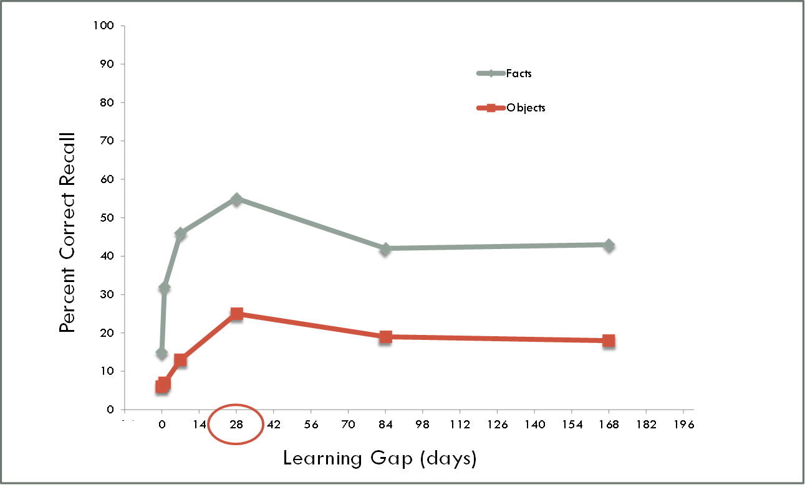
Optimizing Spaced Learning
Notes:
0 1 7 28 84 168
Facts15 3246 554243
Objects 67132519 18

Slide 35
Study of Spacing Effects in
Medical Teaching
Participants – 38 University of Toronto Medical Residents
Objective – Compared repeated, spaced learning over 4 weeks to 4 session, single-day learning on acquisition of a surgical skill
Design – Two counterbalanced groups:
  Group 1 – 4 micro-suturing training sessions on 1 day
  Group 2 – 4 micro-suturing training sessions 1 week apart
  Pre- and Post-tests at time of training
  Final Tests of retention and transfer 4 months after final training session => Surgery on heart valve of living rat
Result 1: Similar levels of surgical skill learning on post-test
Result 2: On final test, spaced training group had higher performance ratings and fewer hand movements to complete the surgery.
Moulton, Dubrowski, MacRae, Graham Grober, & Reznick, Annals of Surgery, 2006
Notes:
SE = Statusepilepticus, MG= Myasthenia gravis

Slide 36
Back to the bookstore…
Notes:
Let’s start with a trip to the Bookstore!
MANY, MANY great summer reading options on the topic of today’s panel. Usually save references for the end, however I would like to introduce them to you today early and often so that you know where to find this information (and share it with your colleagues!) going forward. (Also would like to show how much popular interest there is right now in this topic help sort out some of the signal from the noise with a review of “best-bet” high-quality resources…)
(Brookline Booksmith, Brookline, MA, Photo source: http://fitmamaeats.squarespace.com/home/book-review-chicken-soup-for-the-soul-say-hello-to-a-better.html)

Slide 37

Images of 6 books/articles
Notes:
QUIZ 2 (and spaced presentation!)

Slide 38
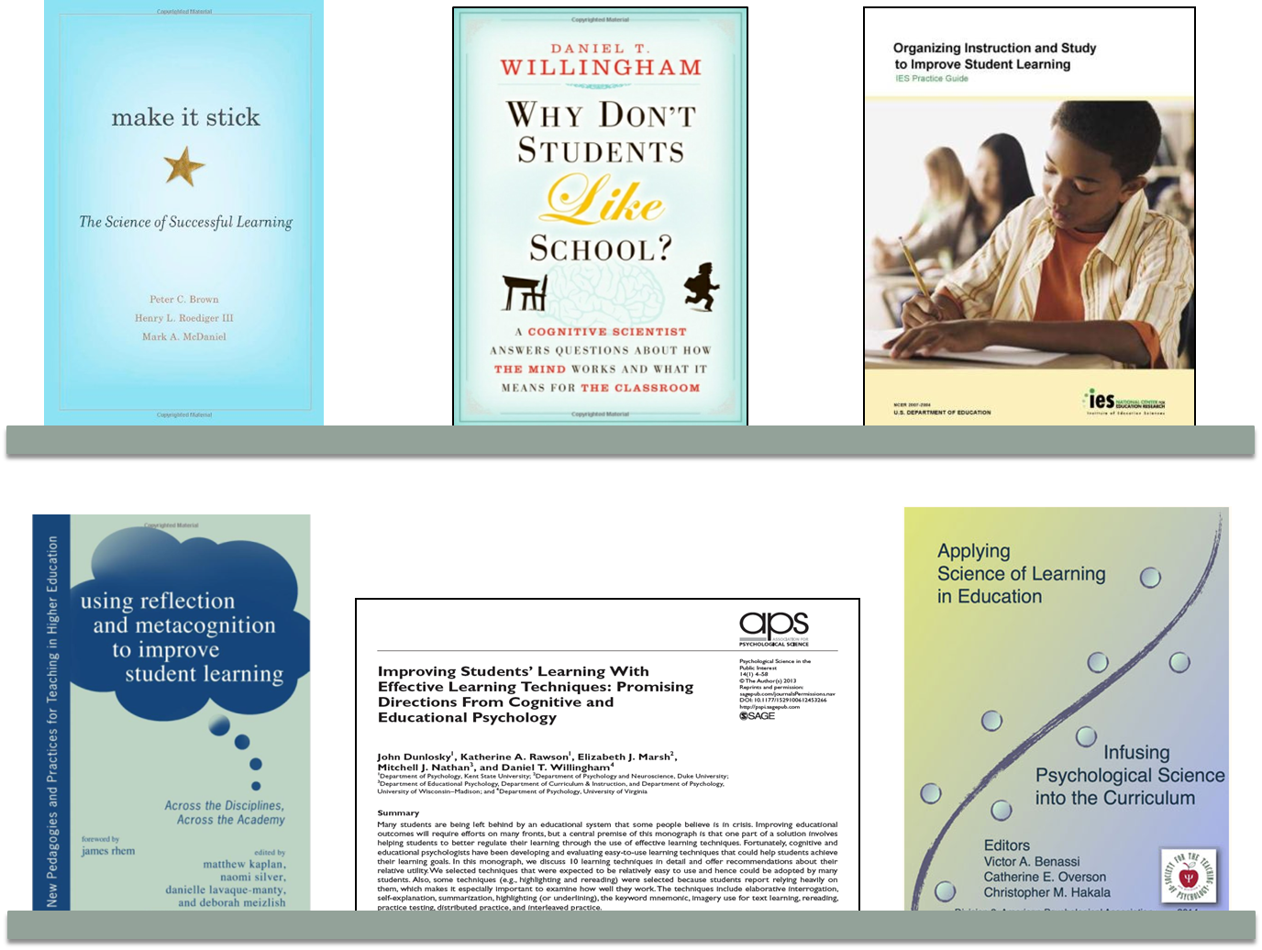
Images of 6 books/articles (continued)

Slide 39
References and Resources

Slide 40
References
Agarwal, P. K. (2012). Advances in Cognitive Psychology Relevant to Education: Introduction to the Special Issue. Educational Psychology Review, 1-2.
Benassi, V. A., Overson, C. E., & Hakala, C. M. (2014). Applying science of learning in education: Infusing psychological science into the curriculum. Retrieved from the Society for the Teaching of Psychology web site: http://teachpsych.org/ebooks/asle2014/index.php
Brown, P. C., Roediger, H.L., McDaniel, M.A., (2014). Make It Stick. Harvard University Press.
Cepeda, N. J., Coburn, N., Rohrer, D., Wixted, J. T., Mozer, M. C., &Pashler, H. (2009). Optimizing Distributed Practice. Experimental Psychology, 56(4), 236-246.
Dunlosky, J., & Metcalfe, J. (2009). Metacognition. Sage.
Dunlosky, J., & Rawson, K. A. (2012). Overconfidence produces underachievement: Inaccurate self evaluations undermine students’ learning and retention. Learning and Instruction, 22(4), 271-280.
Ellis, J. A., Semb, G. B., & Cole, B. (1998). Very Long-Term Memory for Information Taught in School. Contemporary Educational Psychology, 23(4), 419-433.
Hacker, D. J., Dunlosky, J., & Graesser, A. C. (Eds.). (2009). Handbook of metacognition in education. Routledge.
Karpicke, J. D., & Blunt, J. R. (2011). Retrieval practice produces more learning than elaborative studying with concept mapping. Science, 331(6018), 772-775.
Larsen, D. P., Butler, A. C., & Roediger III, H. L. (2008). Test‐enhanced learning in medical education. Medical education, 42(10), 959-966.
Larsen, D. P., Butler, A. C., & Roediger III, H. L. (2009). Repeated testing improves long‐term retention relative to repeated study: a randomised controlled trial. Medical education, 43(12), 1174-1181.

Slide 41
References (continued)
McDaniel, M., Roediger, H.L., & Mcdermott, K. (2007). Generalizing test-enhanced learning from the laboratory to the classroom. Psychonomic bulletin & review, 14(2), 200-206.
Moulton, C. A. E., Dubrowski, A., MacRae, H., Graham, B., Grober, E., & Reznick, R. (2006). Teaching surgical skills: what kind of practice makes perfect?: a randomized, controlled trial. Annals of surgery, 244(3), 400.
Pashler, H., Bain, P. M., Bottge, B. A., Graesser, A., Koedinger, K., McDaniel, M., & Metcalfe, J. (2007). Organizing Instruction and Study to Improve Student Learning. IES Practice Guide. NCER 2007-2004. National Center for Education Research.
Rhem, J. (2013). Using Reflection and Metacognition to Improve Student Learning: Across the Disciplines, Across the Academy. M. Kaplan, N. Silver, D. LaVaque-Manty, & D. Meizlish (Eds.). Stylus Publishing, LLC.
Roediger, H.L., & Karpicke, J. D. (2006). Test-enhanced learning. Psychological Science, 17(3), 249-255.
Roediger, H.L., Putnam, A.L.,& Smith, M.L. (2011). Ten benefits of testing and their applications to educational practice. In J.P. Mestre, & B.H. Ross, (Eds.), The psychology of learning and motivation: Cognition in education (pp. 1-36). Oxford: Academic Press.
Rohrer, D., &Pashler, H. (2010). Recent Research on Human Learning Challenges Conventional Instructional Strategies. Educational Researcher, 39(5), 406 -412.
Schraw, G. (2001). Promoting general metacognitive awareness. Metacognition in learning and instruction: Theory, research and practice, 19, 3-16.
Veenman, M. V., Van Hout-Wolters, B. H., & Afflerbach, P. (2006). Metacognition and learning: Conceptual and methodological considerations. Metacognition and learning, 1(1), 3-14.
Willingham, D. T. (2009). Why don’t students like school?: A cognitive scientist answers questions about how the mind works and what it means for your classroom. John Wiley and Sons.

Slide 42




Metacognition in the K-12 Classroom with Students with Disabilities
Inclusive Middle School Social Studies
Sheri Berkeley
George Mason University
sberkele@gmu.edu

Slide 43
The Textbook Dilemma
As students progress through the educational system,
  they are expected to read much more-- and to learn independently from what they read (Scruggs, Mastropieri, Berkeley, & Graetz, 2010; Wiley, Griffen, & Thiede, 2005), and
  the texts themselves become much more difficult (Berkeley, Kint-Sears, Hott, & Bradley-Black, 2014; Jitendra et al., 2001; Saenz & Fuch, 2002).

Slide 44
Do students “know when they know?”
Or more importantly, do they “know when they don’t know?”
  Often the answer is no
  This is particularly the case for students who struggle with reading– including those with learning disabilities.

Slide 45
So what?
Because these students are not aware that they should actively monitor their comprehension, they do not go back and repair problems with comprehension as more proficient readers do (Gersten et al., 2001).
This failure to self-regulate understanding of text generally results in poor comprehension (Roberts et al., 2008; Wiley et al., 2005).

Slide 46
Can students with LD be taught to monitor their learning?

Slide 47
Study 1: Purpose
(Berkeley, Marshak, Mastropieri, & Scruggs, 2011)
The purpose of the first randomized study was to extend existing research by investigating the effectiveness of an
  easy self-questioning strategy for improving meta-cognition of reading comprehension using
  grade level social studies text content
  with seventh graders in inclusive seventh grade classes.

Slide 48
Method
Pre-post experimental design
  Students were stratified by:
    class,
    disability, and
    English as second language learner (ESOL)
  Then students were randomly assigned within classroom to condition:
    self-questioning strategy group, or
    comparison read-only group
  Teachers (n=2) were randomly assigned to teach the instructional conditions (for each of the 3 participating classes)

Slide 49
Participants (N = 57)
Mean age = 159.39 months (SD = 5.95)
Gender (boys = 28, girls = 29)
Ethnicities of students
  40% White,
  35% Asian,
  12% Hispanic, and
  12% African-American
Students receiving special education services (15.8%)
  5 Learning disabilities (LD),
  1 other health impairments (OHI),
  1 hearing impairment (HI), or
  2 504 services
Students receiving services for ESOL (22.8%)
  7 received services in the school’s ESOL program,
  6 received varying degrees of monitoring services
Students in general education (61.4%)

Slide 50
Strategy
Condition
Materials
  Strategy Steps
  Notes Sheet
  History Textbook
Lessons:
  Lesson 1
    Modeling lesson
  Lesson 2
    Guided Practice
  Lesson 3
    Independent Practice

Slide 51
Read-Only Condition
Materials
  History Textbook
    questions at the end of the chapter
Lessons (independent learning)
  Students were directed to:
    “Read to page __ and try to remember as much as you can. I can read any words to you, but cannot tell you what they mean. There will be a quiz on Friday.”

Slide 52

Results
Students in the strategy group outperformed students in the read-only group on a multiple choice content test
2 condition (Self-questioning versus Read-only) ANCOVA (with pre-test as covariate)
  F(1,54) = 10.29, p = .002
  ES = .92 (large)

Slide 53
Gain Scores:
Condition and Student Type

Slide 54
Results
Students in the strategy group outperformed students in the read-only group on an open ended content test
Independent t-test
  t(55) = 5.81, p<.000
  ES = 1.61 (large)

Slide 55
Post-test Scores:
Condition and Student Type

Slide 56
Study 2 : Purpose
(Berkeley & Riccomini, 2009)
The purpose of the second randomized study was to investigate the effectiveness of the
  easy self-questioning strategy for improving meta-cognition of reading comprehension using
  grade level social studies text content
  with sixth and seventh graders in inclusive seventh grade classes.
This investigation included:
  a mnemonic cue (QRAC-the-Code)
  an increased amount of text (3 chapters)
  a note-taking comparison group
  instruction in large group classes
  a larger number of special education students

Slide 57
Method
Pre-post experimental design
  Students were stratified by:
    Grade,
    Period, and
    Disability status.
  Then students were randomly assigned by period to classroom condition typical of whole class instruction
    Strategy group
    Comparison note-taking group
Researchers (n=3) provided instruction for the strategy group and teachers (n=2) provided instruction in the note-taking comparison group.

Slide 58
Participants (N = 319)
Rural Middle School (6th & 7th Grade)
  The two previous schools, now combined, received unsatisfactory ratings on their 2007 state report cards and did not meet adequate yearly progress.
Gender (boys = 51%)
Ethnicities of Students
  92% White
  3% African-American
  3% Hispanic
  <1% Biracial
  <1% Other
32 Students with Disabilities (10%)
  LD, OHI
47% Free or reduced Lunch

Slide 59
Strategy Condition
QRAC-the-Code Strategy
  QUESTION (turn each heading into a question)
  READ (read the section and STOP)
  ANSWER (ask yourself: Can I answer my question?)
  CHECK (check to be sure your answer was correct OR summarize section)
  Fix-Up Steps
    Did you understand the vocabulary? Look for bold words
    Were there clues in the text features? Maps & graphs
    Do you know anything else about the topic? Prior knowledge
    Was your question NOT answered? Try to summarize section:
      Who as the section about?
      What happened in the section
      Tell what the section was about in less than 2 sentences.
    Really, really stuck? Reread section

Slide 60
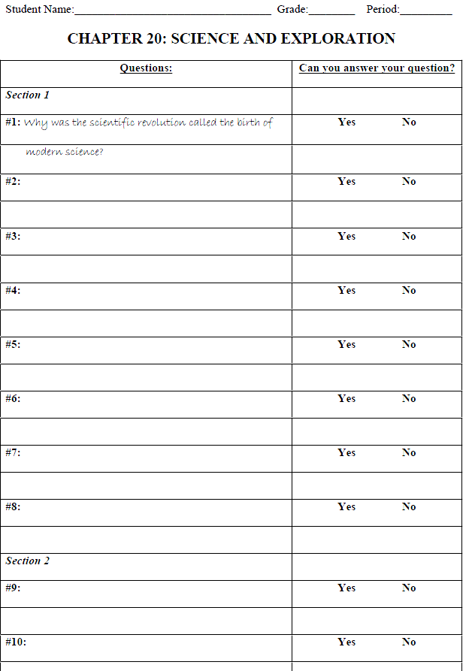
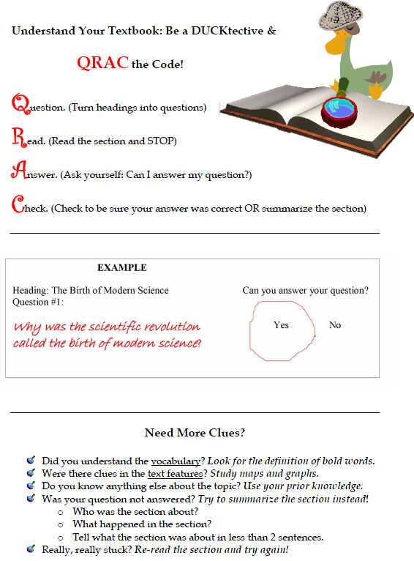
Strategy Materials
  Notes Sheet
  Strategy Sheet

Slide 61
No Strategy Condition
Typical classroom instruction (independent reading and note taking)
  Materials
    Social Studies textbook
    Notebook paper
    Social Studies related crossword with novel content for those finishing reading early.
  Students were directed to:
    “Read to page __ and record three main points from the readings and any other notes that you think will help you understand what you read.”

Slide 62
Data Analysis
Pre-test data with instructional groups as nested factor within condition:
  Significant differences were not observed for condition, F(1,314) = 2.95, p = .087.
  Significant differences were observed between instructional groups, F(1,314) = 1.83, p = .014, and between general and special education students, F(1,314) = 6.92, p = .009.
  Therefore, gain scores are used instead of post-test scores for all subsequent analysis

Slide 63
Results
Students in the strategy group outperformed students in the no strategy group on the Content Test
2 condition (strategy, no strategy) by 2 group (general, special education) ANOVA using gain scores with instructional group treated as a nested factor within condition¹:
  Statistically significant main effect:
    F(1,293) = 7.40, p=.007
    ES = .48 (moderate)
1Parallel analyses using ANCOVA of post-test scores with pre-test as covariate and instructional groups treated as a nested factor within condition yielded an identical main effect, and no statistically significant effect for instructional groups nested within treatment.

Slide 64
Results (continued)
Gain Scores: Condition and Student Type

Slide 65
Conclusions
Findings from these studies indicate that:
  A questioning strategy (QRAC-the-Code) using actual social studies textbook materials can be successfully taught to middle school students in inclusive classes.
  Both general education and special education students who received strategy instruction improved both on content recall identification and production tests.
  The majority of students who were taught the strategy said it helped them remember, and almost all remembered two or more of the strategy steps.

Slide 66
What does this mean for teacher preparation?
Recent reviews of the special education literature have indicated that strategy instruction is very effective for improving learning for student with disabilities. (e.g., Edmonds et al., 2009; Gersten, Fuchs, Williams, & Baker, 2001).
However, teachers attitudes impact the acceptance and implementation of research-based teaching practices. (Fagella-Luby & Deshler, 2008; Mastropieri, Scruggs, & Graetz, 2003).

Slide 67
Addressing Fidelity and Sustainability
Do we ensure that teachers:
  Understand WHY the strategy is needed for students with disabilities?
  Understand the most effective ways to teach the strategy?
  Understand the elements of the strategy that should not be altered?

Slide 68
Questions?

Slide 69
References
Berkeley, S., King-Sears, M.E., Hott, B.L., & Bradley-Black, K. (2014). Are history textbooks more “considerate” after 20 years? Journal of Special Education, 47, 217-230.
Berkeley, S., Marshak, L.R., Mastropieri, M.A., & Scruggs, T.E. (2011). Improving student comprehension of social studies text: A self-questioning strategy for inclusive middle school classes. Remedial & Special Education, 32, 105-113.
Berkeley, S., & Riccomini, P.J. (2013). QRAC-the-Code: A comprehension monitoring strategy for middle school social studies textbooks. Journal of Learning Disabilities, 46, 154-165.
Edmonds, M. S., Vaughn, S., Wexler, J., Reutebuch, C., Cable, A., Tackett, K. K., & Schnakenberg, J. W. (2009). A synthesis of reading interventions and effects on reading comprehension outcomes for older struggling readers. Review of Educational Research, 79, 262-300.
Fagella-Luby, M. N., & Deshler, D. D. (2008). Reading comprehension in adolescents with LD: What we know; What we need to learn. Learning Disabilities Research & Practice, 23, 70-78.
Gersten, R., Fuchs, L. S., Williams, J. P., & Baker, S. (2001). Teaching reading comprehension strategies to students with learning disabilities: A review of research. Review of Educational Research, 71, 279-321.
Jitendra, A. K., Nolet, V., Xin, Y. P., Gomez, O., Iskold, L., Renouf, K., & DaCosta, J. (2001). An analysis of middle school geography textbooks: Implications for students with learning problems. Reading and Writing Quarterly, 17, 151-174.

Slide 70
References (continued)
Mastropieri, M. A., Scruggs, T. E., & Graetz, J. E. (2003). Reading comprehension instruction for secondary students: Challenges for struggling students and teachers. Learning Disability Quarterly, 26, 103-116.
Roberts, G., Torgenson, J. K., Boardman, A., & Scammacca, N. (2008). Evidenced-based strategies for reading instruction of older students with learning disabilities. Learning Disabilities Research & Practice, 23, 63-69.
Saenz, L. M., & Fuchs, L. S. (2002). Examining the reading difficulty of secondary students with learning disabilities: Expository versus narrative text. Remedial & Special Education, 23, 31-41.
Scruggs, T.E., Mastropieri, M.A., Berkeley, S., & Graetz, J.E. (2010). Do special education interventions improve learning of secondary content? A meta-analysis. Remedial & Special Education, 31, 437-449.
Wiley, J., Griffin, T. D., & Thiede, K. W. (2005). Putting the comprehension in metacomprehension. The Journal of General Psychology, 132, 408-428.

Slide 71


Applying the learning sciences to teacher education
Mary T. Brownell, Director
H325A120003

Slide 72

Collaboration for Effective Educator Development, Accountability and Reform
(CEEDAR) www.ceedar.org
H325A120003
Notes:
In light of many of these difficulties, CEEDAR was developed as a response.

Slide 73
Disclaimer
This content was produced under U.S. Department of Education, Office of Special Education Programs, Award No. H325A120003. Bonnie Jones and David Guardino serve as the project officers. The views expressed herein do not necessarily represent the positions or polices of the U.S. Department of Education. No official endorsement by the U.S. Department of Education of any product, commodity, service, or enterprise mentioned in this website is intended or should be inferred.

Slide 74
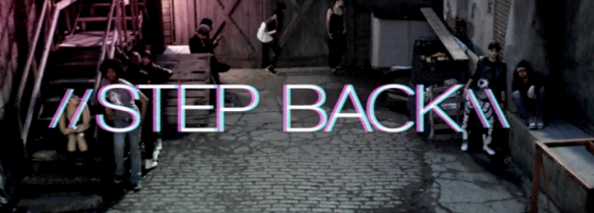
Step Back
Notes:
Want to step back and think about what we are trying to achieve in teacher education and how what we have learned from cognitive science might be useful in rethinking our work.

Slide 75
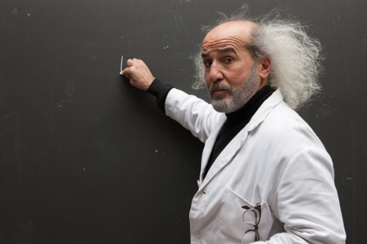
Goal of teacher education
Put teachers on the path of developing expert performance
Notes:
The goal is not to learn information in courses more effectively, but to learn information in ways that will promote expert performance.
In other words, we don’t simply want people learning information more effectively; e.g., differences between vowel diagraphs and vowel dipthongs and lists of evidence based practices, we want them to learn to use their knowledge and those practices fluently and in integrated ways in response to some specified student need and the demands of the content. What we are trying to do is put teacher candidates on the path to develop expert performance.. So what would we have to consider if the development of expert performance is our goal?

Slide 76
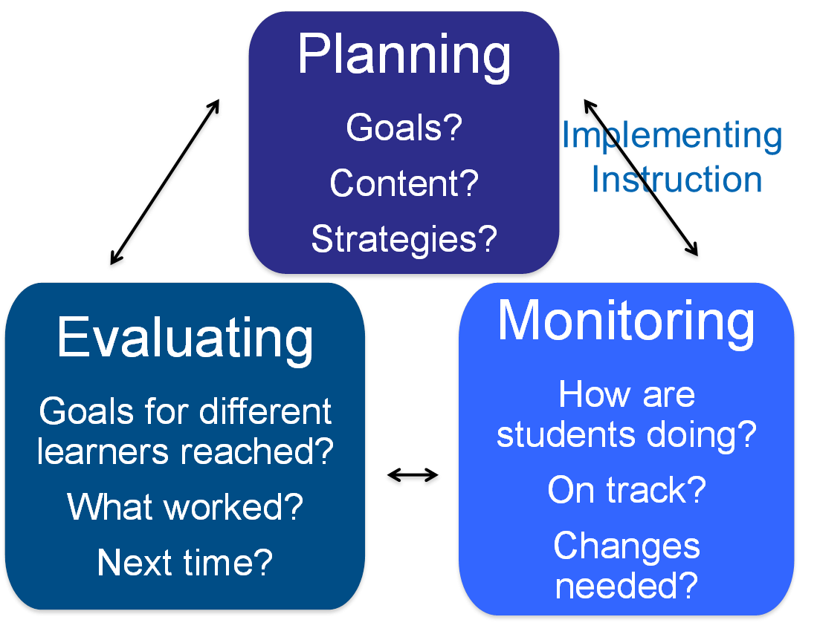
Teaching is a meta-cognitive task
Notes:
Experts are better able to represent a problem and select better solutions or strategies for addressing that plan. Additionally, they are better able to anticipate what might happen in a situation, in this case a lesson, and respond to it using more effective strategies – in other words they develop lesson goals that are appropriate to students needs, and choose appropriate content and strategies to meet those needs. Further they are able to retrieve their knowledge more quickly, and have more automatic retrieval of skill that frees up cognitive space so they can monitor what students are doing in response to their instruction and make decisions to change in response to student need. And they can do this because. . .

Slide 77

Rapid retrieval
is essential to skilled performance
Notes:
The procedures and knowledge that is essential to expert performance in the classroom can be retrieved easily. We need to understand what this knowledge and these procedures are in order to understood so that we can actively teach them to teacher candidates. What knowledge patterns and routines do expert teachers consistently employ that must be taught through distributed and deliberate practice with feedback to novice teachers?

Slide 78

Well integrated knowledge structures
Facilitate perception and allow experts to focus on key features of a problem
Notes:
They can detect features of a problem that novices often overlook because they are looking for patterns that are well established. They also quickly retrieve these knowledge structures to solve problems. But what knowledge structures do teachers have who demonstrate expert performance?

Slide 79

Think about Paige
Notes:
I use an example to help the audience see what I mean by well integrated knowledge.
Paige is a special education teacher providing tier 3 instruction to third graders
Strategy for decoding and understanding multisyllabic instruction is being taught in core instruction; they are learning to add prefixes to words as part of this instruction
Paige knows her students will struggle with both decoding the words and understanding their meaning once prefixes are applied, so she, in collaboration with her general education colleague, she decides to teach the students the most common prefixes by family (in this case the not family, un, dis, and in). She also works with the students to apply some of the rules they have been learning to decode the base words (e.g., using common syllabication rules to decode words). Further, she engages students in a dialogue and one or two activities to help them understand how the meaning of words change when she adds or deletes the prefix. When we watch students engaged in the lesson, we see Paige smoothly move through the activities, she has developed. She uses engaging activities and has all students responding. When students make mistakes, she quickly helps them focus on the mistake and helps them respond correctly. She also reinforces students for their correct answers and effort.

Slide 80

To put teacher candidates on the path of becoming experts
Notes:
Or more like Paige

Slide 81

Some hard decisions must be made

Slide 82
Tasks that capture
expert teaching and the knowledge that underlies them must become the basis for the curriculum
But how do we determine what the tasks are that are essential to expert teaching?

Slide 83
Evidence-based practices?
In our analysis of the reading and mathematics literature, we identified 89 essential components of effective k-12 reading instruction and 49 essential components of effective mathematics instruction
Notes:
Clearly, there are too many essential components to consider covering in the teacher education curriculum. Have to move away from content coverage to repeated learning of fundamental teaching behaviors and essential content.

Slide 84

Need some way of prioritizing
Notes:
But how do we decide exactly how to focus on the BIG IDEAs as the framework for organizing or programs.
Grossman and McDonald (2008) discussed the need to pinpoint what is common to all examples of teaching, across all grade levels.

Slide 85
High leverage practices
Making content explicit through explanation, modeling, representations, and examples
Eliciting and interpreting students’ thinking
Recognizing particular common patterns of student thinking in a subject matter domain
  Teachingworks.org
Notes:
Deborah Ball and her colleagues have attempted to do just this. They have identified 19 practices that they call high leverage practices. These practices cut across content domains and grade levels. They are those strategies that are the essence of effective teaching.

Slide 86
High leverage content
In mathematics, for example:
  Place value
  Number concepts and operations
  Fractions
  Explaining mathematical ideas and relationships
Notes:
Strategies, however, are implemented within content. What is the key content that teacher candidates might need command of before leaving a preparation program?

Slide 87

What would be the equivalent in special education?
Notes:
Some practices would be similar and others might be different, either in kind or type. For instance, we would teachers to be able to recognize problematic patterns of student performance that will require intervention. We might have the same high leverage content in those areas where we would deliver tier iii intervention, but we would want specific strategies for addressing that content that have been shown to be effective with students (e.g., Schema based strategy instruction for teaching students how to solve problems involving whole number operations and fractions). Or rather than teach all of the essential elements of effective reading instruction, we might want to identify key areas and select strategies for providing instruction in those areas that teacher candidates will practice repeatedly.

Slide 88
Once we have a framework,
we can begin to think systematically about how to use strategies that support the development of integrated knowledge, its fluid enactment, and metacognition

Slide 89

Strategies for deliberate, distributed practice
must enable teacher candidates to practice working with key knowledge and skills they will need to enact effective instruction

Slide 90
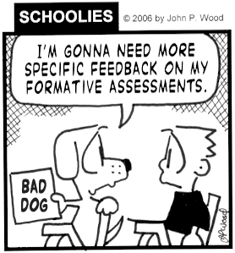
And provide feedback
on key aspects of performance

Slide 91
Some ideas from research
Microteaching + case studies
Tutoring individual or small groups using a structured approach
Engaging in lesson study and peer coaching
Bug in the ear coaching
Virtual simulations
See for review, Kamman, McCray, and Brownell (2014); Dieker, Smith, Kennedy, & Rock (2014)
Notes:
Unfortunately, we have left much of the practice of teacher education to largely unknown territory – the field placement. We have little knowledge of how well students have the opportunity to integrate their knowledge in those settings and receive feedback on the key aspects of their performance. Need to rethink the ways in which we are helping teachers practice.
Microteaching could involve analyzing a student case, identifying patterns in performance, developing a lesson to respond, and teaching a portion of that lesson to peers. Peers could be taught to provide feedback on specific high leverage strategies and content. Such an approach would enable teacher candidates to develop more integrated knowledge of students, content, and instruction. It would also help them to focus attention on key aspects of performance and monitor performance as it unfolds, particularly if teacher candidates are prompted to respond to specific questions and taught to analyze performance.
Tutoring individual or small groups of students, when using a structured approach, can enable students to analyze student performance, learn to enact high leverage strategies and high leverage content, and monitor the impact of their instruction. Research on structured approaches to tutoring combined with feedback on performance seem productive. (Spear Swerling, 2009)

Slide 92

Questions

Slide 93
References
Chaffin, R. (2011). Thinking about performance: Memory, attention, and practice. International Symposium on Performance Science, 689-699.
Charness, N., & Tuffiash, M. (2008). The role of expertise research and human factors in capturing, explaining, and producing superior performance. Human Factors, 50, 427-432.
Chi, M.T.H. (2006). Two approaches to the study of expert characteristics. In K. A. Ericsson, N. Charness, R. Hoffman, & P.J. Feltovich (Eds.), The Cambridge Handbook of Expertise and Expert Performance, pp. 69-86.
Dieker, L., Smith, S. J., Kennedy, M., & Rock, M. (2014). Technology in teacher education.

Slide 94
References (continued)
Ericsson, K. A. (2008). Deliberate practice and acquisition of expert performance. Academic Emergency Medicine, 15, 988-994.
Ericsson, K. A., & Charness, R. N. (1994). Expert performance: It’s structure and acquisition. American Psychologist, 49, 725-747.
Grossman, P., & McDonald, M. (2008). Back to the future: Directions for research in teaching and teacher education. American Educational Research Journal, 45, 184-205.
Kamman, M. L., McCray, E. D., & Brownell, M. T. (2014). Teacher education pedagogy review. Under review, available in fall 2014.

