Slide 1


What Have We Learned And
Where are We Going?
Thirty Years of Research Collaboration
Thomas E. Scruggs and Margo A. Mastropieri

Slide 2
Tom and I Benefitted from
OSEP Funding
Margo -
  Federal Fellowship for Master’s Degree – UMASS-Amherst (Early Childhood/Special Education)
  Doctoral Leadership Grant - Teaching Assistantship for PhD – Arizona State University (Special Education/minor Ed Psych)
  Post-doc Research fellow on EIRI (OSEP) at USU
  Faculty position at USU funded by OSEP - taught all BD licensure classes
Tom –
  Doctoral Leadership Grant - Teaching Assistantship funding for PhD – Arizona State University (Special Education/minor Ed Psych)
  Ran two OSEP funded research grants at USU
    One in tutoring
    One in test-taking skills

Slide 3

Research Interests
  Asking & Answering Questions
Why can’t those students learn?
How can we teach them so they learn better, faster?
What if? How does A influence B? What is the effect of C on D? What is happening in this situation?
Cognition and learning
Memory-enhancing strategies
Science education
Socially-mediated learning
Literacy skills
Test-taking skills
Research Synthesis

Slide 4
A Few Memorable Illustrations
Tom’s Dissertation –
  What students did was more important than how they were labeled
Margo’s Dissertation –
  Students with learning disabilities REALLY learned.
  General topics sustained us throughout our careers with replication, extension and adaptations

Slide 5

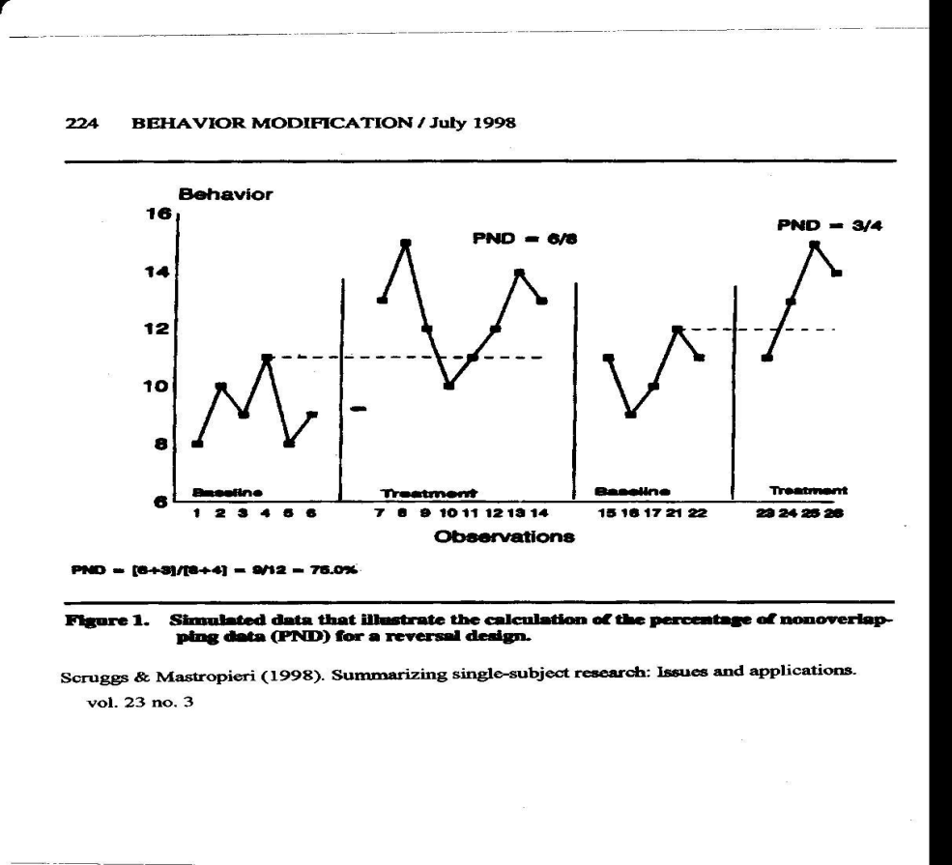
USU Experiences (soft money positions)
While a post doc @ USU my office was an old bathroom!
Tutoring, test-taking skills; Early intervention meta-analysis
Karl White and Glen Casto said “go figure out how to synthesize single subject research”
We developed “PND” (percent of nonoverlapping data)
  Widely used to synthesize N=1 research (over 50 syntheses)

Slide 6

Purdue University
Mnemonic Strategies
Cognitive Strategies
Science - Prioritize
  Mechanics vs Content of Science
  Prioritize the Content
  Focus on Most Important Concepts

Slide 7
jettison throw overboard
Notes:
In one of our mnemonic investigations we taught 3rd grade students with and without learning disabilities important vocabulary for a story they were reading. We taught them in 3 conditions [show slides]: in one, we showed the word and definition only. In the second, we showed the word and definition with a related picture. In the third, we used the mnemonic keyword method that we just practiced with the Italian vocabulary. Notice, in this instance, the only difference is the explicit verbal link (the keyword) between the target word and it’s definition.

Slide 8
jettison throw overboard

Slide 9
jettison (jet) throw overboard

Slide 10
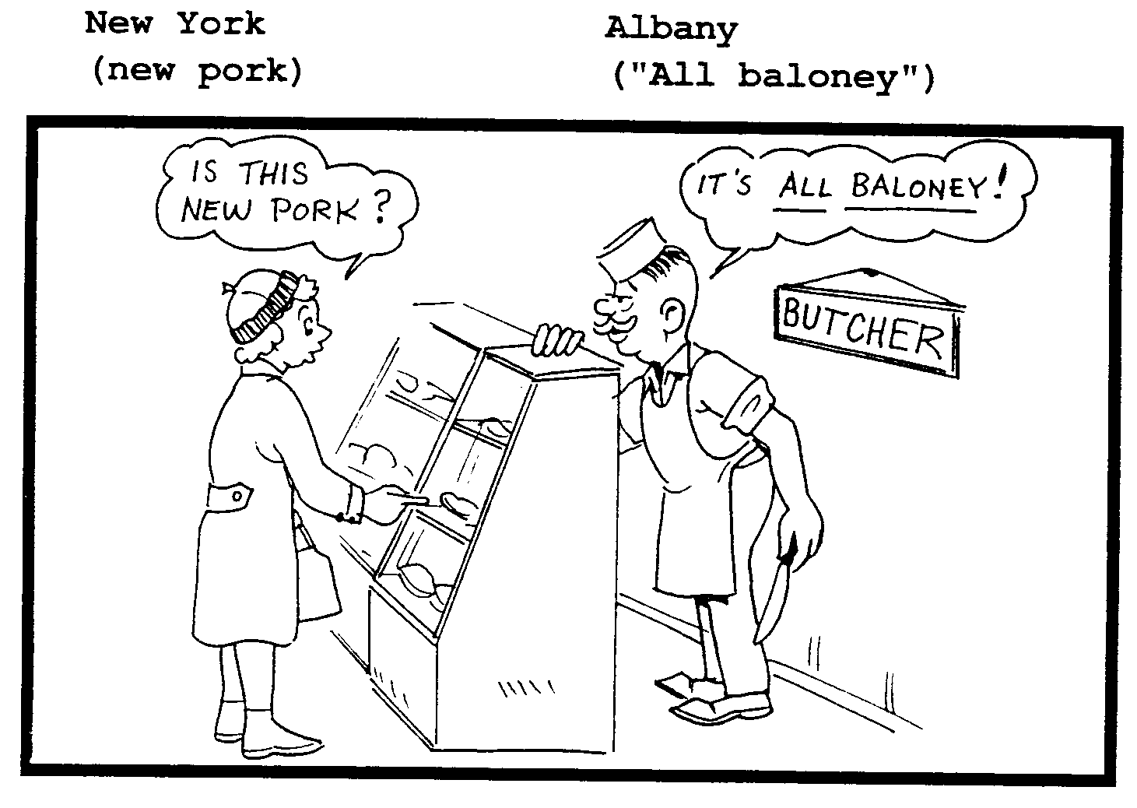
Cartoon illustration

Slide 11



Mnemonic strategies have affected outstanding learning gains in:
  English vocabulary
  Foreign language vocabulary
  SAT vocabulary
  Geology
  Paleontology
  American history
  Invertebrate animals
  Vertebrate animals
  Chemistry

Slide 12
Results, 34 experiments
>2000 participants (M_{es} = 1.62)

Slide 13
Science for Students with Disabilities
Research
Topics
Ecosystems
Magnetism and electricity
Rocks and minerals
Pendulum motion
Atmospheric science
Plant growth and development
Simple machines
Inventions and discoveries
Air
Measuring and weighing
Physiology
Chemistry
Buoyancy
Anatomy
Life Science
560 Participants
16 Qualitative and Quantitative Studies
  Experiential learning
  Guided Inquiry
2 Curriculum analyses
Hands-on learning
  M_{ES} = 1.14

Slide 14
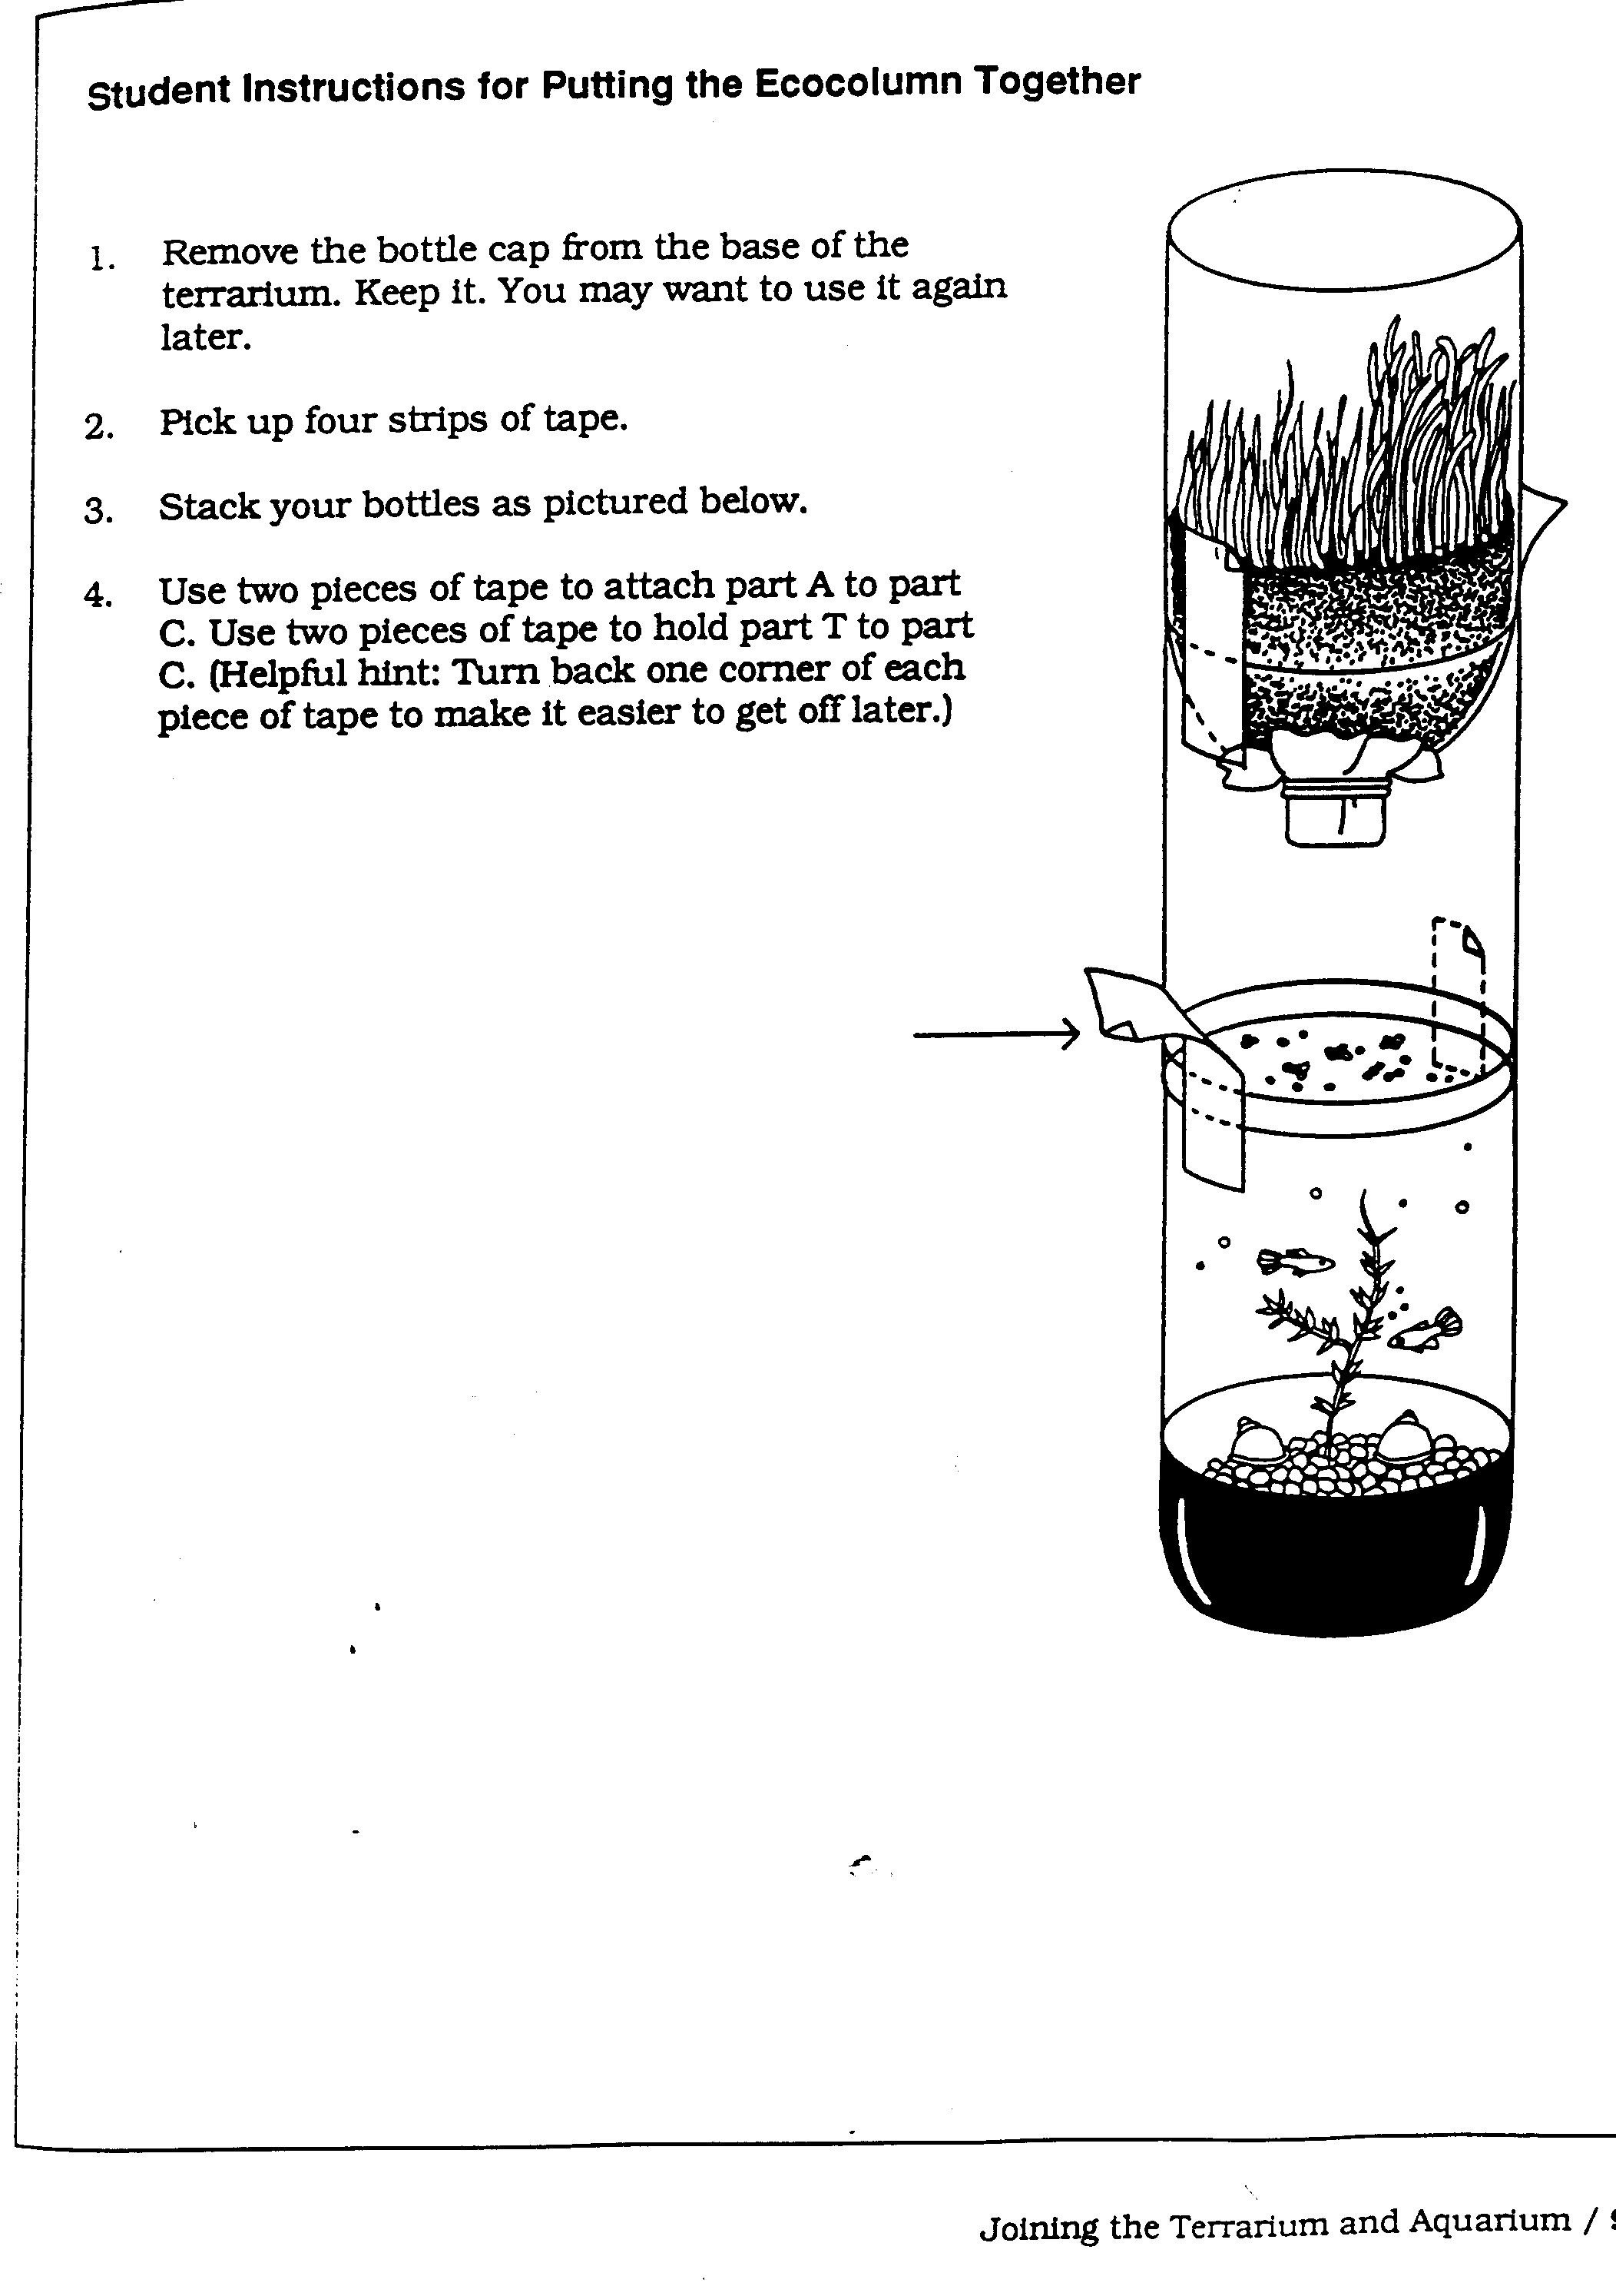
Worksheet 1

Slide 15
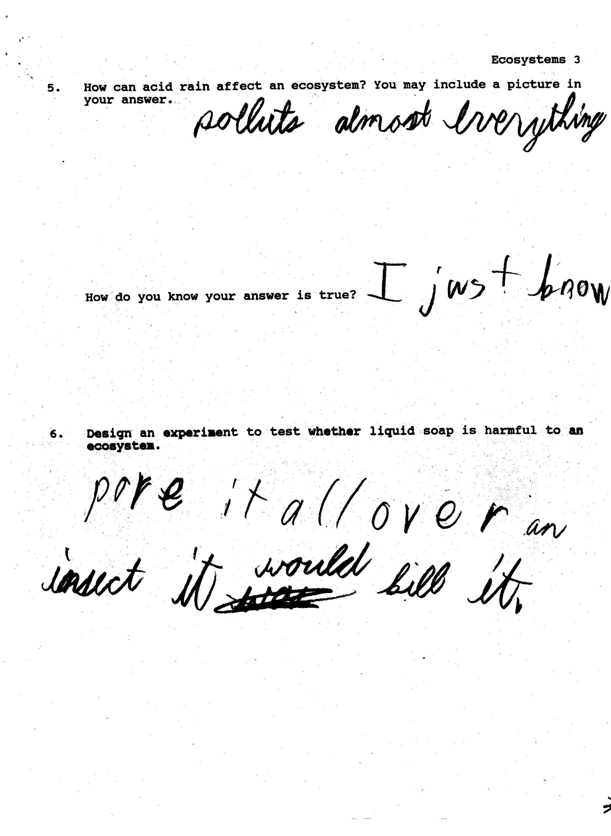
Worksheet 2

Slide 16
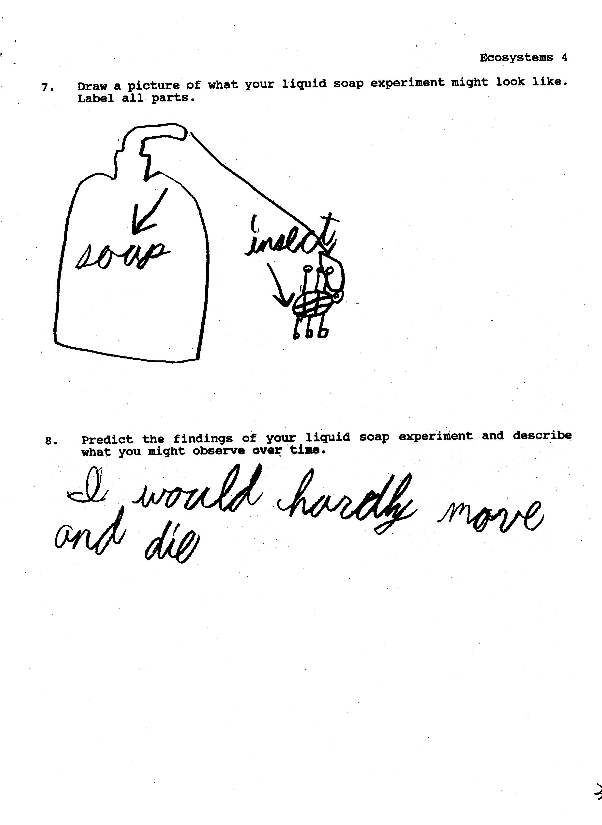
Worksheet 3

Slide 17
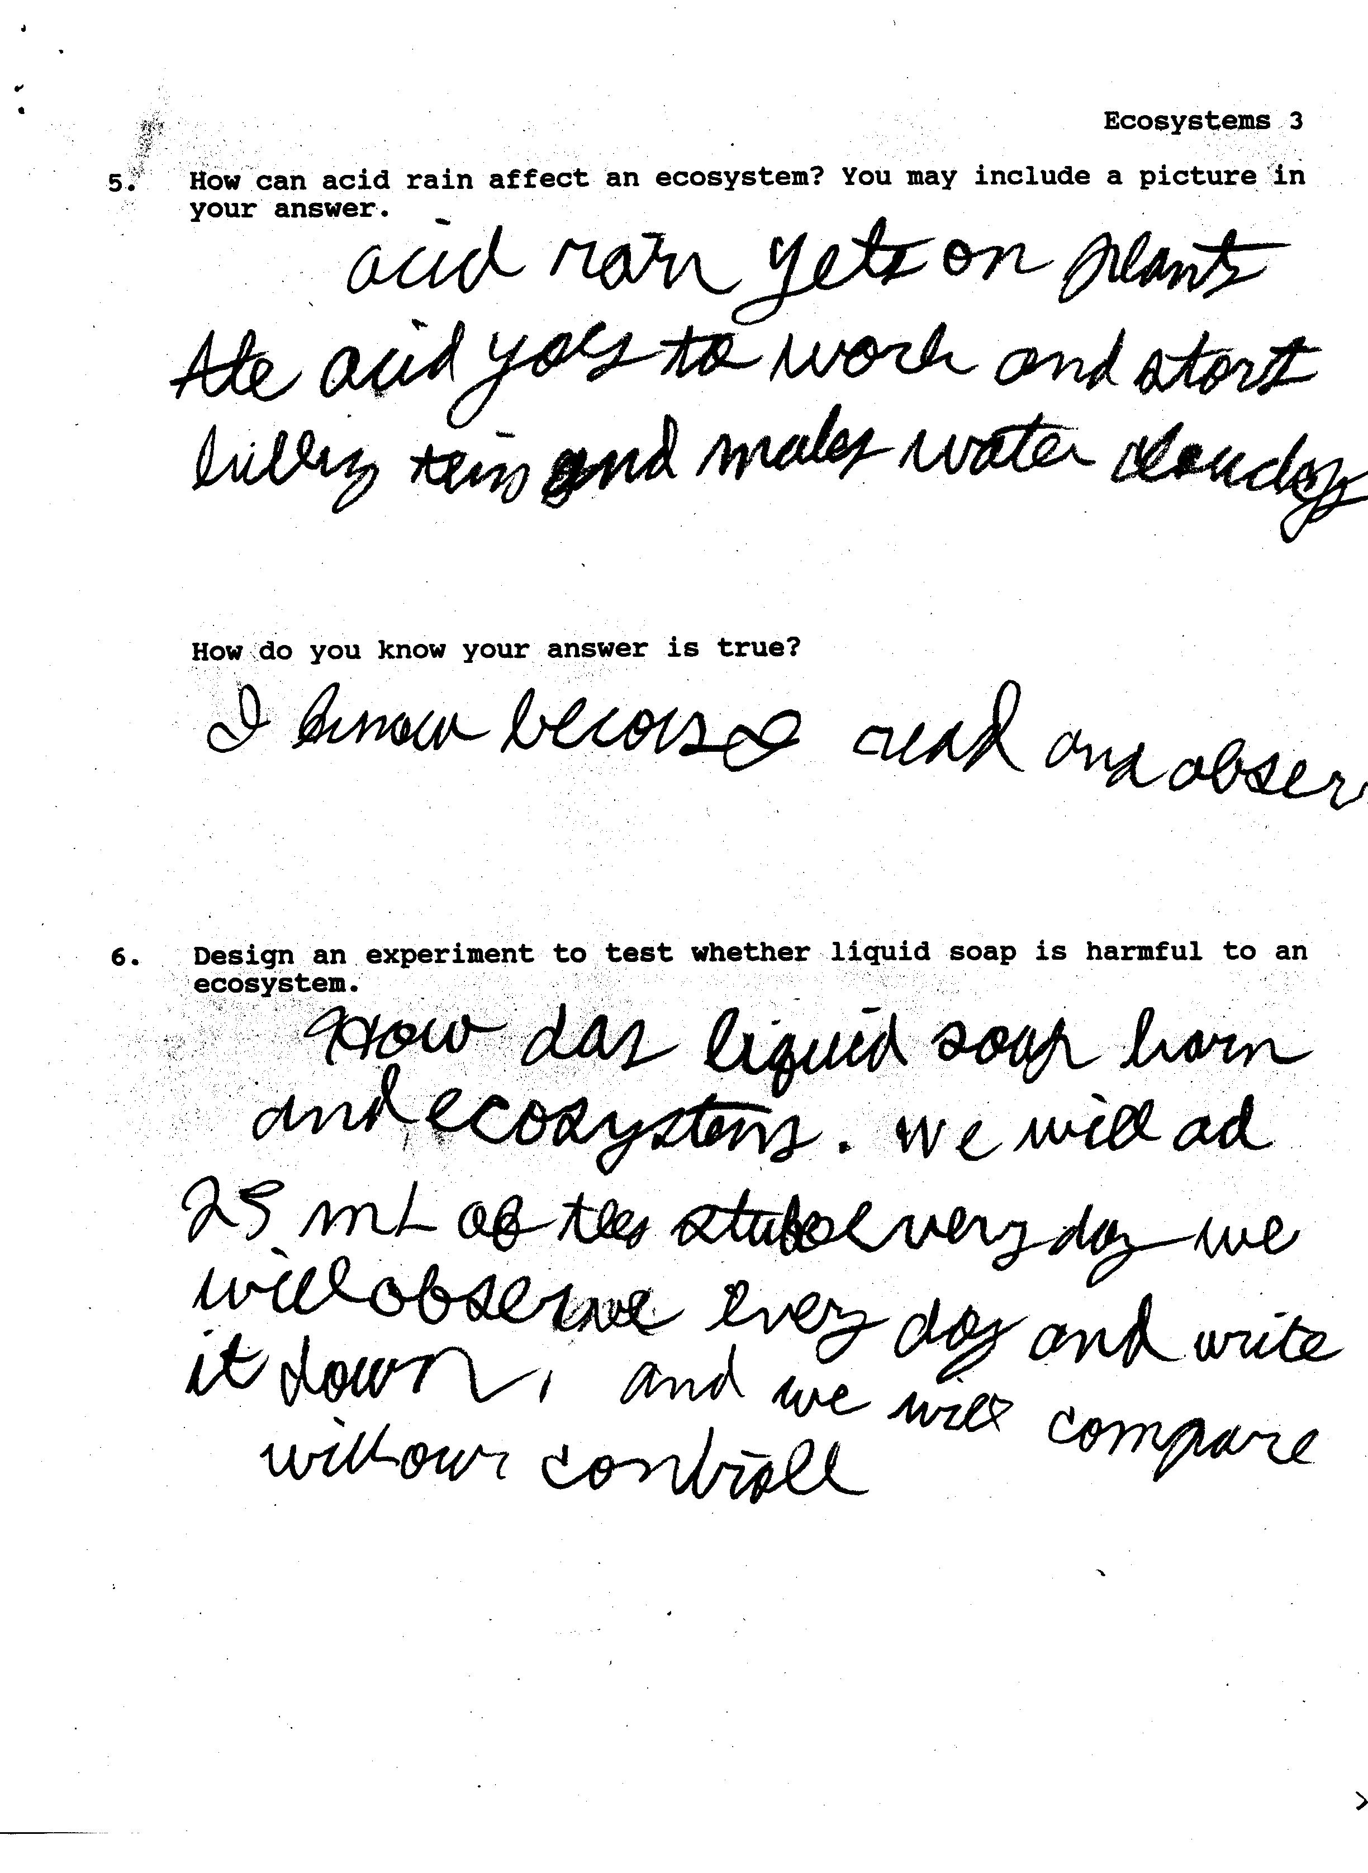
Worksheet 4

Slide 18
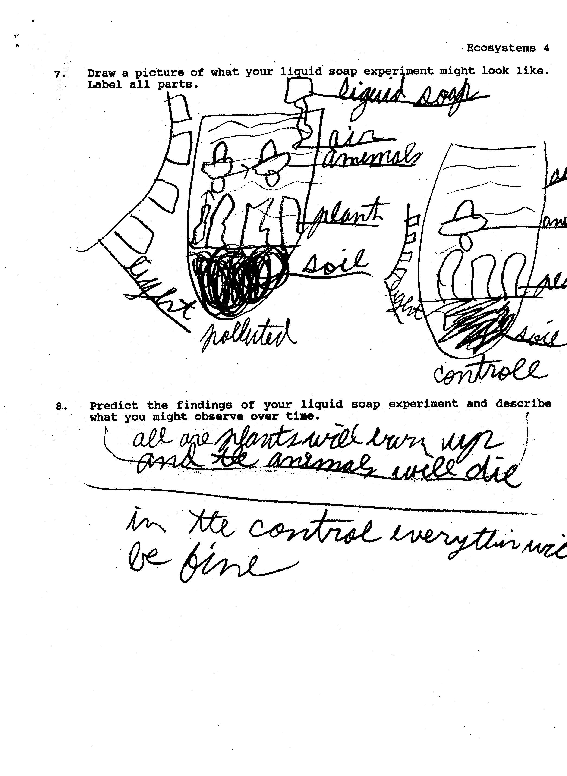
Worksheet 5

Slide 19
Results: Ecosystems

Slide 20

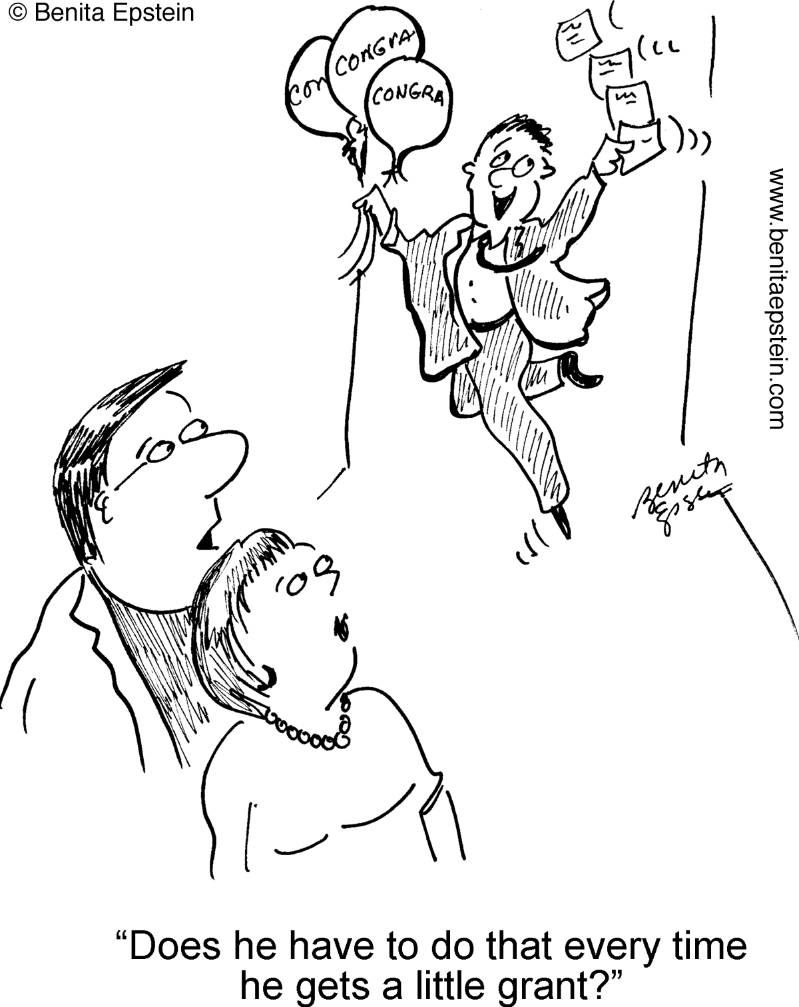
George Mason University
Content learning
Literacy

Slide 21
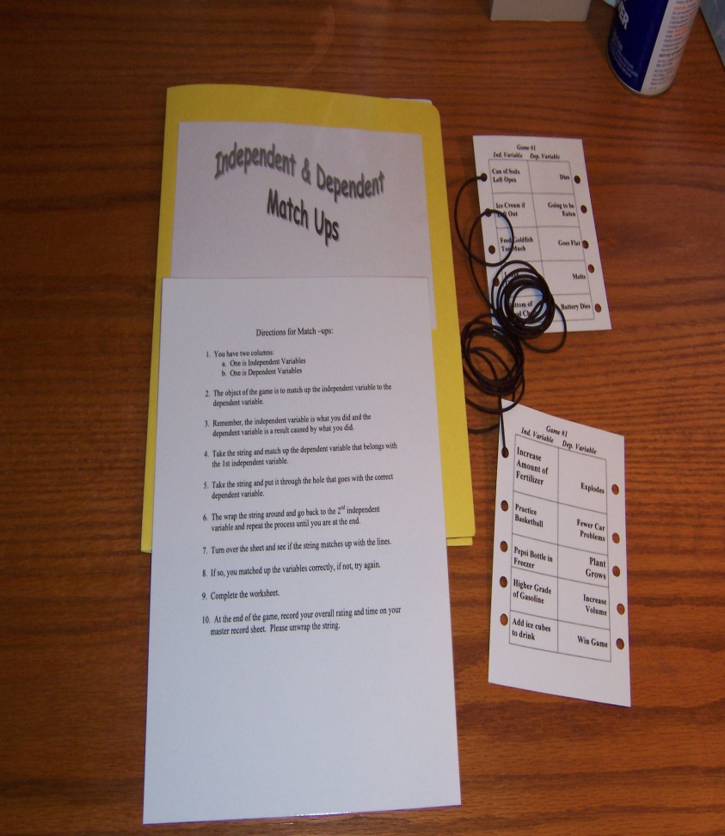
Differentiated Activities:
Middle School Science
3 levels
Sample Match-ups
Level 1: Identify correct answers from a multiple choice or matching format, with prompts to help ensure success
Level 2: Production of correct answers, with prompts when needed
Level 3: Unprompted production of correct answers

Slide 22
Charts and Graphs
Mission
Possible
Charts & Graphs

Slide 23
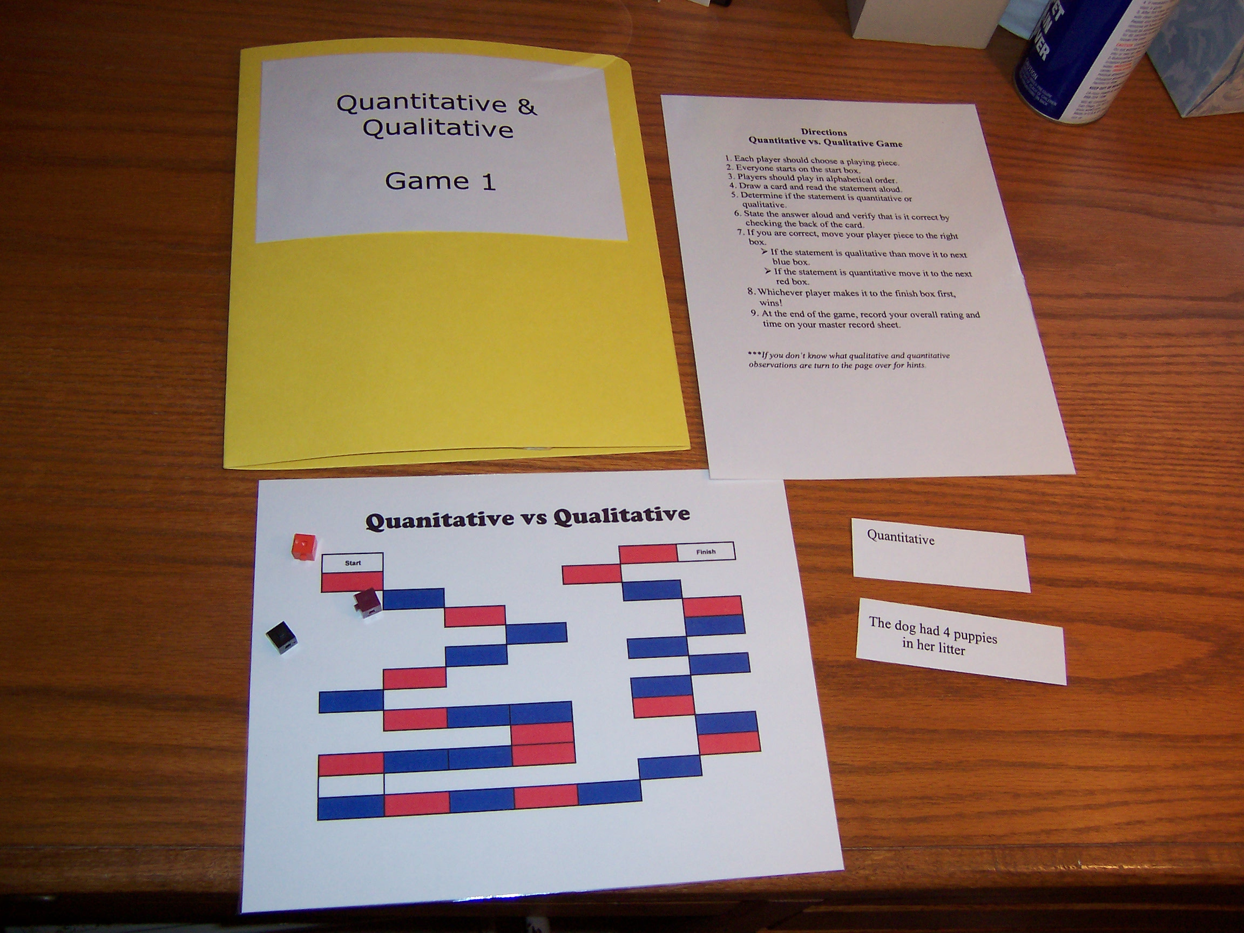
Quantitative Vs Qualitative

Slide 24
Worksheet 6

Slide 25
Peer Tutoring Formats
  Involving:
  Additional practice opportunities and strategic instruction only when needed with content in
    Chemistry
    Social studies
  Embedded Strategies
  Strategies including mnemonics, elaborations; used only when students failed to respond
  Discussion of factual content (“What else is important about ….?)
  Applications (“Give me an example of ….”)

Slide 26
Worksheet 7
What was the US position at the beginning of World War I?
Neutrality – not to take either side.
What was the Zimmerman telegram?
A coded note sent by the Germans to Mexico asking them to fight the US on the Texas border. The note really angered the US.
US ties to Great Britain, Alliance System, un-restricted German submarine warfare, sinking
the Lusitania; Zimmerman telegram; a financial stake in the Allies winning.
What were the main causes behind the US entering WWI?
The Lusitania was a British passenger ship sunk by a German submarine on which 128 Americans were killed. President Wilson threatened to break off relations with Germany.
What was the Lusitania and why was it important?
Was the stalemate in the trenches on the Western Front a reason for US involvement in the Great War?
No it was not a reason.
Content Sheet for World War I

Slide 27
Recording Sheet
Write the card you practiced in this column
(Example: Tanks)
Write date you practiced this item with your partner
(Feb. 14; Feb. 18)
Place date you covered the information, but still need more practice
(Feb. 18)
Please check and date when mastered the content
(Feb.14 )

Slide 28
Summary: 10 experiments inclusive content learning
1128 students, 283 special needs
Authors Content Effect size
Gen ed Sp ed
Mastropieri, Scruggs, & Marshak (2008) US History .15 > .41
Scruggs, Mastropieri, & Marshak (2012) US History .28 > 1.04
Mastropieri , Sweda, & Scruggs (2001) State History .35 > 2.39
Simpkins, Mastropieri, & Scruggs (2008) Physical Science .36 > .43
McDuffie, Mastropieri, & Scruggs (2009) Genetics .47 > .63
Uberti, Scruggs, & Mastropieri (2002) English .76 > 3.33
Mastropieri, Scruggs, & Graetz (2005) Chemistry .78 > .93
Mastropieri, Scruggs, et al. (2006) Science Methods .79 > 1.15
Marshak, Mastropieri, & Scruggs (2012) US History 1.09 > 1.90
Bulgren, Shumaker, & Deshler (1994) Social Studies 1.29 > 1.82
________________________________________________________________________
Mean .63 > 1.40
Wilcoxon z = 2.803, p = .005

Slide 29
Experimental-Control Change:
10 experiments (Wilcoxon z = 2.803, p = .005)

Slide 30
Student Response When Asked to Write
I HATE WRITING.
WRITING AND ME HAVE NOTHING IN COMMON.
I AM NOT WRITING.

Slide 31

Me Teaching Writing
Me (approaching): Hi Maria, do you need some help getting started with your essay?
Maria (looking right at me): Something smells.
Me: Oh?? Well, let’s look at your paper…
Maria (looking right at me): No, I
I mean something really
smells. Real bad.
Me: Well, anyway, what is your
topic sentence…
Maria: Don’t you get it? You smell!

Slide 32
Worksheet 8
TOPIC Sentence
Tell what you believe! (adapted from Graham & Harris, 2005)
Yes_________
No_________
POW + TREE
Transition Words | R Reasons -3 or More Why do I believe this? Will my readers believe this? | E EXPLAIN Reasons Say more about each reason
E ENDING
Wrap it up right! DID YOU? __________
E EXAMINE
DID YOU? __________

Slide 33
Worksheet 9
Table 2
Maria’s Pre- and Post Test Writing Samples
First Essay (”Should students have cell phones?”):
Children from the ages 10 and up should have cell phones. When children need to call there parents or 911 they need to have a cell phone. Like if I broke my leg, And couldn’t move what would I do sit there? I would need help and what would I do if no one else was around. I would need too call for support or help. All these reasons and more are why we need a cell phone.
78 words

Slide 34
Worksheet 10
Second Essay (“Would you rather be given a sweater or a gift card as a gift?”):
I would rather receive a 30$ gift card than a sweater as a present because, you have more options, it’s less humiliating, cooler, more ordinary, and gift cards are more popular.
First, with a gift card you have more options. You can get what you want. You can get more than just a sweater. Plus, you can spend it on what you want rather than have someone pick you out a tacky sweater.
Second, getting a gift card is a lot less humiliating. Because, when you get a sweater from your grandmother, you are going to get laughed at rather you like it or not by all your friends. You are defiantly going to look and feel weird. Plus, everyone in school is going to criticize you.
Third, gift cards are a lot cooler that stupid sweaters. You can use the gift cards with your friends if you want. Then you can use the gift card just about anywhere. Plus, with a sweater you don’t have to feel pressured to tell everyone that your grandmother got you the stupid sweater and that she made you were it to school.
Fourth, a gift card is a normal gift. A sweater is not. Plus, gift cards don’t itch you to death like stupid sweaters do. Then gift cards don’t suffocate you I swear that who ever designed the sweater made it as a touchier device.
Fifth, gift cards are very popular. Everyone has had a gift card at leased once in there lives. So, you don’t have to feel out of date with the times. Plus, if you have no use for it you can give it to someone else without feeling embarrassed about it.
In conclusion, give a gift card as a gift not a sweater. There great to have and they won’t embarrass you. Therefore, gift cards are much better gifts than sweaters.
313 words

Slide 35
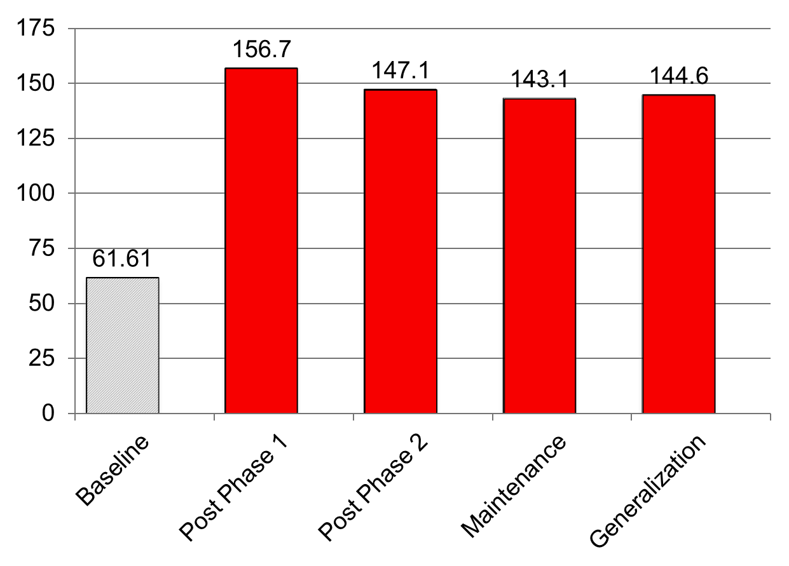
Essay Length (# words): Eight Studies (N = 112)

Slide 36
Essay Parts: Eight Studies (N = 112)

Slide 37
Overall 8 Studies Essay Quality (N = 112)
p < .028 all baseline with post measure comparisons, Wilcoxon Tests

Slide 38


What we have learned,
1979 - 2014
Prioritize, Adapt, Systematically Teach, Systematically Evaluate
Teach directly and intensively the content/skills/concepts to be learned
Teach students to attend more carefully, and think more systematically through information to be learned
Use structure, clarity, redundancy, enthusiasm, appropriate pace; maximize engagement. Monitor outcomes frequently and be ready to change your approach.
That we learn best by doing; and that our experience informs our understanding.
Persevere, persevere, persevere, persevere
Every Day Is a Gift - That's Why They Call It "The Present"

Slide 39
Where have we come as a field; where are we going?
State of art and practice then and now
Attitudes then and now
The Future: Unresolved issues
  Instructional delivery
  General education, common core curriculum
  Role of special education teacher
  Role of RTI
  Future research needs

Slide 40
State of art and practice, now and then
1970s
2010s
“Process” assessment and training
Theoretically-based instructional models: e.g., Kephart, Barsch, Doman-Delacato
Beginnings of ABA
Beginning work in attention, memory, cognition
Beginning professional literature
Focus on evidence-based practice
Focus on authentic tasks, real-life settings
Explosion of research in cognitive, behavioral domains
New research synthesis procedures
New instructional practices, e.g., RTI
A large professional literature on best practice

Slide 41
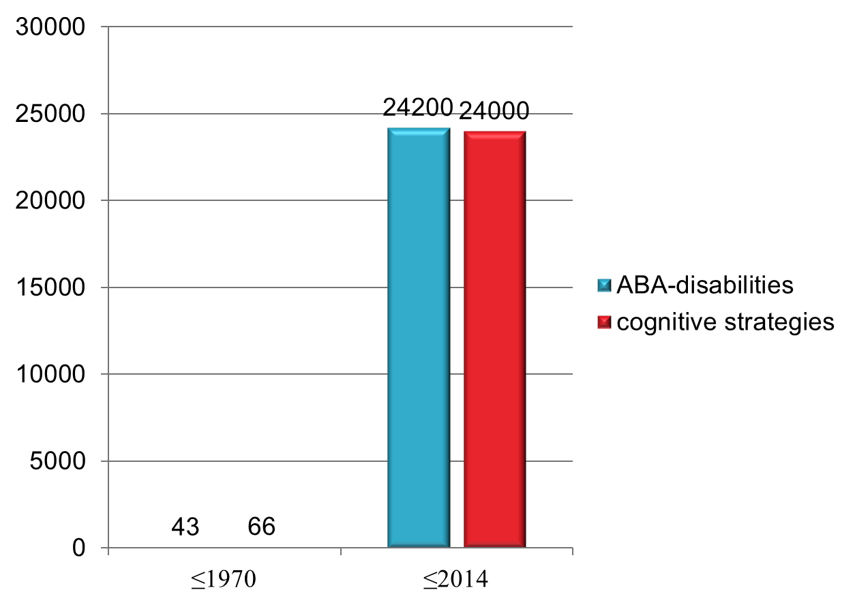
Empirical research: then and now

Slide 42
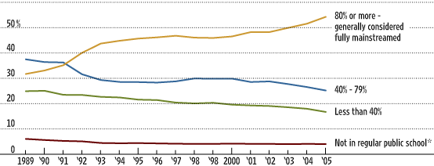
Growth of inclusive classrooms
Source: U.S. Department of Education, Office of Special Education Programs, Individuals with Disabilities Education Act (IDEA) database

Slide 43
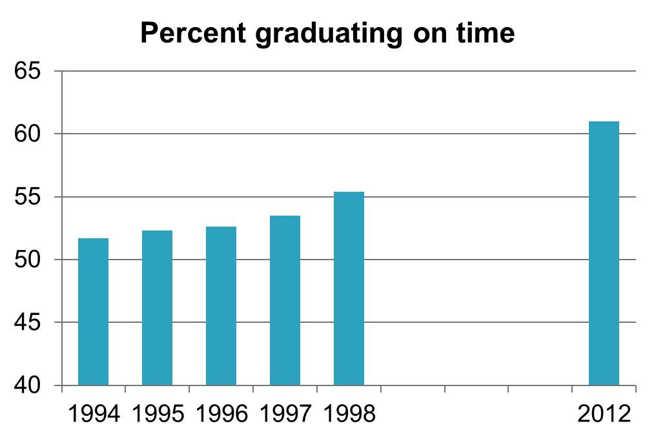
On-time Graduation rate: students with disabilities
U.S. Department of Education, OSERS, “Education Department Celebrates IDEA 25th Anniversary: Progress Continues for Students with Disabilities,” press release, November 29, 2000.
National Center for Education Statistics, U.S. Department of Education, 2014

Slide 44
Some things haven’t changed much
Teacher attitudes toward inclusion
  Survey synthesis 1: 1958-1996
  Survey synthesis 2: 1996-2010

Slide 45
Results Across all Surveys:
1. 1958-1996: 28 surveys, n = 10,568
2. 1997-2010: 40 surveys, n = 8,366
overall support the concept of inclusion
willing to teach students with disabilities
Higher agreement for more generally worded items of less intensity
1958-1996 1996-2010
62.8% 65.0%
61.4% 54.4%
General: “I support mainstreaming…”
Strong: “Total integration is a realistic goal…”

Slide 46
Strong Support for Inclusion, 1971-1996

Slide 47
General and Strong Support for Inclusion, 1971-1996

Slide 48
Strong Support for Inclusion, 1997-2010

Slide 49
General and Strong Support for Inclusion, 1997-2010

Slide 50
Support for Inclusion 1971-2010

Slide 51
Do Teachers Have Enough…?

Slide 52
Unresolved Issues
Delivery of instruction
Inclusive learning of common core curriculum v. intensive individual instruction in targeted need areas
Role of special education teacher in inclusive classrooms
Inclusive instruction, RTI can’t be viewed exclusively as a special education undertaking
Need for ideas

Slide 53

How will instruction be delivered?
When individual need area is not taught in general education classroom, e.g.,
  Speech and language
  Study skills
  Social skills
  Basic reading skills (e.g., in high school)
When students need more intensive instruction, taught at a more deliberate pace.

Slide 54
how will instruction be delivered?
-Inclusive learning VS.
-Intensive individual instruction in targeted need areas
Intensive SRSD instruction for students with EBD
General education curriculum
Average 12 weeks – just persuasive essays
  10-55 sessions
  4-5 days a wk; 30-45 min sessions
Writing practice throughout the instruction
Small group instruction (2-3 best)
12-20 essays written
  3-5 days devoted to grammar, syntax, language usage, and persuasive essays
  Two complete persuasive essays written (typically during unit)
  Whole class instruction

Slide 55

What happens in inclusive classrooms?
(Scruggs, Mastropieri, & McDuffie, 2007)
Synthesis of 32 qualitative investigations of co-teaching in inclusive classrooms
453 co-teachers, 142 students, 42 administrators
Most participants favored co-teaching, however:
  Whole class, teacher-led instruction dominated
  Special education teacher as subordinate
  Content knowledge a challenge to special education teacher

Slide 56
Co-taught classrooms
Specialized instructional or learning strategies were almost never observed:
    Practices known to be effective and frequently recommended—such as peer mediation, strategy instruction, mnemonics, study skills training, organizational skills training, hands-on curriculum materials, test-taking skills training, comprehension training, self-advocacy skills training, self-monitoring, or even general principles of effective instruction were only rarely observed (Scruggs et al., 2007, p. 412).

Slide 57
Role of Special Education Teacher
Behavior management. “Michael presents many challenges -- the fear of the other students is real and I will pledge to keep them safe. Mary will restrain and remove him while I continue with the rest of the class. It has taken its toll on all of us” (Bessette, 1999, p. 141).
Behavior management. “[The general education teacher] actually presents the lesson information while [the special education teacher] stands off to one side and focuses most of her attention on monitoring the behavior of three of the seven LD students” (Feldman, 1998, p. 80).
Classroom assistant. “After Janet completes the calls … she starts collecting the homework. Occasionally, during the lecture Janet would interject a comment to the class. At one time she said, ‘Remember when we talked about what enzymes did?’” (Hardy, 2001, p. 166).
Classroom assistant. “Because whole-class instruction continued to be the norm, special education teachers had few opportunities to offer individual instruction…” (Magiera et al., 2005, p. 22).

Slide 58
Role of Special Education Teacher, Comments
"The first year I was a model for the students. Often, if [the subject teacher] is lecturing, I would do the notes on the overhead [projector] to model note-taking" (Rice & Zigmond, 2000).
In a first grade class, the general education teacher led the class in a song, while the special education teacher “moved about the room organizing the chairs and picking up materials that were out of place from the previous activity” (Rosa, 1996, p. 84).
  “…none of what we saw would make it more likely that the students with disabilities in the class would master the material. . . We virtually never saw the special education teacher provide explicit strategic instruction to facilitate learning or memory of the content material” (Zigmond & Matta, 2004, p. 73)

Slide 59
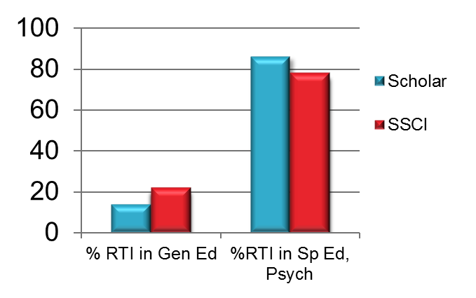
Inclusive instruction, RTI can’t be viewed essentially as a special education undertaking
Source | % RTI articles in General Ed Journals | % RTI articles in Special Education, or Ed/School Psychology journals
Google Scholar | 14% | 86%
SSCI Web of Science | 22% | 78%

Slide 60
Reconcile rti with inclusion:
A PROBLEM
GENERAL EDUCATION CLASSROOM
General school problems: systematic, validated Tier 1 services, in class
Special ed placement in inclusive…
Testing, referral to special education
Tier 1 doesn’t work: more intensive, validated Tier 2 services, in or out of class
Intensive Tier 2 services don’t work, need for even more intense services/special education

Slide 61
Don’t lose focus on ideas
Special education has correctly renewed its emphasis on high quality in design and data analysis
We must maintain high standards in quality research; however, we must not forget the important need for new ideas to address the critical issues and challenges of today
Continued and increased collaboration, among teams of federal agencies, practitioners, researchers and methodologists can help address challenges of the present and future.

Slide 62

thanks

