Slide 1
One State’s Journey
Supporting Iowa’s Students with
Significant Disabilities
Access, Participate, & Demonstrate Performance
of College & Career Ready Standards

Slide 2
Special Education in Iowa Three Big Areas of Work
Create Positive Outcomes for Eligibile Infants, Toddlers & SwD
Build Collaborative Partnerships
Facilitate System Structures and Processes

Slide 3
Curriculum Components
Content
Access
Plan
Instruction
Participate
Teach
Assessment
Performance
Report Out

Slide 4
Literacy, Language, & Communication Students with Significant Disabilities
Partnership
University of Northern Iowa
Area Education Regional Agencies
Districts
Notes:
Working together to create an integrated system of support. Five year partnership with University of Northern Iowa in supporting Area Education Regional Agencies and Districts in comprehensive literacy instruction aligned to the Iowa Core Essential Elements

Slide 5
Concurrent Conceptual Model of Literacy and Language Development
Speaking/
AAC
Reading
Writing
Listening
(Koppenhaver, Coleman, Kalman, & Yoder, 1991 – adapted from Teale & Sulzby, 1989)
Notes:
Literacy Instruction grounded within the concurrent model of literacy and language development.
These systems develop together and in interrelated fashion, each affecting the other. It is the recognition that children must be actively and communicatively and mindfully engaged as they construct their language in interaction with others. Language is not a process of response and reinforcement, which is descriptive of the opportunities presented to many of our children, but is a developmental process constructed through social engagement. During the emergent years, this must occur apart from judgment, yet most of our students experienced the language and literacy activities as responses to adult contrived situations in which they could and were adjudged as either right or wrong.

Slide 6
The Link Between Literacy, Language & Communication
ELA
Reading
Writing
Speaking
& Listening
Language
Iowa Core ELA Strands
Comprehensive Literacy Instruction
Concurrent model of literacy development
Notes:
The Iowa Core ELA strands include reading, writing, speaking & listening, and language. The enactment of comprehensive literacy instruction supports the concurrent model of literacy development.

Slide 7
Years 1-3 Reaching Potential through Systemic & Sustainable Statewide Professional Development
Ongoing Professional Development
Knowledge
Dispositions
Practices
Changes in Student Outcomes
Notes:
In years 1-3 of the project , IDOE partnered with faculty from University of Northern Iowa Center for Disabilities Studies in Literacy Language and Learning, and Dr. Karen Erickson, Center for Literacy and Disability Studies, School of Medicine at the University of North Carolina at Chapel Hill.
The project efforts were prioritized to focus on the development of interdisciplinary teams (consortia) across the state that could, collectively, increase literacy opportunities across educational settings for students with significant developmental disabilities.
As a result of the establishment of these teams and the initial and ongoing professional development support they have received, the educational experience of these students has changed. Students have increased their literacy skills as their teachers have changed their practices.

Slide 8
Change in Student Outcomes
Engagement, attention, and clarity
Growth in conventional literacy skills
Two case studies
Molly
Tucker

Slide 9
Molly

Slide 10
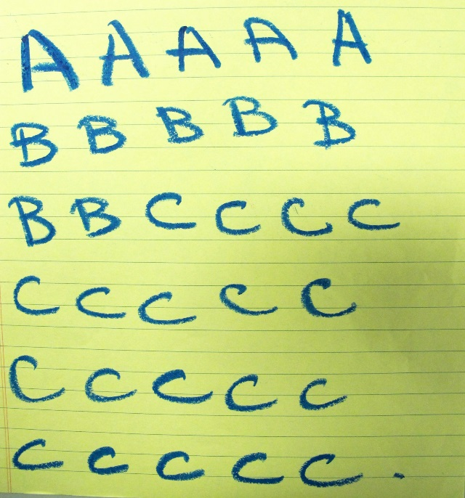
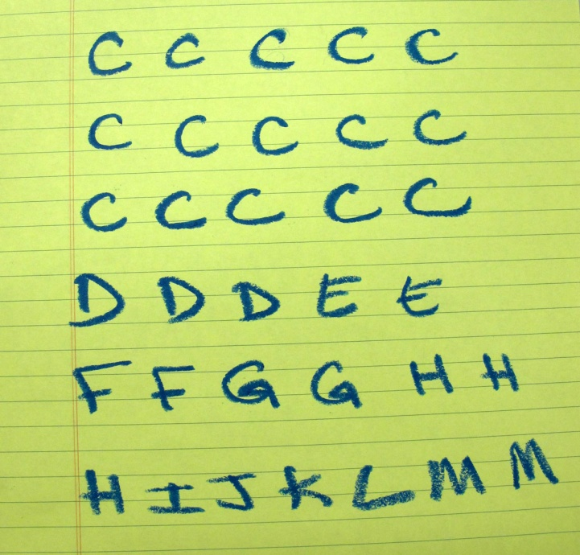
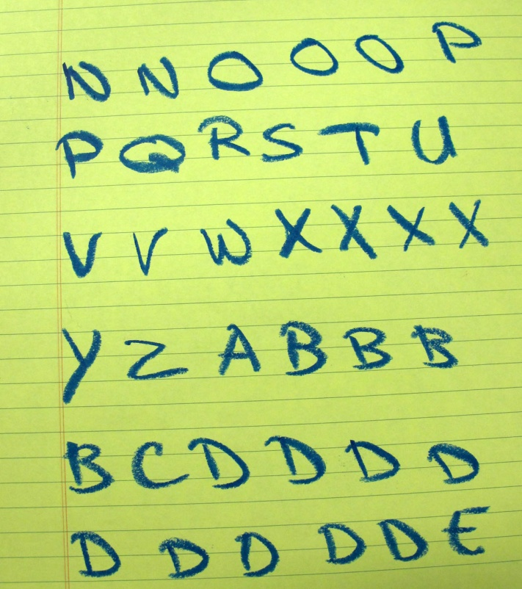
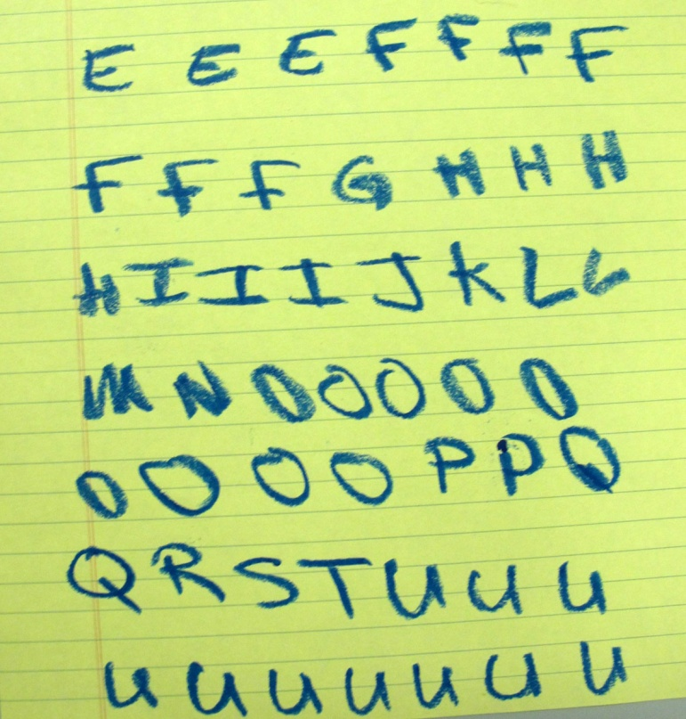
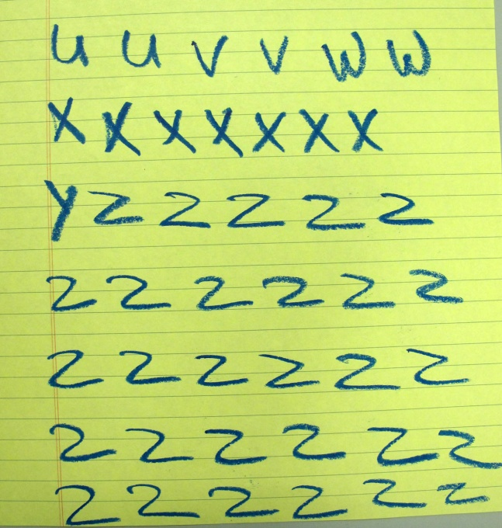
Beginning Writing Sample
Notes:
Beginning writing sample- exploring the alphabet - she did this for between 30-40 minutes. First opportunity for independence with writing anything.

Slide 11
Molly Video
Notes:
This example is illustrates the nonverbal communication between UNI Faculty Evette Edmister and Molly. Evette pays attention to the student’s signals. The student wants to be independent but Evette is attentive to when she needs to offer partner assisted scanning. Evette assumes the student knows what she wants to write so that’s how she interacts – she is the scribe for the students ideas. She’s not a teacher in this scenario.

Slide 12
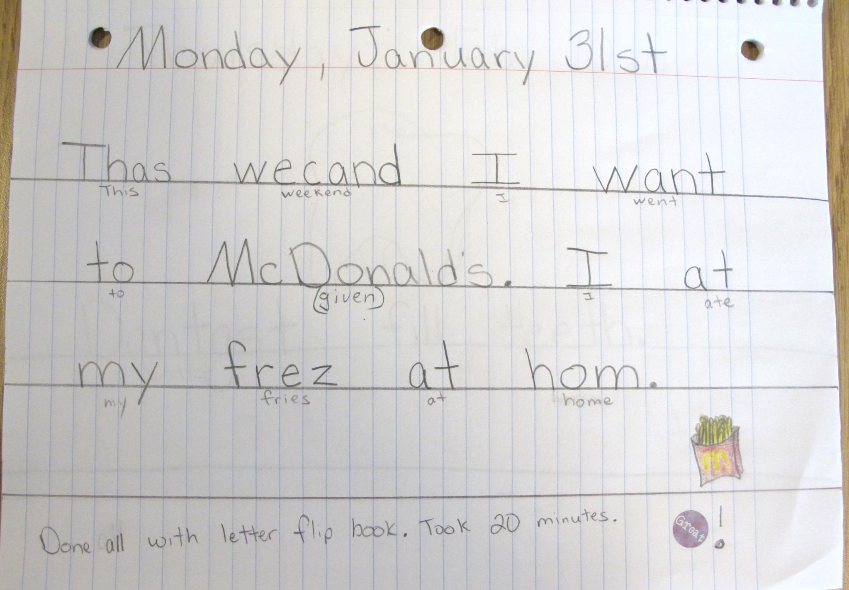
Writing Sample After One Year
Notes:
Writing sample after one year –this isn’t the sample Molly was producing with Evette but it is quite representative of journal samples she produced that spring of first grade.

Slide 13
Molly Skills Summary
 | Fall ‘09 | Spring ’10 | Spring ‘11
Letter Identification | 5/10 – chose to stop | 52/54 | N/A
Concepts About Print | 2/24 | 4/24 | Demonstrating knowledge in class
Writing Sample | Wrote letters using alternate keyboard | Began to vary letters selected | Wrote 2 sentences using communication system and adapted keyboard
Developmental Spelling | Not attempted | Not attempted | Phonetic cue (1-3 sounds in a word)
Ohio Word Test | Not attempted 4/50 class sight words – K curriculum | 41/50 sight words from class – K curriculum
Word Identification | Not attempted | Preprimer Frustrational | Preprimer Independent
Listening Comprehension (adult reading to the student) | Preprimer Frustrational | Primer Instructional | Primer Instructional
Reading Comprehension (student reading) | N/A | N/A | Preprimer Frustrational
Notes:
This is a student who has motor issues. Her team spent a couple of years working on electronic eye gaze, finding switch sites, = nothing was really successful. This was a determined kid and she wanted to do everything her peers did. She spent at least half the day in the gened room as a kindergartener and nearly the entire day in gened as a first grader. Had a para. The para did lots of partner-assisted scanning with her. The team was creative in figuring out low tech solutions so she could participate – magnetic letters for sign in, yes/no, etc.
We didn’t repeat letter id in spring of 11 because she knew her letters the year prior
Caps = didn’t repeat in spring of 11 because she demonstrated those understandings in class
She was able to compose connected text using a combination of spelling and communication device
Phonetic cue means she is using letters sounds to spell words. That’s pretty evident in her writing sample as well as developmental spelling test. She also had sight words she could spell. Developing inner voice or inner speech really helps with spelling and that’s often considered lagging in kids who don’t speak
Didn’t repeat ohio word test in spring of 11 because we just did graded word lists- she’s behind but progressing
Comprehension was behind but progressing
Writing was a relative strength for her. Can be used to build skills in other areas. All areas were improving though.

Slide 14
Reading Foundational Skills
Reading Foundational Skills
Phonics and Word Recognition
EE.RF.1.1 Demonstrate emerging understanding of the organization of print.
EE.RF.1.3 Demonstrate emerging letter and word identification skills.
Fluency
EE.RF.1.4 Begin to attend to words in print.
Text Type and Purposes
EE.W.1.3 Select an event and use drawing, dictating, or writing to share information about it.
Production and Distribution of Writing
EE.W.1.5 With guidance and support from adults, add more information to own drawing, dictation, or writing to strengthen it.
Notes:
Alignment of instruction to the Iowa Core Standards (Essential Elements)

Slide 15
Tucker
Video - Writer’s workshop (conferencing)
Notes:
Tucker’s parent provided consent for presentation mode only not through the internet. I’ll need to upload this video in DC prior to the presentation.

Slide 16
Tucker’s Poem
Notes:
Tucker’s Poem:
My hand
It tickles. It turkey. Shadow dog. Prrr cat to pet. Holding hands with you.

Slide 17
Tucker Skills Summary
 | Fall ‘09 | Spring ’10 | Spring ‘11
Letter Identification | 28/54 | N/A | 44/54
Writing Sample | Wrote “mom”, “dad” | Wrote in cursive strokes
Developmental Spelling | Not attempted | Not attempted | Attempted task - for many of the 12 words he had a letter
Ohio Word Test | 0/15 | N/A | 4/15
Word Identification | Not attempted | 10/20 on preprimer | Not done
Listening Comprehension (adult reading to child) | Frustration at preprimer level | Frustration at preprimer level | Independent at first grade level
Notes:
Decoding is challenging. Beginning to use sounds to figure out words – otherwise things are sight words for him. His growth is in comprehension (more than two years in two years), attention, and writing. Views himself as a capable learner now.
As a middle schooler, the biggest task with him was to help him come to see himself as a learner, as capable. He knew some things but had little perseverance and would often say he was stupid. He avoided tasks often times because of that. His teacher did a great job of nurturing him and building his confidence and the merging of his class with a gened class for english broadened his community. The work they did really helped him improve. He showed himself as a poet. His comprehension improved.

Slide 18
Writing
Text Types and Purposes
EE.W.6.2 Write to share information supported by details.
Production and Distribution of Writing
EE.W.6.4 Produce writing that is appropriate for the task, purpose, or audience.
Speaking and Listening
Comprehension and Collaboration
EE.SL.6.1 Engage in collaborative discussions.
Notes:
Alignment of instruction to the Iowa Core Standards (Essential Elements)

Slide 19
Years 4-5 Reaching Potential through Systemic & Sustainable Statewide Professional Development
Development of multimedia modules with information on implementing effective literacy practices, support materials for instruction, and networking connections with other educators in the field
Notes:
In years 4-5 the project dimensions shifted to allow for scaling up of professional development across the state so that a greater number of educators will have access to resources they can utilize in an organized, informed manner to change their instructional practices for their students.

Slide 20
Anticipated Modules
Foundational
Overview of Comprehensive Literacy
Creating a Collaborative Professional Community
Getting Started
Assessment
Communication
Instructional
Comprehension
Word Study
Writing
Self-Selected Reading
Notes:
Differentiated modules-first five are foundational and the final four instructional.

Slide 21
Framework for Effective Instruction Students with Significant Disabilities
Framework for Effective Instruction
DLM Instructional PD
UNI Modules
Model Curriculum Framework
What Iowa Teachers Should Know & Do
Notes:
Integrating Professional Development modules into a model curriculum framework.

Slide 22
Preparation for Opportunity
If you can imagine things aren’t quite what they seem, and dream of possibilities that only you can dream of, then anything is possible”
Bart Vivian

