Slide 1
Challenging All Students to Meet High Expectations:
Supporting Schools in Raising the Bar
for Students with Disabilities
Office of Special Education Programs
Project Directors' Conference
July 2014
Vision
Kristen Brown, Ph.D., Project READ Director, Common Core State Standards and Assessment Liaison, Special Education Division, California Department of Education
Jodi Fortney, Special Education High School Teacher, Tulare County Office of Education
Notes:
Introductions
Sue Austin is a visionary. Listen to a 1 minute excerpt on how she is redefining the popular notion of disability.
1 minute version:
http://youtu.be/kiUjkT5SsHM
Entire version:
http://www.ted.com/talks/sue_austin_deep_sea_diving_in_a_wheelchair
Multimedia, performance and installation artist Sue Austin keeps a fascinating mission at the center her work: to challenge the idea of disabled as “other” and represent her experience as a wheelchair user in a brighter light. She does this by creating quirky, unexpected juxtapositions -- bringing a sense of whimsy and empowerment to the discussion of disability.
Austin is the founder and artistic director of Freewheeling, an initiative aiming to further the genre of Disability Arts. In 2012, she was asked to be a part of the Cultural Olympiad in Britain, a celebration of the arts leading up to the Olympic and Paralympic Games. The work she created for the event, called “Creating the Spectacle!,” is a groundbreaking series of live art and video works of an underwater wheelchair.

Slide 2
Overview
The Least Dangerous Assumption
Essential Concepts
Multi-Tiered Systems of Support (MTSS)
Common Core State Standards (CCSS)
Aligning Individual Educational Plans (IEPs) Activities and Resources
National Center and State Collaborative--Aligning Instruction to the CCSS for the students with significant cognitive disabilities
Using Language Arts Activities with Scripted Systematic Instruction (LASSI) to Raise the Bar

Slide 3
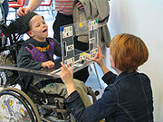
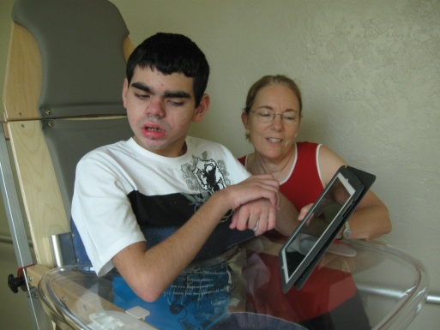
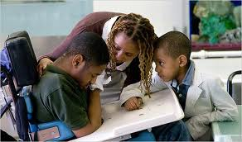
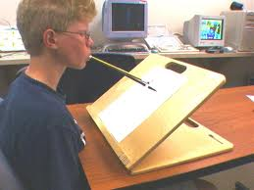
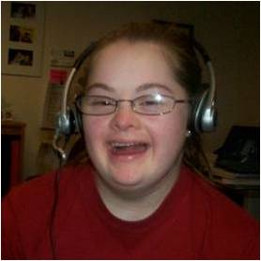
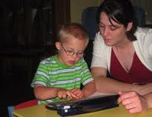
The Least Dangerous Assumption
We assume that students with the most significant cognitive disabilities are competent and able to learn, and we support increased educational opportunities in a range of learning environments.
Source: NCSC South Carolina Meeting Curriculum and Instructional Supports February 27th, 2013
Notes:
Based on the principle of the “least dangerous assumption” (Donnellan, 1984; Jorgensen, 2005), we assume that students with the most significant cognitive disabilities are competent and able to learn and we promote increased educational opportunities in a range of learning environments.
As a result of
assuming competence gained by students through increased opportunities to learn academic content (rather than a lack of or limited opportunities )
the use of evidence-based instructional practices
increased communicative competence,
is that students will acquire new knowledge and skills and become college, career, and community ready.

Slide 4
Essential Concepts
MTSS
Systematic
RtI
^{Individualized}
Addresses the needs of ALL students
Universal screening
Multiple tiers of intervention
Data-driven decision making
Problem solving teams
Focus on CCSS
Aligns the entire system of
initiatives, supports, and resources
Implements continuous improvement processes at all levels of the system
Multi-tiered System of Supports: A Comprehensive Framework for Implementing the California Common Core State Standards professional learning module found at http://www.myboe.org/portal/default/Content/Viewer/Content?action=2&scId=509627
Notes:
MTSS is a framework that can integrate a state, district, or school system by connecting general, gifted, and special education with intervention, supports and enrichment designed to maximize access and resources leading to increased achievement for all students.

Slide 5
Integration of MTSS, College, Career, and Community Ready
The integration of MTSS incorporates preparing students to be college, career and community ready by relying on the CCSS to provide a framework and a set of critical tools to support teaching and learning at differing levels of intensity, depending on the academic needs of the students.
(Gamm, Elliott, Halbert, et. al., 2012)
Notes:
Linking MTSS with College, Career and Community Ready and the CCSS.

Slide 6
Common Core State Standards Rationale
“The CCSS addresses the deep challenges of inequality of opportunity between different students exposed to radically unequal opportunities when it comes to the material they study and the quality of instruction they have received.”
(Coleman, D. 2011)

Slide 7
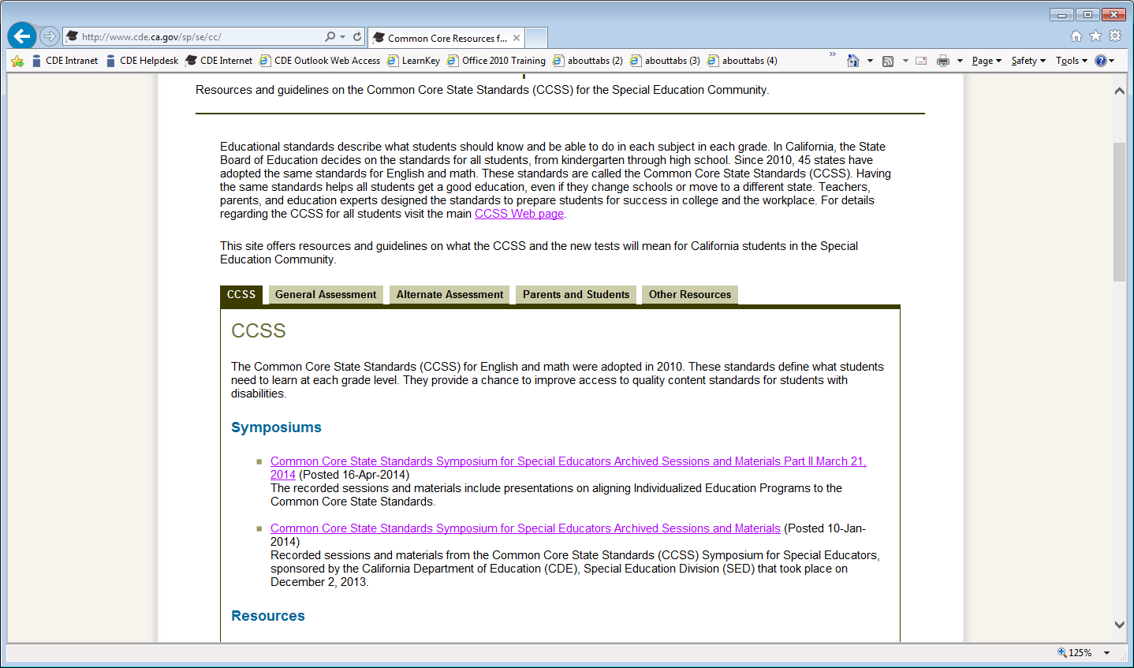
California Common Core Special Education Web site
http://www.cde.ca.gov/sp/se/
Parent and student resources in English and Spanish

Slide 8
National Center and State Collaborative Consortium Project
Led by 5 centers and 24 states
Alternate assessment in grades 3 through 8 and grade 11
To develop a system of assessments supported by curriculum, instruction, and professional development to ensure that students with the most significant cognitive disabilities achieve increasingly higher academic outcomes and leave high school ready for post-secondary options

Slide 9
College, Career, and Community Readiness
Career
College
Community
Curriculum
Common Standards
Learning Progressions
Core Content Connectors
Instruction
Grade-level Lessons
Accommodations
Systematic Instruction
Assessment
Formative
Summative
Communicative Competence
Notes:
Over the past several decades, powerful insights have been gained into how students represent knowledge and develop competence in specific domains, as well as how tasks and situations can be designed to provide evidence for inferences about what students know and can do for students across a full range of performance.
Researchers are finding strong evidence of academic skill and knowledge development among students who participate in AA-AAS, including abstract concepts and transfer of learning.
Each component of the triangle (curriculum, instruction and assessment) is used to inform the other components which are all directed toward the goal of College, Career, and Community readiness.
Communication competence is defined as the use of a communication system that allows students to gain and demonstrate knowledge. Communicative Competence is critical to this domain-based model of learning and is a key focus of the project.
In order for any student to benefit from challenging curriculum and high quality instruction, he or she has to be able to communicate what they know and can do. Communicative Competence is the base.
Consistent communication intervention is needed to ensure that students can access the content.

Slide 10
Commitment to Communicative Competence
Communication at some level is possible and identifiable for all students regardless of functional “level,” and is the starting point for developing communicative competence. Communication competence is defined as the use of a communication system that allows students to gain and demonstrate knowledge.
NCSC Parent Materials September 2013.
http://www.ncscpartners.org/Media/Default/PDFs/Resources/Parents/NCSC-Communicative-Competence-9-10-13.pdf

Slide 11
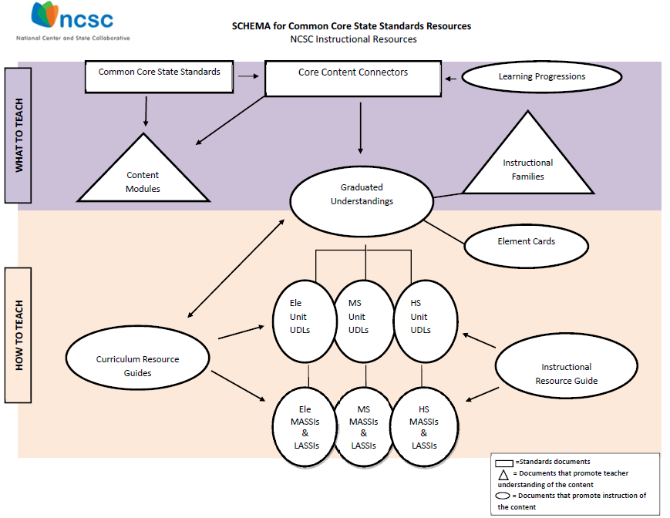
SCHEMA for Common Core State Standards Resources NCSC Instructional Resources
Notes:
What to teach-explain elements
How to teach-explain elements
Instructional Families:
Provide educators with easily interpreted visual representations of the areas of curricular emphasis within and across grades; and
Reference the CCSS and the Learning Targets of the Learning Progression Frameworks.
Element Cards:
Define the Essential Understandings as Concrete Understandings and Representational Understandings derived from the Core Content Connectors; and
Articulate suggested instructional strategies, supports and scaffolds.
Instructional Resources
Provide guidance on how to “unpack” the instructional and assessed content;
Promote strategies and resources for teaching challenging academic content through professional development opportunities; and
Align challenging and attainable content that is observable and measurable for use in instruction and through a system of assessments.

Slide 12
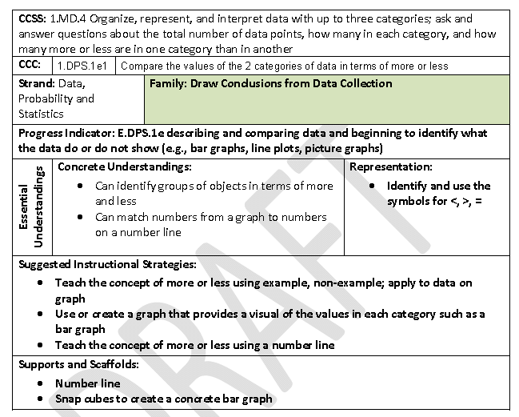
Element Cards
Notes:
Digestible way to look at the CCSS, CCCs and instructional strategies.

Slide 13
Math and Language Arts Activities with Scripted Systematic Instruction
MASSI: The “Math Activities with Scripted Systematic Instruction” offer a model for teaching CCSS to students with significant cognitive disabilities.
LASSI: The "Language Arts Activities with Scripted Systematic Instruction" offer a model for teaching CCSS to students with significant cognitive disabilities.

Slide 14
Introducing a Game Changer
Jodi Fortney…
Taught Special Education for 25 years, with the past 13 years being at the high school level
Serves students with moderate to severe cognitive disabilities which includes students with autism, hearing, visual and physical impairments, and down’s syndrome
Teaches a Special Day high school class at Mt. Whitney High School in Visalia, California
Active participant on the NCSC LASSIs field test as well as the NCSC assessment writing study.

Slide 15
From Materials to Practice
Using the LASSIs to guide instruction in a high school classroom (excerpt) https://www.youtube.com/watch?v=MpBQD-ILecg
Using the LASSIs to guide instruction in a high school classroom (full version)
https://www.youtube.com/edit?action_reinstate=1
Notes:
Now, I will share with you my classroom experiences with the LASSIs in the field test. I teach Language Arts to two different classes each day. The students have a wide range of abilities. Many are non-verbal, unable to write and do not have an effective communication system. Others are beginning readers with limited verbal skills and others are reading at around a 2nd grade level. I also have general education student aides helping in the classroom. The LASSI I am going to focus on for this presentation is The Pearl by John Steinbeck. I used an adapted version of the text which was at approximately a 5th grade reading level. Much of the original vocabulary was retained in the adapted version and these words were taught prior to reading each chapter. The LASSI focuses on Building Essential Understanding – some prerequisite skills, Building a Grade-Aligned Component – the CCSS (passage comprehension, using to context clues, theme etc), and Building Toward Independent Reading- increasing sight words.
Each student had a copy of the adapted text in a binder, and I projected it on the board as I read aloud to them. They were all engaged in the text, even though there were not pictures. The most amazing part of the LASSI is when the students use the response boards with options presented in written and visual formats. Students who had previously been unable to respond to higher level questions due to a lack of communicative competency were now able to participate. I have a short video clip of me presenting Chapter 1 of The Pearl to a small group of students. (show clip) Everyone who participated in this instruction benefitted. Students with higher academic skills learned to listen for information, to answer questions that went beyond recall and also to ask questions. Students with more limited academic skills, learned to listen and use a response board to answer questions. All the students felt a sense of pride because their general ed. peers were also interested in the lesson and carried on conversations with them about it. I had students who took the adapted text home and read it to their parents. One family read the book so they could discuss it with their student. The verbal students would look for opportunities to use the vocabulary throughout the day. The techniques demonstrated in the LASSI can be used with any type of text. I now use them every day in history, science and language arts lessons.

Slide 16
Creating Effective Language Arts Instructional Materials
Building a LASSI Video
https://www.youtube.com/watch?v=MZPCckay9_w&feature=youtu.be
Notes:
I had the opportunity to participate in a LASSI field test conducted by the University of North Carolina at Charlotte. As part of the field test, I presented three different LASSIs to my high school students with severe cognitive disabilities: informational text, vocabulary and word study and narrative. I also had to create my own LASSI, which I chose to do on To Kill a Mockingbird.
At the bottom of the slide you will see the link to a video I made that goes through the steps of creating a LASSI. I am not going to show it now, but will give you a brief overview. The first step is to choose a grade appropriate text. Then, after, reading the text, choose 2-3 CCSS that are applicable to that text. When teaching, the original text or an adapted version can be used, as long as the adapted version still reflects the standards on which instruction is focused. The part of the LASSI that really makes the material accessible for all students is the presentation of vocabulary and questions with response options presented in both a written and visual format. Creating LASSIs seems overwhelming at first, but with practice, the steps become part of the natural teaching process.
I have examples of the LASSIs at the elementary, middle school and high school level that we can pass around.

Slide 17
Resources
California Department of Education Special Education CCSS Website
http://www.cde.ca.gov/sp/se/cc/
CCSS and related assessment consortia work
Diving Deeper into aligning IEPs to the CCSS Symposium http://cde.videossc.com/archives/032114/
CCSSS archived sessions and training materials
Aligning IEPs to the CCSS Administrator, teacher, parent and student handouts
http://www.cde.ca.gov/sp/se/cc/
These one page handouts are translated into English and Spanish
NCSC Wiki: Resource Materials
https://wiki.ncscpartners.org/mediawiki/index.php/Instructional_Resources Hosts the materials needed to deliver instruction aligned to the CCSS
NCSC Presentations
http://www.ncscpartners.org/resources-cop-presentations
Content resources, model curricula, and other tools housed on the NCSC Wiki page

Slide 18
Questions?

Slide 19
Contact Information
Kristen Brown, Ph.D.
Project READ Project Director
Common Core State Standards and Assessment Consultant
Special Education Division
California Department of Education
Telephone: (916) 445-1064
E-mail: kbrown@cde.ca.gov
Jodi Fortney
Special Education High School Teacher
Tulare County Office of Education
E-mail: jodif@tcoe.org

