Slide 1
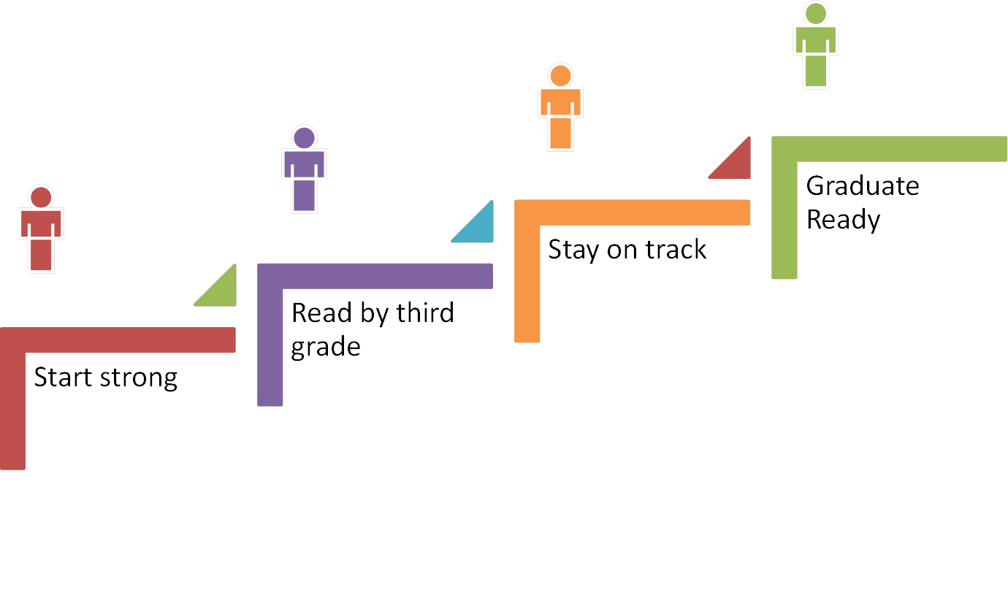
Colorado Department of Education Every Student Every Step of the Way
Tanni L. Anthony, Ph.D., Project Director
Colorado Services for Children and Youth with Combined Vision and Hearing Loss Project

Slide 2
Exceptional Student Services Unit
Supports Colorado personnel serving students, preschool through 21 years with exceptional educational needs
Provides TA and programming support for students who have disabilities, are gifted and talented, and/or are culturally diverse. Also home to the CO Services for Children and Youth with Combined Vision and Hearing Loss Project.
Administers both the state's Exceptional Children’s Educational Act (ECEA) and the federal Individuals with Disabilities Education Act (IDEA) for children with disabilities.
Restructured focus on Results Driven Accountability tied to student achievement.

Slide 3
literacy
Access, Learning, and Literacy Team
Literacy Consultant
Strong focus on all student populations specific to communication, reading, and writing achievement.

Slide 4
Accessibility of State Assessments
General Assessment: multi-step sensory bias review with specific focus on tactile graphics.
Alternate Consortium Assessment: sensory bias review with specific focus on text providing content (not pictures) and “alternate pathways” for items with innate visual bias.

Slide 5
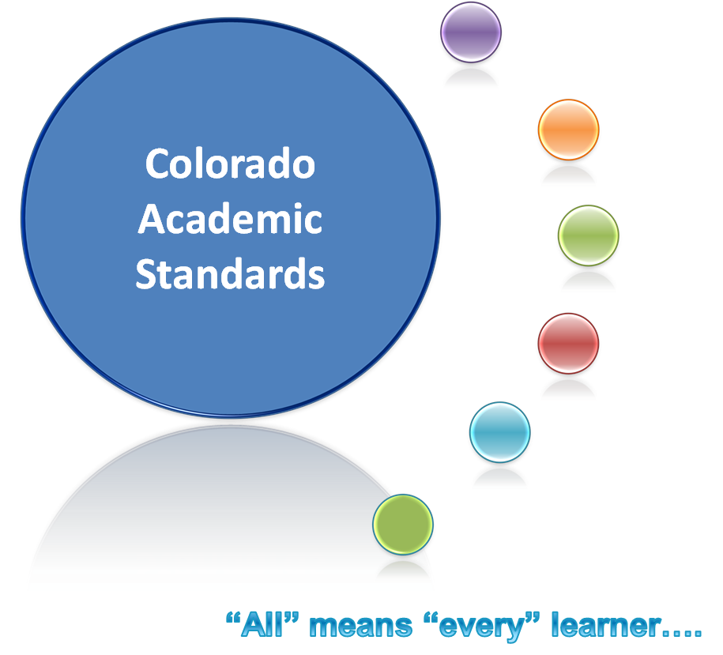
Colorado Academic Standards
Colorado English Language Proficiency Standards (CELPS)
Common Core State Standards (CCSS)
21st Century Learner Skills
Post-Secondary Workforce Readiness (PWR)
Grade-level Skills & Evidence Outcomes (Eos or GLE)
Alternate Standards-Extended Evidence Outcomes (EEOs)
Notes:
In Colorado, “all” means “all” learners. The integration of the Extended Evidence Outcomes into—not along side of or in addition to—but into the Colorado Academic Standards is evidence that students with a disability are not separate learners from their peers, but rather they are supported learners receiving sound standards-based instruction with appropriate levels of support.

Slide 6
The Colorado READ Act
Colorado Reading to Ensure Academic Development Act - passed in the 2012 legislative session.
Focus on all K – 3rd Grade students determined to have a significant reading deficiency (SRD)
Requires a READ Plan for students with a SRD
Provides funding to support literacy interventions.

Slide 7
READ Act and SWD: ALL = Every
Due to limited allowable accommodations on approved interim assessments, some students with disabilities cannot access the assessment. This unintended exclusion of some SWD in the screening and identification of a SRD is currently being addressed:
A state-wide task force is being formed, focused on identifying alternate processes and procedures for specific disabilities categories and issues , e.g., visual impairment, including blindness; hearing impairment, including deafness; deaf-blindness; intellectual disability, multiple disabilities, autism spectrum disorders, traumatic brain injury, and learners with speech language impairment with significant expressive language disorders or who are nonverbal.

Slide 8
ASD Literacy Institutes
75 personnel trained – 17 district teams
Level 1: 5 days of training with individual projects tied to coaching on a designated topic
Implementation in 10 model demonstration sites
Level 2: return of Level 1 attendees; goal = reliability with new assessment tool (adapted RISE)
Notes:
Reading Instruction of Special Education with an ASD lens

Slide 9
Summer Institutes on Deaf-Blindness
Focus on Literacy since 2004 – moving from access to achievement targets.
Five Day Training Institutes – 2011, 2012, 2013
Two 2.5 day Advanced Literacy Institutes – 2014
Benefits: Infusion of training content into five preservice training programs and 12 model SSN demonstration sites (preschool – high school); state grant award specific to “emergent literacy”

Slide 10
Achievement and Growth Grants
Focus: develop and coordinate local resources specific to literacy that advance reading, writing, speaking, and listening skills for students receiving special education services in all disability categories.
Four Awards: one tied specifically to emergent readers and writers with significant support needs

