Slide 1
Successful Technology Interventions: What Are They and How Do We Incorporate Them into Classroom Practice? July 21 or 22, 2014
Presented by Stepping-Up Technology Implementation Cohort 8 Representatives:
Terry Jackson Office of Special Education Programs
Anna Evmenova George Mason University
Margo Izzo & Alexa Murray The Ohio State University
Lori Cooney University of Massachusetts Boston

Slide 2
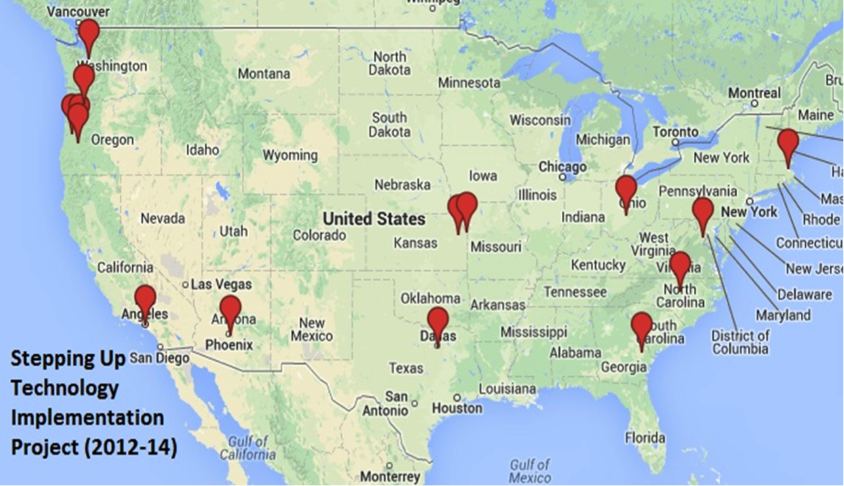
Technology Implementation Projects (2012-14): Where Are They?
Stepping-Up to Technology Cohort 8 and 9
Notes:
There is a map of all of the different Stepping Up projects in the United States.

Slide 3
327s Technology Implementation Projects
Stepping-Up to Technology Cohort 8 and 9
University of Massachusetts Boston
Future Quest Island: Promoting College and Career Readiness for Students with Disabilities in Middle School – using the Second Life platform, Future Quest Island is designed to support the development of college and career readiness for middle school youth with disabilities through activities that promote student self-discovery, advocacy, exploration, organization, and technology literacy skills.
Notes:
there is an image of the Future Quest Island logo on the right.

Slide 4
327s Technology Implementation Projects (continued)
Stepping-Up to Technology Cohort 8 and 9
California State L.A. University Auxiliary Services, Inc.
Improving Literacy and Technology Skills Using the Braille Challenge Mobile Application for VI Students – increasing technology and braille literacy skills of children who are visually impaired through the development, evaluation, validation, and widespread dissemination of a Braille Challenge Mobile App (BCMA) that incorporates evidence-based instructional strategies using a mainstream device.

Slide 5
327s Technology Implementation Projects (continued 2)
Stepping-Up to Technology Cohort 8 and 9
George Mason University
Project WeGotIT!: Writing Efficiently with Graphic Organizers - promoting an effective integration of computer-based graphic organizers (CBGOs) with embedded self-regulated learning strategies in order to improve essay writing across the curriculum for students with high-incidence disabilities in upper elementary and middle schools.
Notes:
there is an image of the George Mason University logo on the right.

Slide 6
327s Technology Implementation Projects (continued 3)
Stepping-Up to Technology Cohort 8 and 9
The Ohio State University
Scaling-Up EnvisionIT: A Model for Teaching 21st Century Skills to Students with Disabilities - using an evidence-based, standards-aligned online curriculum called EnvisionIT (EIT) in order to teach 21st Century skills in four focus areas to students with and without disabilities in grades 8-12: 1) information technology (IT) literacy; 2) English Language Arts (ELA); 3) transition planning; and 4) financial literacy.
Notes:
there is an image of the EnvisionIT logo on the right.

Slide 7
327s Technology Implementation Projects (continued 4)
Stepping-Up to Technology Cohort 8 and 9
University of Oregon/Georgia Southern
Project ESCOLAR: E-text Supports for Collaborative Online Learning and Academic Reading - using E-text Supports for Collaborative Online Learning and Academic Reading Collaborative Online Projects designed to support academic reading of science content for middle school (6th-8th grade) Students with Learning Disabilities (SWLD).

Slide 8
327s Technology Implementation Projects (continued 5)
Stepping-Up to Technology Cohort 8 and 9
University of Washington
Implementing iBESTT in Schools: Increasing the Fidelity of Behavior Plans Using Tablet Technology - developing a behavioral support system for students with or at-risk for emotional behavioral disturbance who show challenging behavior in elementary and middle schools.
Notes:
There is an image of the University of Washington ;ogo on the right.

Slide 9
327s Technology Implementation Projects (continued 6)
Stepping-Up to Technology Cohort 8 and 9
Southern Methodist University
An Experimental Examination of e-Nimble: The Coaching Solution with Special Education - testing a technology-based coaching system called e-Nimble: The Coaching Solution with teachers and students in special education classrooms in order to measure effect on reading instruction as well as compare with traditional models of instructional coaching.
Notes:
There is an image of the SMU logo on the bottom

Slide 10
327s Technology Implementation Projects (continued 7)
Stepping-Up to Technology Cohort 8 and 9
The University of Kansas
The Sustainable Implementation of Innovations for Students Achievement (SIISA) - developing, investigating, and revising: (a) an adoption implementation process/model and (b) a diagnostic, monitoring and implementation support system that will lead to successful use of the evidence-based SOLO 6 Literacy Suite (SOLO) tool along with the SRSD writing intervention.
Notes:
Image of the writing solo logon on the right

Slide 11
327s Technology Implementation Projects (continued 8)
Stepping-Up to Technology Cohort 8 and 9
Oregon Health & Science University
Communication Matrix Community of Practice - using a Communication Matrix virtual CoP designed to be used by parents and teachers collaboratively to improve communication outcomes for students with complex communication needs (CCN), such as autism, multiple disabilities, deaf-blindness that are not well captured by typical assessment instruments.
Notes:
Image of the OHSU logo

Slide 12
327s Technology Implementation Projects (continued 9)
Stepping-Up to Technology Cohort 8 and 9
Arizona Board of Regents for Arizona State University
Integrated Technology Tools for Optimizing Instruction and Assessment Results for SWD - developing technology tools and professional development (PD) resources necessary to integrate data on instruction and assessment from easy curriculum-based measurement (CBM), a widely used evidence-based CBM platform, and MyiLOGS, an online teacher daily log for documenting instructional actions.
Notes:
There is an image of the ASU and University of Oregon Logos on the right

Slide 13
Technology Interventions & Components: INTERVENTIONS
Interventions
Potential characteristics of a successful technology intervention:
Relevance
Intuitive/easy to use
Innovative and adaptable (can be upgraded easily)
Reasonable cost (benefit outweighs cost to use)
Good marketing strategy, company backing, and consumer buy-in
Capable of integrating into mainstream use/culture

Slide 14
Technology Interventions & Components: INTERVENTIONS (continued)
Interventions
Examples include:
Operating systems (i.e. Windows, Linux, Apple, Google);
Assistive technology (i.e. SOLO, Read & Write Gold)
Mobile Devices, (i.e. iPhone, Kindle, iPads)
Course management systems (such as Moodle, Blackboard)
Notes:
There is an image of several mobile devices on the right.

Slide 15
Technology Interventions & Components: COMPONENTS
Components
Back-end components and/or delivery systems are essential to success of a technology intervention
Intervention can become product or tool
These tools can become more effective as part of a larger, more complex technology intervention
Examples can include but are not limited to:
Java, Flash, Second Life, course management systems, SOLO, Microsoft Word, Adobe Reader, You Tube, and open-source technologies
Notes:
platforms contribute to configuration and delivery of software or device - selection of right back-end components and/or delivery systems are essential to success of a technology intervention
Open -source technologies where computer code can be manipulated for the sake of a project
*there is an image of the schoology logo on the right

Slide 16
Technology Access Challenges
Implementation Strategies
Hardware Updates
Archaic and/or Non-Reliable Technology
Internet Access
Firewall Restrictions
Content Filtering
Bandwidth
District Technology Personnel
Compatibility of Operating Systems – e.g., Google Chrome vs. Apple vs. Microsoft
Notes:
image of a yellow sign with "warning challenges ahead" and an arrow pointing up on the right.

Slide 17
Technology Access Solutions
Implementation Strategies
School Speed Test for Internet Access
Content Versions - platform specific
Course Management System Selection
Google/Schoology/Edmodo
Flexibility
Universal Design for Learning Strategies - multiple versions of tool or deliverable
What are some of your experiences with technology access?
Notes:
There is an image of the school speedtest logo on the right.

Slide 18
Site Selection Challenges
Implementation Strategies
Attrition in Urban Schools
Title 1 Funding
Time and Resources
Technology Ready
IRB Process at District
Administration Approval Process
Site Recruitment
Notes:
image of a figure holding back the big hand of a clock on the right

Slide 19
Site Selection Solutions
Implementation Strategies
Early Recruitment
Letters of Collaboration for Grant
IRB on Behalf of Schools
Statewide Leadership Conference Presentations to Recruit Sites
Competition for Site Selection
Integration with District-wide Initiatives
What are some ways you have successfully recruited a site?
Notes:
Image of an institutional review board with a globe and 6 figures around the globe

Slide 20
Participant Readiness Challenges
Implementation Strategies
Recruitment
Technology Skills Assessment
Readiness for Implementing with Fidelity
Priority and Resource Allocations
Diversity of Learners
Diversity in Settings
Technology Support Services
Maintaining Regular Communication

Slide 21
Participant Readiness Solutions
Implementation Strategies
Measuring Technology Skills & Technology Usage
Establishing Prerequisites
Balanced Sampling
Differentiated Instruction
Universal Design for Learning
Text-to-Speech AT
Ongoing TA/In-Classroom Support
Sharing Best Practices
What are some ways you have assessed and increased participant readiness?
Notes:
Image of all different colored hands holding up the globe on the right

Slide 22
Professional Development
Implementation Strategies
Early Recruitment
Ways to Compensate Teachers
Training Delivery Methods Based on Teacher Need (Online and Face-to-Face)
After-School Activities
Project Kick-off Training
Follow-Up Technical Assistance (TA)
Instructional Coaching

Slide 23
Research Methods
Implementation Strategies
Conducting Experimental Research in Schools - IRB and Recruitment Implications
Treatment & Comparison Groups - Offer Incentive to Schools to be in Comparison (e.g., wait-listed control)
Adjust Research Designs to Meet School Needs
Flexible Delivery of Research Measures
Adjust Measurement of Fidelity Based on Research Need
Notes:
Image of a man interviewing a woman in a cartoon on the right.

Slide 24
Factors That Contribute to Sustainability
Sustainability
Selecting the right technology tool
Teacher/administrator buy-in
Cost and ease of use
Relevance (stakeholders see value of intervention)
Universal Design for Learning
Customizable/adaptable
Capable of being integrated into school infrastructure and/or mainstream use/culture

Slide 25
Audience Poll on Poll Everywhere
Poll
What is or was your biggest challenge with project or technology implementation?
a. Site Selection
b. Technology Access
c. Participant Readiness
d. Professional Development
e. Research Methods
f. Other?

Slide 26
What was the most useful part of this presentation?
Question & Answer
For more information, contact:
Terry Jackson Terry.Jackson@ed.gov
Anna Evmenova aevmenov@gmu.edu
Margo Izzo Margo.Izzo@osumc.edu
Alexa Murray Alexa.Murray@osumc.edu
Lori Cooney lori.cooney@umb.edu

