Slide 1
The Pathway to Transformation

Slide 2
Employment First
Rhetoric or Possibility?

Slide 3
Self-Sufficiency is not only better for PWD, It also makes Economical Sense: Supported v. Sheltered Employment
Regardless of disability or severity, Supported Employment (SE) costs less than Sheltered Work (SW)
SE: $6,619
SW: $19,388
SE is more cost-efficient to taxpayers
SE: 1.21
SW: 0.83
SE is more cost-efficient to workers
SE: 4.20
SW: 0.24
Cimera, R. (2007, 2008, 2009, 2010)

Slide 4
How are we Faring Nationally? Trends in State ID/DD Expenditures
METRIC | 2004 | 2008 | 2010
Total % I/DD $$ spent on Integrated Employment | 12% | 11% | 10%
Total % I/DD $$ spent on Facility-Based Employment | 21% | 28% | 21%
Total % I/DD $$ spent on Facility-Based Non- Work | 39% | 31% | 42%
Total % I/DD $$ spent on Community Based Non-Work | 37% | 52% | 57%
Source: ICI State Data Report, 2011

Slide 5
How are we Faring Nationally? I/DD in Integrated Employment
METRIC | 2004 | 2008 | 2010
Total Number of ID/DD Served | 499,849 | 543,257 | 566,188
Total ID/DD Served in Integrated Employment | 105,449 (21.1%) | 114,395 (21.1%) | 113,937 (20.1%)
Total ID/DD Served in Facility-Based Employment | 28.8% | 27.1% | 26.6%
Total ID/DD Served in Segregated Non-Work | 34.4% | 34.6% | 37.5%
Total ID/DD Served in Community-based Non-Work | 33.6% | 44.4% | 46.7%
Total ID/DD Served in Both Settings | 83.6% | 85.3% | 84.9%
Waiting List for Day or Employment Services | 35,739 | 28,345 | 47,046
Source: ICI State Data Report, 2011

Slide 6
How are We Faring Nationally? I/DD in Integrated Employment Continued
METRIC | 2001 | 2007 | 2011
Total Number of ID/DD Served | 169,511 | 188,965 | 211,674
Total ID/DD Served in Integrated Employment | 42,445 25.0% | 43,483 23.0% | 52,759 24.9%
Total ID/DD Served in Facility-Based Employment | 57,069 33.7% | 51,647 27.3% | 54,775 25.9%
Total ID/DD Served in Non-Work Services | 74,812 44.1% | 95,628 50.6% | 126,366 59.7%
Source: ICI State Data Report, 2012

Slide 7
Vocational Rehabilitation Key Role to Play – But Long Way to Go
Is a 30% Success Rate OK?
Closure Type | National I/DD | National All Populations
Closed Successfully into Competitive Employment | 34% | 30%
Closed Unsuccessfully after IPE and services | 35% | 28%
Closed before IPE or delivery of IPE authorized services | 31% | 42%
Also, what is the Role of the Larger Workforce Investment System?

Slide 8
Words of Wisdom
"If no mistake have you made, yet losing you are....a different game you should play."

Slide 9
What is Employment First?
A systems-change framework that is centered on the premise that all citizens, including those individuals with significant disabilities, are capable of full participation in integrated employment and community life.
Under this approach, publicly-financed systems are urged to align policies, regulatory guidance, and reimbursement structures to commit to integrated employment as the priority option with respect to the use of publicly-financed day and employment services for youth and adults with significant disabilities.

Slide 10
The Perfect Storm

Slide 11
It’s A Time of Enormous Opportunity

Slide 12
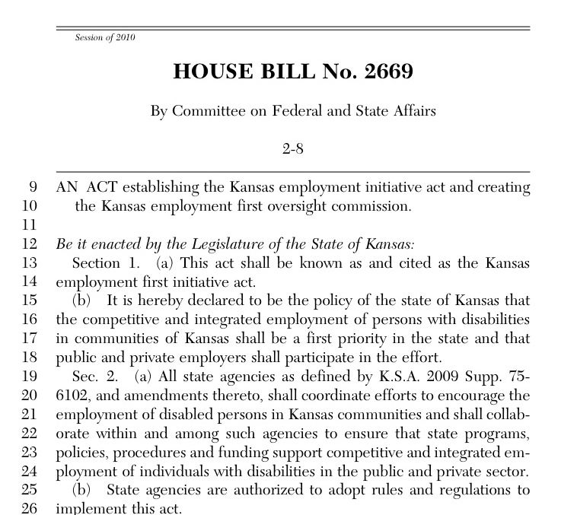
Employment First – the concept that employment should be the first and primary service option for people with disabilities - continues to grow.
Employment First Movement now in 34+ States
20 States with an Official Policy

Slide 13
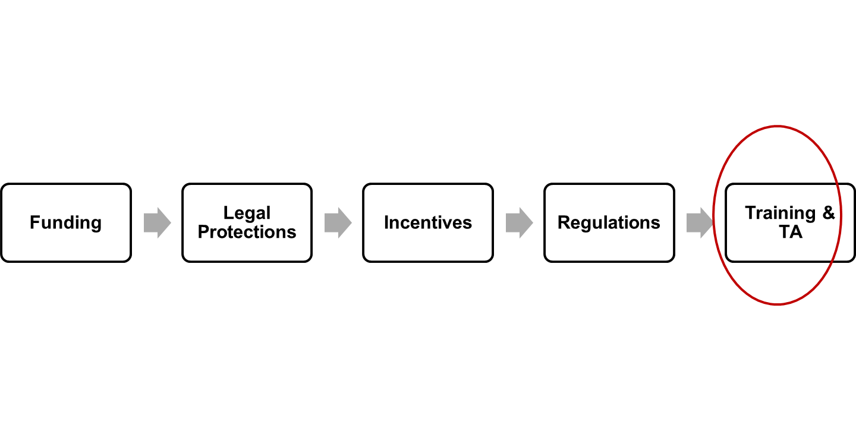
Government Role in Employment First: Developing a Common Cross-Systems Strategic Policy Framework to Effectuate Employment First

Slide 14
ODEP’s Employment First State Leadership Mentoring Program
Planting the Beginning Seeds of a
National Employment First Strategic Framework

Slide 15
Employment First State Leadership Mentoring Program (EFSLMP)
Promoting the promise and expansion of integrated employment by:
Matching “protégé” states (IA, OR, TN) with a state mentoring team (Washington state) for policy and funding alignment
Providing intensive technical assistance from national Subject Matter Experts (SMEs) for Employment First strategic plan development and implementation
Facilitating an ongoing Community of Practice for participating states

Slide 16
Employment First State Leadership Mentoring Program: Unique Features
ODEP requires six state agencies receiving Federal funds to be involved in EFSLMP state teams.
Several states are now requiring all students with special needs to have an integrated work experience during transition years, or to leave school with an integrated employment outcome.
Notes:
Focus of EFSLMP:
Sustained systems-change efforts
State policy development
Provider transformation & capacity building
Efforts-to-Outcomes Implementation Modeling

Slide 17
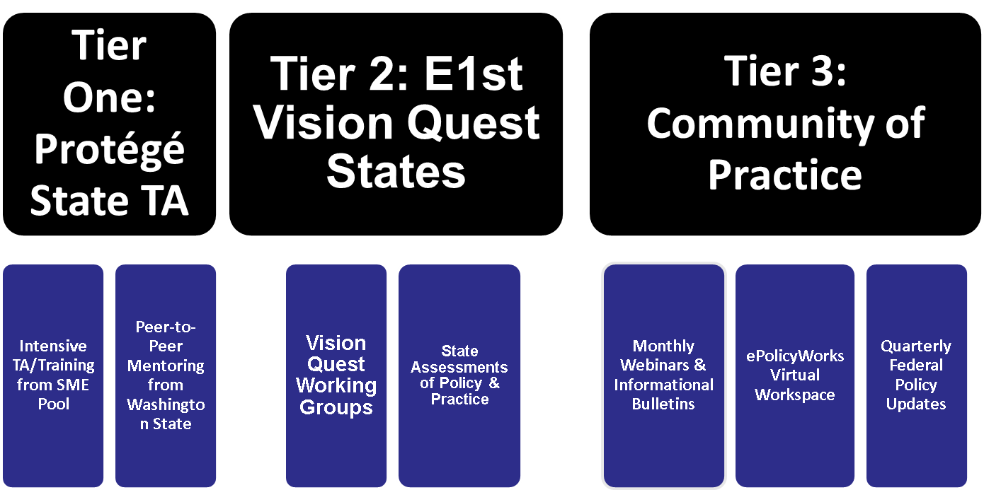
Employment First State Leadership Mentoring Program: Structure & Modes of TA/Training Provided (FY2014)

Slide 18
Employment First State Leadership Mentoring Program: Mentor State – Washington
Washington state implemented its official Working Age Adult Policy in 2006, the first “Employment First” policy in the country.
This policy was the culmination of over three decades of concerted activity to insure that persons with disabilities have quality of life through employment.

Slide 19
Employment Supports are Cost-Effective: Data from Washington State
People in individual integrated employment were working 7.7 hours, or almost 8 hours for each hour of paid support from a provider.^
* Sample from Fiscal Year 2009. Represents approximately 40% of individual employment clients.
^ 880,000 hours worked / 115,000 service hours = 7.7 hours worked for each hour of service
~ (880,000 hours worked – 115,000 service hours) / 1,200 clients = 640 annual hours worked, for each person, without any paid service.

Slide 20
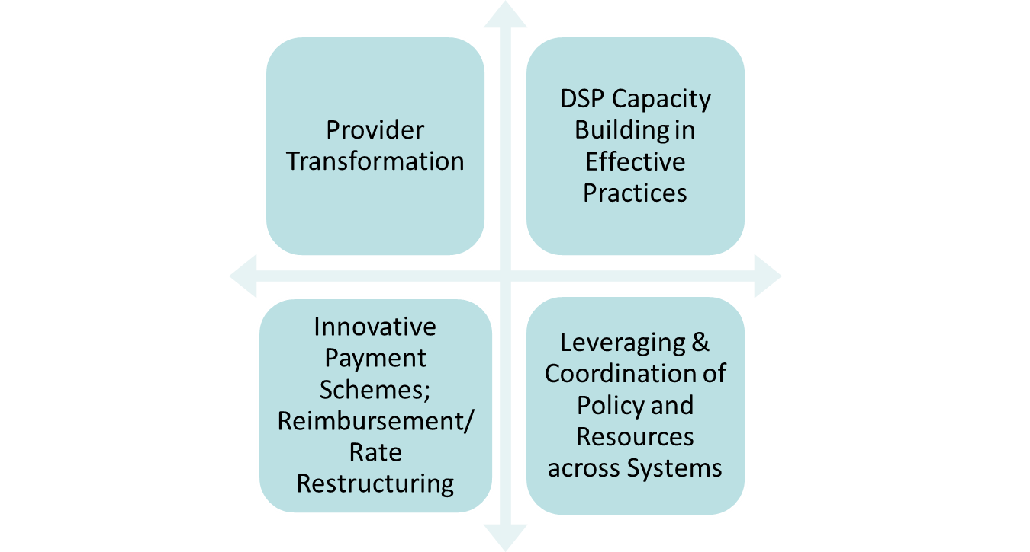
EFSLMP Protégé States – Key Areas of Foci

Slide 21
EFSLMP Current Structure: Protégé States – Iowa
Building on its current Employment First Initiative, using EFSLMP technical assistance to work on modernizing policies and funding mechanisms that emphasize interagency collaboration and result in service delivery that prioritizes integrated employment.
Key Areas of Emphasis: reimbursement rate restructuring; provider transformation; capacity building in the delivery of effective practices; transition school-to-work demo.
Milestones: Cross-Agency Memorandum of Understanding; Executive Order; 7-provider pilot; comprehensive CE training curriculum
Notes:
21

Slide 22
EFSLMP Current Structure: Protégé States – Tennessee
Aligning departmental policies for coordination of integrated employment services.
Key Areas of Focus include: capacity building of provider network; increased use of SSA work incentives; coordination/leveraging of funding across systems; and policy alignment.
Milestones: Executive Order; training of providers by DEI sites to become ENs
Notes:
22

Slide 23
EFSLMP Current Structure: Protégé States – Oregon
Building on its 2008 Employment First Policy to increase the number of high school age youth who transition to integrated employment and decrease the number of adults currently served in facility based employment services.
Key Areas of Emphasis: alignment of state policies and funding mechanisms that support these goals; capacity building and professional development on best practices (customized employment); provider transformation; school-to-work demonstration
Milestones: Executive Order; POP; VR professional development in CE
Notes:
23

Slide 24
EFSLMP Achievements/Results Thus Far
State Participation
4 states receiving intensive TA/training as core states
15 states receiving intensive virtual policy consulting via Vision Quest
32 state teams participating in National Community of Practice
TA/Training: Over 5000 hours of TA/training provided over past 30 months
45 provider organizations receiving mentoring/coaching
Over 300 front-line direct service professionals trained
Policy Results:
12 policy changes in 4 core states
15 additional policy changes across Vision Quest participating teams

Slide 25
ONGOING DILEMMAS FOR STATES & ODEP
Losing Key Political Champions
Holistic Wrap-around Services
Making the Financials Work
Potential for Watering Down Integration (ie. social enterprise, employer of record issues)
Misunderstanding Employers
Asset/Income Limits tied to Federal Benefits
Building & sustaining capacity among direct support professionals in effective practices
Will policy be able to keep up with practice?
Will practice be able to keep up with policy?

Slide 26
POLICIES THAT SUPPORT Employment First
Planting the Beginning Seeds of a
National Employment First Strategic Framework

Slide 27
Policies that Support Employment 1st
All funders presume employability with right job match and supports
We don’t spend precious public dollars asking if someone is employable
We invest in up front services that are focused on determining how – not whether - an individual can be successful in integrated employment

Slide 28
Policies that Support Employment 1st
Special Education Policy:
All transition-age youth will have an integrated, post-secondary employment outcome identified in their Individualized Education Plan and a coordinated set of services to help achieve that outcome.

Slide 29
Policies that Support Employment 1st Continued 1
Medicaid Home and Community-Based Waiver Services:
Every working age adult with disabilities (18-64) is eligible for services that support integrated employment.
Every state waiver offers these services. There is no time limit on these services.
The amount of service authorized will be based on individual need and reviewed regularly.

Slide 30
Policies that Support Employment 1st Continued 2
Vocational Rehabilitation (VR) Policies:
Individuals eligible for or enrolled in a Medicaid waiver (includes supported employment as a covered service):
Are presumed eligible for VR services and are presumed to have a most significant disability.
Trial Work and Extended Evaluation to determine “ability to benefit” shall not be used for individuals eligible for or enrolled in a Medicaid waiver.

Slide 31
Policies that Support Employment 1st Continued 3
Vocational Rehabilitation (VR) Policies:
No extension for eligibility determination permitted for individuals eligible for or enrolled in Medicaid waiver
If an individual has long-term support available through a Medicaid waiver, policy is that Individual Plan for Employment (IPE) should be developed “expeditiously”.

Slide 32
Funding Structures that Support Employment 1st
Pay on a milestone basis for services to get people jobs – incent outcomes, not service delivery
Establish tiered milestone payments to account for different level of acuity/challenge and to prevent creaming

Slide 33
Funding Structures that Support Employment 1st Continued 1
Build expectation of fading into all systems’ reimbursement models
Pay for on-the-job supports based on outcomes (e.g. hours worked)
Factor length of time on job and acuity/challenge level into payment per hour worked

Slide 34
Funding Structures that Support Employment 1st Continued 2
Rebalance payments for services based on staffing ratios
Design reimbursements to support integrated service models
Develop separate reimbursement for community-based wrap-around supports

Slide 35
The intersection between School-to-Work Transition and Employment First
Planting the Beginning Seeds of a
National Employment First Strategic Framework

Slide 36
Transition Challenges Addressed by an Employment First Approach
Ensures that educational and adult service systems are in synch toward a common goal.
Makes integrated employment the priority.
Builds in pre-exit collaboration between systems (which is currently uncommon and not required)
Includes a coordination in planning, service delivery, and outcome measurement/sharing.
Requires methodical resource integration.
Also involves collaborative cost-sharing strategies

Slide 37
Case Study: E1st Approach to School-to-Work Transition in Oregon
Scope: 4 cross-systems pilot sites at county level across state
Projected Milestones
Concrete interagency agreements solidified among required public partners re: policy, practice, service delivery, and funding.
10 students/county in first year placed into integrated employment (40 in total)
Three phases of Training, Technical Assistance and Ongoing Support Combination of Onsite and Virtual TA/training support
Includes both individual partner 1:1 coaching, group/team work, and collective community of practice training opportunities among all four sites.
Informing necessary changes required in state policy to scale the work in the future
Notes:
Originally, Washington applied to participate in the EFSLMP as a protégé state, but ODEP felt Washington’s leadership in the area of Employment First would be a wonderful mentor to the states participating in the EFSLMP.
For the past 18 months, Washington state has provided various mentoring support to the three protégé states and the 32 state teams involved in the EFSLMP Community of Practice.
Timeline
Phase One launched in October 2013; ongoing
Phase Two Training/TA will begin in late November 2013 and go through March 2014
Phase Three will begin by March 1
Measuring Progress
Identical data collection requirements across sites
Quarterly progress reports
Information will be infused into ODEP’s existing evaluation study for EFSLMP

Slide 38
Case Study: E1st Approach to School-to-Work Transition in Oregon
Phase 1: Strategic Planning | Phase 2: Cross-Professional Training on Effective Practices | Phase 3: Ongoing Mentoring and Professional Coaching during Implementation
Help local teams establish consensus on resource integration, service delivery coordination, and policy to ensure seamless, collaborative approach to ensuring integrated work experiences for students with significant disabilities. | Provide cross-training on the use of discovery and other successful alternatives to standard assessments, as well as TA and training on job development and negotiation to ensure integrated work experiences for all youth. | Provide ongoing mentoring and coaching as teachers, transition coordinators, VR counselors, case managers, and other personnel work collectively in a team-oriented model on individual cases.
EDUCATION ROLE: Determining staff and financial resources available to facilitate initial discovery and job development processes; identify and build bridges with other local partners to address resource gaps. | EDUCATION ROLE: Train administrators, transition counselors and teachers on various aspects of customized employment (discovery, community exposure, job development, negotiations) | EDUCATION ROLE: Teachers and transition coordinators will identify potential candidates for the pilot, and then will work to initiate the discovery process, and then work with other local partners to access support around job development/ negotiation.

Slide 39
RESOURCES & SUPPORT FOR ENGAGING TRANSITION PERSONNEL FROM Special Ed/VR INTO STATE EMPLOYMENT FIRST EFFORtS
Planting the Beginning Seeds of a
National Employment First Strategic Framework

Slide 40
EFSLMP Community of Practice: Participating States
32 States Participating Currently
Alaska, Alabama, Arkansas, California, Colorado, District of Columbia, Delaware, Florida, Georgia, Iowa, Idaho, Illinois, Kentucky, Massachusetts, Maryland, Maine, Michigan, Minnesota, Mississippi, Missouri, North Carolina, North Dakota, New Jersey, New York, Oregon, Pennsylvania, Rhode Island, Tennessee, Virginia, Washington, Wisconsin
Membership is Currently Open to all 50 States

Slide 41
CoP Focus: Helping States Deploy Essential Tactical Elements in Promoting Employment First
Notes:
Federal Role in Employment First: Essential Tactical Elements to Enhance the Federal Government’s Role in Promoting Employment First
Access to Info
Enrollment & Eligibility
Employment Related Supports
Systems Capacity building
Cross-Systems Coordination

Slide 42
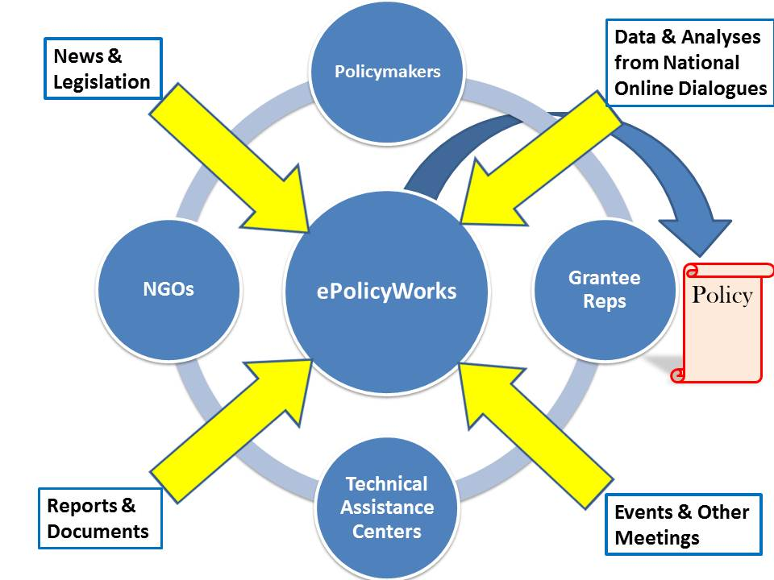
ePolicyWorks: A Virtual Platform for Facilitating Policy Development

Slide 43
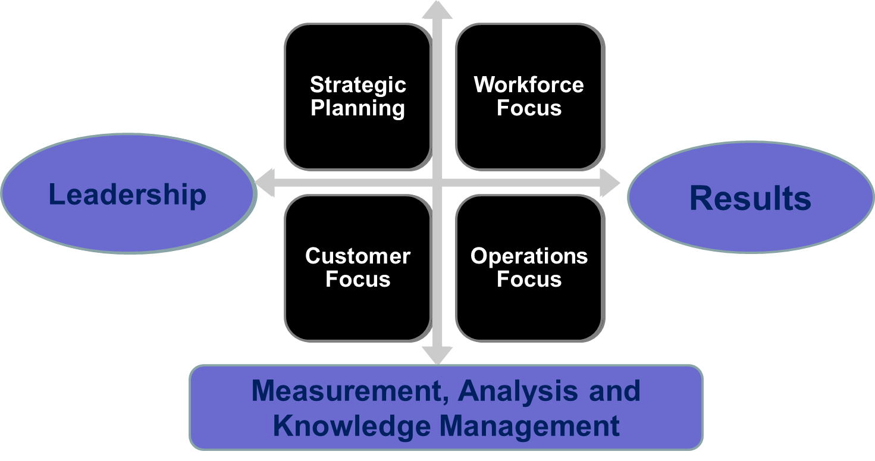
ODEP’s Criteria for Performance Excellence in E1st State Systems Change & Provider Transformation

Slide 44
How can State Leaders Get Involved in Employment First?
Ways to Get Involved in E1st Systems Change:
Access information about your state’s E1st efforts
If your state is participating in ODEP’s EFSLMP Community of Practice, consider registering to access free TA/Training. To subscribe: http://www.econsys.com/eflsmp/?subscribe.
Notes:
All Education is LOCAL. Thus, the active participation of school administrators, teachers, and transition coordinators in state E1st efforts is vital to success.

Slide 45
Comprehensive Informational Resources
Integrated Employment Toolkit:
www.dol.gov/odep/ietoolkit
Notes:
45

Slide 46
Employment First Continued
Rhetoric or Possibility?

Slide 47
Employment First: National Reform is Imminent

Slide 48
Contact
Serena Lowe
Senior Policy Advisor Office of Disability Employment Policy U.S. Department of Labor 202-693-7928 Lowe.Serena.D@dol.gov

