Slide 1


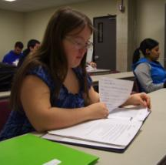
Transition and Postsecondary Program for Students with Intellectual Disability: A National Snapshot

Slide 2

Think College

Slide 3
Postsecondary Education Initiatives

Slide 4
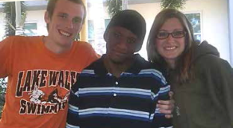
Types of Higher
Education Programs
Dual enrollment for students still in HS
Adults only 18+ who have exited HS
Both dual enrollment & adults 18+ who have exited high school
Individual

Slide 5
What do I mean by access to a higher education for students with intellectual disability?

Slide 6
Rethinking College:
Movie Trailer
https://www.youtube.com/watch?v=auIYOb_rptQ
Notes:
Captioned four minute movie showing what is happening in postsecondary education for students with intellectual disability

Slide 7
Levels of College
Course Access
Full access to college course catalogue
Partial or limited course access
No access – all specially designed courses

Slide 8
Impact of Higher Education
Opportunity Act (HEOA, 2008)
HEOA - legitimacy, federal student aid, inclusion
Comprehensive Transition Programs
Transition Postsecondary Program for
Students with Intellectual Disability (TPSID)
Think College National Coordinating Center
Accreditation recommendations
Building a body of knowledge

Slide 9
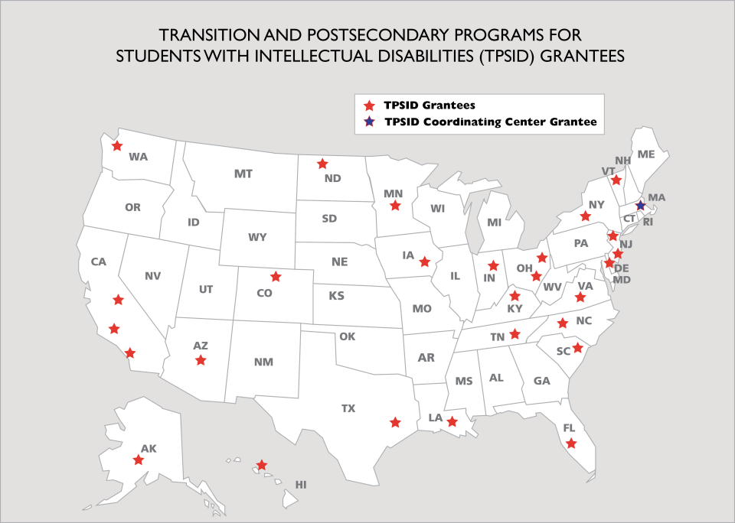
Transition and Postsecondary Programs for Students with Intellectual Disabilities (TPSID) Grantees

Slide 10
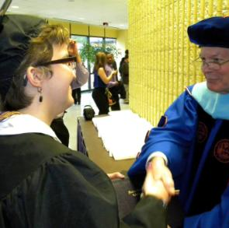
TPSIDs at a Glance
Year 1 – 470 students/42 IHEs
Year 2 – 787 students/43 IHEs
Year 3 – 856 students/44 IHEs
1379 students
15 - 2-year IHEs
30 - 4-year IHEs
67% provide housing
90% use peer mentors

Slide 11
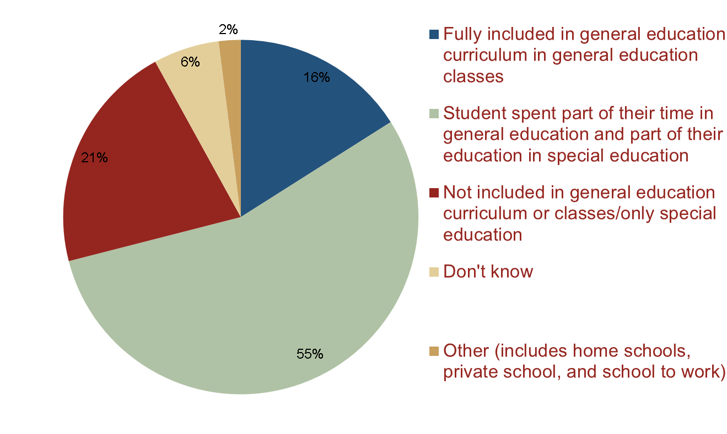
Student Educational Setting in High School
Notes:
Only 16% of students were fully included in general education curriculum in general education classes when in high school – students with intellectual disability need to be better prepared academically and nonacademically

Slide 12
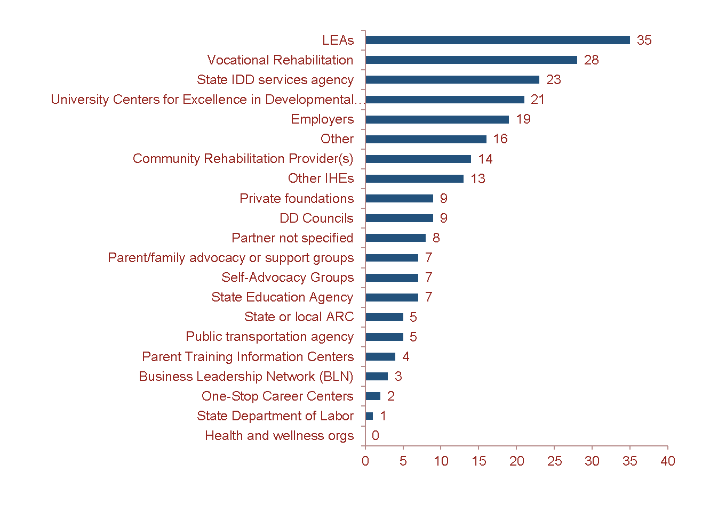
Partnerships
Notes:
TPSIDs are very collaborative with state and local human service agencies
Most common partnerships:
LEAs
Voc Rehabiitation
State IDD Agencies
Most common partner
roles:
Project advisory committee
Student recruitment
Service provision to students

Slide 13

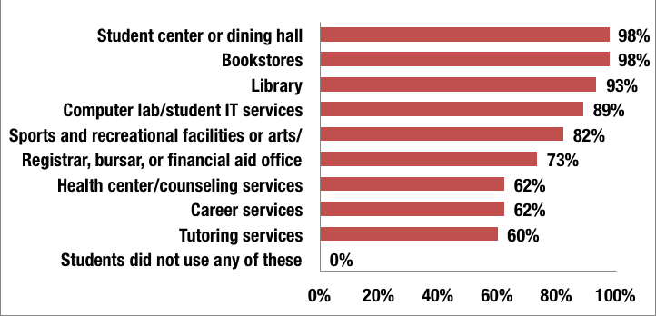
Campus
Membership

Slide 14

Sample Courses
Academic: American Sign Language II, Fundamentals of Writing, Introduction to Sociology, World Civilization II, Pre-Algebra, Careers in Healthcare, American History to 1877, Intro to Psychology
Business: Microcomputer Applications for Business, Principles of Advertising, Principles of Marketing, Principles of Management, Office Management, Hospitality Seminar
Technology: Advanced Microcomputer Applications, Web Page Development I & II, Intermediate Photoshop
Arts: Painting II, Ceramics I, Ballroom Dance, Latin Dance, Vocal Performance, Introduction to Watercolor, Write Your Life Story, Drawing I
Career Exploration: Professional Etiquette, Keys to Effective Communication, Criminal Procedure, Strategies for College and Career, Sanitation & Safety, Child Development, Response to Terrorism, Making Movies, Introduction to Mass Media, Career/Life Planning
Wellness: Personal Fitness, Introduction to Wellness, Swimming, Yoga I & II, Handling Medical Emergencies

Slide 15
Student Employment 2012-13
(N=838)
Over 70% of students participated in career development activities including paid employment, other career development, or both
36% students held a total of 424 paid jobs
42% of students employed in Yr 3 had never held a paid job prior to attending TPSID
89% of jobs were paid minimum wage or higher

Slide 16

Sample Jobs
Art Studio American Red Cross
YMCAs Hospitals
Preschools Middle School Office Aid
Pet Groomers Café Assistant Manager
Retail Stores Neighborhood Markets
Kung Fu Studio Fitness Centers
Public Relations Accounting Firm Secretary
Bakeries Colleges
Amazon Libraries
Automotive Medical Offices
Oil Rig Laborer Theatre Department Crew

Slide 17

Debra Hart
Director, Education & Transition
debra.hart@umb.edu
http://www.thinkcollege.net

