Slide 1
Child-Centered Services: Communication in the Classroom and at Home for Developmentally Delayed Children
Raymond H. Hull, PhD, FASHA, FAAA
Professor, Department of Communication Sciences and Disorders-
Audiology/Neurosciences
College of Health Professions
Wichita State University
Wichita, Kansas
Director—Center for Professional Voice and Speech Enhancement

Slide 2
What I am talking about here is directly applicable to our work with both young developmentally delayed and normally developing children.

Slide 3
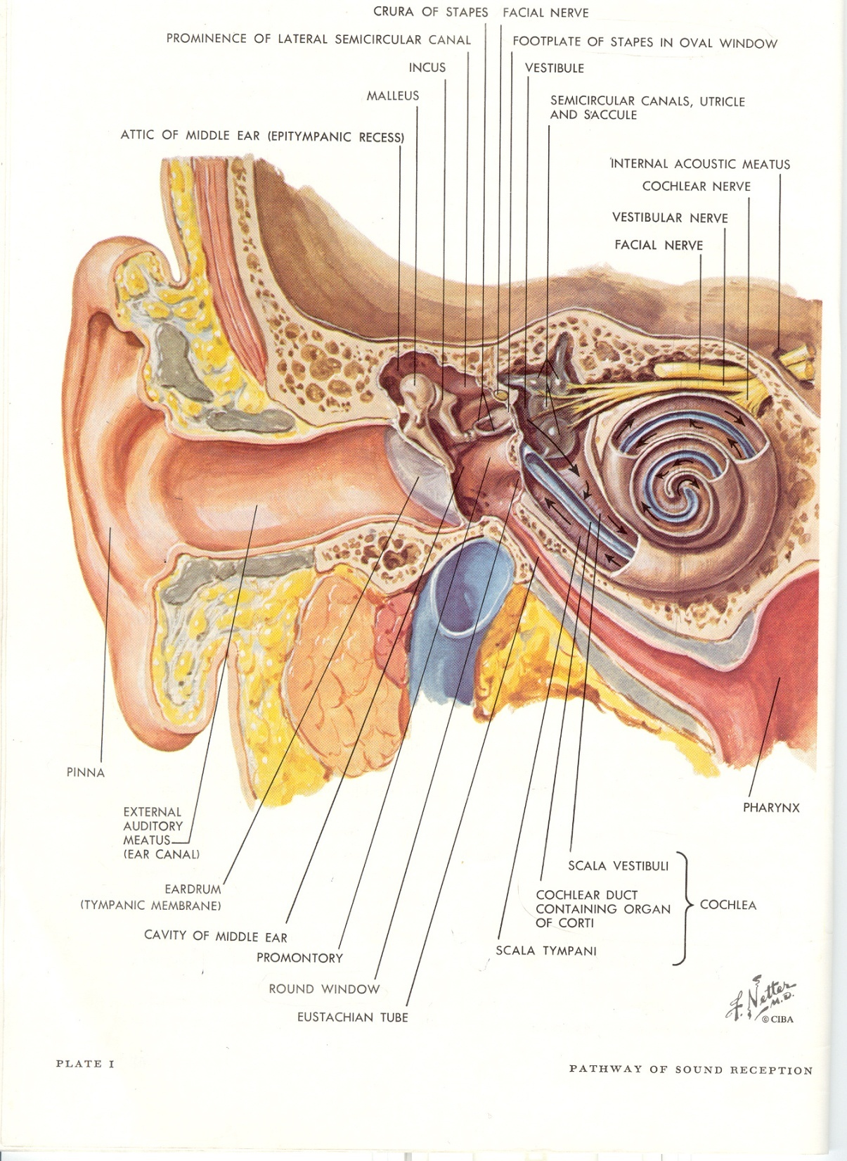
Sound Reception

Slide 4
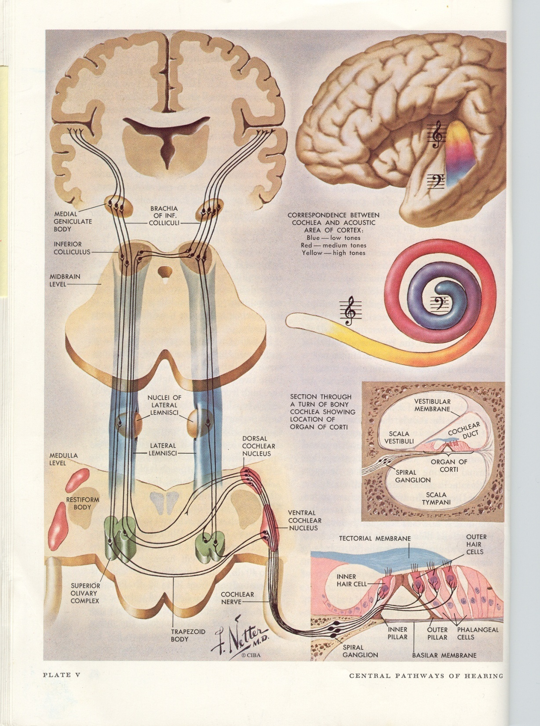
Hearing Pathway

Slide 5
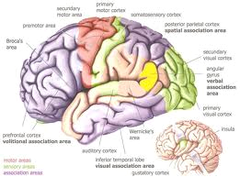
The Brain

Slide 6
As adults, with whom would you rather communicate?

Slide 7
Beside their skill and knowledge, how do you select them?
Tell me how.

Slide 8
Why?
Your hairdresser?
Your dentist?
Your primary care physician?
The manager of your favorite grocery store?
Your pet’s veterinarian
The pastor at the church you attend?
WHY?

Slide 9
Our central nervous system is pre-tuned to accept and interpret input that it receives at the rhythms and rates, and with the synchrony that it can process with greatest ease.

Slide 10
As adults, we choose those with whom we can hear, understand, and communicate with greatest ease.

Slide 11
For children, they are generally chosen for them!
They have few choices in that regard.

Slide 12
So, let’s talk about children.

Slide 13
The Developing CNS Auditory System

Slide 14
Not to criticize, but--- Most teachers, physicians, dentists, SLPs, audiologists, parents and grandparents have not been taught how to talk to children

Slide 15
Children with developmental delays and those who are normally developing are not adults, nor are the auditory transmission, storage and retrieval portions of their central nervous system

Slide 16
Both demonstrate slower than expected auditory time-summation functions, along with slower perception of temporal order and sequencing of acoustic events, particularly when it is presented rapidly.

Slide 17
Both developmentally delayed and normally developing young children demonstrate difficulty analyzing, sequencing and processing incoming phonemic (speech sound) data, particularly rapidly presented speech sound acoustic data with rapid acoustic changes, e.g. adult speech.

Slide 18
Interestingly enough, both normally developing and developmentally delayed children demonstrate slow developing short-term memory that is necessary for storage and rapid retrieval of auditory language information, that in turn is necessary for using their previously learned vocabulary for speech understanding.

Slide 19
Discrimination of rapid changes among spoken consonant sounds has been found to be especially difficult for children with developmental delays. Further, consonant/vowel combinations (this activity we call “speech”) when presented rapidly are consistently misperceived.

Slide 20
Rapid and accurate analysis, sequencing and processing of incoming phonemic (speech sound) data are all critical for the analysis and perception of spoken speech. This is particularly difficult for children with developmental delays, particularly when listening to adult spoken speech.

Slide 21
So, let’s look at what can be expected.
At age 3-5 years, the typical developmentally delayed child’s central auditory system can process the phonemic/linguistic codes of spoken speech at a rate of approximately 120 -124 WPM.

Slide 22
MR. ROGERS spoke (speaks) at a rate of approximately 120 -124 wpm.

Slide 23
For Adults, Walter Cronkite, and Tom Brokaw both practiced speaking at 124 WPM for use during news broadcasts.

Slide 24
Back to Children…
At ages 5 – 7 years, the normal CNS can process phonemic/linguistic codes well at the rate of approximately128-130 WPM when all else in the listening environment is at least nearly optimal…little to no background noise, visual distractions, etc.

Slide 25
For those who are developmentally delayed, the CNS can typically process speech at a rate of approximately 120 to 124 WPM.

Slide 26
Children w/normally maturing CNS auditory systems who are in the upper elementary grades—5th thru 6th--are able to process speech uttered in the135 WPM range. For developmentally delayed young children, 124 WPM is appropriate.

Slide 27
However, the average WPM of most American adults, including elementary education and special education teachers, is approximately 160-180 WPM, and many reach 190 WPM !!

Slide 28
The speed of speech on some children’s television shows that are cartoon in format such as Dora the Explorer are timed at124 WPM so that children can attend to them and understand what they are saying. Captain Kangaroo in the earlier TV series along with characters like Mr. Green Jeans spoke at the same rate! And, again, don’t forget Mr. Rogers.

Slide 29
And, children loved those television shows, particularly the early ones, probably primarily because they could understand what was being said. Perhaps those were among a few times children could understand what adults were saying without difficulty.

Slide 30
Sponge Bob!
Children’s television shows such as “Sponge Bob” contain speech timed at over 180 WPM. That program, and other cartoon shows for example on The Cartoon Network are timed at over 180-190 WPM. Children neglect the task of listening, and simply watch the action, so watching those shows becomes a visual rather than auditory/language activity, and do NOT assist in auditory/language development.

Slide 31
They have actually been found to be detrimental to the ability of young children, particularly children with developmental delays to attend to spoken language at home and in the classroom since those TV shows discourage listening, but rather encourage the visual aspect.

Slide 32
And, for adults, news broadcasters who this presenter has worked with have been timed by me at rates exceeding 200 WPM! And, they wonder why the television station receives complaints that adult viewers cannot understand what they are saying!

Slide 33
Teachers and parents of children with developmental delays wonder why children do not seem to understand what they are saying, are not attentive, or “My children just aren’t good listeners! How many times do I have to say it before they understand! They just don’t seem to listen! I gave the assignment to the children three times, and they still acted like they didn’t understand! Why don’t they listen!”.

Slide 34
Parents say, “I have to repeat everything I say at least 4 times before Jimmy will do what I ask him to do. Finally I say, “Jimmy……listen to me! I….want….you…to….make….your….bed…NOW!” He then says, “O.K.”. It seems as though I have to get angry before he listens and does what I tell him!”

Slide 35
Teachers, therapists and parents must talk to children who are at all levels of development at a rate that the child’s CNS auditory system can be expected to process efficiently—both in speed of presentation, and vocabulary. They must also take the time to ask the simple question, “Do you understand? Do you know what that word means?”

Slide 36
Something else happens!
Something else happens when speed of spoken speech is reduced. Our CNS doesn’t like silence. Therefore, our CNS will inadvertently cause us to fill in those silent gaps of spoken speech with vowels and consonants that have greater duration, increased or enhanced suprasegmental aspects of speech, and more meaningful pauses. Thus, greater clarity!!

Slide 37
When those changes are made, teachers and parents, nurses, doctors, dentists and others who talk to children are impressed with the sudden increase in apparent attentiveness and understanding of the children who are listening to them! WHAT A RELIEF!

Slide 38
The Environment

Slide 39
Four Acoustical Phenomena That Influence Speech Understanding For Children In All Listening Environments, but Particularly In The Classroom

Slide 40
Those are--
Signal--The primary signal (the teacher);
Noise-- Usually around 0 to +10 dB S/N;
Reverberation–(most classrooms are nothing more than reverberation chambers);
Modes– Room resonance (The acoustical influences of sound transmission in that environment).

Slide 41
TO COMPENSATE FOR THOSE FACTORS First and Foremost

Slide 42
After enhancing one’s speech habits, Enhance the Listening Environment

Slide 43
Change The Acoustical Characteristics Of The Room Which does not always mean adding carpet!

Slide 44
Most classrooms and service environments are filled with reflectent and reverberant elements
Rooms are square or rectangular
Floors are covered with reflectant tile
Ceilings are covered with “acoustical tile”
Blackboards
Exposed windows
Wooden desks and/or polyethylene chairs

Slide 45
Add absorbent material, if possible including:
Pretty drape material 2’ wide on the walls;
Curtain material on the sides of windows;
Shelves filled with books and materials;
Stuffed toy animals on top of shelves;
Anything soft and absorbent!

Slide 46
ENHANCE THE VISUAL ENVIRONMENT

Slide 47
Florescent Lights—cause tearing, headaches, inattentiveness, seizures;
Uncovered windows reflect sound & light
Other reflecting surfaces including:
desk tops
metal window blinds
“white” boards
Do Anything To Cut Down On Glare!
Use incandescent lightening whenever possible

Slide 48
ENVIRONMENTAL DESIGN AT HOME

Slide 49
At Home--
Parents must reduce auditory distractions— Turn down (or off) the TV or radio when they are talking with their child;
The parent should not speak unless the child can see her or his face; in other words, not from another room or while walking away from the child.

Slide 50
At Home
While schools are generally reverberation chambers, homes are anechoic chambers. Therefore, speech does not travel well in a home environment, only 6-7 ft. maximum for adequate auditory perception.
Nor, does speech travel well (1) around corners, (2) up or down stairs, or (3) through open doors!

Slide 51
THANK YOU FOR LISTENING! HAVE A GREAT DAY!

