Slide 1
Providing Culturally Responsive Teaching in Field-Based and Student Teaching Experiences: A Case Study
OSEP 2014 Project Directors’ Conference
Washington D.C.
July 20-24, 2014

Slide 2
RATIONALE
Traditional pedagogical strategies previously used in teacher preparation programs find limited success in today’s diverse classrooms.
Many teacher candidates are unprepared to effectively teach culturally diverse students, communicate with their families, and thrive in diverse communities.
Teacher education programs must become culturally responsive to preservice teachers (Trent, Kea, & Oh, 2008).
Pedagogical approaches should be examined and re-conceptualized in terms of curricula, course content, evaluations, relationships and other aspects that take in consideration multiple and diverse perspectives to successfully prepare preservice teachers (Ambe, 2006).

Slide 3

DR. CATHY KEA, PROFESSOR
NORTH CAROLINA A&T STATE UNIVERSITY
Dr. Cathy Kea is a Professor of Special Education at North Carolina A&T State University. Dr. Kea’s research interest and engagement focuses on the intersection between general education, special education, and multicultural education- a trilogy to be transformed. Her current research focuses on preparing teachers to design and deliver culturally responsive instruction in urban classrooms and ways to infuse diversity throughout course syllabi and teacher preparation programs.

Slide 4

DR. STANLEY C. TRENT, ASSOCIATE PROFESSOR
UNIVERSITY OF VIRGINIA
Dr. Stanley Trent has written extensively on disproportionality and the use of concept maps to assess student change in their conceptualization about diversity in the classroom. Most recently, Trent, Kea, & Oh (2008) completed an extensive review of the literature to examine how far teacher preparation programs have come in preparing its candidates to work with diverse students, parents, and classrooms. Trent’s recent work focuses on creating culturally responsive Schools of Education through an iterative process for individual and collective self-study.

Slide 5
PARADIGM SHIFTS
U.S. public schools are more racially, ethnically, and linguistically diverse and different than ever before and [yet] the racial and ethnic demographics of educators remain relatively unchanged or stable.
--(Ford, 2012)

Slide 6
TEACHER PREPARATION
Teachers: White, Female & Monolingual (83.5% White, 6.9% Hispanic, 6.7% African American)
Limited English proficiency
Second language acquisition
Cultural differences
Ortiz, 2011

Slide 7
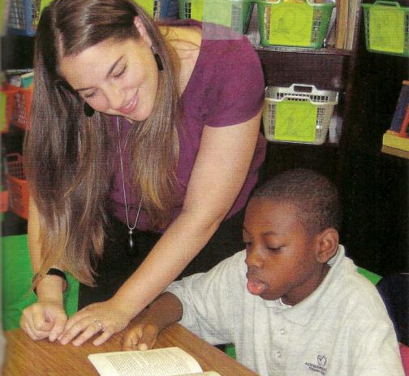
WORKFORCE

Slide 8
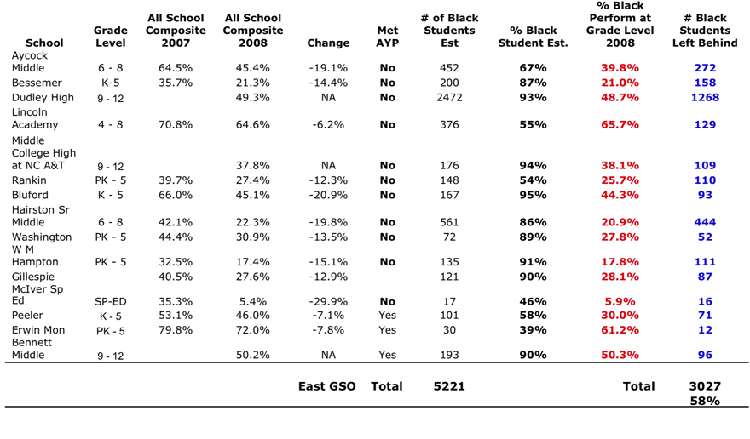
IMPETUS FOR REDESIGN—EAST GSO SCHOOL PERFORMANCE DATA
Miller, D. (2009, May). Greensboro’s Promise it takes a village: A movement, not a program. Presented at the SOE Research Collaborative Meeting
North Carolina A&T State University, Greensboro, NC.

Slide 9
ORGANIZATIONAL CULTURAL COMPETENCE SELF-ASSESSMENT QUESTIONS
  What culturally diverse groups are you serving?
  What drives your diversity efforts?
  What are the cultural barriers/issues your teacher candidates face in providing quality services?
  What linkages and contacts do you have within culturally diverse communities?
  What cross-cultural “success stories” or examples of cultural strengths does your teacher candidates experience?
  What more does your TEP aspire to do? Why? How?

Slide 10

CLOSING THE OPPORTUNITY GAP

Slide 11
325T PROJECT FIRE: FOSTERING INCLUSIVE RESPONSIVE EDUCATORS-PURPOSE
How do we prepare highly qualified personnel from culturally diverse backgrounds who can provide quality instruction utilizing evidence-based best practices, curriculum and pedagogy responsive to the needs of students with high incidence disabilities in urban school settings K-12?

Slide 12
CONTEXT- NC A&T SU
Bachelor’s in Elementary Education
    CUIN Department
Special Education Corollary Focus Area
Dually licensed-Initial A Level License
    Elementary Education K-6
    Special Education: General Curriculum K-12
Highly Qualified in Elementary
Not Highly Qualified in Secondary
MAT Special Education: General Curriculum K-12

Slide 13
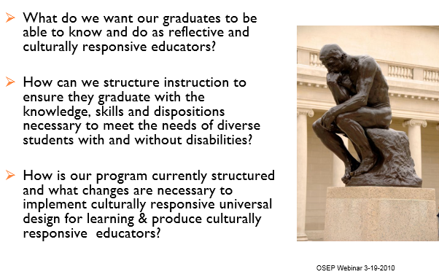
STARTING WITH THE END IN MIND
(COVEY, 2004; MCTIGHE & WIGGINS, 2005)

Slide 14
LOOKING BACK TO MOVE FORWARD

Slide 15

HOW DO YOUR COURSES & PROGRAMS INFUSE DIVERSITY?
Ethnicity
Race
Socioeconomic status
Gender
Exceptionalities
Language
Religion
Sexual Orientation
Geographical Area

Slide 16
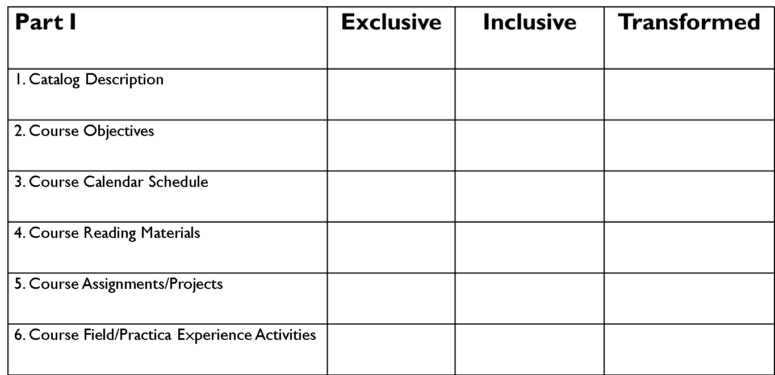
NC A&T SU COURSE SYLLABUS REVIEW LEVELS OF COURSE TRANSFORMATION
Course Syllabus_________ Reviewer Code_________________
Review SPED 4227 course syllabi levels of course transformation examples. Rate each section of the course syllabi as exclusive, inclusive, or transformed.
Notes:
16

Slide 17
LEVELS OF COURSE TRANSFORMATION
Exclusive level teaches minor aspects of diversity at the lowest level.
    Diversity is restricted to one part of the course
Inclusive level adds diversity content but retains the traditional, original structure.
    Diversity is discussed throughout part of the course and compared to the dominant norm.
Transformed courses and curriculum challenge traditional views and encourage re-conceptualization and new ways of thinking about diversity (Morey & Kitano,1997; Schmitz,1999).
Notes:
17

Slide 18
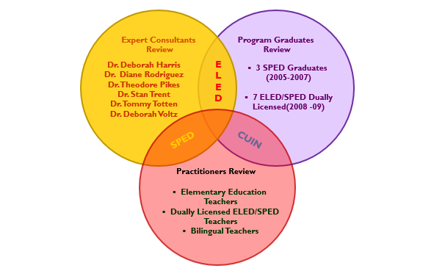
COURSE SYLLABI REVIEW PROCESS

Slide 19
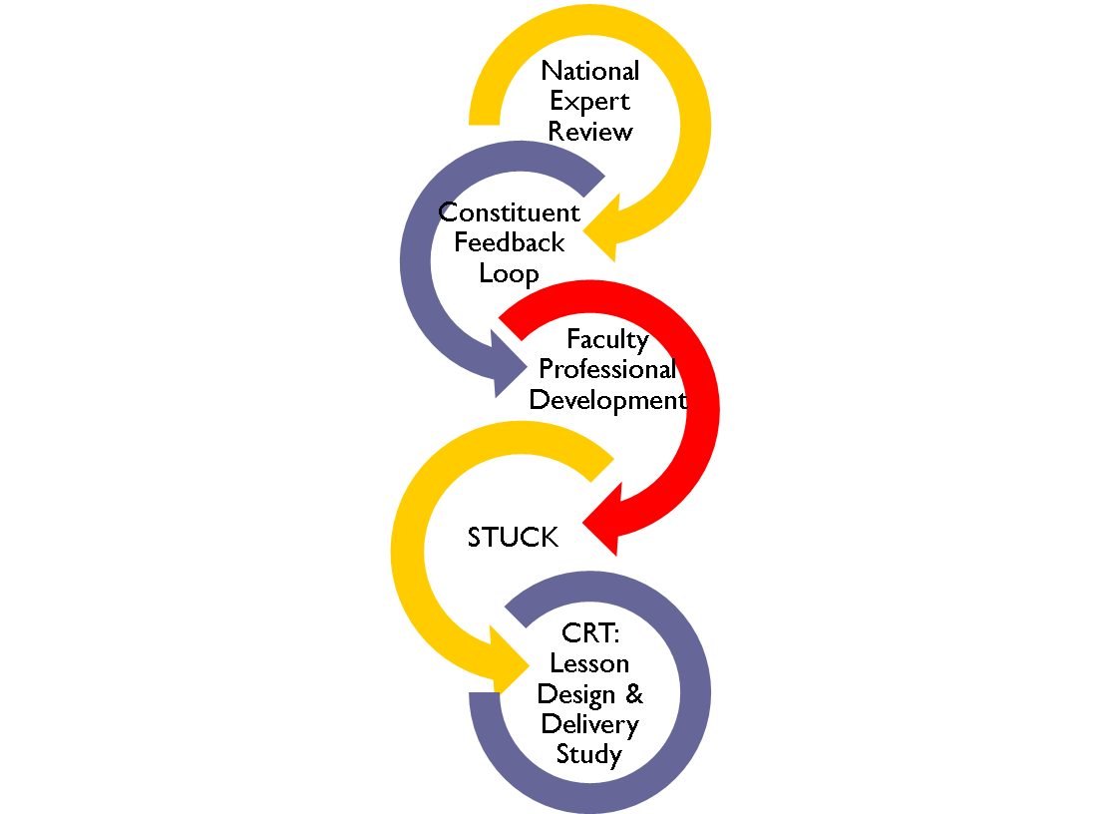
PROCESS

Slide 20

DIVERSITY INFUSION: FROM COURSEWORK TO CLASSROOM

Slide 21
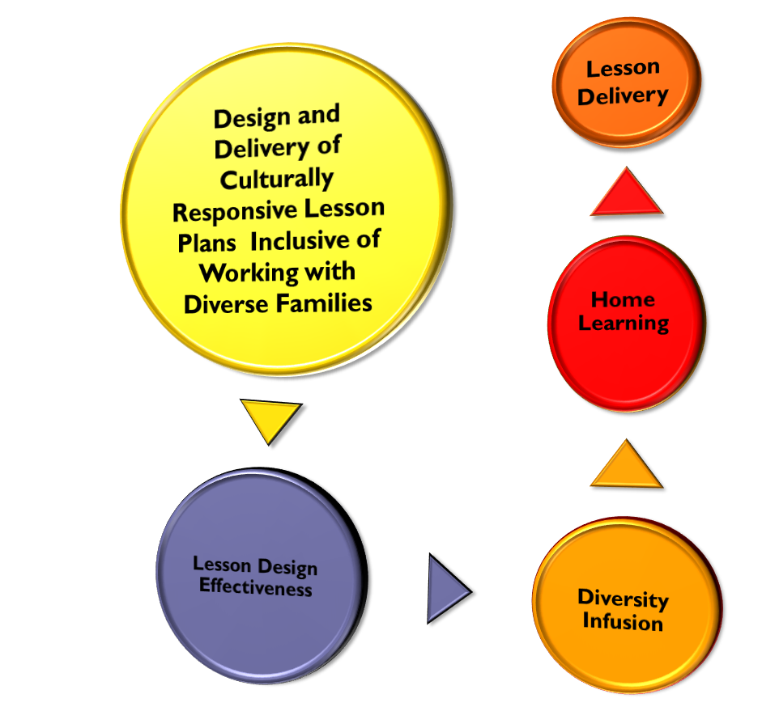
METHODOLOGY

Slide 22
REVIEW OF LITERATURE
  Yield - 4 Empirical studies & 3 dissertations:
    Ambrosio, Seguin, Hogan, & Miller (2001)
    Huang (2002)
    Jones (2008)
    Salsbury(2008)
    Garii & Rule(2009)
    Udokwu(2009)
    Dover(2010)
    Search terms included: “culturally responsive, diversity, multicultural, cultural competence” in combination with the terms” lesson and curriculum design.”

Slide 23
TABLE OF STUDIES
Study | Findings
Ambrosio, Seguin, & Hogan (2001) | Authors investigated the extent to which students successfully designed and evaluated lesson plans with an emphasis on cultural diversity. They found that approximately half of students demonstrated at least minimal skills in creating an effective plan.
Dover (2010) | This study explored how secondary English Language Arts teachers conceptualized and taught for social justice. Participants emphasized integration of content based and social justice oriented curricula. Three dimensions of teaching for social justice were identified by teachers: curriculum, pedagogy, and social action.
Garii & Rule (2009) | Garii and Rule analyzed the lesson plans of 26 teacher candidates for academic and social justice content. Almost 75% of lessons approached content through social justice lens, but less than 25% effectively introduced both academic and social justice content. This suggests that teacher candidates need a deeper knowledge of content and modeling of how to integrate social justice and academic content.
Huang (2002) | Huang analyzed the multicultural lesson plans of teacher candidates according to Banks’ approaches to curriculum reform and Bennett’s goals of multicultural lessons. Approximately half of the plans applied Banks’ contribution and or additive approach, while less than one quarter applied the more desired transformation and social action approaches. Almost all of the lessons’ goals related to strengthening cultural consciousness and developing multiple historical perspectives, while almost 75% of plans related to strengthen intercultural competence. Very few plans focused on combating discrimination and building social action skills.

Slide 24
TABLE OF STUDIES (continued)
Study | Findings
Jones (2008) | In this study, Jones found that participation in multicultural training significantly increased the multicultural content and activities included in lesson plans developed by preservice special education teachers. However, the training did not affect the writing of lesson plan objectives.
Salsbury (2008) | Salsbury investigated the effectiveness of a mnemonic strategy linking children's literature and cultural elements in helping 36 preservice teachers identify and choose possible cultural elements to integrate into their instruction when planning a lesson. Following strategy instruction, participants’ definitions of culture were more precise and directly referenced the strategy terms. On a written assessment asking students to identify cultural elements, just over 40% of participants described all aspects of strategy while 30% of participants did not reference the strategy at all. More than half of participants specifically referenced the strategy when reflecting on lesson planning.
Udokwu (2009) | Udokwu investigated the cultural responsiveness of pedagogical practices of 12 urban middle school science teachers. Teacher and student reports of culturally responsive practices were often not reflected in observational data collected by the researcher. Over two thirds of teachers and students reported use of culturally responsive pedagogical practices, while less than half of teachers were observed using these practices.

Slide 25

RESEARCH QUESTIONS
When preservice teacher candidates’ are exposed to culturally responsive curricula during coursework, do they infuse it in lesson plan development?
When preservice teacher candidates’ are exposed to culturally responsive curricula during coursework, do they infuse it in lesson delivery during field-based internship lesson observation?
When preservice teacher candidates’ are exposed to culturally responsive curricula during coursework, do they infuse it in lesson delivery during student teaching lesson observations?

Slide 26
CULTURALLY RESPONSIVE PEDAGOGY DEFINED
Culturally responsive pedagogy embodies a method of teaching and learning that builds on and values the cultural experiences and knowledge of all participants.
In short, our operationalized definition of culturally responsive pedagogy is when the curriculum, lessons, and classroom environment reflects or relates the student’s culture, home/community life, lived experiences, and interests into the teaching and learning process(Kea,2008).
It brings the elements of the student’s culture into the classroom to provide a better rationale for student engagement.
Culturally responsive strategies connect the home, school and community environments.

Slide 27
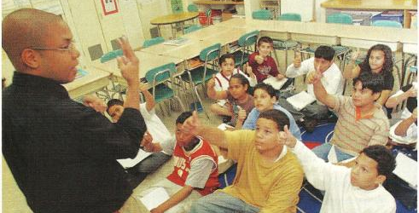
ENGAGEMENT

Slide 28
PROCEDURE
Extant Data Reviewed
Lesson plans and field-based lesson observation outcomes from Fall 2006,2007, 2008, 2009 & 2010.
Lesson delivery of preservice candidates in student teaching placements Spring 2007,2008,2009,2010 & 2011.
Reviewed 233 lesson plans,74 field-based lesson observation outcomes & 45 student teaching lesson observations.
  A total of 81 students were enrolled in SPED 564/ 764 over the 5 years.
    7 students were non-completers.

Slide 29
SPED 564 PRESERVICE UNDERGRADUATE PARTICIPANT DEMOGRAPHICS
Semester | Number of Students | Ethnicity: African American | Ethnicity: European American | Gender: Males | Gender: Females | Class Mean Age | Number of Lesson Plans Reviewed | Number of Lesson Observations Reviewed
Fall 2006 | 1 | 1 | ----- | 0 | 1 | 20 | 3 | 1
Fall 2007 | 8 | 6 | 2 | 2 | 6 | 25 | 21 | 6
Fall 2008 | 2 | 1 | 1 | 0 | 2 | 22 | 6 | 2
Fall 2009 | 5 | 5 | ----- | 0 | 5 | 21 | 15 | 5
Fall 2010 | 11 | 11 | ----- | 0 | 11 | 22 | 33 | 9
Total | 27 | 24 | 3 | 2 | 25 | 22 | 78 | 23

Slide 30
SPED 764 PRESERVICE GRADUATE PARTICIPANT DEMOGRAPHICS
Semester | Number of Students | Ethnicity: African American | Ethnicity: European American | Gender: Males | Gender: Females | Class Mean Age | Number of Lesson Plans Reviewed | Number of Lesson Observations Reviewed
Fall 2006 | 17 | 12 | 5 | 3 | 14 | 33 | 47 | 16
Fall 2007 | 16 | 11 | 5 | 1 | 15 | 37 | 47 | 15
Fall 2008 | 8 | 4 | 4 | 2 | 6 | 35 | 22 | 7
Fall 2009 | 3 | 3 | ----- | 1 | 2 | 40 | 9 | 3
Fall 2010 | 10 | 8 | 2 | 2 | 8 | 28 | 30 | 10
Total | 54 | 38 | 16 | 9 | 45 | 35 | 155 | 51

Slide 31
INSTRUMENTS
Culturally Responsive Lesson Plan Template
Culturally Responsive Lesson Plan Rubric
Checklist for Teaching Practices
Lesson Plan Evaluation Form
Copyright© 2008. All Rights Reserved By Dr. Cathy D. Kea

Slide 32
CULTURALLY RESPONSIVE LESSON PLAN TEMPLATE
Provides a description of the desired outcomes for each of the 10 step lesson plan:
Focus and Review
Lesson Objective
Teacher Input
Guided Practice
Independent Practice
Closure
Adaptations and Modifications
Infusing Technology
Infusing Cultural Diversity
Infusing Working with Families

Slide 33
Lesson plan template

Slide 34
Lesson plan checklist

Slide 35
CHECKLIST FOR TEACHING PRACTICES
Checklist
  Instructional Time
  Student Behavior
  Instructional Presentation
  Instructional Monitoring
  Instructional Feedback
  Instructional Critique
  Diversity Infusion

Slide 36
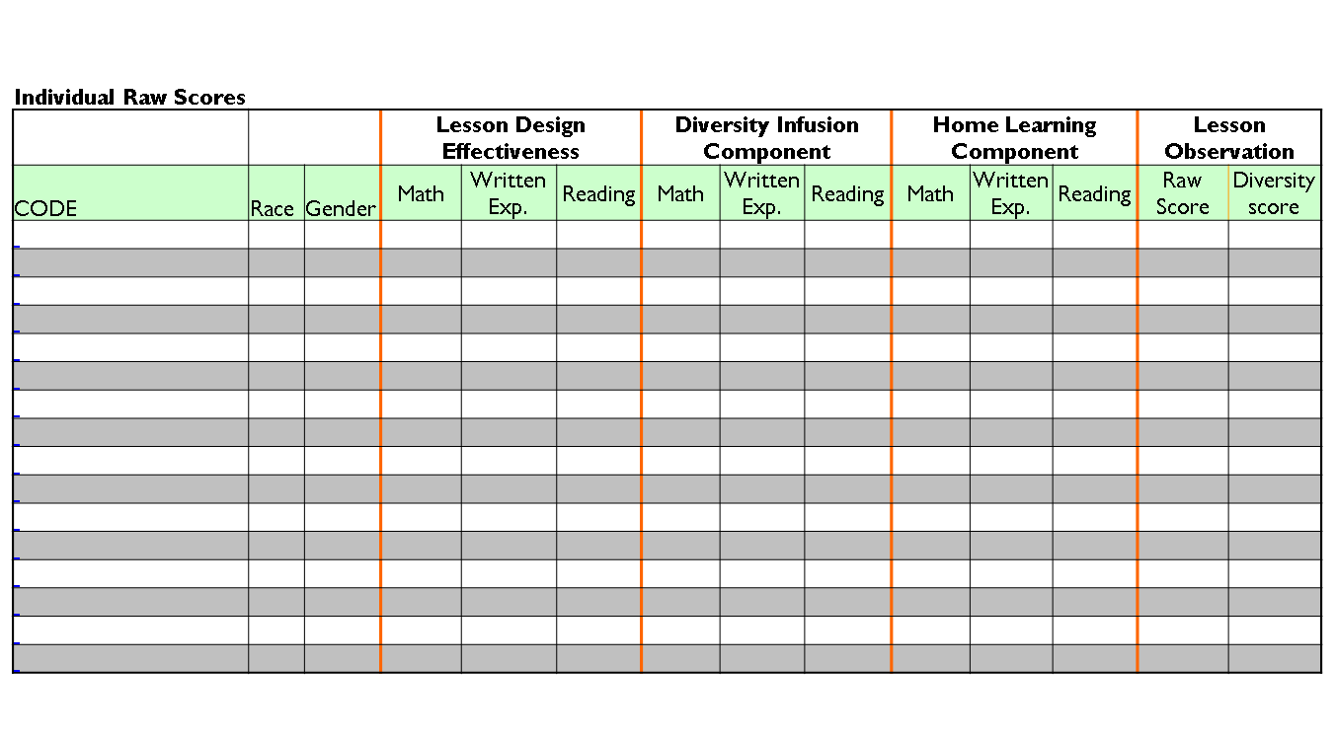
LESSON PLAN EVALUATION FORM
Spreadsheet to record raw data from lesson plans and observations.

Slide 37
LOOKING BACK TO MOVE FORWARD
(continued)

Slide 38
RESULTS FOR SPED 564

Slide 39
TABLE 1: SPED 564 PRESERVICE UNDERGRADUATE PARTICIPANT DEMOGRAPHICS
Semester | Number of Students | Ethnicity: African American | Ethnicity: European American | Gender: Males | Gender: Females | Class Mean Age | Number of Lesson Plans Reviewed | Number of Lesson Observations Reviewed
Fall 2006 | 1 | 1 | ----- | 0 | 1 | 20 | 3 | 1
Fall 2007 | 8 | 6 | 2 | 2 | 6 | 25 | 21 | 6
Fall 2008 | 2 | 1 | 1 | 0 | 2 | 22 | 6 | 2
Fall 2009 | 5 | 5 | ----- | 0 | 5 | 21 | 15 | 5
Fall 2010 | 11 | 11 | ----- | 0 | 11 | 22 | 33 | 9
Total | 27 | 24 | 3 | 2 | 25 | 22 | 78 | 23

Slide 40
TABLE 2: SPED 564 LESSON DESIGN EFFECTIVENESS
(FALL 2006, 2007, 2008, 2009 & 2010)
Semester | Number of Lesson Plans | Distinguished (4) | Proficient (3) | Apprentice (2) | Novice (1)
Fall 2006 | 3 | 2 | 1 | 0 | 0
Fall 2007 | 21 | 5 | 8 | 6 | 2
Fall 2008 | 6 | 3 | 2 | 1 | 0
Fall 2009 | 15 | 5 | 8 | 2 | 0
Fall 2010 | 33 | 4 | 13 | 9 | 7
Totals | 78 | 19 | 32 | 18 | 9

Slide 41
TABLE 3: SPED 564 DIVERSITY INFUSION
(FALL 2006, 2007, 2008, 2009 & 2010)
Semester | Number of Lesson Plans | Social Action Approach (4) | Transformation Approach (3) | Additive Approach (2) | Contributions Approach (1) | No Diversity (0)
Fall 2006 | 3 | 0 | 0 | 0 | 2 | 1
Fall 2007 | 21 | 0 | 0 | 0 | 14 | 7
Fall 2008 | 6 | 0 | 0 | 0 | 5 | 1
Fall 2009 | 15 | 0 | 0 | 1 | 12 | 2
Fall 2010 | 33 | 0 | 0 | 1 | 17 | 15
Totals | 78 | 0 | 0 | 2 | 50 | 26

Slide 42
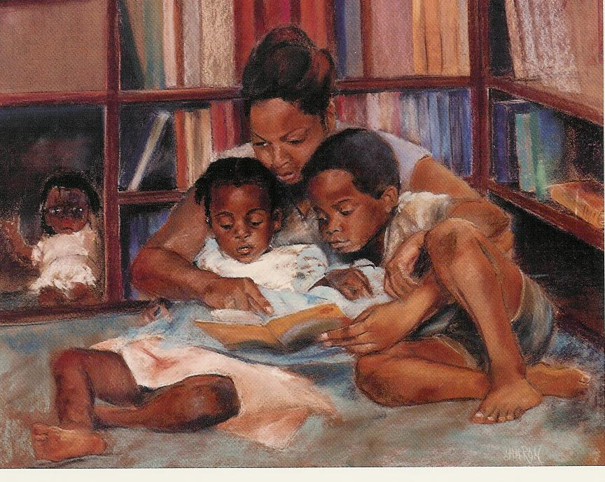
FACILITATE HOME LEARNING

Slide 43
AT HOME ACTIVITY
Dear Parents,
Today we learned about proper nouns. Proper nouns are important people, places, and things. We learned today that we capitalize proper nouns with big letters. You can help us with learning more proper nouns by helping your son or daughter with one of the activities below. After your son or daughter completes one of the activities, sign and return this sheet to class by the end of the week. Call or email me if you have questions. As always, thank you for helping your child be a Superstar!
Thank you!
Mrs. Compton
acompton@nomail.com
336-999-0505
Activity #1: Being Proper in the House
The child should take pieces of paper or index cards and walk around the house. Any items that he/she sees that are proper nouns, he/she can write the item on the card and place it on the object. For example, he/she might label the car with a card that says “Honda Civic”. Some items you might look for are people in the house, holiday decorations, magazine titles, book titles, store names, labels on products, pet names, and characters on toys. He/she should try to find at least 5 items that are proper nouns. Make sure he/she capitalizes the first letter of the words.

Slide 44
AT HOME ACTIVITY (continued)
Activity #2: “I Spy” a Proper Noun
After going to the store (grocery store, Wal-Mart, gas station, corner store), the child should write on a piece of paper all of the proper nouns he/she “spied” in the store or on the way to the store.
Some examples of proper nouns he/she may look for are the name of the store, names of products, the streets you took to get there, or the names of people who were there. He/she should have at least 5 proper nouns. Make sure he/she capitalizes the first letter of the words.

Slide 45
TABLE 4: SPED 564 HOME LEARNING
(FALL 2006, 2007, & 2008, 2009 & 2010)
Semester | Number of Lesson Plans | Distinguished (4) | Proficient (3) | Apprentice (2) | Novice (1) | No HL Activity (0)
Fall 2006 | 3 | 0 | 0 | 0 | 0 | 3
Fall 2007 | 21 | 4 | 5 | 5 | 5 | 2
Fall 2008 | 6 | 4 | 2 | 0 | 0 | 0
Fall 2009 | 15 | 2 | 8 | 4 | 0 | 1
Fall 2010 | 33 | 3 | 8 | 12 | 8 | 2
Totals | 78 | 13 | 23 | 21 | 13 | 8

Slide 46
MAJOR FINDINGS: LESSON PLANS
  Research Question 1: When preservice teacher candidates are exposed to culturally responsive curricula during coursework, do they infuse it in lesson plan development ?
  The majority 65.5% (51) of the 78 preservice undergraduates’ lesson plans were between the proficient and distinguished levels.
  The majority 64.1% (50) of the 78 preservice undergraduates’ lesson plans infused diversity at the contributions level, 2.6% (2) additive level and 33.3% (26) were absent of diversity.
  Less than half 48% (36) of the 75 preservice undergraduates’ lesson plans home learning activities were between the proficient and distinguished levels, 45.3% (34) in the apprentice/novice range and 6.7% (8) were absent of a home learning activity.

Slide 47

ARCHER, BROOKS, & RANKIN ELEMENTARY SCHOOL PROFILES
Archer Elementary
Demographics:
49.4% African-American, 21.8% Asian
17.7% Hispanic, 3.8% White
6.2% Multi-Racial 1% American Indian
90% free and reduced lunch
AYP results:
Designation 2010-11: Priority School, Expected Growth
Did not make AYP in 2010-11.
Brooks-Global
Demographics:
46.0% African-American, 2.4% Asian
1.8% Hispanic, 31.9% White
17.6% Multi-Racial 0.2% American Indian
24% free and reduced lunch
AYP results:
Designation 2010-11: Honor School of Excellence, High Growth
Did make AYP in 2010-11.
Rankin Elementary
Demographics:
57.4% African-American, 12.6% Asian
6.7% Hispanic, 6.9% White
2.5% Multi-Racial 13.8% American Indian
100% free and reduced lunch
AYP results:
Designation 2010-11: Priority School, High Growth
Did not make AYP in 2010-11.

Slide 48
MAJOR FINDINGS:
FIELD-BASED LESSON OBSERVATION
  Research Question 2: When preservice teacher candidates are exposed to curricula during coursework, do they infuse it in lesson delivery during field-based internship lesson observation?
  Only 52% (12) of the 23 preservice undergraduates infused diversity (contributions approach) during the SPED 564 field based internship lesson observation.
  The mean lesson delivery effectiveness observation score was 16.5 (proficient) out of 20 (distinguished) for the 23 preservice undergraduates during the SPED 564 field-based lesson observation.
  82% (19) of the 23 preservice undergraduates lessons were between distinguished and proficient.

Slide 49
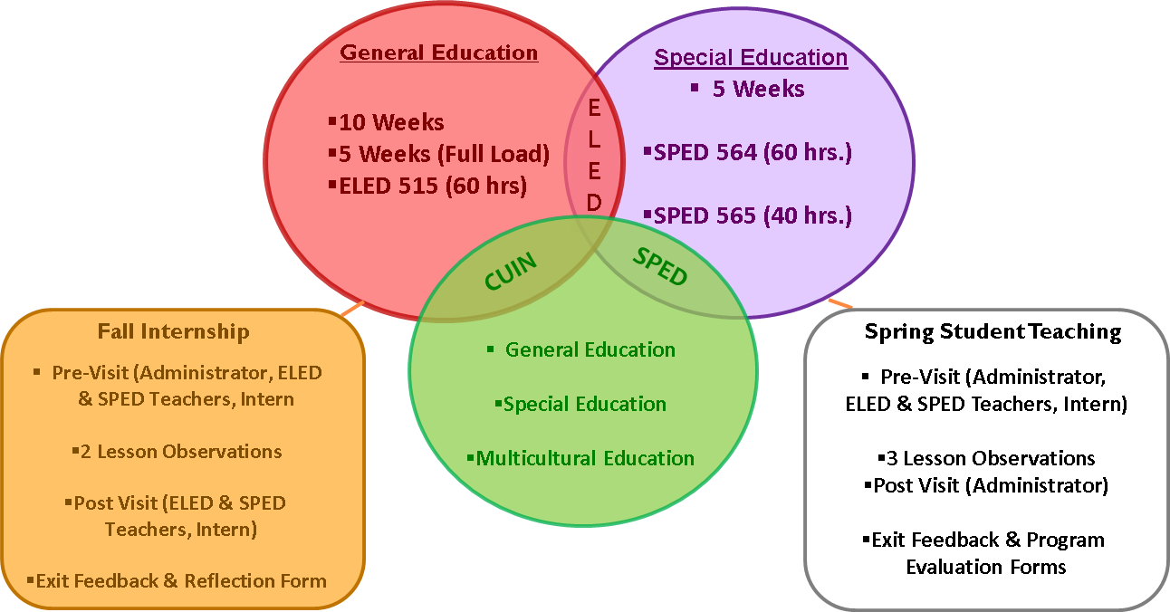
FIELD INTERNSHIP & STUDENT TEACHING FEEDBACK LOOP PROCESS
Copyright © 2010. All Rights Reserved by Cathy Kea

Slide 50
MAJOR FINDINGS:
STUDENT TEACHING PERFORMANCE
  Research Question 3: When preservice teacher candidates are exposed to culturally responsive curricula during coursework, do they infuse it in lesson delivery during student teaching lesson observations?
Only 16% (7) of the 45 lesson observations infused diversity during student teaching.
Four (4) of the 7 lesson observations infused diversity at the contributions level.
Three (3) of the 7 lesson observations infused diversity at the additive level.
Semester | Number of Students Teachers | Gender: Males | Gender: Females | Ethnicity: African American | Ethnicity: European American | Number of Lesson Observations | Number of Diversity Infused Lessons
Spring 2007 | 1 | 0 | 1 | 1 | 0 | 2 | 0
Spring 2008 | 5 | 1 | 4 | 3 | 2 | 15 | 2
Spring 2009 | 2 | 0 | 2 | 1 | 1 | 6 | 1
Spring 2010 | 5 | 0 | 5 | 5 | 0 | 10 | 4
Spring 2011 | 4 | 0 | 4 | 4 | 0 | 12 | 0
Total | 17 | 1 | 16 | 14 | 3 | 45 | 7
Only 16% (7) of the 45 lesson observations infused diversity during student teaching.
Four (4) of the 7 lesson observations infused diversity at the contributions level.
Three (3) of the 7 lesson observations infused diversity at the additive level.

Slide 51
OUTCOMES
Lesson plans were effectively designed.
  Few lesson plans infused diversity successfully. The majority 64.1% (50) of the 78 preservice undergraduates’ lesson plans infused diversity at the contributions level, 2.6% (2) additive level and 33.3% (26) were absent of diversity.
  No lesson plans infused diversity at the higher levels(i.e. transformed or social action).
  One-half infused diversity during field –based lesson observations. Only 52% (12) of the 23 preservice undergraduates infused diversity (contributions approach) during the one(1) field-based internship lesson observation.
Only six student teachers infused diversity during the 45 student teaching lesson observations.

Slide 52
TEACHER CANDIDATES:
STUDY ATTRITION
  Ten(10) teacher candidates were lost from the study due to:
  Course Rigor
  Inability to pass PRAXIS II Exam
  Field of Special Education no longer a career option
  Premature program exodus

Slide 53
6 STUDENT TEACHERS: RETROSPECTIVE REVIEW
  Twelve lesson plans were at the proficient level, 4 distinguished level, & 2 apprentice level.
  The majority (78%, n=14) of the 18 lesson plans infused diversity—13 contributions level and 1 additive level.
  During the one field-based lesson observation, 5 teacher candidates infused diversity at the contribution level.
  Seven(39%) of the 18 student teaching lesson observations infused diversity—4 at the contributions level and 3 additive level.

Slide 54
DIVERSITY LESSON PLAN EXCERPT EXAMPLES
  Student Teacher #2: Completed a “Famous African American” worksheet on nationally recognized heroes earlier in the week. Next, the students were asked to research African American heroes in their city/town, choose one hero, and display four major facts using a graphic organizer on the computer. Also, students were instructed to design a poster of their chosen African American town hero for display. They had little to no knowledge about African American heroes in their small town (Additive).
  Student Teacher #4: Used everyday home item examples for math concepts to teach students how to estimate the lengths of an object using centimeters and inches. A rap song was developed to help her 5th grade students remember the metric and British systems before lesson delivery and was taught during the math class (Additive).
  Student Teacher #5: Read and discussed the contributions of the Greensboro Four sit-in A&T college students through a selected children’s book to first graders (Contributions).

Slide 55
TOO MUCH, TOO LITTLE, TOO LATE: PURPOSE
  To gain a better understanding of how special education preservice teacher candidates infused CRT in lesson plans during coursework, field-based and student teaching experiences after receiving instruction in culturally responsive curricula in a methods course.
  To examine the first author’s efficacy in preparing teacher candidates to integrate multicultural content in lesson plan design and delivery over time.

Slide 56
TOO MUCH
  Not enough time was devoted to exposure of varied culturally responsive activities and multiple examples of how to integrate diversity in subject matter content.
  Would changes in content delivery (e.g., more time, more explicit connections between culturally responsive pedagogy and instruction) resulted in increased integration of CRT in lesson design and delivery?
  Course was the last one to be taken in the methods block by dually licensed teacher candidates.
  Overwhelming because the course instructor focuses heavily on multiple aspects of effective teaching (i.e., lesson plan design, metacognitive strategies, evidence-based practices, CRT infusion in five content areas).
  Requirement of composing a detailed scripted lesson plan is laborious and requires anticipation and critical thinking for each step.

Slide 57
TOO MUCH (continued)
  For example, the first six steps—focus and review, lesson objective, teacher input, guided practice, independent practice and closure, denotes instructional presentation and effective lesson design.
  Candidates were required to incorporate cultural diversity across these six steps of the instructional presentation process.
  Infusing diversity is both developmental and experiential (Alvaraz McHatton, et. al, 2011).
  Teacher candidates often commented, “this course should be taught first in the methods block”, “it provides the foundation and is all inclusive” and “other methods courses should utilize the same format as the one that you have provided us.”
  Continued discourse and reflection have led to refinement of course goals and objectives, changes in presentation formats (e.g., less lecturing and increased cooperative learning, micro teaching, lesson plan feedback, diverse culturally responsive teaching activities and technology). In addition, Banks’s four approaches to multicultural education that were initially covered in a general manner are now covered more explicitly.

Slide 58
LIMITATIONS
  Data came from extant lesson plans and field experience documents.
  Candidates were not interviewed to determine why so few were able to incorporate Banks’ approaches beyond the additive level.
  Course instructor collected the data which may have introduced bias into the data collection and data analysis processes. Nonetheless, this approach afforded her the opportunity to observe first-hand how the candidates were applying the content presented in the methods course.
  Small sample size makes it difficult to generalize the findings to the population at large.
  In some cases, the purpose of inquiry may be to enhance understanding of a specific issue, improve a program or expand knowledge-base in the field of study (Richardson, 1994).
  Within the framework of case study research, transferability is more important than generalizability.

Slide 59
OBSERVATIONS
Candidates
The concept of infusing diversity is both developmental and experiential.
Modeling of successful integration of CRP and CRT.
Cross-cultural experiences outside of own ethnic group.
TEPs
Diversity must be infused across TEPs in a meaningful and substantive way(Alvarez-McHatton et al.,2011).
Culturally responsive practices must become an integral part of TEPs.

Slide 60
TOO LATE! IMPLICATIONS
  Multiple opportunities to design and deliver CRT are needed since most preservice teacher candidates have not had this experience in their K-12 schooling (Jackson, 2009).
  Teacher education programs must reposition “culture” at the center of all teacher preparation.
  This means moving away from fragmented superficial treatment of diversity or the “little dab will do you” mentality.
  Restructuring programs, curriculum revisioning and integrating culturally responsive principles to frame and guide the implementation of CRT throughout teacher education curriculum across all programs inclusive of diverse field-based experiences and internships is recommended.

Slide 61
TOO LATE! IMPLICATIONS (continued)
  Continuous collective reflection and discourse among faculty on how to infuse this content across the program in a systematic and developmental manner (e.g., completion of course rubrics across the program to identify how diversity is infused, study groups to determine how diversity content such as Banks’ approaches will be infused throughout the program, and sustained assessment to monitor and revise).
  Methods course instructors may want to corroborate on the content of all methods courses, how they will be delivered, the extent to which CRT content will be modeled and assessed, and the extent to which the teacher candidate will demonstrate mastery in the classroom setting.
  Field placements and student teaching experiences must be modified to provide support for candidates as they attempt to infuse diversity into their lesson plans and execute these plans more successfully.
  Cooperating teachers need to be included in ongoing discussions with clinical and methods course faculty instructors to determine what culturally responsive teaching should look like in the classroom

Slide 62
TOO LATE! IMPLICATIONS (continued 2)
  We hypothesize that this collaboration will increase the likelihood that field-based teachers will exhibit characteristics of culturally responsive teachers (Villegas & Lucas, 2002) and implement CRT in the lesson plan designs and delivery (Irvine & Armento, 2001).
  This study elucidates the importance of documenting the extent to which candidates are able to apply what they learn during coursework completion when they are standing in front of a classroom.
  We as teacher educators teach our classes and assume that students will be able to translate theory into practice during field-based internships, student teaching, and even move into their novice years as teachers.
  I was able to assess my practice and identify what needed to happen at the course and program level to bolster candidates’ understanding and application of instruction.

Slide 63
SUMMARY
  Focal to this methods course was bridging home and school cultures through the integration of multicultural content in curriculum, lesson plan development, and instructional delivery.
  Participants demonstrated minimal skills in preparing lesson plans that successfully infused CRT , even though they were effectively designed.
  None of the participants’ lesson plans infused diversity at the higher levels of transformation or social action.
  Less than a third infused diversity during field-based and student teaching observations.

Slide 64
SUMMARY (continued)
  On-going examination of the challenges teacher candidates face in teaching CLD learners in high need urban schools has led to the emergence of a goal-oriented definition of multicultural education within a special education context.
  Seven goals developed by Sleeter and Owuor (2011) include:
    Preparing teachers to form relationships with students from backgrounds different from their own backgrounds
    To bridge home and school cultures
    To integrate multicultural content into the curriculum
    To use pedagogy equitably in the classroom so they teach all students well
    To reduce prejudice and build relationships among students
    To be change agents who can recognize and challenge injustice.

Slide 65

MULTICULTURAL CLASSROOMS

Slide 66
SESSION LEADER
Dr. Cathy Kea, Professor
North Carolina A&T State University
Curriculum & Instruction Department
1601 East Market Street-247 Proctor Hall
Greensboro, NC 27411
(336) 285-4428 (office)
(336) 334-7524 (fax)
cdkea@ncat.edu or cdkea9@yahoo.com

Slide 67
PRESENTATION CITATION
Kea, C.D., & Trent, S.C. (2013,Summer). Providing culturally responsive teaching in field-based and student teaching experiences: A case study. Interdisciplinary Journal of Teaching and Learning,3(2)81-100.

