Slide 1
Using IRIS Resources to Embed Evidence-Based Practices in Personnel Preparation Programs
OSEP 2014 Project Directors’ Conference
Washington, DC
The IRIS Center is funded through a cooperative agreement U.S. Department of Education, Office of Special Education Programs (OSEP) Grant #H325E120002. The contents of this presentation do not necessarily represent the policy of the U.S. Department of Education, and you should not assume endorsement by the Federal Government. Project Officers, Sarah Allen and Tracie Dickson.
Notes:
Introduce ourselves
Show of hands (Personnel Prep training grant, TA&D network, Comp Center; Equity Assistance Center, REL, anyone else?)
How many know the IRIS resources?

Slide 2
What IRIS Does
Develops free online instructional materials and resources
Provides TA, training, and dissemination services
Serves three primary consumer groups
College and university faculty
Professional development providers
Independent learners
Seeks to improve the knowledge and application skills of future and current education professionals about evidence-based practices
Notes:
Go through quickly for those that are new.
IRIS is the one of the few TA&D centers that serves universities in the nation, the rest work with states or districts.
Focuses on higher ed faculty, personnel preparation.
We have expanded our scope to cover children birth to 21, prior that we we were only focusing on school age. Mostly high incidence disabilities.

Slide 3
The IRIS Center Staff
IRIS@VU - Vanderbilt University
Resources Development
Modules and Materials Production
Technology and Website
Evaluation
IRIS@CGU - Claremont Graduate University
Training and Technical Assistance
Outreach and Support
Evaluation
Notes:
The IRIS Center provides resources and training, each housed in different locations.

Slide 4
IRIS Instructional Resources
STAR Legacy instructional, interactive modules
Case Studies
Activities
Information Briefs
Interviews (Podcasts)
Video Vignettes
Film Tool
Book Tool
Evidence-based Practices Summaries
Note: Some resources are available in Spanish.
Notes:
The Center develops an array of IRIS materials, which include modules, case studies, and other resources. How many of you have used the IRIS resources before? Which ones?
We have a new searchable collection of video: Video Vignettes—representations of classroom and instructional scenarios, as well as stories about individuals with disabilities, their family members, advocates, teachers, and service providers—. Currently, there are some 128 vignettes with more to follow.
Evidence-Based Practices (EBP) Annotations: representing evaluations and descriptions of a wide variety of instructional and behavioral practices and interventions. EBPs we want to make these available so teachers have reliable information-the information is “vetted”
4

Slide 5
IRIS Resource Delivery
The IRIS Website http://iris.peabody.vanderbilt.edu OR
http://www.iriscenter.com
Barrier-free
508 compliant
No passwords
Free (no cost to users)
NEW!
Notes:
5

Slide 6
IRIS Services
Webinars
Web Tours
Faculty and PD Seminars
Work Sessions

Slide 7
Using IRIS: Resources for Faculty
Faculty Guide to Using IRIS Resource
Top Tips for Faculty
Sample Syllabi
Wrap Around Concept Maps
Curricular Matrices (coming soon)
Coursework Planning Forms
Standards
CEC
CAEP
DEC
Notes:
Note: We have handouts for 1st 2 bullets

Slide 8
Using IRIS: Resources for PD Providers
PD Guide to Using IRIS Resources
Top Tips for PD Providers
Wrap Around Concept Maps
Planning Forms
Sample PD Activities (coming soon)
Standards
INTASC
Notes:
Note: Handouts for 1st 2 bullets

Slide 9
HQ-TEEMS Grant: Highly Qualified Teachers of Exceptional Education, Math, and Science
California University of Pennsylvania
Katherine Mitchem, Ph.D., BCBA-D

Slide 10
OSEP: Personnel Development Program
Invests IDEA funds to improve the quality and increase the number personnel to effectively use evidence-based practices to improve outcomes for students with disabilities
325T Program
From 2007 – 2011, OSEP funded 72 discretionary grants to
redesign and restructure special education teacher preparation programs
ensure program graduates will implement evidence-based practices.
Domains addressed:
align program with state licensure (or certifications) standards
improve program’s organizational structure and instructional delivery
improve curriculum and course content
improve support for teacher candidates
developed and implemented comprehensive program evaluation

Slide 11
325T: Essential Elements of the Program
Strategic focus on evidence-based practices
Comprehensive review and revision of curriculum and individual courses
Access resources on evidence-based practices
IRIS Center modules embedded in coursework across the curricula
What Works Clearing House / Doing What Works resources
Center for Applied Science Technology (CAST)
Resources allocated for faculty time
Professional development to build the capacity of faculty and school partners
Ongoing communication and collaboration

Slide 12
Infusion of IRIS Modules into Coursework: Blended GE/SE K-6
Courses:
Intro to Special Education
Elementary Methods
Applied Behavior Analysis

Slide 13
Course: Introduction to Special Education
IRIS Modules:
School Counselors: Facilitation Transitions
The Pre-Referral Process
Serving Students with Visual Impairments: The Importance of Collaboration
Accessing the General Education Curriculum
Effective School Practices

Slide 14
Course: Elementary Methods
IRIS Modules:
Content Standards
CSR: A Reading Comprehension Strategy
Accommodations: Instructional and Testing Supports
Differentiated Instruction
Study Skills (Part 1)
Study Skills (Part 2)

Slide 15
Course: Applied Behavior Analysis
IRIS Modules:
Addressing Disruptive and Noncompliant Behaviors (Part 1)
Addressing Disruptive and Noncompliant Behaviors (Part 2)
Classroom Management (Part 1)
(for non-SE majors only)
Classroom Management (Part 2)
(for non-SE majors only)
Functional Behavioral Assessment
SOS: Helping Students Become Independent Learners
IRIS Activities:
Behavior-Conduct an ABC Analysis
Duration and Latency Recording
Frequency and Interval Recording

Slide 16
Training Highly-Qualified Effective Practitioners: Project THEP
University of Alabama at Birmingham
Scott Snyder
ssnyder@uab.edu

Slide 17
Context: UAB
Pre 325T
Regular Ed and Special Ed in separate departments, undergraduate/graduate programs, no RTI
Post 325T
Closure of undergraduate Special Ed
Regular Ed, Special Ed, and ELL in same department
Integration of RTI principles/practices into Regular Ed initial certification
Continuing efforts to enable dual or triple certification
19 courses re-designed across SE, ECE/ELE, and Secondary Ed (15 with IRIS modules) with a focus on EBP and RTI

Slide 18
Lessons Learned
While IRIS modules are intuitive, faculty needs support in efficient and effective integration
Faculty awareness of EBPs remains a challenge (e.g., Clearer links between WWC and IRIS modules would help)
Fidelity of implementation remains a challenge
http://ncipp.education.ufl.edu/files_33/CandidateEBPsurvey.pdf
Faculty report a desire for implementation videos

Slide 19
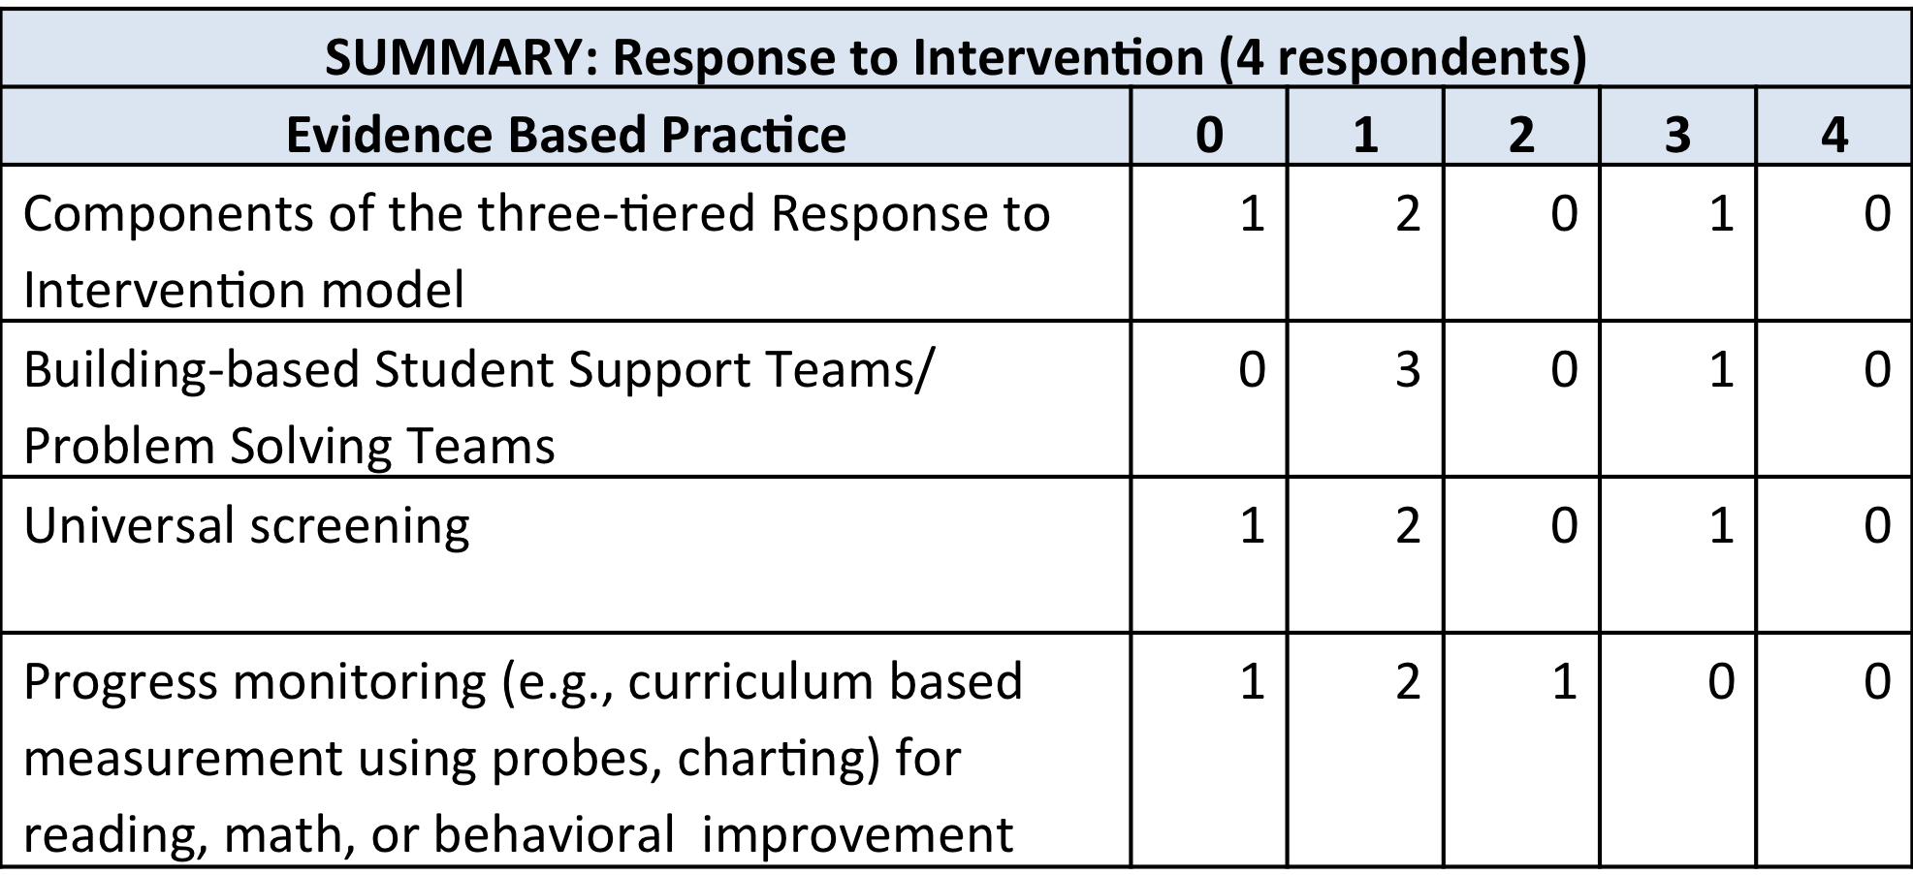
Illustration of Results from an Online Faculty Survey
Evidence Based Practices Rating Scale:
0= Not mentioned in the course
1=Mentioned/Discussed in the course
2= Mentioned/Discussed in the course plus assignment/assessment
3=Demonstrated/Modeled in the course
4=Demonstrated/Modeled/Applied in Classroom Context

