Slide 1
OSEP
Personnel Development Program
Welcome!
Program Meeting
Bonnie D. Jones, Program Lead
July 21, 2014
Notes:
The Personnel Development Program (PDP) in OSEP is one of the Nation’s oldest and most prominent federal student financial aid programs, originating in 1958 under P. L. 85-926, the Education of Mentally Retarded Children Act for training personnel in mental retardation. The need for well–prepared and skilled personnel to provide special education and related services to infants, toddlers, and children with disabilities and their families remains critical some fifty years later. Today, Section 662 of the Individuals with Disabilities Education Act (IDEA) authorizes the preparation of special education and related service personnel and specifies the highly-qualified teacher requirements in Part B for special education teachers.

Slide 2


Agenda
Performance Measure Results
Discussion Groups

Slide 3
Discussions (4:30-6:00)
Grant Priority or Focus
Room Number
Early Childhood
High Incidence (Ts)
Leadership
Minority Institutions
Paraprofessional
Related Services/Low Incidence
Exhibit Hall A
Washington 5 & 6
Washington 4
Washington 1
Balcony B (7/22)
Washington 2

Slide 4

Summer 2014 Doctoral Interns
American University
George Mason University
Howard University
University of Central
Florida
University of Maryland
University of Pennsylvania
University of South Florida
University of California, Los Angeles
Vanderbilt University

Slide 5
Program Goal & Objectives
To prepare personnel in areas of critical need who are highly qualified to improve outcomes for children with disabilities --
  Objective 1. Improve the curricula of IDEA training programs to ensure that personnel preparing to serve children with disabilities are knowledge and skilled in practices that reflect the current knowledge base. (Measures 1 and 2)
  Objective 2. Increase the supply of teachers and service providers who are highly qualified for and serve in positions for which they are trained. (Measures 3 through 6)
  Objective 3. Enhance the efficiency of the expenditure of Federal dollars under this program. (Measure 7)

Slide 6
Government Performance and Results Act (GPRA)
As required by the Government Performance and Results Act (GPRA) of 1993, OSEP has developed a strategic plan for measuring performance and will collect information to assess progress and performance.

Slide 7
Program Performance Measures
FY 2011 Data
Collected & Reported in 2013
Published in 2014
http://www2.ed.gov/about/overview/budget/budget14/justifications/j-specialed.pdf
Google: Special education budget justification FY 2015
Notes:
Budget Services and OMB have approved the definition of fully-qualified as it relates to special education personnel data collection:
If the position is an elementary or secondary general education/special education teacher, use “highly qualified”;
if the position is general education/special education paraprofessional/aide or early intervention, early childhood or preschool paraprofessional/aide, use “qualified”; or
if the position is administrator/coordinator, for related or supportive services in a school setting, or for teacher, related services, or supportive services in early intervention, early childhood, use “fully certified.”)

Slide 8
Scholars were pursuing…
Of the 5,511 scholars enrolled in programs during FY 2011 -
16% of scholars were enrolled only in a program leading to a state credential or endorsement
Less than .5% of scholars were enrolled in post doctoral studies (n=15)
Less than 1% of scholars were pursuing an Associates degree
Nearly 6% were pursuing a Bachelors degree
53% were pursuing a Master’s degree
6% were enrolled in an ED Specialist program
Nearly 18% of scholars were pursuing a Doctorate degree

Slide 9
Performance Measure 1
Percentage of projects that incorporate evidence-based practices into their curricula
Target = 95

Slide 10
FY 2011 Scholars
Priority Area | Number of Completing Scholars | Number of Scholars Exiting Prior to Completion | Total Number of Scholars Completing or Exiting
325D | 165 | 120 | 285
325K – EC | 307 | 34 | 341
325K – LI | 689 | 102 | 791
325K– RS | 341 | 23 | 364
325K – MI | 413 | 60 | 473
All Areas¹ | 1,997 | 369 | 2,366
Notes:
The following measures use the number of completers in their calculation.

Slide 11
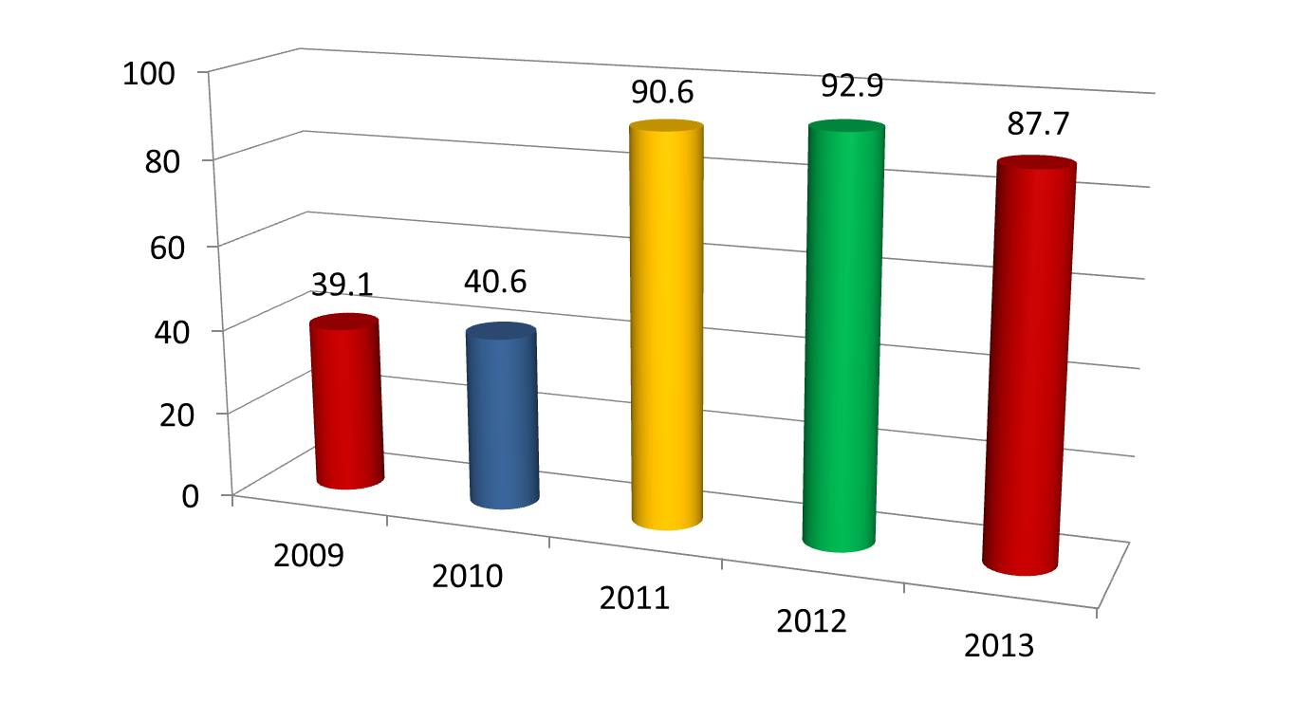
Performance Measure 2
Percentage of scholars completing OSEP- funded training programs who are knowledgeable and skilled in evidence based practices for infants, toddlers, children, and youth with disabilities.
Target = 85

Slide 12
Performance Measure 2- Additional Analyses
Measure 2: Additional Analyses | Percent
 | RY 2010 (FY 2008) | RY 2011 (FY 2009) | RY 2012 (FY 2010) | RY 2013 (FY 2011)
Scholars who took an exam/measure and passed | 40.6 | 90.6 | 92.9 | 87.7
Scholars who took an exam/measure and did not pass | 1.8 | 1.2 | 0.3 | 1.7
Scholars who did not take any exam/measure | 33.5 | 6.7 | 5.8 | 9.4
Scholars whose exam/measure completion status was unknown | 24.1 | 1.4 | 0.9 | 1.2
Total | 100.0 | 99.9 | 99.9 | 100.0
Totals may not sum to 100 due to rounding.
Notes:
The first row in this table repeats the data presented on the previous slide. Scholars who are not included in the first row are distributed over three categories: those that took a measure and did not pass, those that didn’t take any measures, and those for whom data on measure completion was not known. The final two categories were particularly problematic prior to FY 2009 with nearly half of scholars being reported in one of those categories. We saw significant improvement in FY 2009, but based on feedback in cognitive interviews, we believe there is still some confusion about the types of measures to be reported and that there is still potential for reducing the number of scholars who do not take any measures.

Slide 13
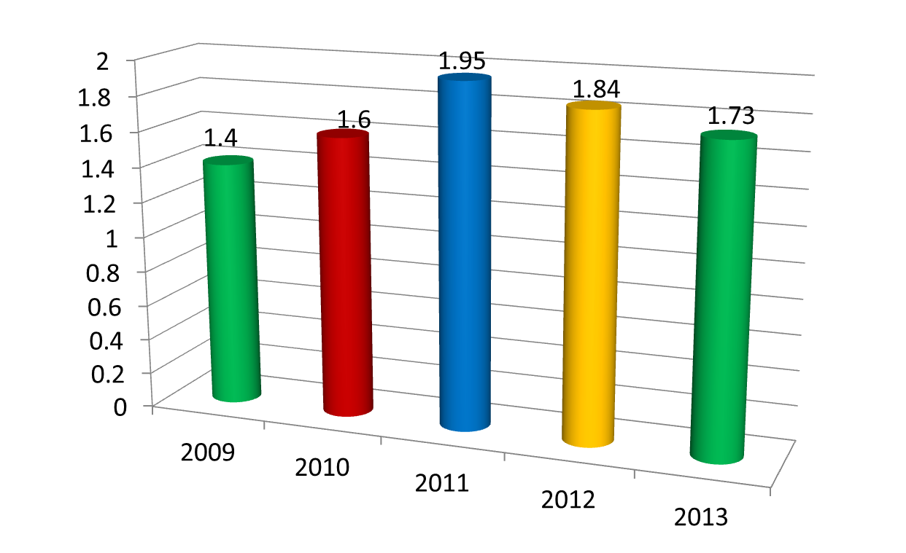
Performance Measure 3
Percentage of program scholars who exit preparation programs prior to completion due to poor academic performance
Target = 1.9
Notes:
(Measure 2.1 of 4) The numerator for this percentage is based on SDR Section E, Item 11. It is the number of scholars who exited training prior to completion due to poor academic performance. This includes scholars who exited for poor academic or field-based performance alone or in combination with another exit reason. The denominator is based on SDR Section C, Item 6. It is the number of scholars that exited the training program. This number includes all scholars who completed the training program plus scholars who exited prior to completion.
1.73% of scholars who exited in FY 2011 left grant-supported training due to poor academic or field based performance.

Slide 14
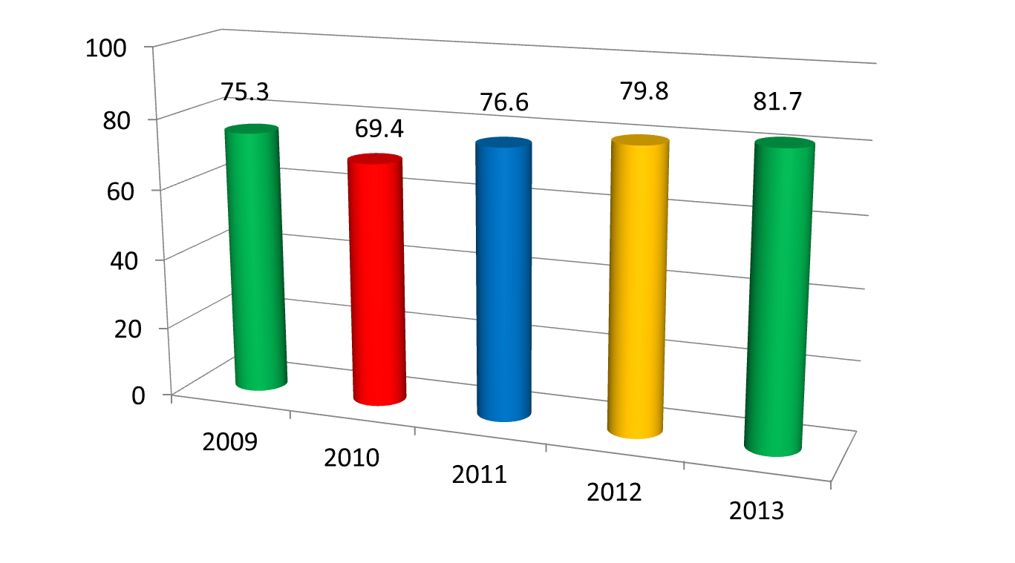
Performance Measure 4
Percentage of funded degree/certification program recipients who are working in the area(s) in which they were trained upon program completion.
Target = 84
Notes:
(Measure 2.2 of 4) The numerator is based on a comparison of SDR Section C, Item 5a (CQ5a) and SDR Section F, Item 6a (FQ6a). A scholar will be coded “employed in area of training” if the area of training and the area of employment are similar as categorized by OSEP. If none of the responses to these two items are similar, then the scholar is coded as “NOT employed in area of training.” If either CQ5a or FQ6a are missing, then the scholar is considered not employed in the area of training.
The denominator is based on SDR Section F, Item 1. It is the number of scholars that exited the training program through program completion who are currently employed as well as scholars who are not employed and those scholars who the grantee does not know they are employed (i.e., grantee checks “Yes,” “No,” or “Don’t Know” on Section F, Item 1).
Scholars who received a grantee-issued endorsement or course completion only and scholars who were missing data on type of degree earned were excluded from this analysis.
Of scholars who received degrees and certifications in FY 2011, 81.7% were employed in the areas for which they were trained.

Slide 15
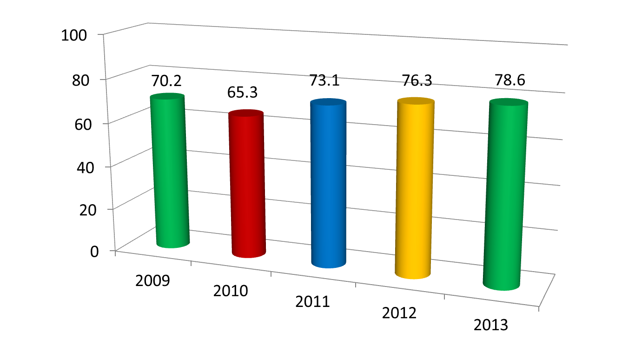
Performance Measure 5
Percentage of funded degree/certification program recipients who are working in the area(s) in which they were trained upon program completion and who are fully qualified under IDEA.
Target = 80
Notes:
(Measure 2.3 of 4) The numerator is based on a comparison of SDR Section C, Item 5a (CQ5a) and SDR Section F, Items 6a (FQ6a) and 7 (FQ7). A scholar will be coded “employed in area of training” if the area of training and the area of employment are similar as categorized by OSEP. If none of the responses to these two items are similar, then the scholar is coded as “NOT employed in area of training.” If either CQ5a or FQ6a are missing, then the scholar is considered not employed in the area of training. Responses to FQ7 will then be examined for those scholars identified as “fully qualified under IDEA.”
The denominator is based on SDR Section F, Item 1. It is the number of scholars that exited the training program through program completion who are currently employed as well as scholars who are not employed and those scholars who the grantee does not know if they are employed (i.e., grantee checks “Yes,” “No,” or “Don’t Know” on Section F, Item 1).
Scholars participating in Leadership grants, scholars who received a grantee-issued endorsement or course completion, and scholars who were missing data on type of degree earned were excluded from this analysis. The denominator can also be calculated using only SDR Section C, Question 6 to identify scholars that exited the training program through program completion. Previously, this indicator was calculated by using FQ1 to exclude scholars who were not employed (i.e., FQ1 = No). When OSEP and Budget agreed to include scholars with “No” for FQ1 in the denominators, FQ1 became less of a defining variable for selecting cases. The measure now uses all scholars completing programs as the denominator minus a couple exceptions (i.e., scholars missing data on degree received, scholars who received grantee endorsements/course completion only)
Of non-Leadership scholars who received degrees and certifications in FY 2011, 78.6% were employed in the areas for which they were trained and were fully qualified under IDEA.

Slide 16
Performance Measure 6
Percentage of funded degree/certification program recipients who maintain employment in the area(s) for which they were trained for 3 or more years and who are fully qualified under IDEA.
Notes:
(Measure 2.4 of 4)
Data reported in 2008 and 2009 were based on a temporary collection methodology using a small sample (n = 9) of the IHEs, which received the most funding under the Personnel Development Program.
Beginning in 2010, the Department shifted the data source for this measure to the National Center for Service Obligation (NCSO) which is contracted by OSEP to track scholars (obligees) after graduation for compliance with the Program’s service obligation requirement beginning with grants awarded in FY 2005.
In recent years, the Department has found it difficult to accurately and meaningfully calculate and report data on this measure. As such, we are currently evaluating this measure and the available methodologies for accurately calculating it. The Department expects a revised measure or methodology to be in place by March 2015.

Slide 17
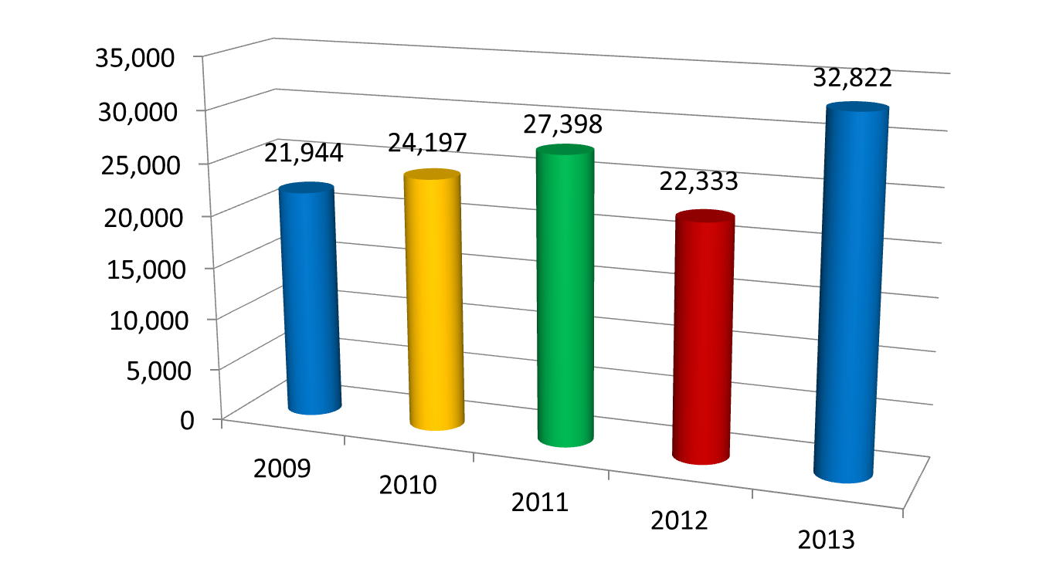
Performance Measure 7
The Federal cost per degree/certification program recipient who completed the program.
Target = $25K
Notes:
( Measure 3.1 of 1) The numerator is based on funding data from the Department of Education’s grant database, G5. It is the sum of grant funds given to each grant that ended between October 1, 2010, and September 30, 2011. This sum reflects the total funding given to each grant over the life of the grant. The denominator is based on SDR Section C, Item 6. It is the total number of scholars that exited the training program through program completion during the life of grants that ended between October 1, 2010, and September 30, 2011. Scholars who do not earn a degree/certificate during the life of the grant (e.g., exit prior to completion due to grant ending) are excluded from the denominator.
The results for Measure 3.1 of 1 have varied over the last five years, ranging from an average cost per degree recipient of approximately $22,000 in FY 2007 to an average cost of $32,822 in FY 2010. This variation is also reflected when the data are examined by grant competition and focus area. In addition, the average cost per degree recipient has been greater for Leadership grants than non-Leadership.

Slide 18

New Outcome Measures
Employment in High-Need Schools
Teacher Retention
Effectiveness of Employees
Notes:
The Personnel Development Program is required to develop methodologies for three new outcome measures. You may have noticed these three measures introduced in the Administration’s Blueprint for the ESEA Reauthorization.
We expect to develop methodologies for data collection on these measures over the next year, with piloting of measures projected to begin in 2015 for a three year period.

Slide 19

Program Improvement
Grantee Training on –
Preparing Annual Performance Reports
Using Logic Models
Writing Performance Measures
Improving Performance Measurement Data Quality
Training for Peer Reviewers
Data Reporting Requirements for New Grantees

Slide 20
Early Childhood Personnel Center
  http://www.ecpcta.org/
Collaboration for Effective Educator Development, Accountability, and Reform (CEEDAR)
    http://www.ceedar.org/
Great Teachers and Leaders (GTL Center) http://www.gtlcenter.org/
IRIS Center
    http://iris.peabody.vanderbilt.edu/
Technical Assistance
Supporting Improved Preparation Programs

Slide 21
Program Reminders
Personnel Development Program Data Collection System (DCS). DCS launched on July 2, 2014. Phased data entry: grantees now; scholars this fall. https://pdp.ed.gov/osep
Required use of OMB-approved Pre-Scholarship Agreements and Exit Certification forms. Must be signed and uploaded into DCS.
Quarterly monitoring by OSEP of grantee reporting. Monitoring includes key performance measures: (# Enrolled, exited, completed, employed.)

