Slide 1
OSEP TA&D Program Performance Measurement
OSEP Project Directors’ Conference
July 21, 2014

Slide 2
Government Performance and Results Act
The Government Performance and Results Act (GPRA) of 1993 required all federal agencies to establish and report annually on goals, measures, and targets
The law was reauthorized in 2010 as “GPRA Modernization Act of 2010”
Notes:
OSEP has organized its program performance measures to be the Government Performance and Results Act (GPRA) measures

Slide 3
Performance Measures
OSEP reports progress on program performance measures annually to OMB and Congress
This provides an aggregate picture of performance
Their review of our performance data affects the continued funding of IDEA Part D programs
OSEP uses the data to improve the TA&D Program’s performance

Slide 4
TA&D Program Performance Measures
Annual
Quality of New Service or New Product
Relevance of New Service or New Product
Usefulness of New Service or New Product
Federal Cost per unit of New Product or New Service (Efficiency)
Meeting project benchmarks (Productivity)
Long-term
Implementation of evidence-based practices
Promotion of effective models

Slide 5
Review for Annual Measures
Scientific Review Panel
Panel receives the New Product and New Service Description Guides as well as electronic copies of the product and supporting materials for services
Rates the quality of evidence-based products and services
Stakeholder Review Panel
Panel receives the New Product and New Service Description Guides as well as electronic copies of the product and supporting materials for services
Rates the quality of policy-related products and services and the relevance and usefulness of all products and services

Slide 6
How is Quality Rated by the Panel?
Annual Measure
Percentage of Special Education Technical Assistance and Dissemination (TA&D) Products and services deemed to be of high quality by an independent (Scientific) review panel.
Substance:
Does the product content or the content delivered through the service reflect evidence of conceptual soundness and quality, grounded in recent scientific evidence, legislation, policy, or accepted professional practice?
Communication:
Is the product content or the content delivered through the service presented in such a way so as to be clearly understood, as evidenced by being well-organized, free of editorial errors and appropriately formatted?

Slide 7
How is Relevance Rated by the Panel?
Annual Measure
Percentage of Special Education Technical Assistance and Dissemination (TA&D) Products and services deemed to be of high relevance by an independent (Stakeholder) review panel.
Need:
Does the product content or the content delivered through the service attempt to solve an important problem or deal with a critical issue?
Pertinence:
Does the product content or the content delivered through the service address a problem or issue recognized as important by the target audience(s)?
Reach:
To what extent is the product content or the content delivered through the service applicable to diverse segments of the target audience(s)?

Slide 8
How is Usefulness Rated by the Panel?
Annual Measure
Percentage of Special Education Technical Assistance and Dissemination (TA&D) Products and services deemed to be useful by an independent (Stakeholder) review panel.
Ease:
Does the product content or the content delivered through the service address a problem or issue in an easily understood way, with directions or guidance regarding how the content can be used to address the problem or issue?
Likelihood of Use:
Is it likely that the information derived from the product content or the content delivered through the service will eventually be used by the target audience(s) to achieve the intended benefit?
Replicability:
Is it likely that the information derived from the product content or the content delivered through the service will be used repeatedly in multiple settings to achieve the intended benefit?

Slide 9
How is Cost Calculated?
Annual Measure
The federal cost per unit of TA provided by the special education technical assistance program, by category of technical assistance.
Cost per unit:
Cost for developing and distributing/delivering the new product/service divided by number of target audience units reached directly by the product/service.
Under Review

Slide 10
How is Productivity Reviewed?
Annual Measure
The percentage of projects that achieve proposed milestones within the approved timeline.
The milestones and timeline are what was proposed in your application or in the annual work plans submitted to your project officer.
Submitted as part of APRs.

Slide 11
Selection for Annual Measures
2013 Sample Selection
Random selection of projects by The Study Group Inc. (TSG)
Additional TA&D Centers selected by TSG to ensure areas in the strategic plan are represented
10 TA&D Centers and 10 State Deaf-Blind Projects

Slide 12
Sample Selection and Data Collection for Annual Measures
Data Collection
Projects generated a list of new products/services developed or delivered during the prior fiscal year
TSG randomly selected one product and one service from the list
Projects provided a description of the selected product and service
Descriptions and products were sent to a scientific review panel (for evidenced-based products or services) to rate quality and a stakeholder review panel to rate relevance and usefulness

Slide 13
4-Point Rating Scale for Quality, Relevance, and Usefulness Annual Measures
0= Very Low; 1=Moderately Low; 2=Moderately High; 3=Very High
Maximum total score of 9
Total average panel rating of 6 or above considered “high”

Slide 14
TA&D Program Performance Outcomes for Annual Measures
 | Percentage of Sampled Projects Rated High
Year | Quality | Relevance | Usefulness
2013 | 100 | 94.0 | 83.2
2012 | 91.0 | 100 | 93.5
2011 | 85.4 | 100 | 88.1
2010 | 87.4 | 95.9 | 84.9

Slide 15
Results for the 2013 Long-Term Measure
 | Percentage of States successfully promoting the implementation of EBP with local programs
Year | Target | Actual
2013 | 86 | 83.3
2012 | NA | NA
2011 (Baseline Established) |  | 85.7

Slide 16
National Evaluation of the IDEA Technical Assistance & Dissemination Program (IES, 2013)
The study team gathered data for the TA&D Program Evaluation from surveys and interviews to address the primary research questions.
Respondents included 27 centers funded under the TA&D Program (i.e., TA&D grantees); 51 Part C Early Intervention Coordinators (Infants and toddlers); and 51 Part B Special Education Directors (School age) representing all 50 states and the District of Columbia and 805 state staff.
Data were collected between November 2012 and March 2013. The focus of the evaluation was on the activities of the topical and specialty centers, Regional Resource Centers, PEPNet centers, and state deaf-blind projects.

Slide 17
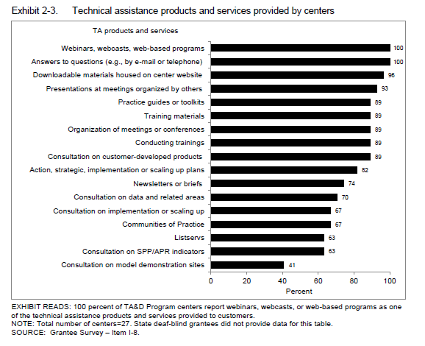
Products and services provided by TA&D Program centers

Slide 18
To what extent are states satisfied with the products and services received from TA&D Program centers?
Using a 4-point scale with response options ranging from very dissatisfied (1) to very satisfied (4), state specialists reported a mean level of overall satisfaction of 3.7, with 71 percent of interactions during 2010-11 rated as very satisfactory
On average, customers receiving the highest intensity technical assistance (frequent training and consultation) were significantly more satisfied than those receiving lower intensity technical assistance, infrequent training and consultation, frequent web-only access, or infrequent web-only access.

Slide 19
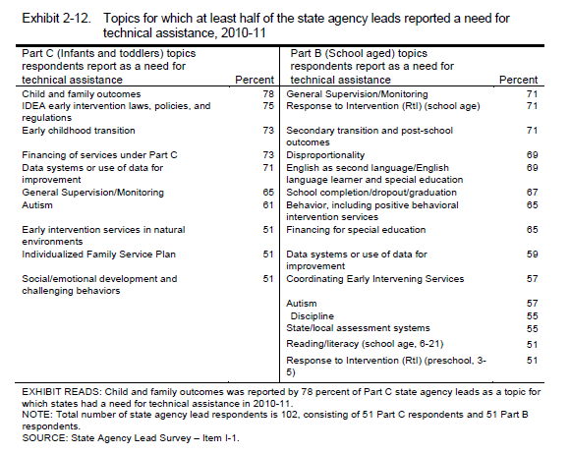
Topics for which at least half of the state agency leads reported a need for technical assistance for 2010-11

Slide 20
What are state needs for technical assistance and to what extent are these needs addressed by TA&D centers or other sources?
The area for which state needs for technical assistance was greatest was identified as state and local capacity building, reported by 34 percent of state specialists on Part C topics and 35 percent on Part B topics.
For topics designated as among their top three areas of greatest need, the percentage of state agency leads for the Part C and Part B programs who reported that their needs for technical assistance had been largely addressed were 60 and 55 percent, respectively.

Slide 21
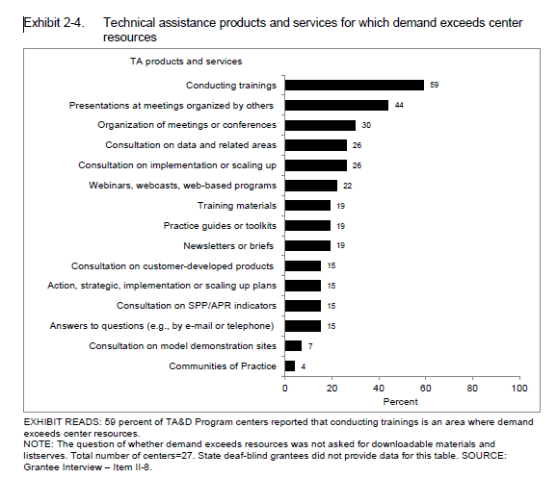
Technical assistance products and services for which demand exceeds center resources

Slide 22
Our Partnership is the Key to Successful Performance

