Slide 1
Welcome to Washington, It’s More than House of Cards

Slide 2
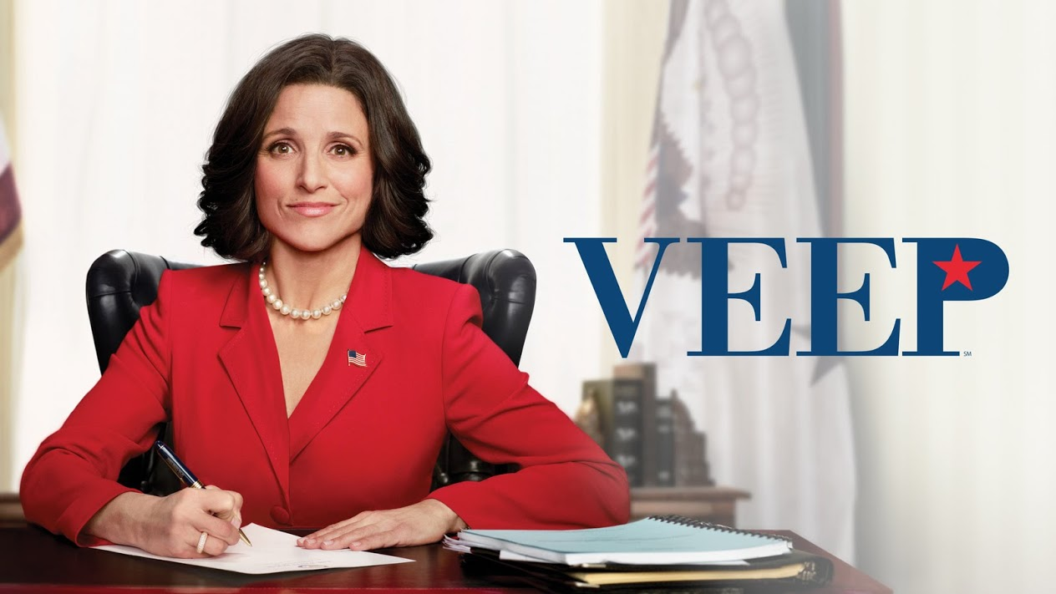
More than House of Cards
Notes:
Yes, it is more than House of Cards, we have Homeland, Veep, and Scandal …
It’s amazing that you came to Washington!

Slide 3
Intersection of Politics and Policy
Politics
Policy

Slide 4
Change…It’s Everywhere…
Notes:
9 stages of transition …

Slide 5
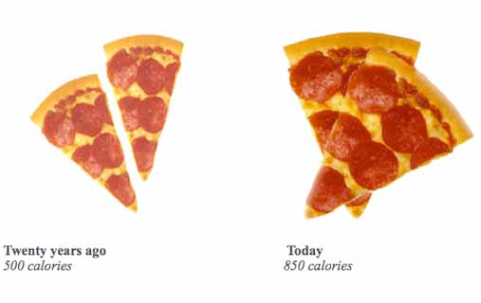
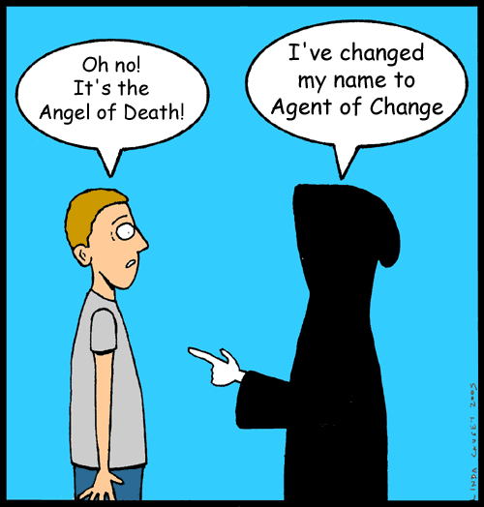
Then and Now
Notes:
A lot has changed over the last 20 years …. (CLINTON/OBAMA)
My kind of change (PIZZA)
And sometimes with change comes an opportunity to rethink/rebrand (Angel of Death)
Today, we’re going to talk about the major changes in education policy over the last 5 years….

Slide 6
2012 Election Demographics: Race & Gender
Women: Obama 55%
LGBT: Obama 76%
African American: Obama 93%
Hispanic: Obama 71%
Asian: Obama 73%
White: Romney 59%
Obama’s share of the white vote shrank, but the overall number of white voters also shrank.
Notes:
Nationally, nonwhite voters made up 28% of all voters, up from 26% in 2008. Obama won 80% of these voters, the same as four years ago.
According to the Center for Information and Research on Civic Learning and Engagement, an estimated 22-23 million young voters turned out, comprising 19 percent of the American electorate -- 1 percent larger than in 2008, and 2 percent larger than in 2004.
Ages 18-29 are the millenials – Born from 1980 on, there are 50 million of them total and they are the most diverse group in history.
With even a 50/50 split in the youth vote in Ohio, Virginia, Florida and Pennsylvania, we would be inaugurating President Romney on January 21st.

Slide 7
Young People Voted
18-29 Obama 60%
30-44 Obama 52%
45-64 Romney 51%
65+ Romney 56%
Voters under age 30 were 19% of the electorate.
1% > 2008
Pew Research Center, Nov. 26, 2012
Notes:
This is down slightly from 2008 when Obama won 66% of all youth vote. The Obama Campaign knew this – Campaign science – just quickly – Play a short clip that talks about how Obama reached out to what used to be considered “nontraditional” audiences.

Slide 8
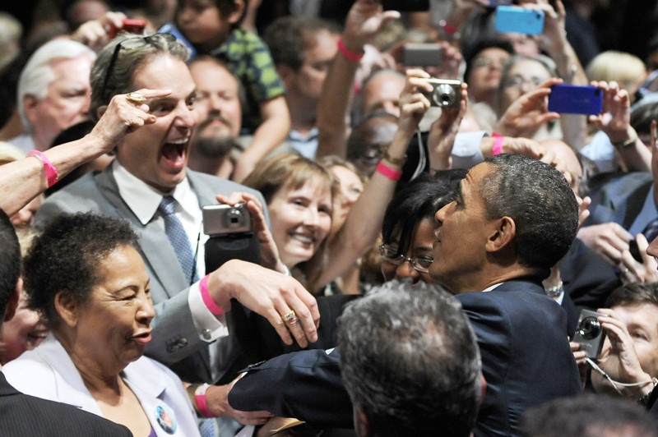
The Fans Go Wild!

Slide 9
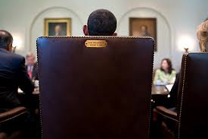
This seat is taken…
This seat is taken…

Slide 10
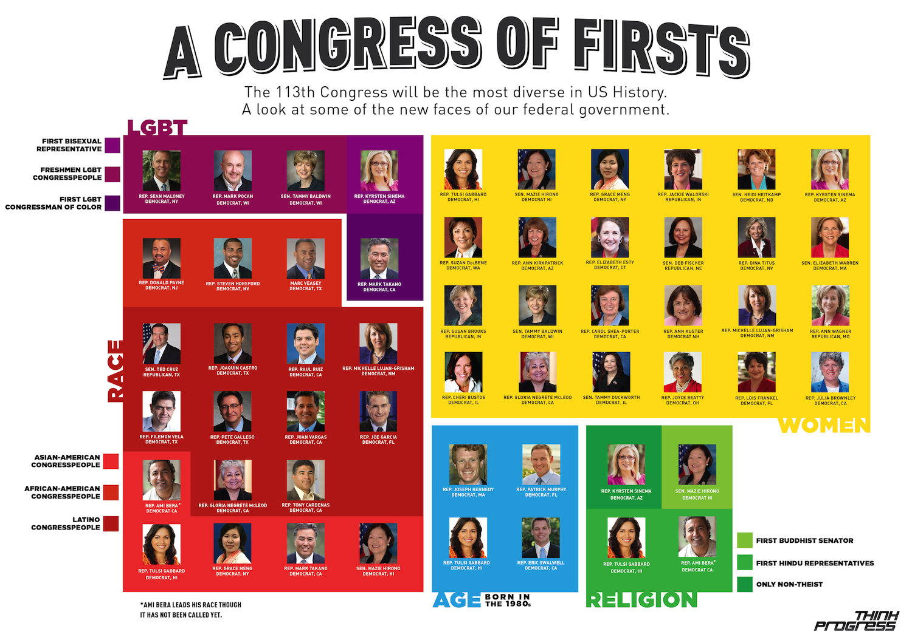
A Congress of Firsts

Slide 11
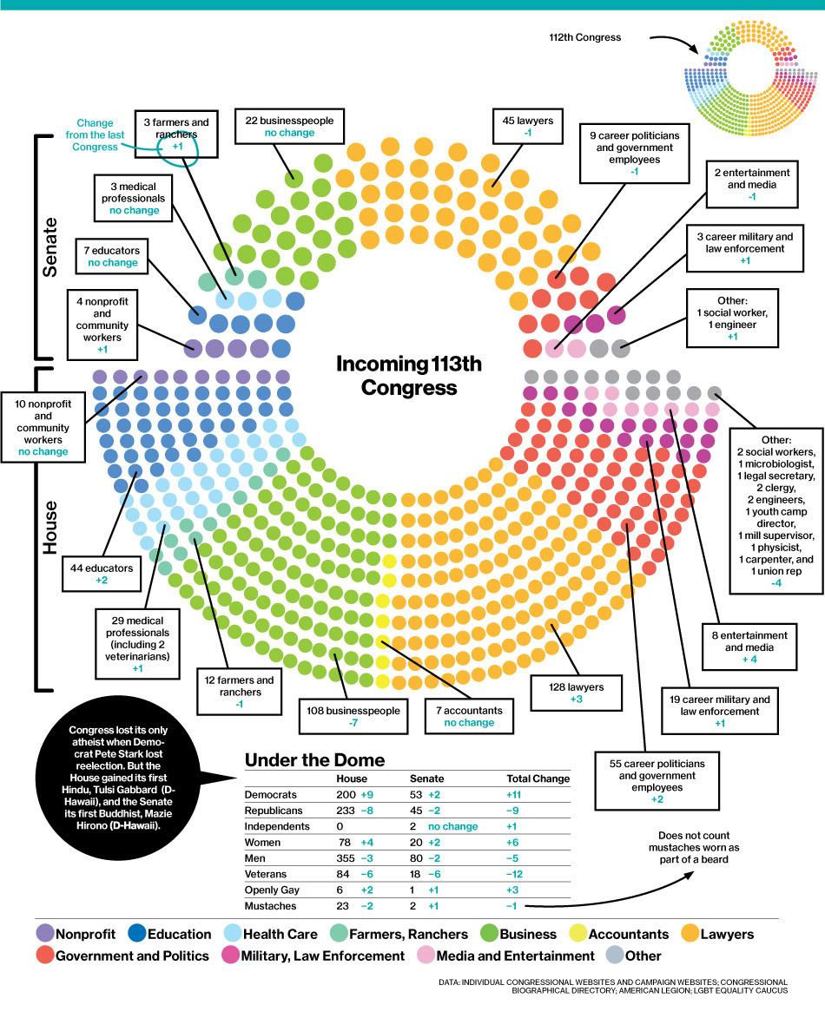
Incoming 113th Congress
Notes:
Why does this all matter?
Changing demographics impact education just like they’re impacting elections.
51 Educators in Congress --

Slide 12
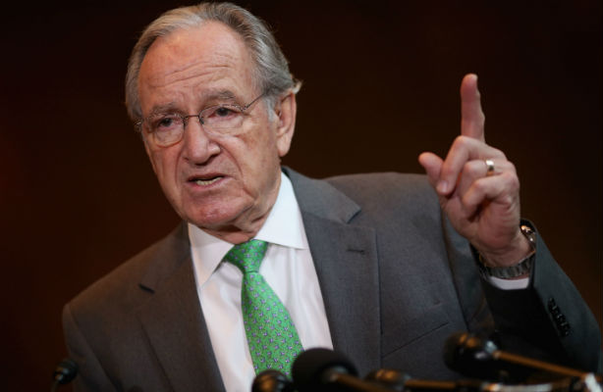
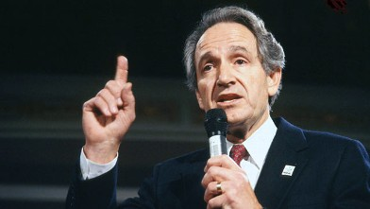
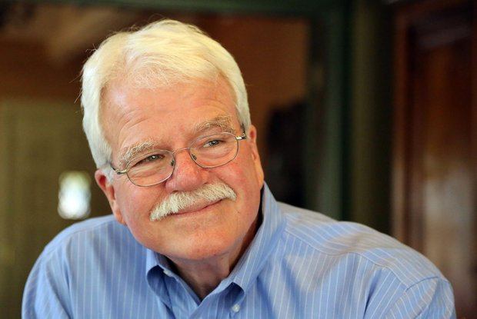
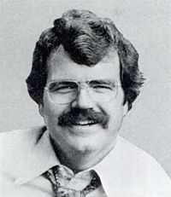
2014 Midterm Elections
Casualty list…
31 Retirements (25 House, 6 Senate)
13 House Members running for Senate
10 Resigned (or resigning)

Slide 13
Congressional Champions
Thank You
Tom Harkin &
George Miller!

Slide 14
2014 Mid-Term Elections
Senate Prediction:
Democrats: 48 ▪ Republicans: 48
Toss-Ups: 4
Courtesy of University of Virginia www.centerforpolitics.org/
Notes:
Due to the mix of seats up for election this year, just 2 million voters across six states—0.6 percent of the U.S. population—could end up deciding the fate of the Senate. Read more: http://www.politico.com/magazine/story/2014/05/10-maps-that-explain-the-2014-midterms-106347.html#ixzz33gCyAJH9
Democrats hold more senate seats that should be thought of as republican (because they went for romney in 2012 presidential election) than republicans holding seats thougth of as democrat (only Mark Kirk IL and Susan Collins ME)
Colorado race The Republican nominee this year, Rep. Cory Gardner, is a better candidate than Buck, whom Gardner recently bigfooted out of the race. But Sen. Mark Udall, the Democratic incumbent, is arguably a better candidate than Bennet. Polls here are very close, and if Republicans are to win any Obama-state Senate seats this year, Colorado might be the one (other contenders are Iowa, Michigan and New Hampshire). Read more: http://www.politico.com/magazine/story/2014/05/10-maps-that-explain-the-2014-midterms-106347.html#ixzz33gGINZWA

Slide 15
Not All Senate Classes Are Equal
1/3 of Senate up for re-election every two years
2014 “Class” = More D’s in R leaning states than in other “classes”
6/11 Democrats from States that Obama won by less than 45% are on ballot this year …. Republicans must net 6 seats to win Senate!
These 6 states – AK, AR, LA, MT, SD, WV – 3.8% of U.S. Population!
Notes:
his year ought to be a good one for the GOP, because Senate Class 2, the most Republican-leaning of the three Senate classes, is up. (The University of Virginia Center for Politics’ Crystal Ball ratings for each race are pictured above.) Over the past four presidential elections, the Democratic presidential nominee has won an average of 51.2 percent of the national two-party presidential vote, while the Republican nominee has taken 48.8 percent. Yet in the Class 2 batch of Senate states, over the same time frame, the Democratic nominee has taken an average of 46.6 percent of the vote. Read more: http://www.politico.com/magazine/story/2014/05/10-maps-that-explain-the-2014-midterms-106347.html#ixzz33gEtJyTi
Plus, six of the 11 Democrats from places where Obama won less than 45 percent in 2012 are on the ballot this year, which also happens to be the number of seats Republicans must net to win the Senate. Read more: http://www.politico.com/magazine/story/2014/05/10-maps-that-explain-the-2014-midterms-106347.html#ixzz33gFBVzJD
Republicans, as mentioned, need to net six seats to win the Senate, and there are six Democratic-held seats on this map where Obama got less than 45 percent of the vote in 2012. Let’s assume the GOP nets those six seats, but everything else remains the same, which is a perfectly plausible scenario. Those states—Alaska, Arkansas, Louisiana, Montana, South Dakota and West Virginia—represent just 3.8 percent of the U.S. population. Read more: http://www.politico.com/magazine/story/2014/05/10-maps-that-explain-the-2014-midterms-106347.html#ixzz33gFa8Min

Slide 16
House of Representatives
DEMOCRATS
REPUBLICANS
House Prediction:
Democrats: 193 ▪ Republicans: 230 ▪ Toss-Ups: 12
Current outlook: Republicans net 5-8 House seats
Notes:
More than a quarter of the current House Democratic caucus (50 of 199) hails from CA and IL (thanks redistricting!) Read more: http://www.politico.com/magazine/story/2014/05/10-maps-that-explain-the-2014-midterms-106347.html#ixzz33gGkEHVO

Slide 17
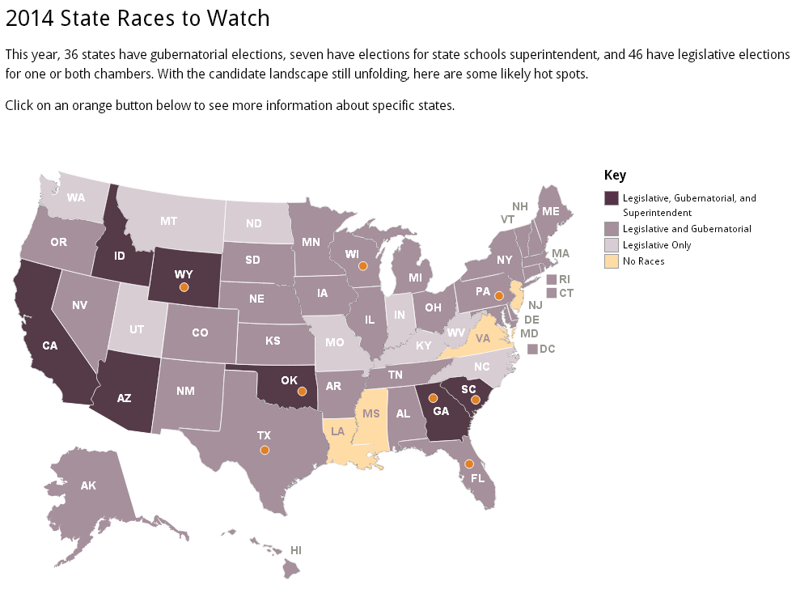
2014 State Races to Watch
Notes:
PENNSYLVANIA
With low approval ratings, incumbent GOP Gov. Tom Corbett could face a difficult fight for re-election, and education could be one of his trickiest issues to handle. His demands for changes to Philadelphia schools in exchange for badly needed state funds have provoked controversy, and his pledge to make school funding more fair could be an attempt to broaden his political support in 2014.
SOUTH CAROLINA
With the impending retirement of state chief Mick Zais, there could be a crowded field to replace him in a state where the common core is under threat after a pledge by Gov. Nikki Haley, a Republican, to abandon the standards. Potential challengers in the GOP might face questions about their views on Gov. Haley’s proposed boost to K-12 funding, as well as school-choice policies.
GEORGIA
This race will pit incumbent Gov. Nathan Deal against current state schools’ Superintendent John Barge in the Republican primary. The common core promises to be a complicated subject, since both candidates have questioned changes related to the standards, such as new tests and suggested reading lists. There is also significant opposition to the standards among some grassroots GOP voters in the state. The race will also feature state Sen. Jason Carter, the grandson of former President Jimmy Carter and the only Democrat to have declared as of last week.
FLORIDA
There’s a tough race ahead for incumbent GOP Gov. Rick Scott, not least because he’ll be tracking how the Common Core State Standards and aligned tests are playing in his state. Gov. Scott has ordered a review of the standards and has sent mixed signals about his support for the common core. He’ll also face teachers’ union members who are eager to replace him following K-12 budget cuts and controversial teacher-evaluation policies, as well as a high-profile Democratic challenger, former Gov. Charlie Crist, who served as a Republican.
TEXAS
Two of the candidates with the highest profiles are state Sen. Wendy Davis, a Democrat who has put forward a three-part education plan that would include major reforms for public school teachers, and state Attorney General Greg Abbott, who in a recent interview on a Texas radio station said that teachers are underpaid and also advocated for more school choice.
OKLAHOMA
The state’s A-F school accountability system has been a controversial subject for incumbent state Superintendent Janet Barresi, a Republican first elected in 2010. She could face ongoing questions about that system throughout 2014, as well as Republican challengers who might vigorously criticize the state’s adoption of the common core.
WISCONSIN
Republican Gov. Scott Walker’s re-election bid will highlight numerous K-12 battles from his tenure. They include the provisions of a law he pushed through in 2011 that was fiercely opposed by teachers’ unions, school funding levels, and the ongoing fight to expand school choice.
WYOMING
If Gov. Matt Mead, a Republican, seeks reelection, the race will be similar to Georgia’s, since Wyoming’s own state Superintendent Cindy Hill is seeking to become governor. The difference is that Gov. Mead signed a law last year that stripped the state superintendent of virtually all her power. Ms. Hill, who was elected in 2010 like Gov. Mead and who has the support of tea party activists, last month won a court battle to have the law overturned.

Slide 18
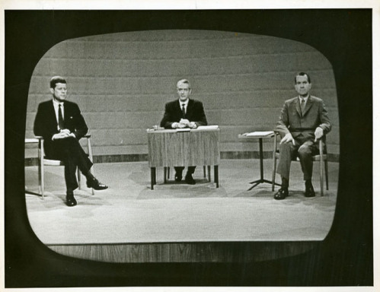
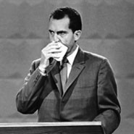
Changes in Past Election
Notes:
We have had some pretty amazing changes in past election …

Slide 19
What is Coming
Notes:
We can only imagine what is coming

Slide 20
Why Is this All Important??
Elementary & Secondary Education Act
Individuals with Disabilities Education Act
Workforce Investment Act
Childcare Block Development Grant
Perkins Career & Technical Education Act
Education Sciences Reform Act
FUNDING!!!

Slide 21
Politicians: They’re People Too
Rep. Gwen Moore

Slide 22
Increasing Special Education Research Opportunities
The policy behind expanding evidence-based practices

Slide 23
A Quick Look Back…
2004
IDEA Reauthorization
2004
National Center for Special Education Research Created
2006
NCSER Awards First Grants
By 2013
Over 260 Grants, in 30 states awarded
2002
Education Sciences Reform Act
Est. Institute of Education Sciences

Slide 24
Dramatic Funding Loss
30%

Slide 25
Dramatic Funding Loss & Impact on New Research
75% fewer research grants in 2013
4% of high quality grants funded in 2013, down from 12% in 2012

Slide 26
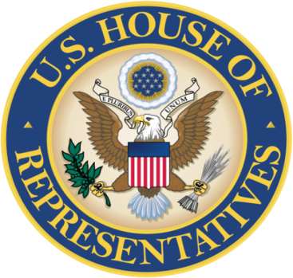
Strengthening Education Through Research Act
House Education and the Workforce Committee Report
“[The Strengthening Education Through Research Act] includes important policy changes to address requests from the special education community, including the Council for Exceptional Children and National Center for Learning Disabilities.”
May 2014

Slide 27
Strengthening Education Through Research Act
Emphasizes the elimination of the achievement gap between students with and without disabilities.
Increases dissemination and collaboration with the Office of Special Education and Rehabilitative Services (OSERS).
Highlights children with disabilities who are also English language learners, gifted and talented .
Increases the pipeline of early career special education researchers.
Ensures peer reviewers have expertise in areas relevant to grant applications.

Slide 28
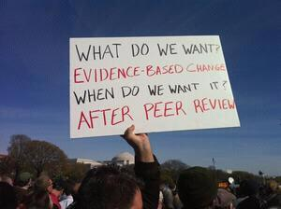
What Do We Want?

Slide 29
U.S. Ratification of the United Nations Convention
on the Rights of Persons with Disabilities
Deborah A. Ziegler, Ed.D
Associate Executive Director for Policy and Advocacy
Council for Exceptional Children

Slide 30
How many Countries have Signed or Ratified the CRPD?
Needed 20 countries to ratify for CRPD to enter into force (become legally operative)
As of June:
158 signatures to CRPD
147 ratifications of CRPD

Slide 31
CRPD Signatories and Ratifications

Slide 32
What will be the Potential Impact of the CRPD?
CRPD as tool to address abuses
International Disability Rights Movement
International Cooperation Agencies & UN Bodies
International Law

Slide 33
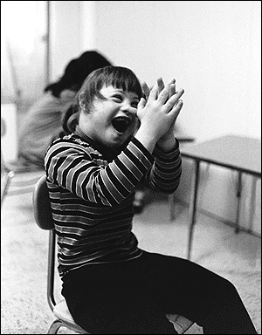
Collection of Photographs of children

Slide 34
Photograph of wheelchair

Slide 35
Treaty Facts: Why U.S. Ratification
Ratification of the CRPD exports U.S. leadership.
CRPD ratification improves global accessibility.
Ratification of the CRPD will NOT infringe upon U.S. sovereignty
Ratification of the CRPD does NOT establish new rights or required change to current U.S. policy.
Ratification of the CRPD will NOT harm parental rights of parents with children with disabilities and will NOT impair the right to home school.
Senator Menedez (D-NJ), intends to bring the treaty to the full floor of the Senate in July 2014. Coinciding with the anniversary of the Americans with Disabilities Act.

Slide 36
Collection of pictures

Slide 37
PK-12 Education Reforms
Impact of Esea flexibility
2007…2008…2009…2010…2011…2012…2013…2014??
What a difference 7 years makes!!

Slide 38
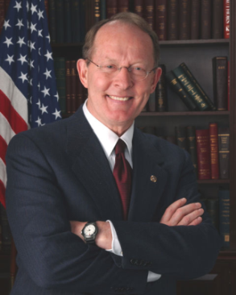
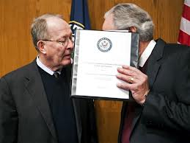
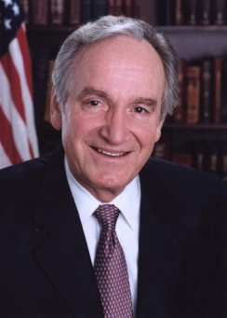
Lots of Talking …
Senator Tom Harkin
D- Iowa
Senator Lamar Alexander
R-Tennessee
Notes:
So, what’s been happening? Lots of talking among leaders in Congress … and in the meantime…

Slide 39
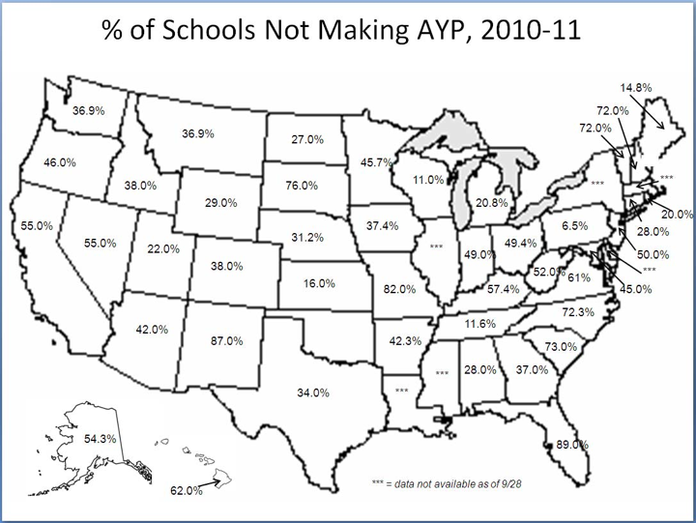
% of Schools Not Making AYP
82%
American Association of Administrators, Policy Insider Oct 2011
Notes:
In the meantime …
Without making any changes to NCLB, 82% would have been labeled as “failing”, according to Sec. Duncan during a Congressional hearing.

Slide 40
Image of a man riding a horse

Slide 41
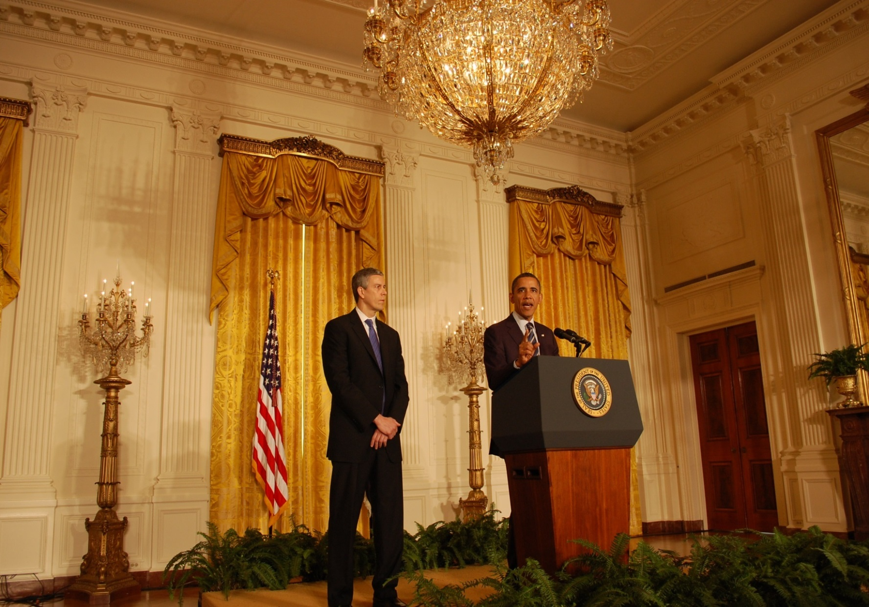
White House Announces Waivers
September, 2011
Notes:
While Congress was talking, the Obama Administration – led by Arne Ducnan, U.S. Secretary of Education.
In September 2011, Obama and Duncan announced that states could apply to receive waivers from controversial provisions of NCLB (talk about those in a minute).

Slide 42
ESEA Waivers
43 States + Washington, DC; Puerto Rico have waivers
BREAKING NEWS:
Washington State Waiver Revoked on
April 24, 2014
ESEA FLEX
Notes:
43 States + DC have been approved
But, on April 24, Washington state was the first to have its waiver revoked. This is because Washington has not met the department's timeline for tying teacher evaluations to student performance metrics. The loss will give local districts less flexibility in using federal funds. For instance, they may now be required to spend millions on private tutoring services for at-risk students. The waiver revocation could also result in nearly every school across the state being labeled as failing under NCLB. Washington had pledged in its waiver application to make student growth a significant factor in teacher and principal evaluations by the 2014-15 school year. But the state Legislature refused to pass a bill mandating that student performance on statewide assessments be included in teacher evaluations. The department placed the state on "high-risk" status in August. Arizona, Kansas and Oregon are also at risk of losing their waivers.

Slide 43
ESEA Waivers Checklist
ESEA Waivers Checklist
Remove 2014 AYP deadline
Funding Flexibility
Changes to Accountability
Flexibility for HQT Plans
Notes:
Key provisions that can states can waive ….

Slide 44
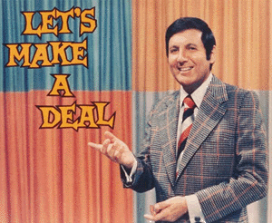
ESEA Waiver Conditions
4 Conditions:
Adopt College & Career Ready Standards
Develop Assessments that Measure Student Growth
Develop Guidelines for Local Teacher and Principal Evaluations Based on Effectiveness
Develop Differentiated Accountability System
Notes:
But in order to get a waiver, States had to adopt 4 new education reforms.

Slide 45
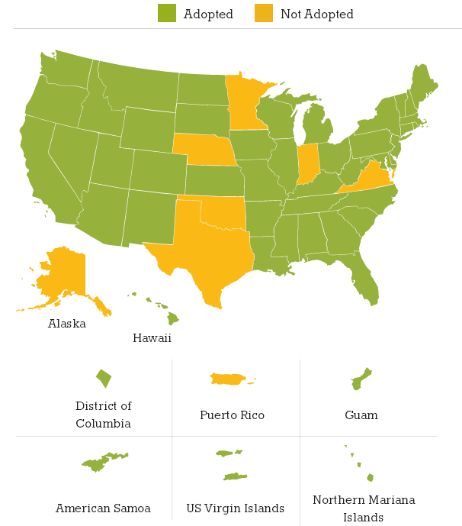
Transition #1: College & Career Ready Standards
45 States + District of Columbia

Slide 46
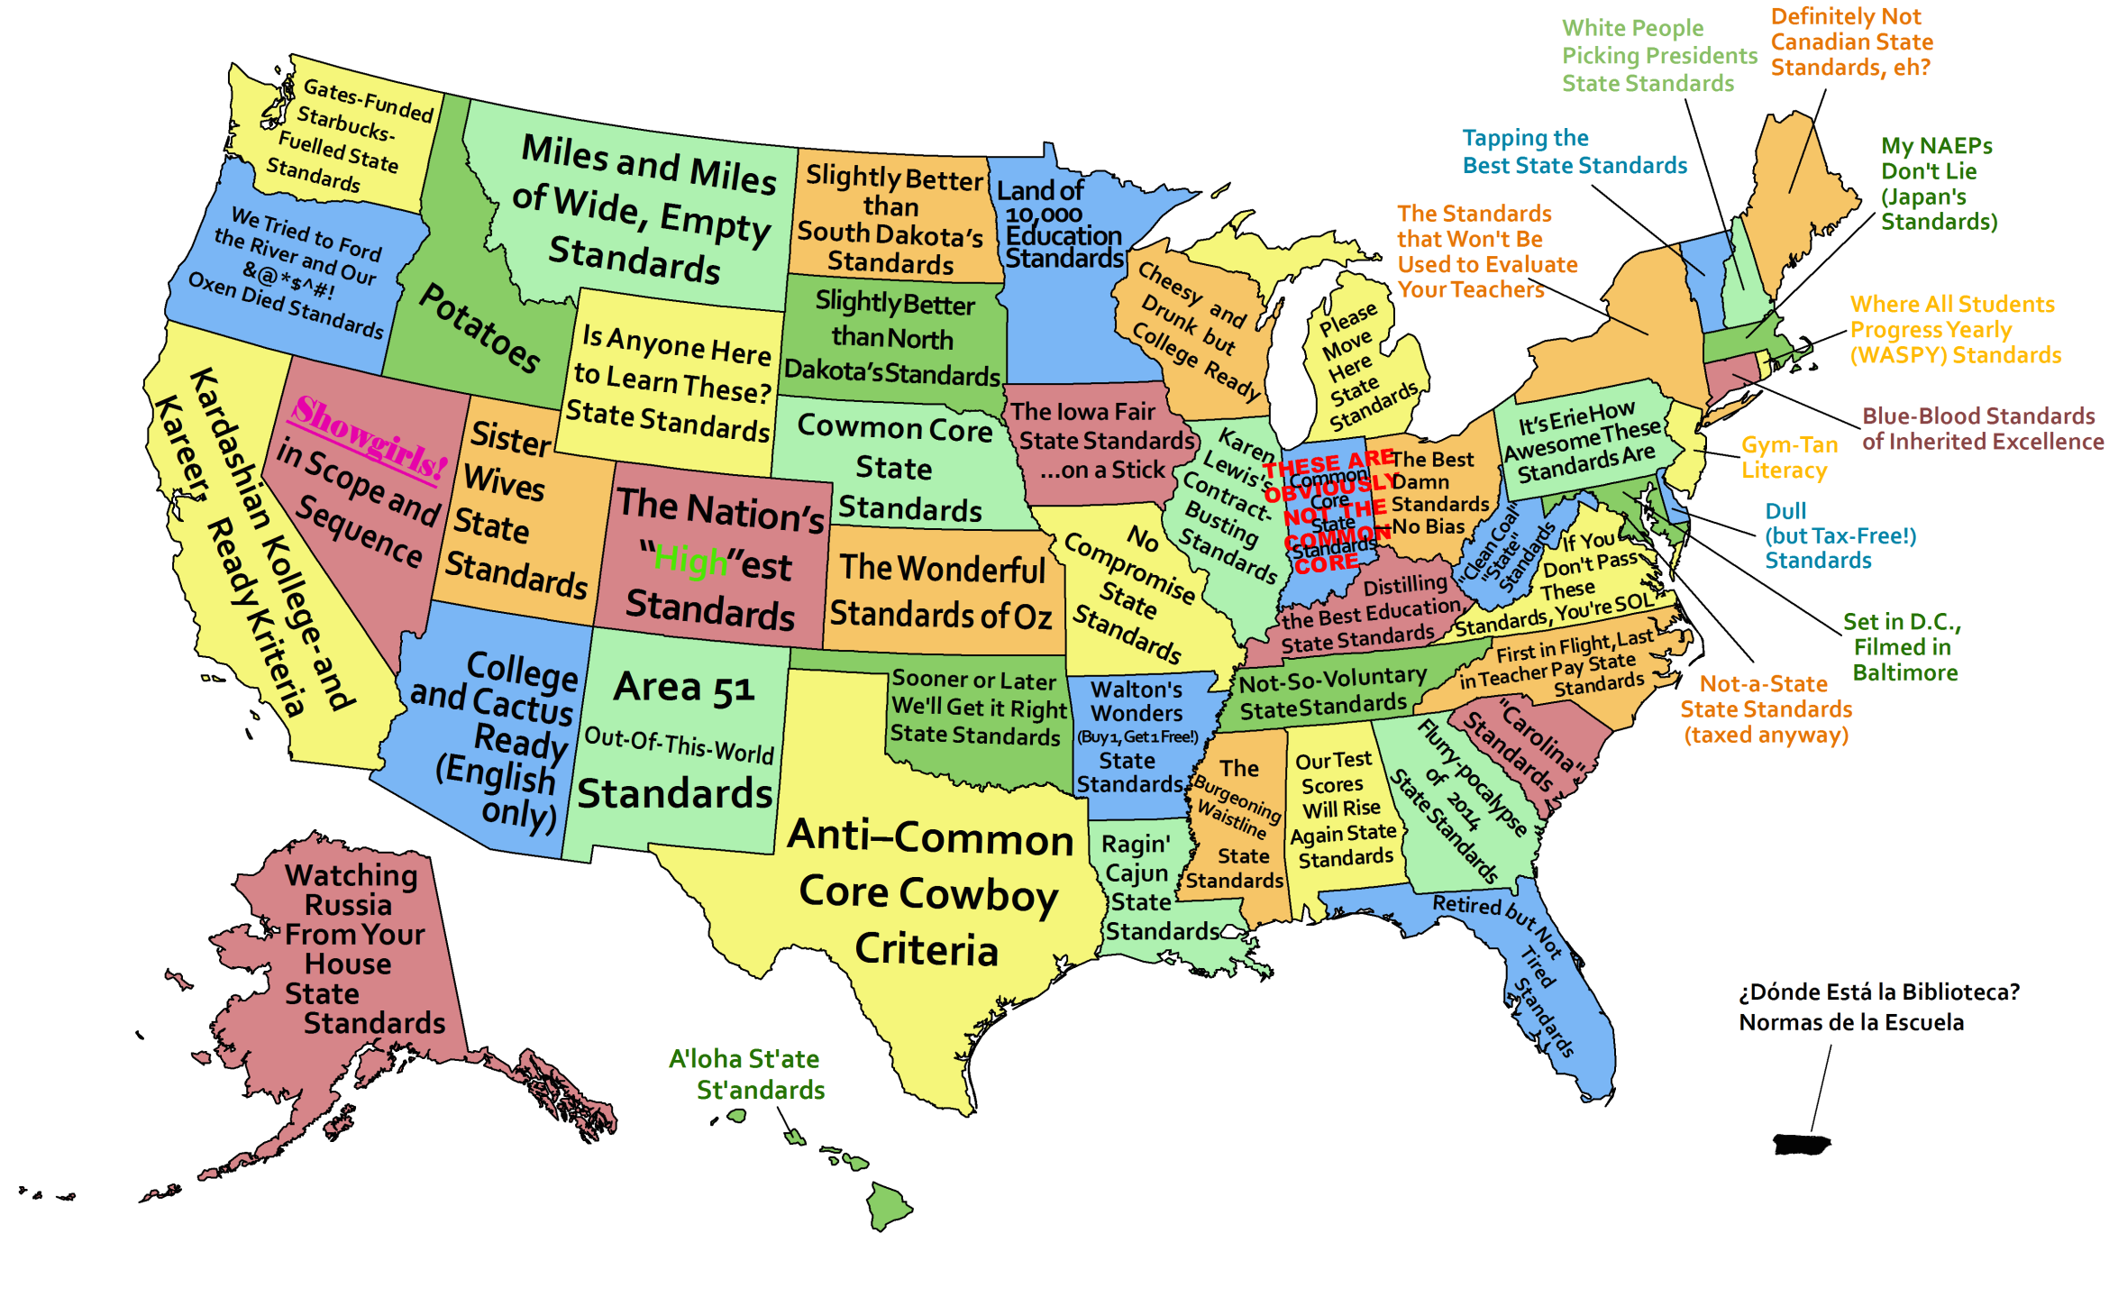
Map of united states
Source: Fordham Institute

Slide 47
Transition #2: New Assessments
Transition #2: New Assessments
Next Generation of Assessments
1%
National Center & State Collaborative
99%
Smarter Balanced Consortia
99%
PARCC
Consortia
1%
Dynamic Learning Maps
Notes:
Through the two consortia, 44 states and the District of Columbia are taking part in shaping the new assessments, which are scheduled to debut in the 2014-15 school year.
Both consortia, complying with federal requirements, will deliver end-of-the-year standardized tests in grades 3 to 8 and high school. Both say they will offer interim and formative assessments, teacher training and lots of useful, immediate data on individual students. Furthermore, both consortia will argue that their assessments will measure critical thinking and deeper subject knowledge that the current multiple-choice tests don’t measure; they will tell teachers how well students are learning in the current year, not what they failed to learn last year, and provide strategies for better instruction. They will project ahead, telling parents whether 8th or 10thgraders are on track to attend college.
Whether either or both can deliver all of their ambitious promises and meet the 2014-15 deadline for when the first tests will be administered is the big question the State Board must weigh. Cost is another; both consortia will use computer-based assessments and will assume that member states have technology in the schools.
The grant requests, totaling approximately $330 million, are part of the Race to the Top competition and will be awarded to the Partnership for Assessment of Readiness for College and Careers (PARCC) and the SMARTER Balanced Assessment Consortium (SBAC) in the amounts of approximately $170 and $160 million respectively.
The Partnership for Assessment of Readiness for College and Careers is a coalition of 26 states including AL, AR, AZ, CA, CO, DC, DE, FL, GA, IL, IN, KY, LA, MA, MD, MS, ND, NH, NJ, NY, OH, OK, PA, RI, SC and TN.
The PARCC coalition will test students' ability to read complex text, complete research projects, excel at classroom speaking and listening assignments, and work with digital media. PARCC will also replace the one end-of-year high stakes accountability test with a series of assessments throughout the year that will be averaged into one score for accountability purposes, reducing the weight given to a single test administered on a single day, and providing valuable information to students and teachers throughout the year.
Arizona is a governing state - Governing States make the strongest commitment to PARCC and its activities and therefore have the most decision
making authority. The chief state school officers of the Governing States serve on the PARCC Governing Board and make
decisions on behalf of the Partnership on major policies and operational procedures. Each Governing States also
designates lead staff to coordinate the state’s participation in PARCC, including by serving on committees and as a part
of working groups that will conduct the major assessment design and development activities. Through the PARCC grant,
Governing States will receive funding to defray the costs associated with staff time devoted to PARCC activities. In
addition, Governing States will receive some flexible funds to engage postsecondary leaders and faculty members in
both assessment development and broader engagement activities.
Each Governing State agrees to participate exclusively in PARCC and has committed to administer the assessment
system statewide during the 2014–15 school year. These states have also committed to pilot and field test the
assessment system components during the 2011–12, 2012–13 and 2013–14 school years. Furthermore, Governing
States have committed to use the results from the proposed assessment system in their state accountability systems.

Slide 48
Transition #2: New Assessments, Additional Considerations
Transition #2: New Assessments
Field Tests:
March –June 2014
4 million + students
36 states, District of Columbia
“The newness of this program will generate a few hiccups.”
– PARCC Official, March 2014
What Works? What Doesn’t?
Hardware? Bandwidth? Desktops? Laptops? Tablets?
Confusing? Overwhelming for students?
Accommodations Policies, Implementation
Notes:
There are some key differences between the field tests and the fully operational assessments that will be used in the spring of 2015. Length, for instance: Students will typically be involved in three to four hours of field-testing, less than half as long as what they’ll face next spring.
In the real PARCC test, students will take both a multiple-choice, end-of-year component and a more extended and complex performance-based section. On the field test, only 25 percent to 30 percent of students will take both pieces, and only in one subject, said Jeffrey Nellhaus, the director of assessment for PARCC. The rest will take either the end-of-year or performance segment.
The Smarter Balanced operational test in 2015 will be computer-adaptive—adjusting the difficulty of questions to the student’s skill level—but the field test, for the most part, will not be. A small number of students will get the adaptive version at the end of the field-testing window, said Ms. King. That’s because test-makers will use the questions students answer earlier in the field test to calibrate the adaptivity of the test engine later in the field-testing window.

Slide 49
What’s Next for Waivers?

Slide 50
ESEA Reauthorization…
Has the process stalled???

Slide 51
Picture of lightening
Notes:
Lightening strikes and Congress gets itself in gear…

Slide 52
2013 House vs. Senate ESEA Bills
Total Opposites!!

