Slide 1
ESEA Reauthorization
The silence is deafening
Last year at this time I said Senate bill would go to floor in September
Silly me – must have meant September 2015
Old Jewish commentary: If I am only for myself, then what am I? And if not now, when?
Congress, are you listening?
Notes:
I was given this topic for this but came up empty handed. So I decided to talk about something else.

Slide 2
House Version of ESEA
States can design their own accountability systems
Continues subgroup disaggregation
Gets rid of maintenance of effort
Eliminates cap on alternate assessment
Merges numerous programs -- Could transfer funds among programs
Requires use of teacher evaluation system based in part on student outcomes

Slide 3
ESEA Critical Issues
Impact of waivers on reauthorization
Highly effective teachers vs. highly qualified teachers
What to replace AYP with?
Use of PBIS/RtI/multi-tiered interventions/UDL
Transferability of funds
Graduation rate calculations
Title I/IDEA working group recommendations – paper available at www.nasdse.org

Slide 4
More on ESEA Reauthorization -- Not
Other interesting ESEA issues:
Autism bills
Seclusion/restraint
Concussion bills
Community schools bill

Slide 5
More on Not-ESEA Reauthorization
Charter school bill – bipartisan bill passed the House
New special ed/charter schools center: National Center for Special Education in Charter Schools (NCSECS)
www.ncsecs.org
Expecting new RFP for charter school center
Vouchers
Continues to be a state issue – increasing interest in Congress/DC voucher program
Notes:
Although perhaps less since Cantor was defeated in his primary

Slide 6
Appropriations
Stalled in the Senate.
Labor/HHS/Education set for markup by Appropriations Committee, but Sen. Mikulski indefinitely postponed it
In the House – haven’t even set a subcommittee hearing

Slide 7
Let’s Talk About Other Legislation
Workforce Innovation and Opportunity Act (WIOA)
Actual bipartisan agreement on this bill – passed Senate and the House – on to the President for his signature
Key component supports youth transitioning out of high school
Reduces reliance on sheltered workshops and focuses on supported employment

Slide 8
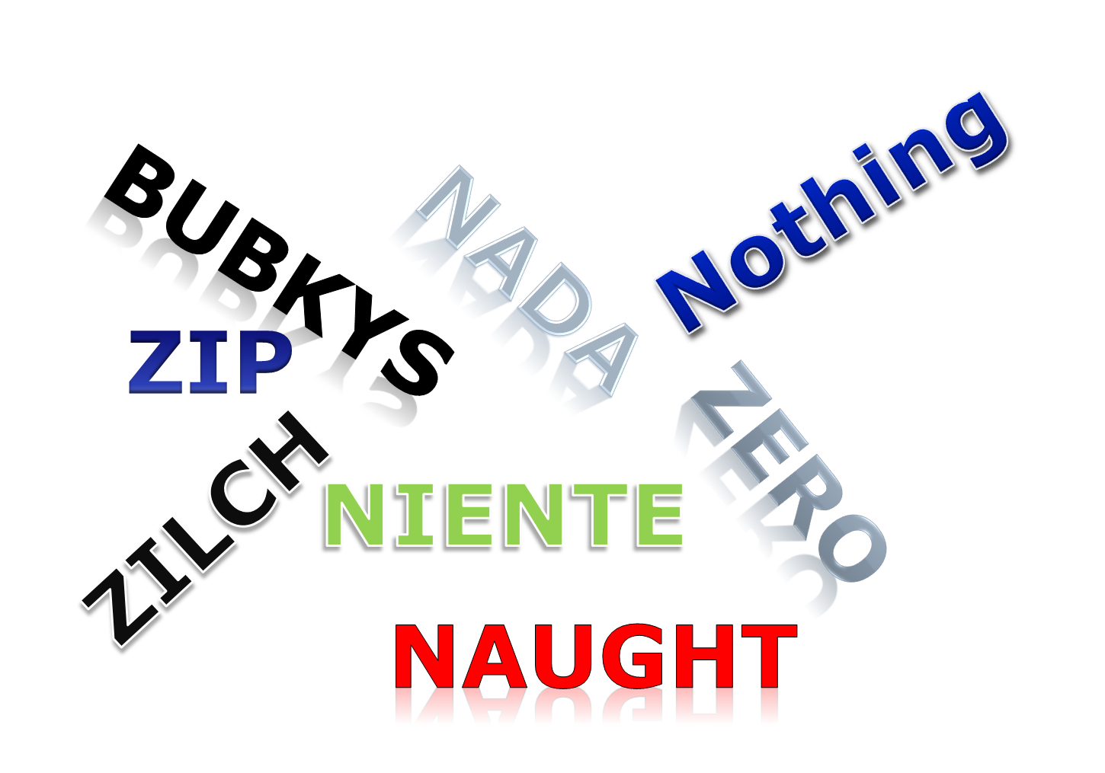
Overall Analysis of this Congress (113th) and the Last One

